Slide 1
Short Review of CS 412 Midterm
Lu An Tang

Slide 2

Motivation
Many students ask about the issues of mid-term
Short review session based on the TA’s own experience to help you better prepare the exam
I have not seen the exam paper yet – NOT responsible if I miss something
Next Week’s Office Hour: 3-5 pm, Tuesday (before the midterm)
HW1, HW2, Mid-term FAQ (see newsgroup)
My email: tang18 AT uiuc.edu

Slide 3

CS 412 Mid Term
Usually 5 Questions
  Data Preprocessing
  Data Warehousing
  Data Cube Computation
  Frequent Pattern Mining
  Opinion (3 pts) – do not forget to answer
Each question has 3-5 sub-questions, with total 15 – 35 points

Slide 4
Key Issues
Control your time: 10 pages with about 16 to 20 sub questions, and the time is only 90 minutes, avg 5-10 mins a question
Try to solve easy question first
  Difficulty: Opinion < Preprocessing < Warehousing < Frequent Pattern < Cube Computation
Write down concise and succinct answers
Underline your major points

Slide 5
Example Answer
Outline the FP growth algorithm.
Answer:
  1) Scan the dataset and find out length-1 frequent items.
  2) For each frequent item, construct its conditional pattern-base, and then its conditional FP-tree;
  3) Performing recursively on FP-tree;
  4) Until the resulting FP-tree is empty, or it contains only one path.

Slide 6
How to review CS 412?
Go over the slides, put the valuable things in your cheating sheet
You do not need to remember them
Try your best to compress them into two pages (Two- or Three columns)
Leave some blank space in the sheet and manually draw pictures there, e.g., the star tree or FP tree
Do not copy the entire slides to the cheating sheet – take too much space
An Example is provided in Midterm FAQ

Slide 7
Data Preprocessing I
Easiest question to warm up
data visualization techniques: which one belongs to which category (e.g., chernoff faces – icon-based tech.)
We will not ask you to draw the chernoff faces ☺
The value range and application scenario of measures
e.g., Jaccard Coefficient [0,1], apply in diseases comparison in medical tests

Slide 8
Data Preprocessing II
Calculation Question
Compute mean, variance, standard deviation, min-max normalization, z-score normalization …
Bring a calculator
Write down the steps and formulas
Wrong number, right formula/process – almost full points
Only wrong number --- zero pts

Slide 9
Data Cube Techniques I
Counting the cells – hardest question, leave it to last if you are not confident – talk about it later
Measures: holistic, algebraic and distributive
Prove a measure can be efficiently computed
  Give the formula of that measure
  Point out each parameter in the formula is algebraic or distributive
Cube computation algorithms: The detailed steps of three algorithms (BUC, Multi-Way, Star) are not likely to be tested, weak and strong points of each algorithm

Slide 10
Data Cube Techniques II
More advanced Cubing Algorithm
  Shell Fragments
  Ranking Cube
  Sampling Cube
You should be able to outline such algorithms
Put the contents in your cheating sheet
Star schema, snowflake schema – be able to draw
Once again, I have not seen the exam paper, those are just based on my own experience
Detailed cube computation is covered in last lecture

Slide 11
Frequent Pattern Mining
Two basic algorithms, Apriori and FP Tree
Be able to draw an FP Tree, as the homework
Mining Correlations with different measures
  What is the problem? Ask to give an Example (milk, coffee; basketball, cereal, etc)
  Analysis the strong and weak points of each measure: association is not correlation, null invariant, etc
  Give a good measure: Kulc measure

Slide 12
Counting the Cell
Lu An Tang

Slide 13
First, Let’s make clear some terms
The following descriptions are not formal, just help you to understand the intuitions of those concepts:
(Data) Cube: General name of the data model, it refers to the technique or model, such as Iceberg cube, ranking cube, text cube …… It is non-countable ☺
Cuboid: data summarization on a subset of cube’s dimensions (e.g., [location, time, branch; sales (measure)])
Cell: a specific unit of the cuboid (e.g, [Urbana, 2009, Wal-Mart; 10M sales])

Slide 14
Data Cube is a lattice of cuboids
all
0-D(apex) cuboid
time
item
location
supplier
1-D cuboids
time,location
item,location
location,supplier
2-D cuboids
time,item
time,supplier
item,supplier
time,location,supplier
3-D cuboids
time,item,location
time,item,supplier
item,location,supplier
4-D(base) cuboid
time, item, location, supplierc
Data Mining: Concepts and Techniques

Slide 15
Cuboid is a set of cells
Cuboid ABC is a set of cells, such as (a0,b0,c0), (a0,b0,c2) … The measure is omitted here
C
c3
61
62
63
64
c2
45
46
47
48
c1
29
30
31
32
c 0
B
60
b3
13
14
15
16
44
B
9
28
56
b2
40
5
24
52
b1
36
20
b0
1
2
3
4
a0
a1
a2
a3
A
Data Mining: Concepts and Techniques

Slide 16
Base and aggregate cells/cuboids
Suppose there are totally n dimensions
The fact table (n-D cuboid) is called a base cuboid, the cells in base cuboid are called base cells or base tuples. Indeed they are the tuples in relational table
The top most 0-D cuboid is called the apex cuboid
Except the base cuboid, all the cuboids are aggregate cuboids, their cells are aggregate cells

Slide 17
Non empty
For example, if there is no record of Chicago’s Wal-Mart in the fact table
Then, the cell (Chicago, 2009-10, Wal-Mart) is empty
And all the following cells are empty, too
  (Chicago, 2009-9, Wal-Mart); (Chicago, 2009, Wal-Mart)
  (Chicago, *, Wal-Mart)
Will there be “empty cuboid”?
As long as there is one tuple existing in the fact table, there will be no empty cuboid, e,g., (Location, time, branch) will never be empty even if there is only one tuple in fact table

Slide 18
Short Summary
Cube: A general name, you will never be asked to count a “cube”
Cuboid: A subset of the dimensions in data cube, if the fact table is not empty (no one will ask you to count an empty cube…), then there will be no empty cuboids
Cell: A specific unit of the cuboid
Aggregate Cuboid: All the cuboids except the base cuboid

Slide 19
Example Question
Assume a base cuboid of 20 dimensions contains 3 base cells, as shown below, where a_{i} ≠b_{i}. The measure is count.
  (1) (a1, b2, b3; b4…… , b20)
  (2) (b1; a2; b3; b4 ……, b20)
  (3) (b1, b2, a3; b4 ……, b20)
1. How many nonempty aggregated cuboids?
2. How many nonempty aggregated cells are there?
3. How many nonempty aggregated cells are there for the iceberg cube with count ≥2 ?
4. How many closed cells?

Slide 20
The symbols we will use in the following slides
More generally, suppose there are n dimensions in the cube, and p base cells in the base cuboid. Among the p cells, there are c common dimensions
Example
  (1) (a1, b2, b3; b4…… , b20)
  (2) (b1; a2; b3; b4 ……, b20)
  (3) (b1, b2, a3; b4 ……, b20)
Total dimension n = 20
Number of base cell p = 3
Common dimension (b4 … b20) c = 17

Slide 21
Counting the Number of Cuboids
Rule 1: The number of cuboids has no relation to the number of base cells
If there is no concept hierarchy (most questions are in this case), the formula to compute the cuboid is
Total Cuboid number = 2^{n} (n is the number of dimension)
Example question 1:
n = 20, the total number of nonempty cuboids is 2²⁰.
Number of nonempty aggregated cuboids = 2²⁰ – 1

Slide 22
Strategy for Counting the Number of Cells
Calculate the total number of cells;
Calculate the overlapping cells;
Answer = Total – overlapping cells*overlapping times
For the p cells, we can replace each value of their dimensions as a * (*, b2, b3; b4…… , b20)
Total Cell number = p*2^{n}
But some cells will be the same (Overlapping)
(*, *, *; b4 ……, b20) count: 3 – aggregate cell
Such aggregate cells are counted repeatedly, we have to deduce their overlapping times

Slide 23
Overlap Example
Suppose we have two base cells
  (Urbana, 2009, Wal-Mart) count: 1
  (Chicago, 2009, Wal-Mart) count: 1
If we roll up in the location dimension to *, both the two cells will be:
(*, 2009, Wal-Mart) count: 2
Here two cells overlap as one cell. The cell’s count is 2. We call it overlap once/1 time.

Slide 24
Calculate the total number of cells
Formula: Total Cell number = p*2^{n}
In the example question, p = 3, n = 20
Total cell number = 3*2²⁰

Slide 25


Calculate the overlaps I
Strategy:
Start from the max count, then reduce one by one, stop until count = 1
The max possible count in the example is 3 (since there are only 3 base cells in the fact table)
Except common dimensions, if we set all other dimensions as *, no matte how we select other dimensions, then the count will always be 3. e.g.,
  (*,*,*, b4……b18, * , b20) count 3
  (*,*,*, b4, *, b6……, b20) count 3
  (*,*,*,*……*) apex cell, count 3
So how many are those count 3 cells?

Slide 26
Calculate the overlaps II
Formula: Number of Max count cells (Count 3 cells) = 2^{c} (c is the number of common dimensions)
In the example question, c = 17
Count = 3 cells (overlap 2 times) 2¹⁷
The next step is to compute count = 2 cells (overlap 1 time)

Slide 27
Calculate the overlaps III
Unfortunately there is no formula in this step, we have to count by ourselves
  (1) (a1, b2, b3; b4…… , b20)
  (2) (b1; a2; b3; b4 ……, b20)
  (3) (b1, b2, a3; b4 ……, b20)
How can count = 2 cells (overlap once) happen?
If we set the first two dimensions as “*”, then it will be
  (*, *, b3; b4 ……, b20) count 2
  (*, *, a3; b4 ……, b20) count 1

Slide 28
Calculate the overlaps IV
And remember, each common dimensions may be “bi” or *, e.g.,
  (*, *, b3; b4 ……, b20) count 2
  (*, *, b3; *, b5……, b20) count 2
  (*, *, b3; *, ……, *) count 2
So for this case, there are also 2¹⁷ cells

Slide 29
Calculate the overlaps V
So how many count = 2 cells in total?
In this question, there are three cases, each has 2¹⁷ cells
  (b1, *, *)
  (*, b2, *)
  (*, *, b3)
Count = 2 cells (overlap 1 times): 3* 2¹⁷
Enumerate the cases for non-common dimensions: X
X * 2^{c} c is the size of common dimensions

Slide 30
Calculate the final answer
Question 2. Final Answer is:
Total cell – overlap twice cells *2 – overlap once cells *1 – base cells
3*2²⁰ - 2 * 2¹⁷ - 1* 3* 2¹⁷ – 3 = 3*2²⁰ - 5* 2¹⁷ – 3

Slide 31
Calculate the Iceberg cells
With our previous result, it is quite easy to calculate the iceberg cells
Iceberg cells = count 3 cells + count 2 cells
Answer = 2¹⁷ + 3* 2¹⁷ ⁼ 4* 2¹⁷
Be careful, do not multiply with the overlapping times

Slide 32
Closed Cells
A cell, c, is a closed cell if there exists NO cell, d, such that d is a specialization of cell c (i.e., d is obtained by replacing a * in c by a non-* value) and d has the same measure value as c
  a1, a2, a3...a100: 10
  a1, a2, b3...b100: 10
*,* , *,...* :20 is not a closed cell; a1,*,*…*: 20
*,*, b3, *...: 10 is not a closed cell; a1,*, b3, *...: 10
a1, a2, *,…*: 20 is a closed cell

Slide 33
Count Closed Cells
1. All base cells are closed cells
2. The apex cell is usually not the closed cell
Enumerate closed cells
Starting from the base cell, trying to replace the concrete value (usually in the non-common dimensions) with a *, and see whether the count increases, we stop until the max count

Slide 34
Example Step 1
(1) (a1, b2, b3; b4…… , b20)
(2) (b1; a2; b3; b4 ……, b20)
(3) (b1, b2, a3; b4 ……, b20)
Max Count is 3 (There are total 3 base cells)
1. All base cells are closed cells
(a1, b2, b3; b4…… , b20) 1
(b1; a2; b3; b4 ……, b20) 1
(b1, b2, a3; b4 ……, b20) 1

Slide 35
Example Step 2
1) (a1, b2, b3; b4…… , b20)
(2) (b1; a2; b3; b4 ……, b20)
(3) (b1, b2, a3; b4 ……, b20)
2. Try to use a * to replace non-common dimensions
(*, *, b3; b4…… , b20) 2
(*; b2; *; b4 ……, b20) 2
(*, *, b3; b4 ……, b20) 2
(*,*,*; b4 ……, b20) 3 – reaches the max count, stop

Slide 36
Some suggestions to deal with this problem in exam
Frankly speaking, this question is the most difficult problem; but in the exam, it usually appears as question 2 or question 3 (only 5 students get the full score in 2009 mid-term)
Strategy: Control you time spending on this question
Usually the first sub question is counting the cuboid – and it is easy, you can quickly answer it.
2^{n} or 2^{n}-1

Slide 37
Some suggestions II
For the question of counting cells, if you are not very confident, you can leave it as the last one to solve in the exam (especially the mid-term’s time is only 1.5 hours)
When solving the question, try to list out every steps
The calculations are error-prone, but as long as your steps are right, you can get some points even with wrong answer

Slide 38
Example Question
Assume a base cuboid of 20 dimensions contains 3 base cells, as shown below,
  (1) (a1, b2, b3; b4…… , b20)
  (2) (b1; a2; b3; b4 ……, b20)
  (3) (b1, b2, a3; b4 ……, b20)
where a_{i} ≠b_{i}. The measure is count.
1. How many nonempty aggregated cuboids?
2. How many nonempty aggregated cells are there?
3. How many nonempty aggregated cells are there for the iceberg cube with count ≥2 ?
4. How many closed cells?

Slide 39
Example Solution I
1. Total dimension n = 20; Number of base cell p = 3
Common dimension (b₄ to b₂₀) c = 20-3 =17
The total number of cuboids is 2²⁰. Base cuboid is 1
The number of nonempty aggregated cuboids = 2²⁰ – 1
2. Total cell number = 3*2²⁰
Count 3 cells (overlap 2 times), 2¹⁷
Count 2 cells (overlap 1 times), 3* 2¹⁷; Base cells, 3
The number of nonempty aggregated cells:
3*2²⁰ - 2 * 2¹⁷ - 1* 3* 2¹⁷ – 3 = 3*2²⁰ - 5* 2¹⁷ – 3

Slide 40
Example Solution II
3. Iceberg cells = count 3 cells + count 2 cells
nonempty aggregated cells with count ≥2:
2¹⁷ + 3* 2¹⁷ ⁼ 4* 2¹⁷
4. (1) All base cells are closed cells
(a1, b2, b3; b4…… , b20) 1
(b1; a2; b3; b4 ……, b20) 1
(b1, b2, a3; b4 ……, b20) 1
(2) Other Aggregate cells

Slide 41
Example Solution III
(*, *, b3; b4…… , b20) 2
(*; b2; *; b4 ……, b20) 2
(*, *, b3; b4 ……, b20) 2
(*,*,*; b4 ……, b20) 3
So there are totally 7 closed cells

Slide 42
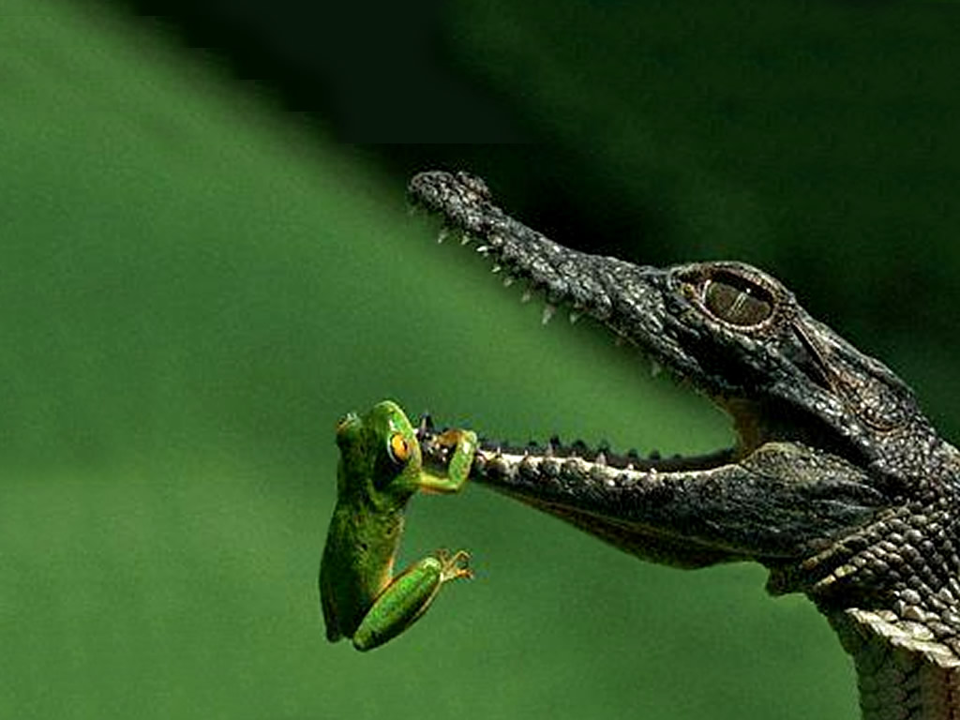
Thank You Very Much! Good luck in the Exams!

