Slide 1
IoT Middleware
Pub/Sub Management
Context processing & storage
IoT Service Discovery
Security
Producer
Device/App Naming Service
Consumer
Sensor
Device Discovery
App
Gateway
Actuator
Service
Smart Things
FIA
Optional: In-network Computing
(Data Aggregation/Fusion)
Network Service
Name-based Routing
Mobility & Security

Slide 2
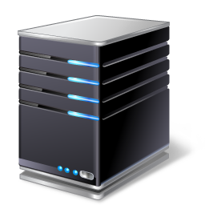

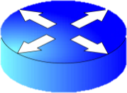

GUID 1 | GUID 2
12345 | 11111
12345 | 22222
GNRS server
R3
11111
R1
Client: Send to Group 12345
R2
R4
22222

Slide 3

Sensor 1
Sensor N
Aggregator
Discover Neighbor
Acknowledgement
Discover Aggregator
Forward
Reply with name
Forward

Slide 4
Aggregator
Aggregator
Broadcast/multicast(well-know-name, certificate )
Unicast(service-name, certificate )

Slide 5
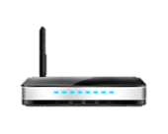

Aggregator
Aggregator
LSG
IoT Server
Subscriber
A1
A2
Publish(service-name)
Subscribe
Reply(service-name)
Request(service-name)
Forward
Reply(data)
Reply(data)

Slide 6
Embedded Device
Aggregator
Apps
Middlware
ICN-lite
802.15.4/ BLE
Apps
Middleware
ICN
802.15.4/BLE/802.11/Cellular
Self-clustering
Data-collection
Device/Service Discovery Service
IoT
Server
LSG
Apps
Middlware
ICN
802.11/802.3
Apps
Middleware
ICN
802.3
Context data Processing& storage
Name Assignment Service
Local/Global ID translation
Sensor data access policy enforcement
Pub/Sub management

Slide 7

Service Requester
Router
Service Host
SR
SH
SH
SH

Slide 8
SR
SH
SH
SH

