Slide 2
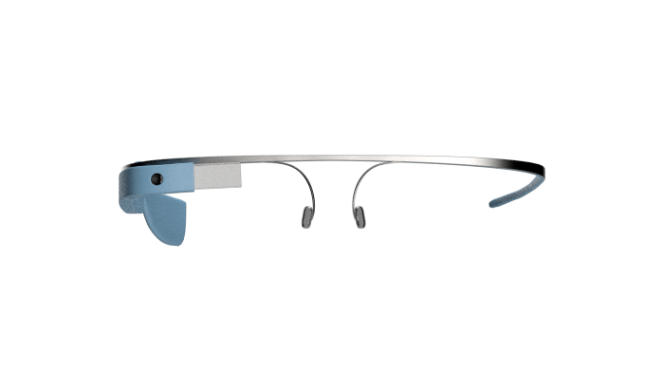



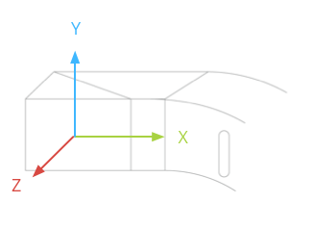


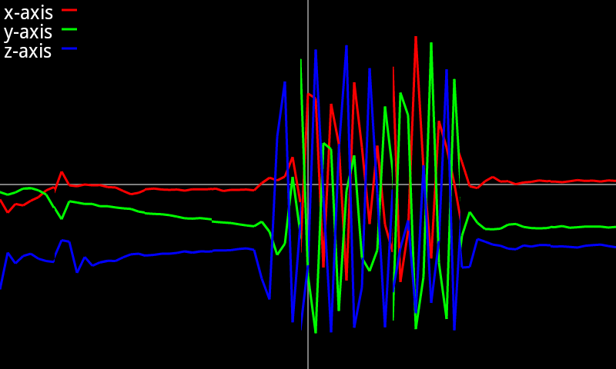
Authentication passed!
Welcome back, my master.

Slide 3
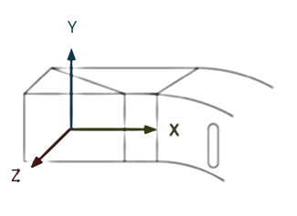
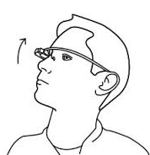


Authentication passed!
Welcome back, my master.

Slide 4
Acc data
Filter
Verification

Slide 5

Authentication passed!
Welcome back,
My master.

