Slide 1
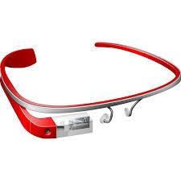
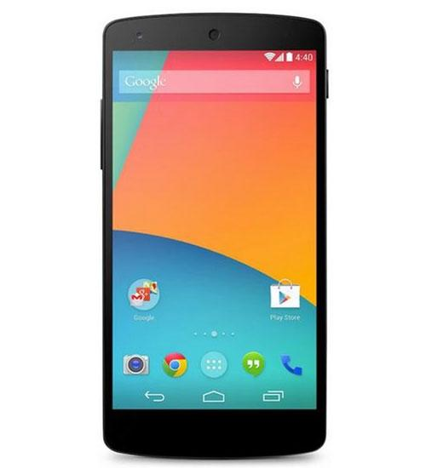
Glass
Data Collection & Filtering Module
Test Data
Feature Extraction
User’s Data Sample
Smartphone
User’s Data Sample
Reference Data Construction Module
User’s Data Sample
Bluetooth
Bluetooth
Classification Module
Reference Data
Reference Data

