Slide 1

Remote Sensing of Vital Signs
with Telecommunications Signals
Bell Laboratories, Lucent Technologies
Victor Lubecke, Olga Boric-Lubecke, Geert Awater, Ping-Wen Ong
Peter Gammel, Ran-Hong Yan
University of Illinois, Chicago
James Lin
Other Contributors
Kit August, Jenshan Lin, Javier Otin, Amy Droitcour, Bram Lohman
Presented at:
Notes:
1

Slide 2

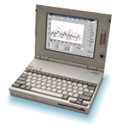
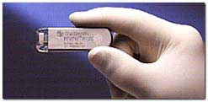
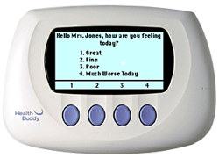
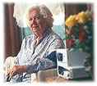

Remote Health Monitoring
An estimated 100 million Americans suffer from chronic medical conditions such as heart disease, diabetes, and lung disorders
Chronic illnesses account for about 75% of total US healthcare costs
There is a growing market for appliances which allow patients to remotely monitor health parameters and transfer data to a physician
PC and Internet Linked Blood Glucose Monitors
(Roche - Camit)
Implantable Cardiac Loop Recorders
(Medtronic - Reveal)
Internet Linked Healthcare Q&A
(Health Hero Network - Health Buddy)
Phone/Pager Linked Vital Signs Monitoring Station
(HomMed - Sentry/Observer)

Slide 3

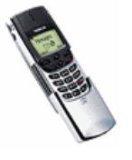



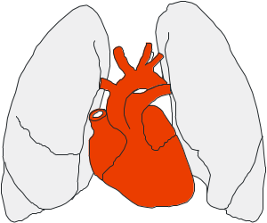


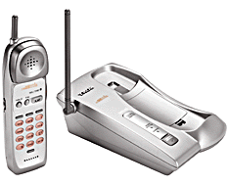
Telesensing of Vital Signs
System Overview
Surface & Internal Reflections
(Sensor )
Telephone or Internet Network
Respiration
Heart
Body Motion
Wireless Telecommunications Device
Subject
PC or Dedicated Data Interpreter
Remote Site:
e.g. Doctor’s office, monitoring station...
Local Site:
e.g. Home-station, pocket-based or handheld unit,...

Slide 4
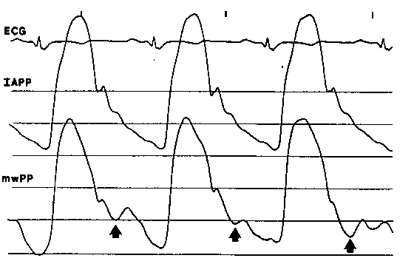
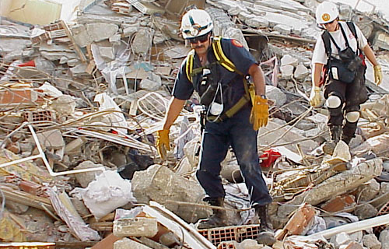
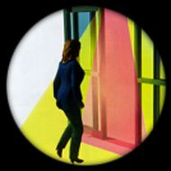
Human Radio Doppler Applications
Medical Diagnostics
  Respiratory, cardiac, and arterial wall movements, proposed in 1970’s ; University of Illinois, Chicago
Post-Earthquake Rescue Operations
  Proposed life-detection systems, operating at distances up to 30m, or through thick (>1m) barrier walls ; Michigan State University
Motion Detection
  Automatic door openers, security sensors ; e.g.. Microwave Solutions, Ltd.
Arterial Pressure Pulse Sensing
J. Lee and J. Lin, 1985
USAID
B.E.A.

Slide 5


Motion Sensor Principle
Constant velocity : shift in f
  frequency proportional to velocity
Periodic motion : FM, AM, & PM
  phase proportional to displacement
Baseband Radio
f
Coupler
Coupler
CW Source
~
cos(ωt)
v(t)
f + f_{d}
f_{d} = 2f v(t)/c
Antenna
cos(ωt)
Mixer
cos(ωt+φ(t))
cos(φ(t))
Filter,
Amplifier
x(t)
φ(t) ~ x(t)
φ(t)
φ(t) = (4π/λ) x(t)

Slide 6

Power Losses at 1 to 10 GHz
Propagation
Absorption
ε_{r} ~ 45
δ(f) = 2.5 - 0.3 cm
skin
muscle
heart
Tx/Rx
R = 1- 2 m
-3 dB
-20\50 dB
fat
bone
D₁~ λ/2
ε_{r} ~ 5.5
δ(f) = 12.8 - 2.6 cm
D₂ ~ 10-50cm?
Radiating Near Field (vs Far Field: R > R_{ff} = 2D²/λ)
  D’s large relative to R, spreading not dominant
Loss budget more complex (vs Radar Eqn: ~ λ ²/R⁴ )
  Spreading, reflection, active area, capture f(λ ²Dir),…
Large dielectric mismatch at surface
  About 50% of power is reflected
Penetration depth ~ 1/f
  Less than 1% of power returns

Slide 7
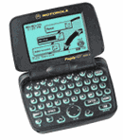
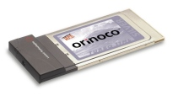
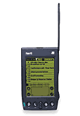

Communications Radios
Typical Specifications
Wireless Phones, PDA’s, 2-Way Pagers
Wireless LAN
800/900 MHz, 1.8/1.9 GHz
< 1 W
Omni-Directional
Wireless Network
2.4, 5 GHz
< 100 mW
Omni- / Semi-Directional
Phone Line/ Internet
Cordless Telephones
Security Sensors
49, 900 MHz, 2.4 GHz
< 500 mW
Omni-Directional
Phone Line
2.4, 10 GHz
< 20 mW
Semi-Directional
Phone Line

Slide 8
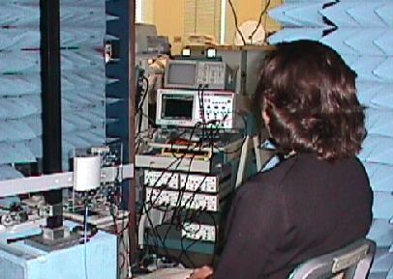
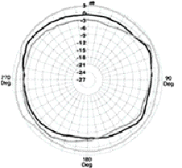
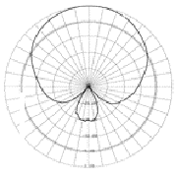
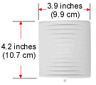
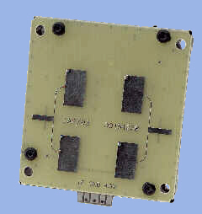
Baseband Radio Experimental Set-Up
CW mode, 1 mW, 800-10,000 MHz
Omni-directional
Directional
Phone Antenna
LAN Radio
4.5 in
(11.5 cm)
4.2 in
(10.7 cm)
Signal from comm. radios or laboratory component simulations. (~20 dB isolation)
Data acquisition with digital oscilloscope or PC A/D card
Vital sign extraction with analog filters & amplifiers and/or PC DSP
LAN Antenna
Motion Sensing Radio
1.9 in (4.9 cm)

Slide 9
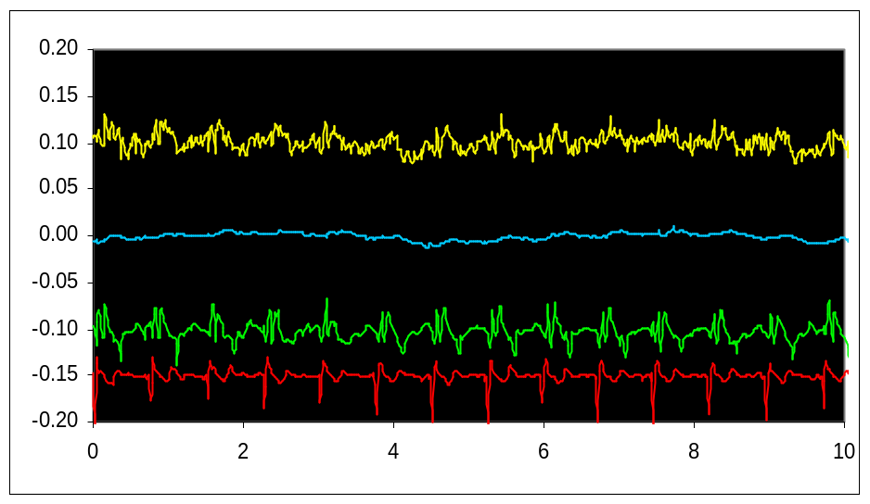
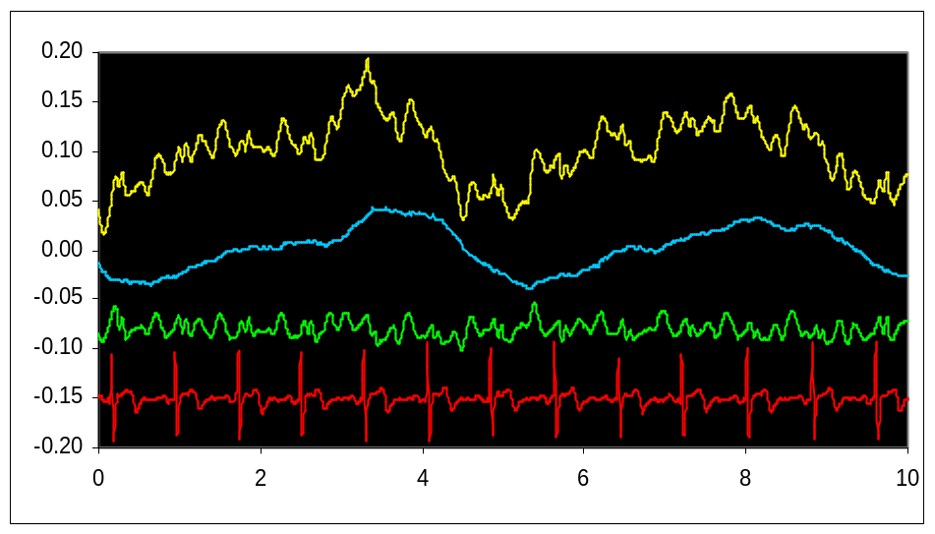
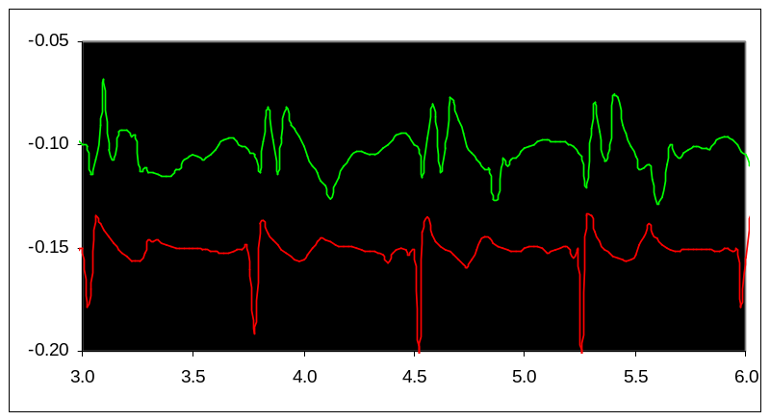
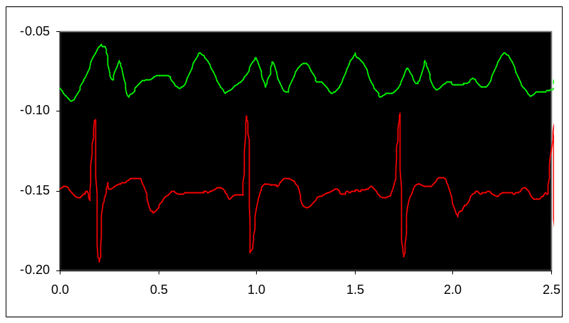
Doppler Sensing of Internal/External Scattering f = 2.4 GHz, P_{source}= 15 dBm, Raw, Resp. 0.03-0.3 Hz, Heart 3-30 Hz, ECG
Contact
1/2 m
Filtered Doppler
ECG
Respiration rate: 0.19 Hz (11 breaths/min.) Heart rate: 1.37 Hz (82 beats/min)
Respiration rate: 0.20 Hz (12 breaths/min.) Heart rate: 1.29 Hz (78 beats/min)

Slide 10
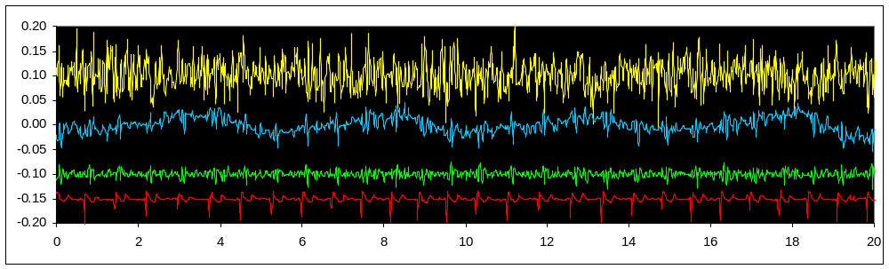
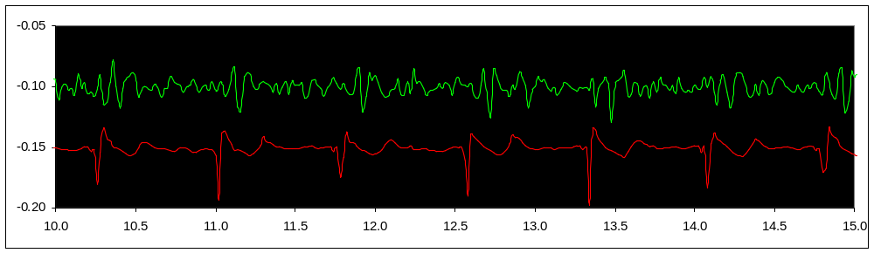
Chest Accelerometer Measurements
Raw, 0-0.3 Hz, 1-10 Hz, ECG
Filtered Acceleration
ECG

Slide 11
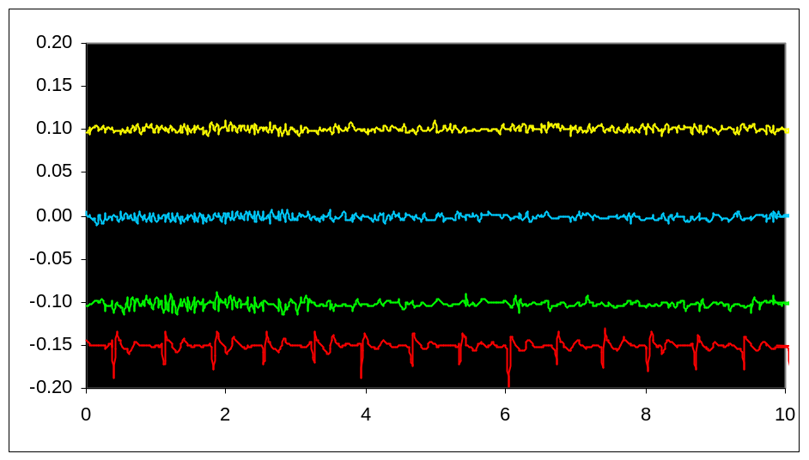
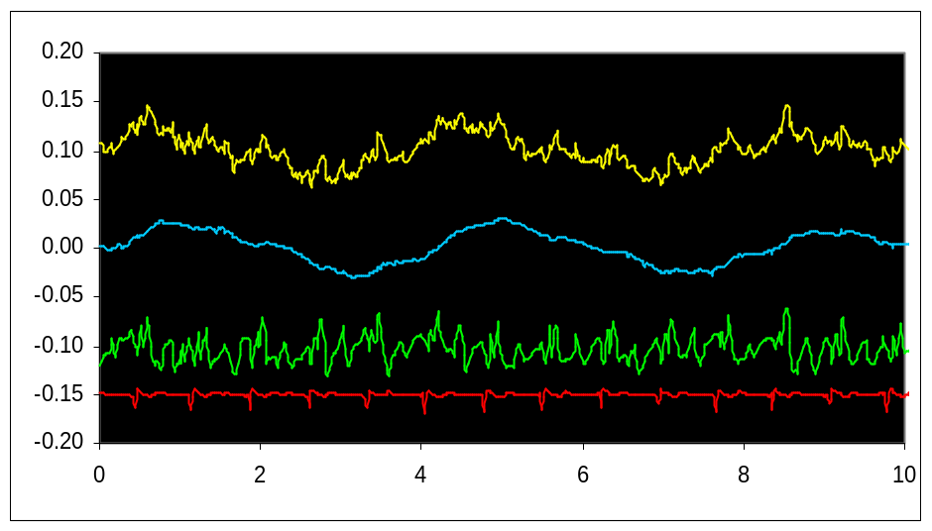
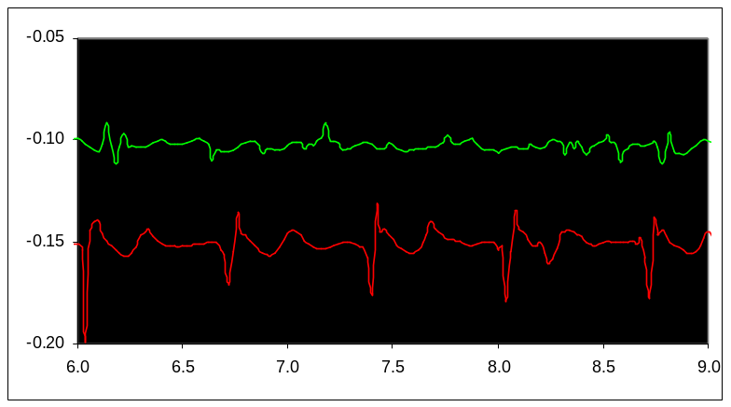
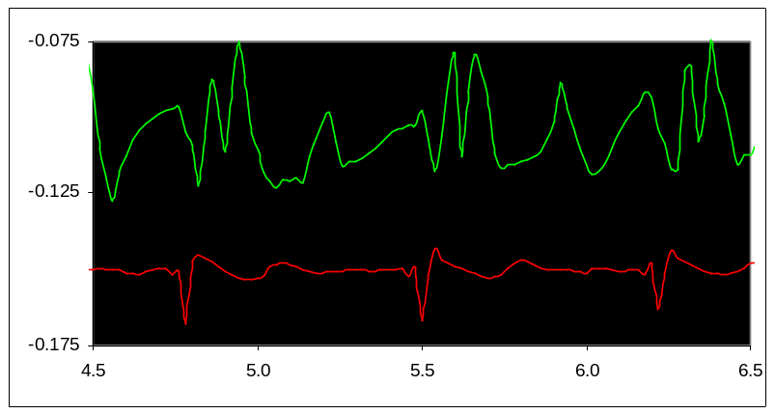
Doppler Sensing of Internal/External Scattering f = 10 GHz, P_{source}= 13 dBm, Raw, Resp. 0.03-0.3 Hz, Heart 3-30 Hz, ECG
Contact
1/2 m
Filtered Doppler
ECG
Respiration rate: ? Hz ( ? breaths/min.) Heart rate: ? Hz ( ? beats/min)
Respiration rate: 0.25 Hz (15 breaths/min.) Heart rate: 1.37 Hz (82 beats/min)

Slide 12
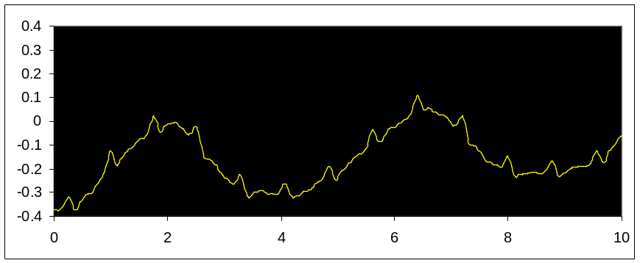
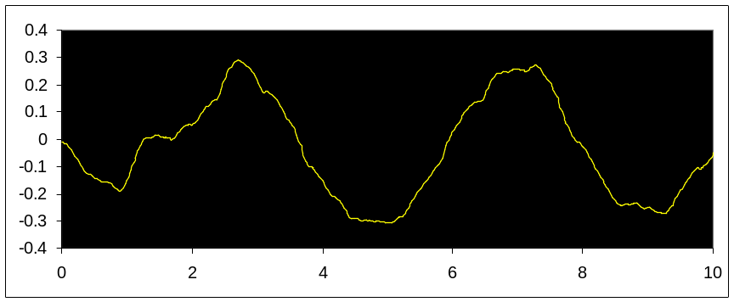
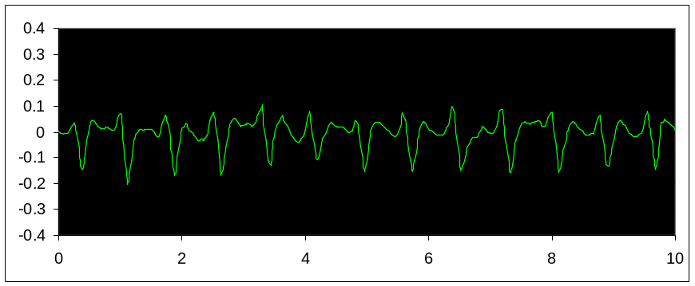
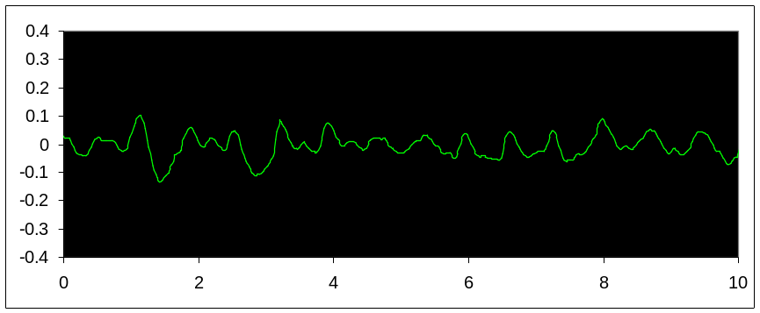
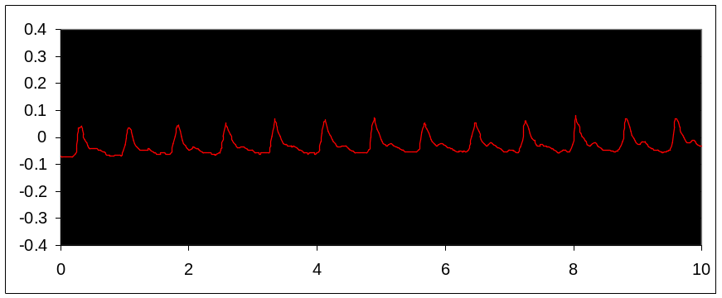
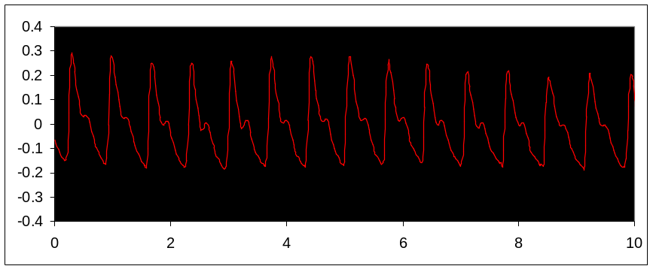
Doppler Sensing at Varied Distances f = 2.4 GHz, P_{source}= 10 dBm
1 m
2 m
Raw
Raw
BP Filter
BP Filter
Reference
Reference
Time [s]
Time [s]

Slide 13
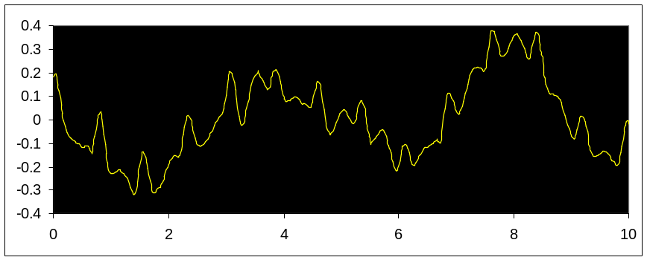
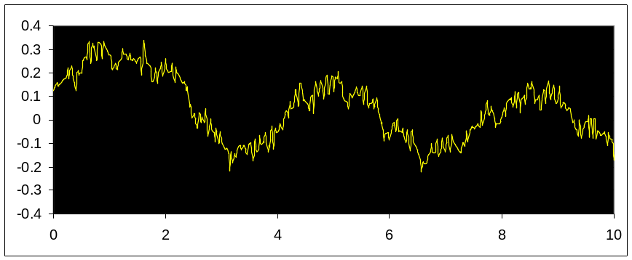
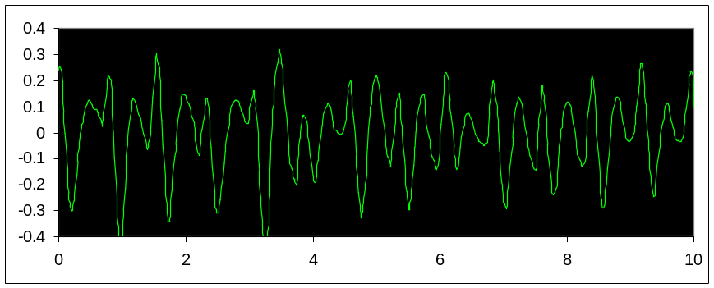
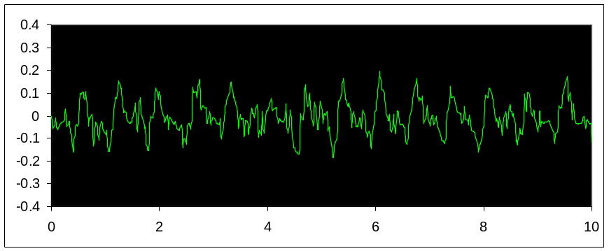
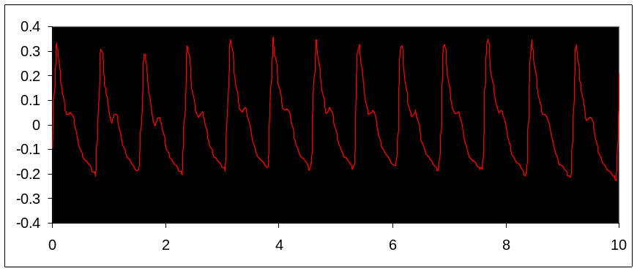
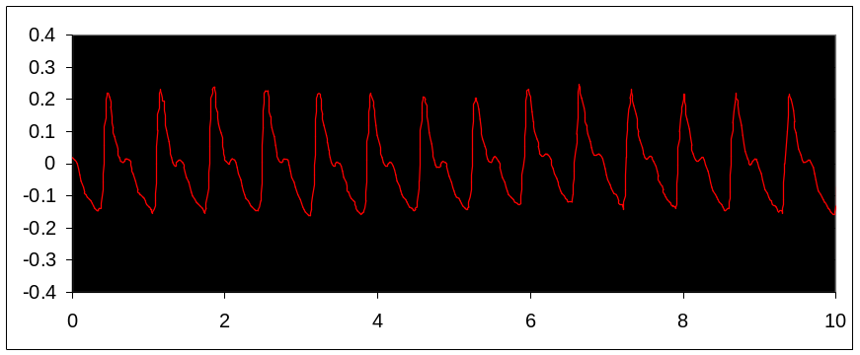
Doppler Sensing with Various Antennas f = 850 MHz, P_{source}= 10 dBm, d = 1 m
Directional Antenna
Rubber Omni Antenna
Raw
Raw
BP Filter
BP Filter
Reference
Reference
Time [s]
Time [s]

Slide 14
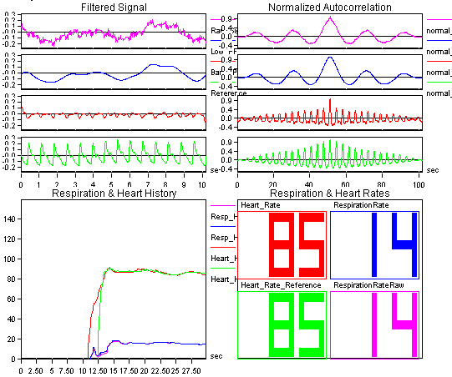
Signal Processing
f = 850 MHz, d = 1 m, rubber omni-directional antenna

Slide 15
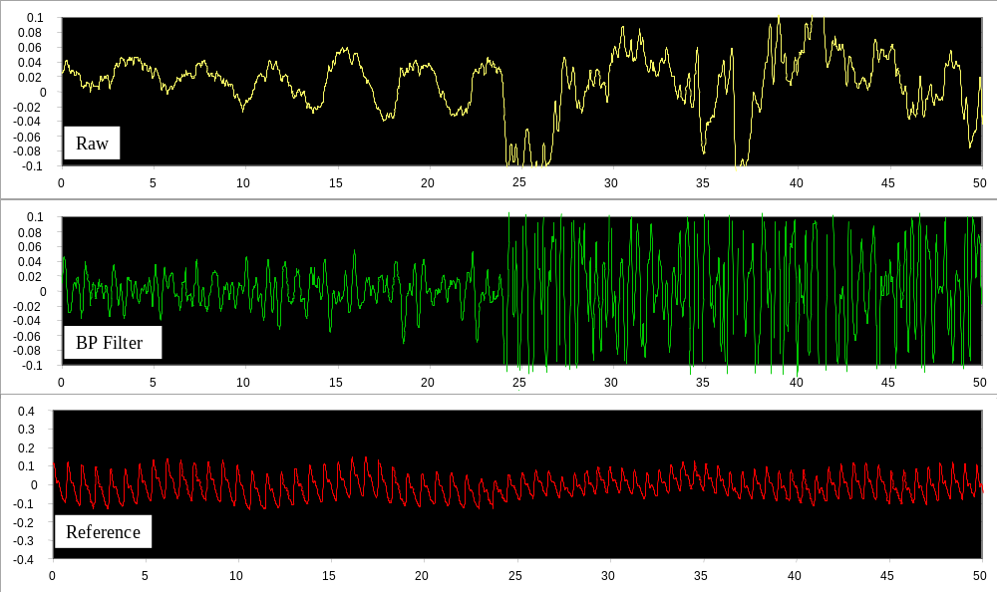
Signal Processing
2.4 GHz data with speaking interference
Time [s]

Slide 16
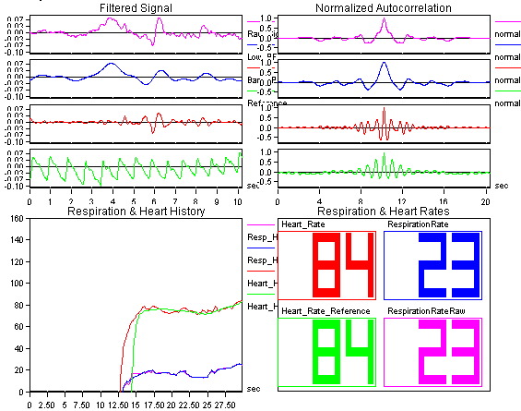
Signal Processing
f = 2.4 GHz, d = 1 m, with speaking

Slide 17

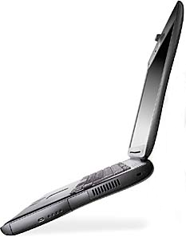

Possible Implementations
Realizations
  Proximity instrument (d<50cm); good SNR, high detail, explicit
  Distance instrument (d~1m); lower SNR, basic rate, transparent, sensor enhanced
Applications
  Medical
  Psychological/Emotional
d < 50 cm
d ~ 1 m

Slide 18
Conclusions
Demonstrated remote sensing of heart and respiration rates with comm. signals
  Heart and respiration rates easily detected.
  Possible to observe respiration and heart signatures
Assessed impact of frequency, antenna, and distance on measurements
  Surface scattered signals dominate
  Detection of internal motion possible with lower frequencies
Improvement through DSP and other enhancements
Demonstrated potential for technology leveraging
  Added feature for communications instrument
  Substitute application for communications instrument
  Dedicated new telesensing instrument based on existing technology

