Slide 1


Slide 2
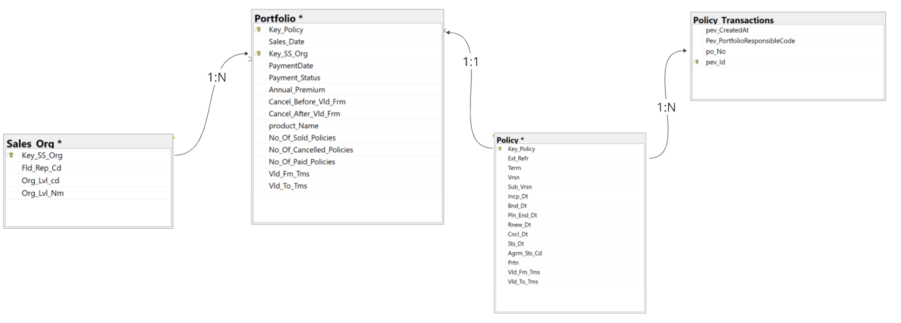
Entity Relationship Diagram
Notes:
Here you can see a chart demonstrating the joins between the tables. Between sales and portfolio, and policy and policy transactions, it was clear the the joins were 1 to many, instead of 121.

Slide 3
Assumptions

Slide 4
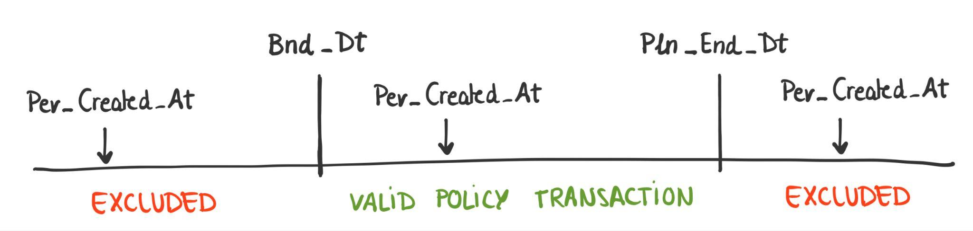
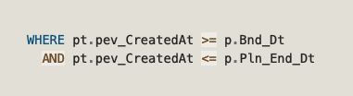
ASSUMPTION 1 – relevant transactions for policies
The record is valid and relevant to the policy
if the transaction falls within Bnd_Dt and Pln_End_Dt

Slide 5
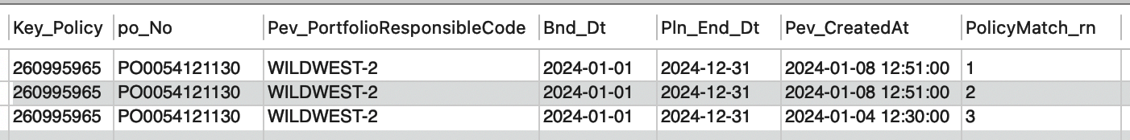
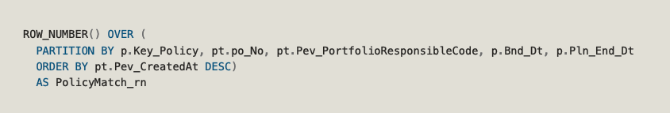
ASSUMPTION 2 – filtering duplicates
Same Key_Policy
The most recent creation date
is the latest version of that policy.
Notes:
Assumptions we’ve made related to duplicates, which are 2 assumptions:
The first assumption is to identify which policies are duplicates – we use the ROW_NUMBER function to assign a unique row number to each policy transaction (which is PolicyMatch_rn column), and we assume that all matches of these fields are duplicates.
And once we have the duplicates, in order to filter them, we order the policies by date of the transaction (Pev_CreatedAt) and we assume that’s the most recent transaction is the latest version of that policy.
This is a screenshot of a random policy number I used a few days ago, so maybe it would be useful to use another policy that has different transaction dates to show our point?
Those records during aug

Slide 6
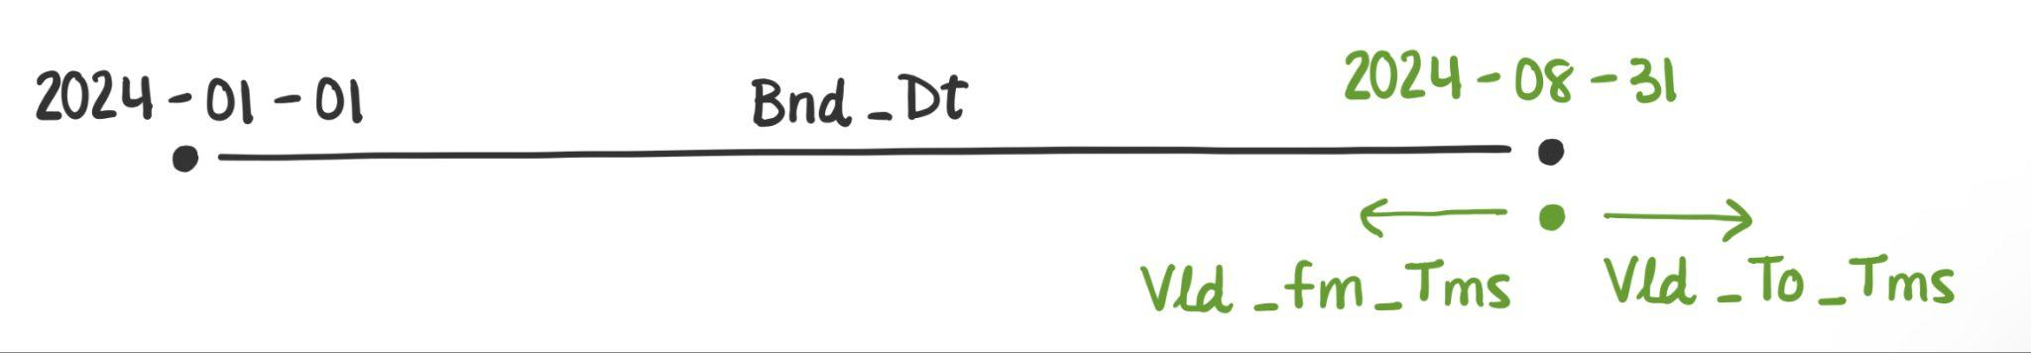
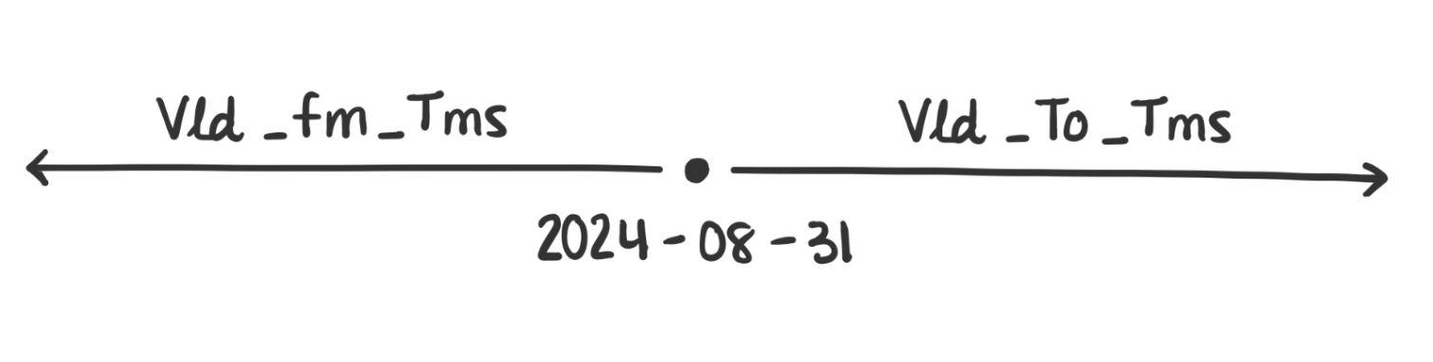
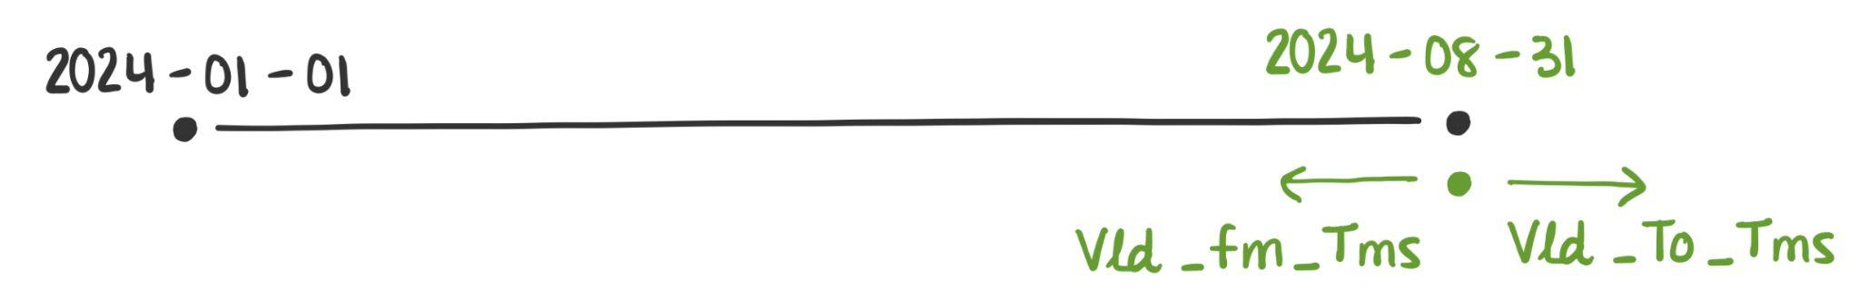

ASSUMPTION 3 – Validity of the record
The record becomes effective on or before August 31, 2024.
The record has an end date after August 31, 2024.

Slide 7
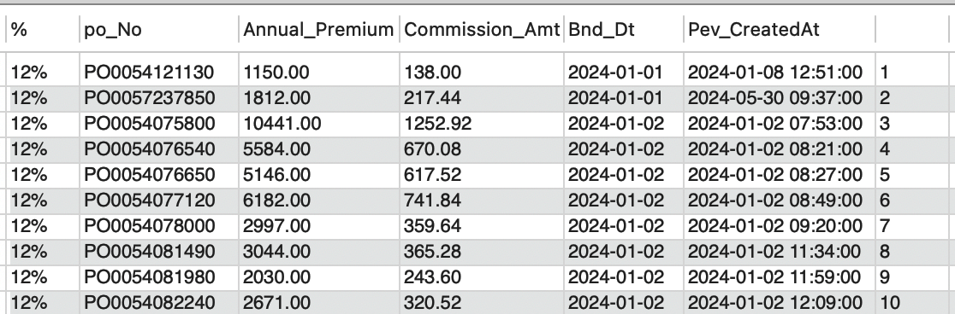
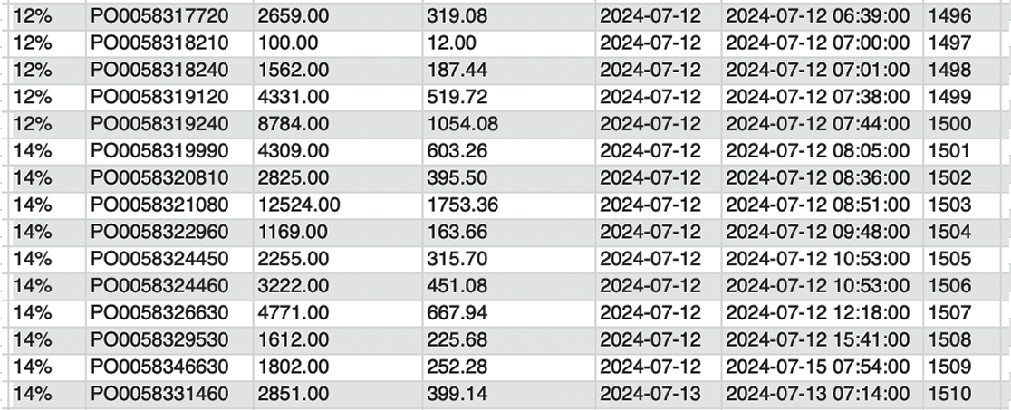
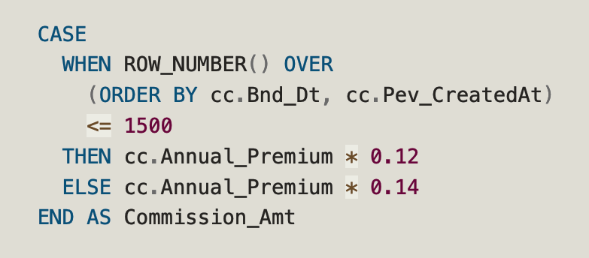
ASSUMPTION 4 – order for commission rates
The order in which policies are processed is the order considered for
applying commission rates.
1
2

Slide 8
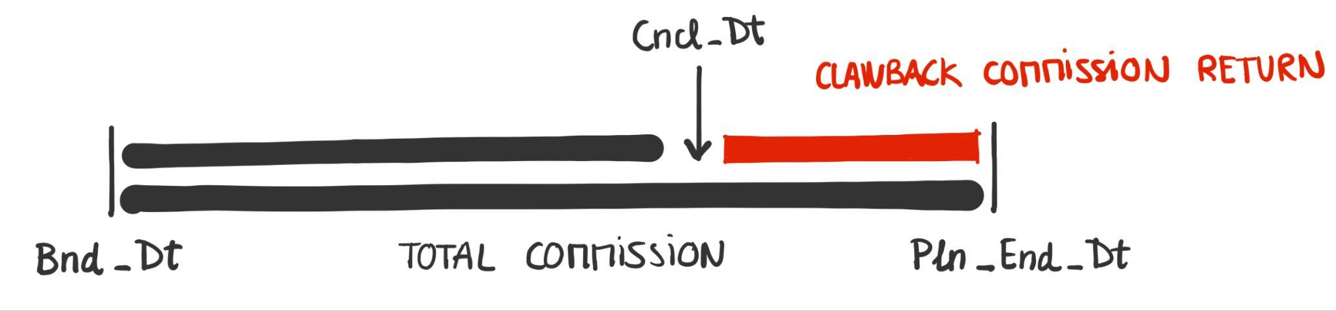
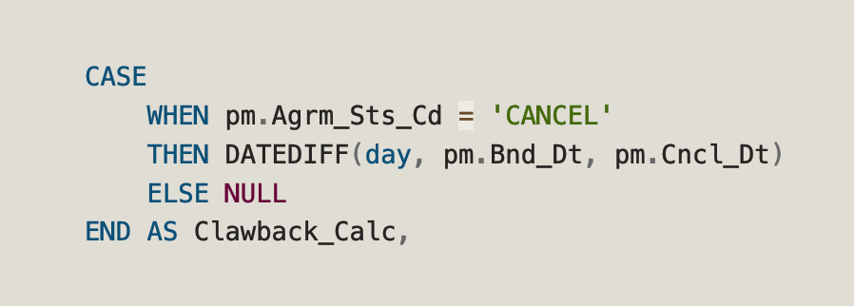
Clawback
ASSUMPTION 5 – Clawback calculation
The days of the active validity of the policy are considered to be between Bnd_Dt and Cncl_Dt.

Slide 9
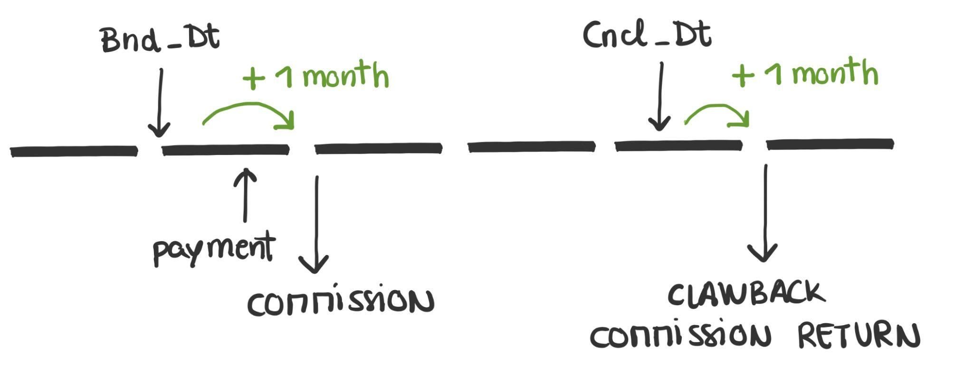
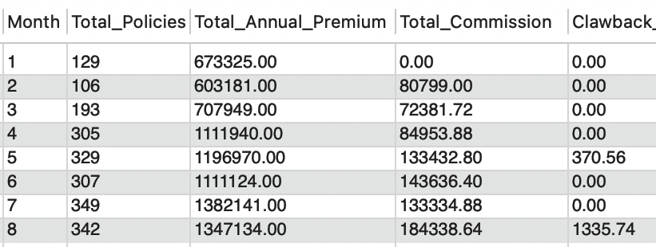
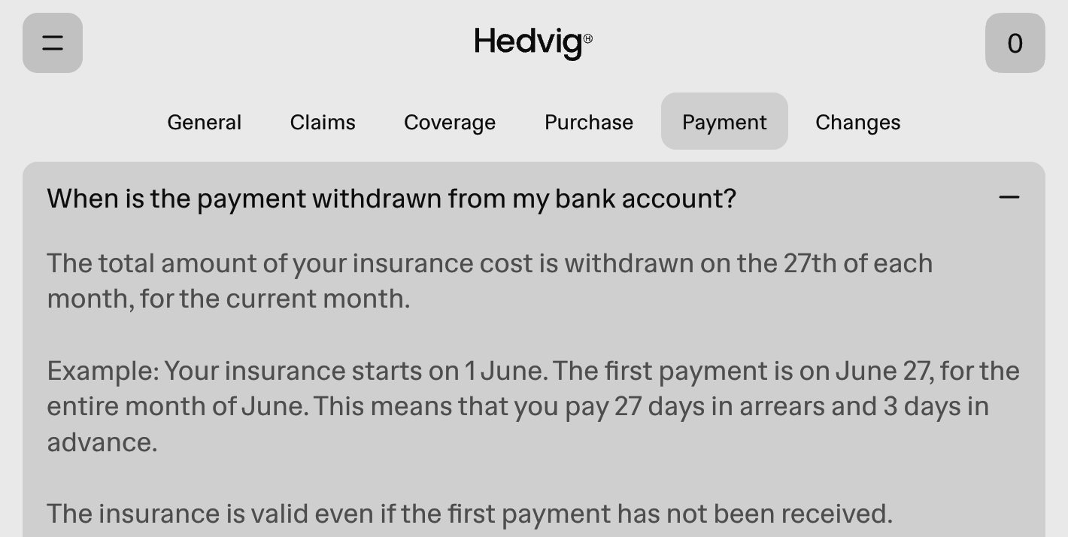
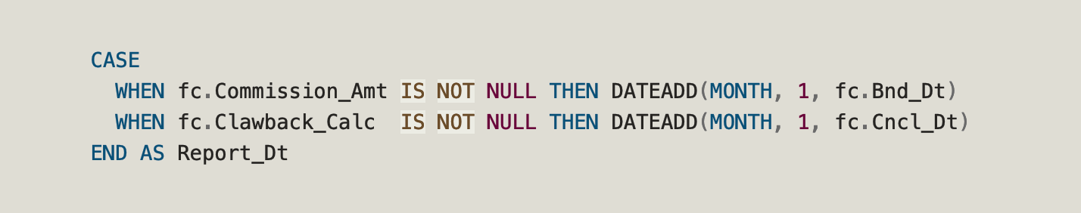
ASSUMPTION 6 – Report date for commissions

Slide 10
Monthly Report (January 2024 - August 2024)
Year | Month | Total_Policies | Total_Annual_Premium | Total_Commission | Clawback_Returns
2024 | 1 | 166 | 739470 | 0.00 | 0.00
2024 | 2 | 154 | 703404 | 88736.40 | 0.00
2024 | 3 | 233 | 772397 | 84408.48 | 0.00
2024 | 4 | 348 | 1185228 | 92687.64 | 0.00
2024 | 5 | 386 | 1297440 | 142227.36 | 370.56
2024 | 6 | 348 | 1208550 | 155692.80 | 0.00
2024 | 7 | 399 | 1478990 | 155822.82 | 0.00
2024 | 8 | 385 | 1431011 | 207058.60 | 1335.74

