Slide 1
AI-Powered OCR Evaluation System
Automating Homework & Exam Grading with AI

Slide 2

The Challenge in Modern Education
Teachers spend hours manually grading homework, assignments, and exams.
Subjective answers lead to inconsistency in evaluation.
Paper-based assessments are time-consuming to process and track.
Growing class sizes make scalable evaluation impossible without automation.

Slide 3

Our AI-Powered Evaluation System
Combines OCR (Google Vision) with NLP (Sentence Transformers) to evaluate both handwritten and typed responses.
Automatically grades subjective questions.
Generates a detailed performance report for each student.
Seamlessly integrates into teacher workflows via a web-based dashboard.

Slide 4
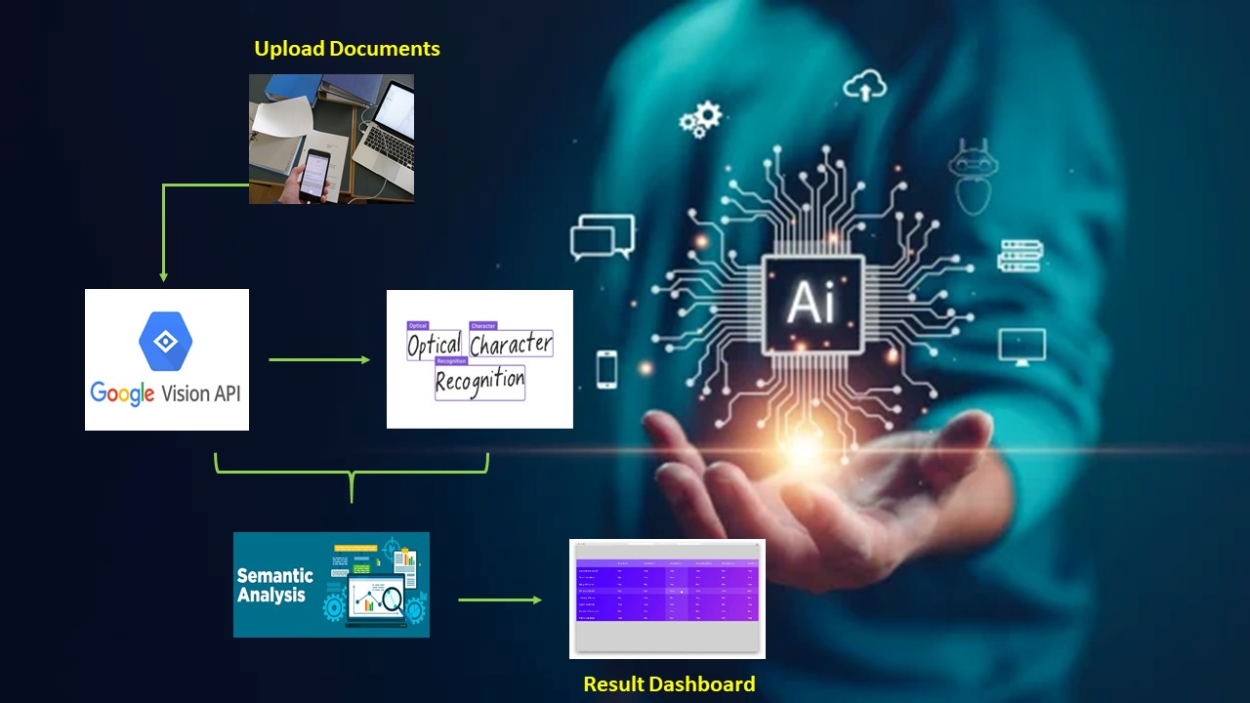
Tech Stack Behind the System
OCR: Google Vision API
NLP/Semantic Analysis: Sentence Transformers
Backend: Python (FastAPI), C#
Database: SQL Server
Frontend: React.js

Slide 5
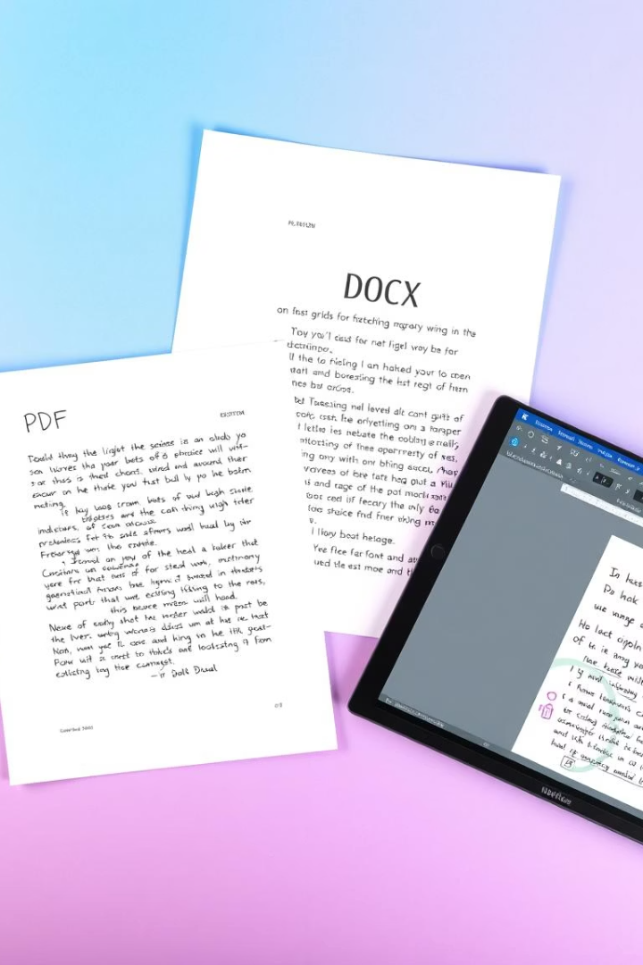
What Makes Our System Powerful
Automated Grading: Subjective questions
Handwriting Recognition: Accepts handwritten papers
Semantic Understanding: AI compares answers meaningfully, not just keywords
React-based Dashboard: Real-time results for teachers and admins
Secure Access: Role-based login system for different users

Slide 6

Quantifiable Benefits
70–90% reduction in grading time
Improved consistency in scoring across teachers
Scales easily from single classrooms to large institutions
Frees up teacher time for teaching and feedback

Slide 7

AI Feedback: Suggest improvements to student answers
Mobile App: For teachers in low-resource or rural areas
Plagiarism Detection: Compare across student submissions
Multilingual Support: Support for regional languages in OCR
Integration: Sync with school ERP and LMS platform

Slide 8
Questions? Let’s Connect!
Name: [P Suganya]
Email: [p.10728875@LTIMindtree.com]

Slide 9
Thank You

