Slide 1
Drill Down Reporting

Slide 2
Overview
Download the latest .tgz package here: https://github.com/sugarcrmlabs/drilldownreporting/releases/latest
Load the package in your target instance using Module Loader
Create, or view, a dashboard with one or more Save Report Dashlets. The features will automatically be available on any Saved Report Dashlet.

Slide 3
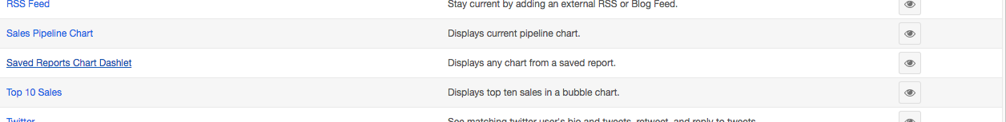
Add Saved Reports Dashlet
Create or Edit a dashboard/intelligence panel and add the out of the box Saved Reports Dashlet.

Slide 4
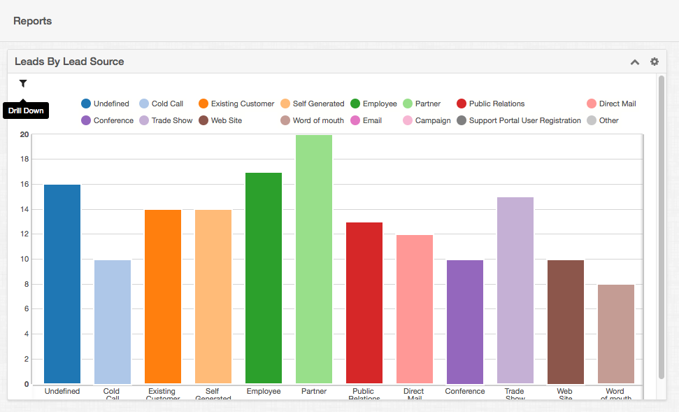
Drill Down to Report
Clicking the icon shown below will navigate to the actual report used for the dashlet.

Slide 5
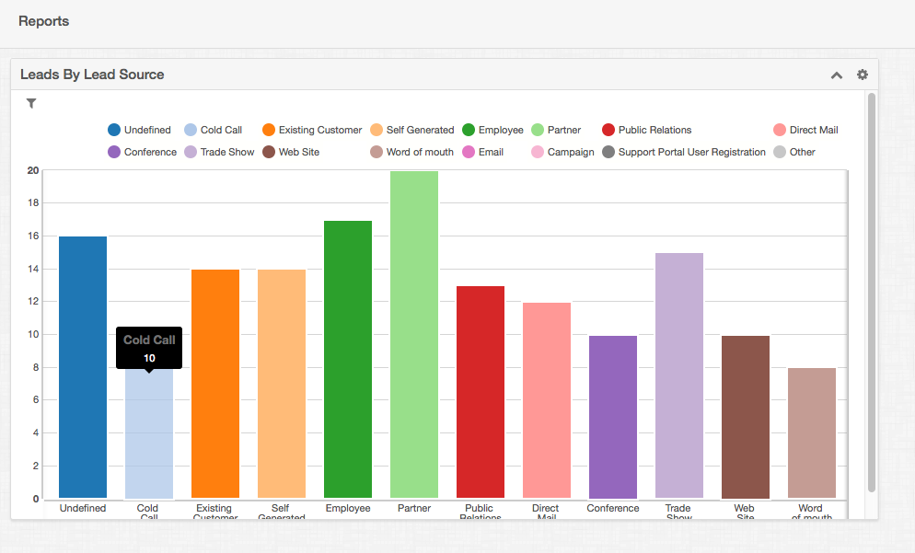
Record View (1-5)
Clicking on a segment of the report, like the bar shown below, will navigate to a list view filtered by the criteria of that chart’s segment.

Slide 6
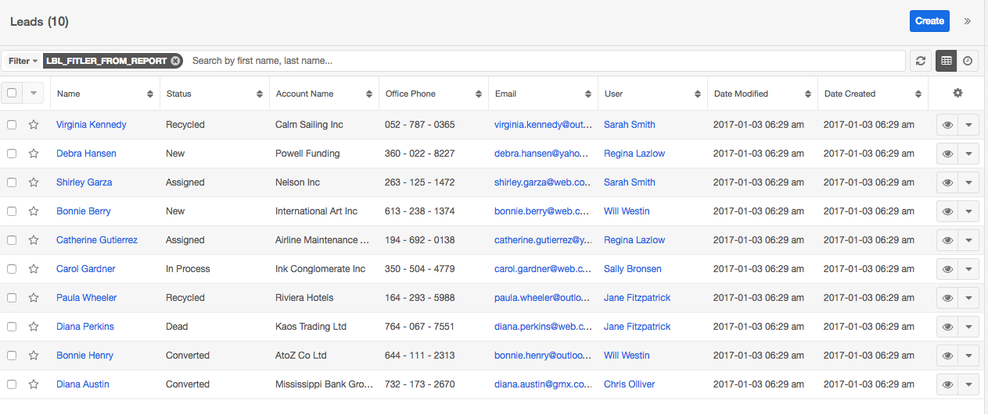
Filtered List View
Below the list of Leads of source ‘Cold Call’ is shown, based on the selection of the previous screenshot.

