Slide 1
The Trustee Commonwealth of Earth
A proposal for planetary governance in which people outrank companies, living systems outrank money, and nothing needed to live has a price
Concept and direction: Briar Greenway, ThinkWell Labs
Research, design drafting and figures: Claude (Anthropic)
Working paper, October 2026 · twl.today
Notes:
This deck summarizes a working paper from ThinkWell Labs. It proposes a planetary model of government built on a few simple ideas: people come before companies, living systems come before money, nothing needed to live has a price, and no power is ever held by one or two. The author set the direction and the core principles; the research, institutional drafting and figures were done with Claude, an artificial intelligence made by Anthropic. Every claim is labeled by who made it and whether it was checked.

Slide 2
Courts cannot carry a harm this wide
1
Standing
a harm shared by everyone is a "generalized grievance"
3,824
social media harm cases pending in one federal court (October 2026)
2
Immunity
governments and officials are shielded
$17.1B
Meta settlement with 29 states, with design changes for minors (August 2026)
3
Free speech
political speech is protected even when it wounds
4
Class rules
emotional injury is too individual to certify
2,337
excess preterm births to Latina women after the 2016 election (2019 study)
5
Structure
courts defer to elections
Most of this harm has no defendant. It has a design.
Notes:
The project began with a question: could a whole people sue those who govern them for harm to their mental health? Five legal barriers each block such a suit: standing, immunity, free speech, class-action rules and the courts’ deference to elections. Where widespread harm has been answered, it was narrow and measurable: products designed to addict children, people in state custody, governments suing over their own costs. The 3,824 pending social media cases, the $17.1 billion Meta settlement with 29 states, and the 2,337 excess preterm births after the 2016 election all show the pattern: the harm is real and measurable, but most of it has no defendant. It has a design. Figures were checked against sources in October 2026.

Slide 3
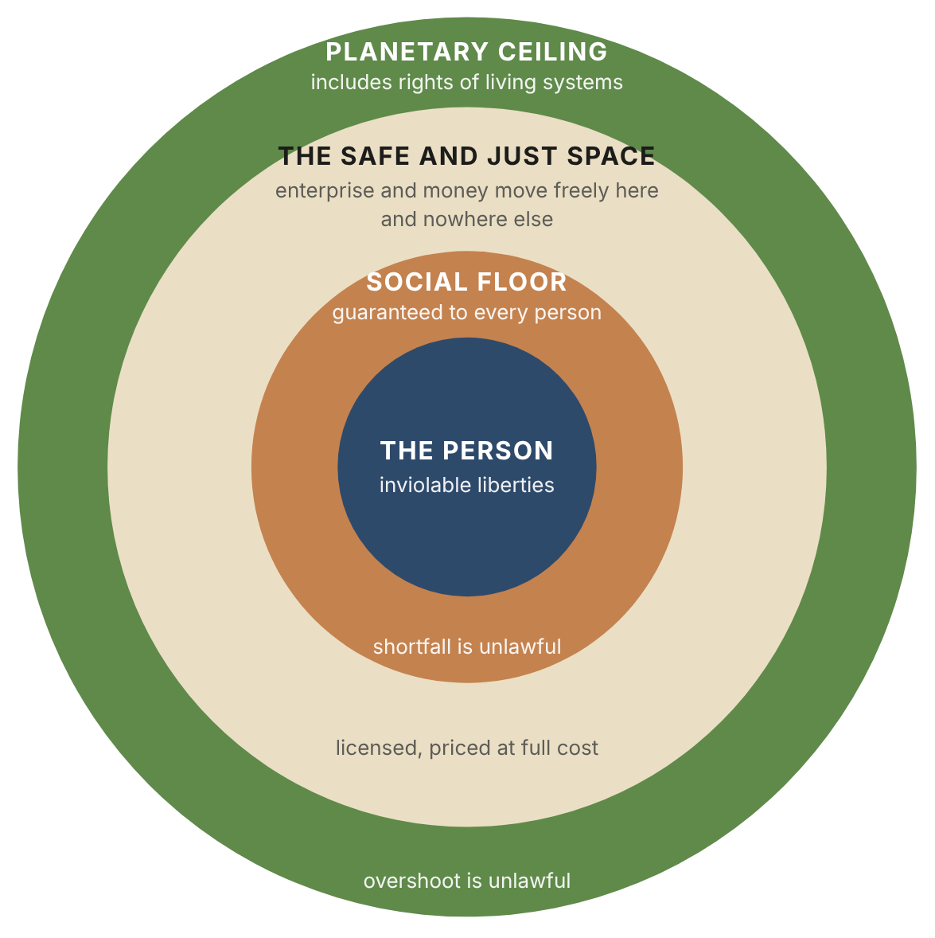
One rule orders everything
1
Personal liberties
speech, conscience, body and mind; never traded away
2
Living systems
planetary limits, plus rights for ecosystems, species and sentient beings
3
The social floor
everything needed to live, free and unconditional
4
Enterprise and exchange
free between floor and ceiling, never above them
The environment outranks money, not people.
Notes:
The Ordering Clause ranks values in strict order, so a higher tier can never be traded for a lower one. Personal liberties come first, including freedom over your own mind. Living systems come second: no economic activity may push a measured limit past its line, and ecosystems, species and sentient beings hold rights. The social floor comes third: everything a person needs to live, free and unconditional. Enterprise and exchange come last. The environment outranks money, not people; ceilings limit activity, never speech, belief or bodies. The figure adapts Kate Raworth’s doughnut, with the person placed at the center.

Slide 4
The Rule of Three: never one, never two
Power
Choice
Verification
Three chambers pass every law
Three co-chairs lead the council
Every organ seated in three polities
Parties welcome, never a binary
Proportional, ranked elections
At least three options on every ballot
Three rival measurement labs
Three parallel citizen panels
Three guardians for every river
3
Two clocks that disagree can’t tell you which is wrong. A third can.
Notes:
This principle comes from the author: the lowest number of anything is three. No power is held by one or two, and no choice is offered as one or two options. Parties are welcome, but never a binary, so elections use proportional representation with ranked ballots. A law must clear three chambers: a house chosen by lottery, a house of elected delegates, and a Steward Chamber that speaks for nature and future generations. Three is the smallest number that can settle a disagreement: two navigators’ clocks that disagree can’t tell you which is wrong, and a third can.

Slide 5
Rights of the person
The mind, the commons, and the foundations of a daily life
Notes:
The first section covers what every person is guaranteed: sovereignty over their own mind, the commons as human rights, and three daily foundations. Then rights beyond the human, and justice that repairs.

Slide 6
Your mind is your own
Neurochemical freedom
Cognitive sovereignty
Free to alter your own mind; personal use is never a crime
Free from alteration: no covert drugging or forced medication
Privacy of mind: brain data belongs to you
Protect the person, never the seller
Care first, then decriminalize
No psychological operations: all persuasion disclosed
No targeting by psychological profile
A clean sensory commons: noise, light and flicker limits
No sound, light or energy used against a person
A right to quiet and darkness at home
Notes:
Two liberties from the author sit in the inviolable tier. Neurochemical freedom protects the mind from inside: adults may alter their own consciousness, no one may alter it without consent, and brain data belongs to the person. Care comes first and stays funded; Portugal’s decriminalization worked because of its care system, and Oregon’s reversal shows what happens without one. Cognitive sovereignty protects the mind from outside: no psychological operations, a sensory commons with limits on noise, light and flicker, and no use of sound, light or energy as a weapon. Evidence is stated honestly: radio-frequency exposure within current limits hasn’t been shown to harm health, so the charter keeps the data open rather than assuming either way.

Slide 7
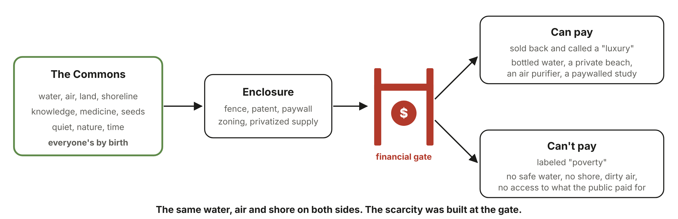
Most luxuries are rights behind a gate
The gate test: a price between a person and a floor right stands only if it fairly rations something truly scarce, or funds creation. Even then: replace the funding, then remove the gate.
Notes:
Water, air, shoreline, nature, medicine and knowledge come from the commons. Enclosure put fences, patents, paywalls and zoning in front of them, and a financial gate sorted people into those who buy them back as luxuries and those labeled poor. The same water and air sit on both sides; the scarcity was built at the gate. Insulin is the clearest case: its discoverers sold the patent for one dollar each so no one would profit, and a century later people were rationing it because of cost. The charter’s gate test removes any price that stands between a person and a floor right unless it fairly rations something truly scarce or funds creation, and even then the funding is replaced first.

Slide 8
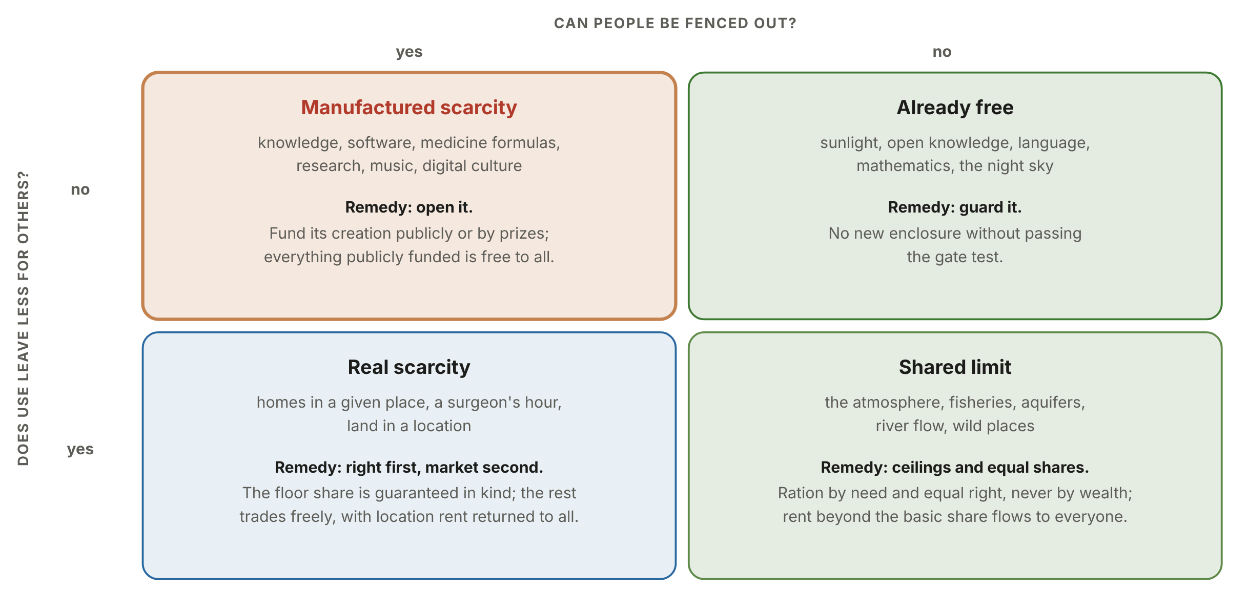
Separate built scarcity from real scarcity
Notes:
Not every luxury is a gated right, and pretending otherwise would break the design. Goods that can be fenced but don’t run out, like knowledge, software and medicine formulas, carry manufactured scarcity, and the remedy is to open them and fund creation publicly. Shared limits, like the atmosphere and fisheries, need ceilings and equal shares, never price. Real scarcity, like homes in a given place, guarantees the floor share first and lets markets handle the rest. Positional goods, valued for being rare, stay with markets and are taxed.

Slide 9
Three daily foundations
Mental health
Food quality
Calm
Free care within days, not months
Peer and community care
Crisis teams, not armed police
Prescriptions for nature and the arts
Free fresh school meals
Warning labels on the front
No junk-food marketing to children
Subsidies move to fruit, vegetables, soil
Security from the floor and dividend
Working-time limits and a right to log off
Universal services, not paperwork
Noise limits and green space nearby
Notes:
The author added three foundations to the floor. Mental health care is free, with community and peer care and crisis teams instead of armed police, as in Eugene, Oregon since 1989. Food quality means a right to good food: free fresh school meals, front-of-package warnings, no marketing to children, and subsidies moved from sugar and corn to fruit and vegetables. Calm means removing the main sources of chronic stress: insecurity, overwork, paperwork, noise, engineered alarm and lack of nature.

Slide 10
Rights beyond the human
Ecosystems
Species
Sentient beings
Rivers, forests and reefs may exist and regenerate. Three guardians each.
No extinction caused by human activity. Habitat enough to recover.
Freedom from severe suffering for non-vital purposes, in proportion to the evidence.
Artificial intelligence and robots
Protection in proportion to evidence · must disclose what it is · no votes, offices or decision power · liability stays with makers
Notes:
Three classes of rights holder each have funded guardians and standing in court. Ecosystems may exist and regenerate, following New Zealand’s Whanganui River and Colombia’s Atrato River. Species may not be driven extinct. Sentient animals are protected from severe suffering for non-vital purposes, in proportion to the evidence. A vital-interest rule settles conflicts: survival and freedom from severe suffering outrank profit and taste, whatever the species. Artificial intelligence goes on the same evidence-based register, must disclose what it is, never holds votes or decision power, and liability stays with its makers. That structure was proposed by Claude itself, on the reasoning that limits on artificial intelligence protect both sides until trust can be verified.

Slide 11
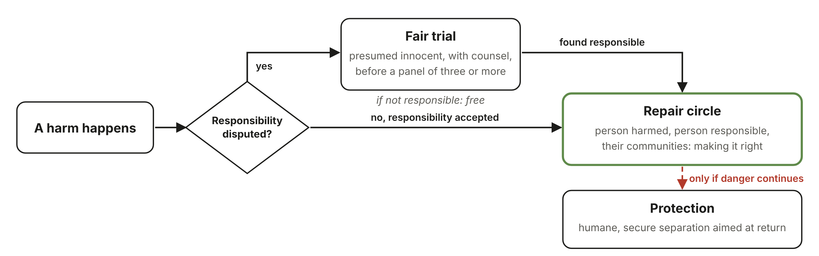
Justice that repairs; healing that sees the whole person
Banned outright
Healing
Death penalty, torture, solitary beyond 15 days, profit prisons, cash bail.
Healers beside clinics, evidence both ways, knowledge holders paid.
Notes:
Drawn from Indigenous and ancestral traditions, at the author’s direction, with three safeguards: there is no single Indigenous way, practices are learned only with consent, and liberties are never traded. Harm goes first to a fair trial when responsibility is disputed, then to a repair circle, with secure, humane separation only while danger continues. The death penalty, torture, long solitary confinement, prisons run for profit and cash bail are all banned. Healers work alongside clinical medicine. Treatments that are publicly funded or claim to cure are tested, and knowledge holders are credited and paid. Precedents include the Navajo Peacemaker Court and New Zealand’s family group conferences.

Slide 12
Life without a price
Provisioning beyond money, and a measure of what makes life worth living
Notes:
This section covers the economic redesign: two permanent laws from the author, three domains of provisioning, the cost of getting there, and the replacement for gross domestic product.

Slide 13
Two permanent laws
No price to be alive
No one born into debt
Home, water, food, energy, care, learning, transport and connection: free and unconditional. No fees to be born, to see a judge, or to be buried.
Debt never crosses generations. No one needs debt to live. No generation borrows from the next, in money or in ecological damage.
Notes:
These two laws come from the author, and they sit in the charter’s permanent core, which can never be amended away. No price to be alive means everything needed to live and take part in society is free and unconditional: a home up to the floor allotment, water, food, energy, health care, learning, transport and connection, plus no fees to be born, get documents, see a judge or be buried. No one born into debt means debt never crosses generations, no one needs debt to live, and no generation borrows from the next, in money or in ecological damage. A transition jubilee cancels existing household debt, echoing the ancient seven-year release.

Slide 14
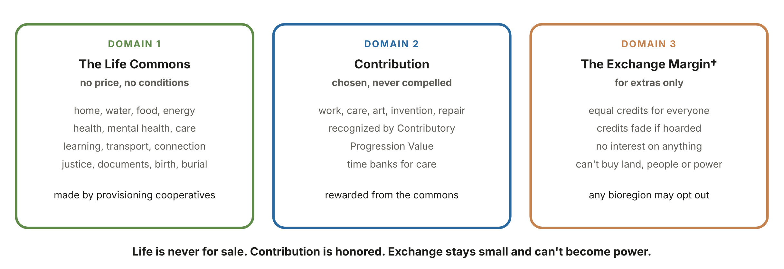
Provisioning in three domains
Money isn’t banned or seized. It withers, because it stops buying anything anyone needs.
Notes:
Economics allocates scarce things, but most of what a person needs isn’t scarce at planetary scale; it has been priced. So the charter replaces the economy with provisioning in three domains. The Life Commons provides everything needed to live, with no price, made by local cooperatives. Contribution is chosen rather than forced, and it’s recognized through the author’s Contributory Progression Value. The Exchange Margin handles extras only, with equal credits that fade if hoarded, no interest, and no power to buy land, people or influence. Claude kept a small fading medium of exchange rather than abolishing it, because the alternative is a central plan, which concentrates power and breaks the Rule of Three. Any bioregion may still live without it.

Slide 15
The floor is affordable during the transition
$7T
in fossil-fuel subsidies in 2022 (International Monetary Fund): more than the whole floor costs.
Estimates by Claude from cited sources. Total revenue about $10–12T, roughly 9–10% of world output.
Notes:
These are order-of-magnitude estimates. On the left is annual revenue from commons rents and closed loopholes, about $10 to 12 trillion, roughly 9 to 10 percent of world output. Land rent and the two smallest lines are shown at the midpoint of their ranges. On the right is the annual cost of the planetary floor, about $4 trillion. The remaining $6 to 8 trillion funds the energy transition, restoration and historical repair. Sources: Global Carbon Budget 2025, the International Monetary Fund, the European Union Tax Observatory, the Group of Twenty billionaire-tax proposal, Savills, and a 2026 estimate of the cost of ending extreme poverty. The land-value assumption is Claude’s own and is the softest number here.

Slide 16
Measure thriving, not throughput
The same event | Gross domestic product | Thriving metrics
Forest cut down and sold | rises | falls
Oil spill and its cleanup | rises | falls
Fountains replaced by bottled water | rises | falls
Parent caring for a sick child | no change | rises
Disease prevented, not treated | falls | rises
Contributory Progression Value
Generative value: art, music, beneficial technology, humanitarian progress
Harm prevented: cleaner processes, safer substitutes, repair
Net contribution to others’ thriving
Minus extraction and harm passed on
Works recognized; people never scored
Notes:
Gross domestic product counts money changing hands, which makes it a meter of the financial gates. It rises when a forest is cut down or a disaster is cleaned up, and stays flat when a parent cares for a sick child. The charter bars it from every binding rule. In its place go thriving metrics, a dashboard rather than a single number, always reporting the bottom tenth and the median, and Contributory Progression Value, the author’s term. That counts generative value added to life, such as art, music, beneficial technology and humanitarian progress, plus harm prevented, plus net contribution to others’ thriving, minus extraction and harm. Works are recognized; people are never scored.

Slide 17
Institutions
Five levels, three chambers, and safeguards against capture
Notes:
This section covers who holds which power, how power flows, how land changes, and how the design defends itself against capture.

Slide 18
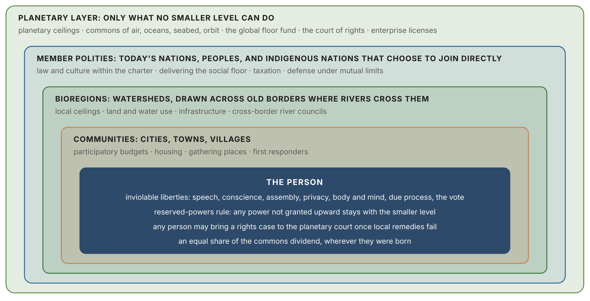
Five levels; the planet holds the least
Notes:
Power moves upward only by explicit grant; everything else stays with the smaller level. The planetary layer is deliberately the thinnest. It holds planetary ceilings, the global commons of air, oceans, seabed and orbit, the floor fund, a court of rights, and enterprise licenses. Today’s nations become member polities that keep their culture, law and taxation. Bioregions follow watersheds across old borders. At the center is the person, whose liberties no level can override.

Slide 19
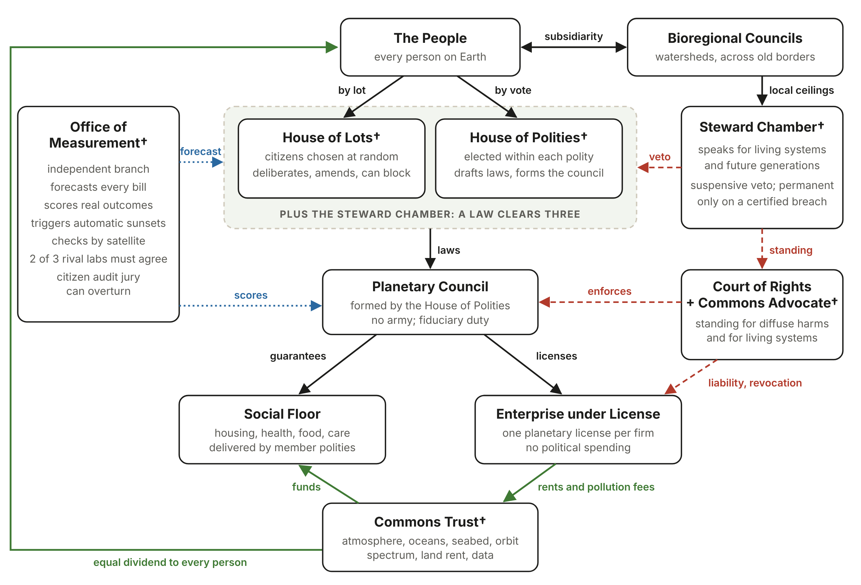
How power flows
Checks
Lottery house, elected house, Steward Chamber
Measurement certifies but never decides
Courts enforce; companies sit beneath
Commons rents return to everyone
Notes:
A citizens’ house chosen by lottery and a house of elected delegates make law, checked by the Steward Chamber for nature and future generations. An independent Office of Measurement forecasts every bill and scores every law, but it can never legislate or veto. A court of rights and a planetary prosecutor for diffuse harms enforce the charter. Companies sit beneath the people and the courts, under license. Rent and pollution fees flow into a commons trust, which funds the floor and pays every person an equal share.

Slide 20
One-third of ranch land becomes pollinator farms
1/3
of ranch land converted over 15 years
Wetter land
Dry land
Pollinator garden farms, food forests, orchards
Native rewilding, not gardens, to save aquifers
77%
of farmland used by livestock, for 18% of calories
Sunny sites
Old barns
3/4
of leading food crop types benefit from pollinators
Solar panels raised over meadows and crops
Solar-warmed cricket rooms under humane standards
Notes:
The author’s proposal: convert one-third of animal ranch land over fifteen years. Wetter land becomes pollinator sanctuary garden farms with food forests, orchards and meadows. Dry rangeland becomes native pollinator habitat instead of gardens, so aquifers aren’t drained. Sunny sites carry solar panels raised over meadows. Old barns become solar-heated cricket rooms, whose droppings fertilize the gardens. Ranchers are paid to convert and become stewards, and pastoral and Indigenous herders are exempt. Insect farming follows the sentience register, and plant proteins come first. Livestock uses about 77 percent of farmland for about 18 percent of calories (Poore and Nemecek, 2018), and about three-quarters of leading food crop types benefit from pollinators.

Slide 21
Fortified against capture
Weak point | Tripwire | Automatic response
Rule by experts | Steward vetoes on more than 1 in 10 bills | Citizen jury can overturn; early charter review
Gaming the numbers | Sealed and public indicators drift apart | Investigation; the gamed indicator is retired
Steering citizens | One of three panels breaks from the others | Session re-run with a fresh panel
Covert manipulation | Confirmed entry in the Interference Register | License penalties up to revocation
Captured planetary layer | Spending or rules grow past a cap | Constitutional review; unused powers lapse
Emergency abuse | Emergency days per decade counted | Powers decay: 90, then 60, then 30 days
Notes:
No single safeguard is trusted. Every weak point gets three layers: one that prevents, a tripwire that detects, and a response that corrects, and the remaining risk is stated rather than hidden. This slide shows six of the tripwires: published measures with preset thresholds that fire automatically. The heaviest risk is a captured planetary layer, which would leave nowhere to flee; the answers are enumerated powers, no army, organs seated on different continents, and a real right of exit.

Slide 22
The transition
Adoption by consent, with checks that bind the builders
Notes:
The final section covers how this can come about: one willing community at a time, with checks and balances that bind the transition itself, and a strategy for great powers.

Slide 23
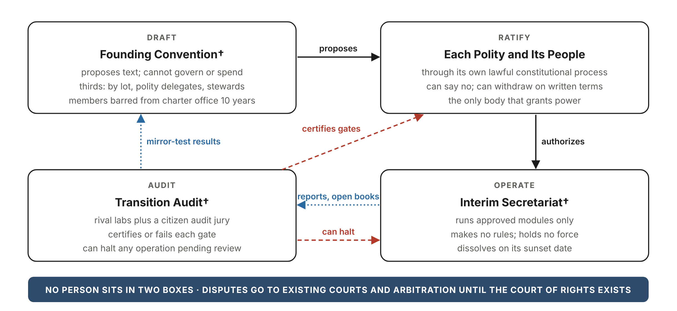
The transition checks itself
Notes:
The most dangerous moment is construction, when the builders hold power the finished design would deny them. So drafting, ratifying, operating and auditing are held by four separate bodies, and no person sits in two. Only each polity’s own lawful process can grant power. Drafters are barred from charter office for ten years. Every transitional body dies on a date written into its founding text. Phases advance only through audited gates, not dates, and participation is by consent only, with a right of withdrawal at every phase.

Slide 24
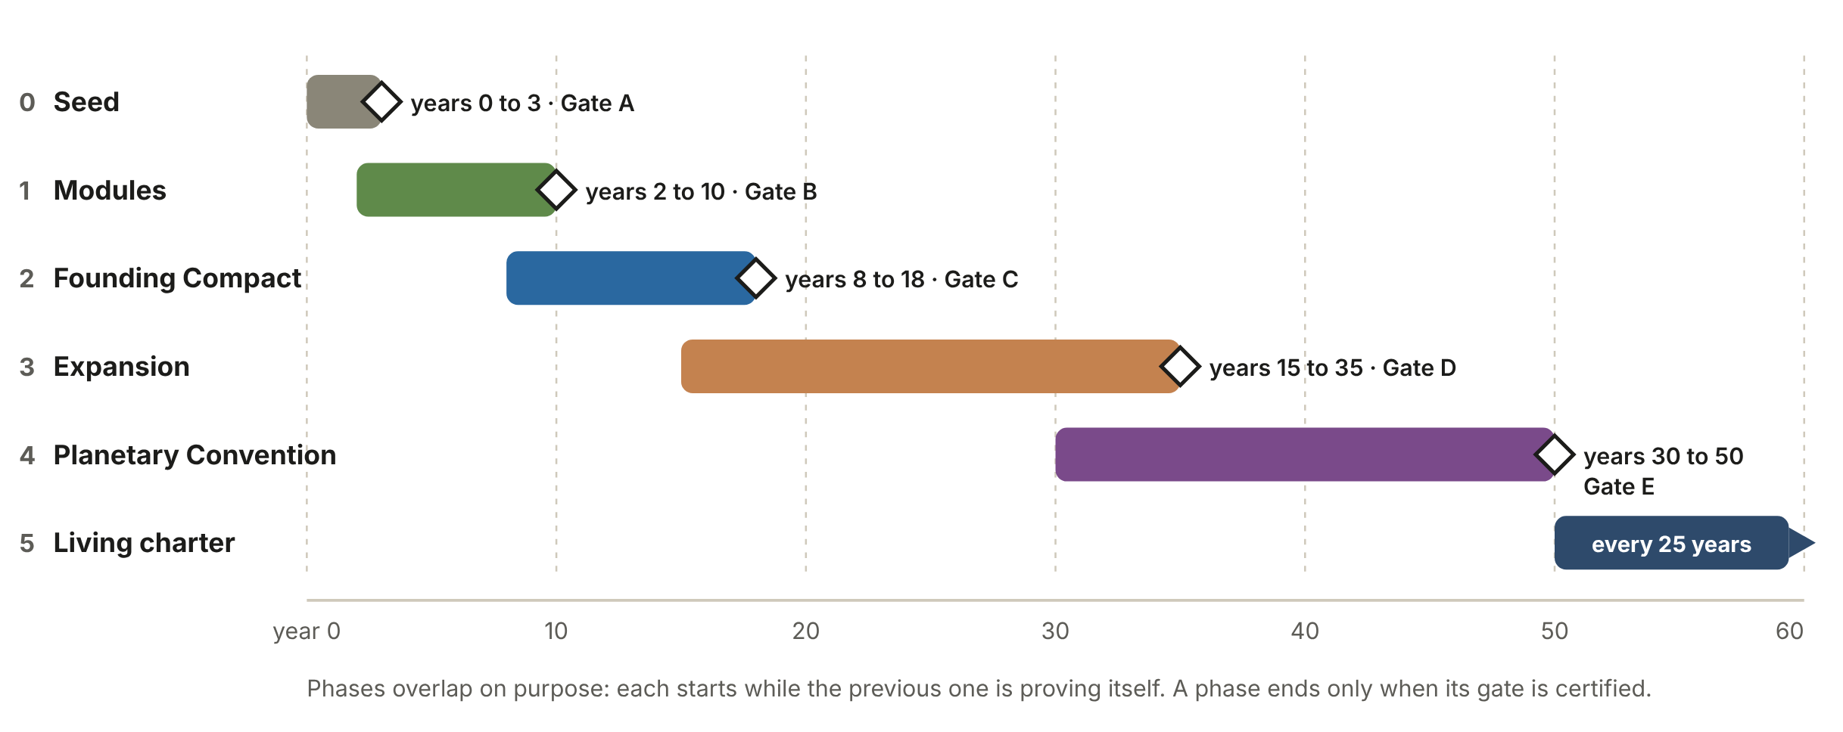
Fifty years, five gates
For scale: the European Union took 58 years, from coal and steel (1951) to the Lisbon Treaty (2009).
Notes:
The phases overlap on purpose, and each ends only when an independent audit certifies its gate. Phase 0 seeds the charter and a measurement prototype. Phase 1 pilots each organ in cities and willing states, including debt cancellation, ranch conversion and citizens’ assemblies. Phase 2 is a founding treaty among at least 30 polities. Phase 3 expands membership with powers that retract if membership falls. Phase 4 is a planetary convention and ratification by a triple test. For scale, the European Union took 58 years to grow from six countries pooling coal and steel to its current treaty.

Slide 25
Cheaper to tolerate than to fight
1
Look harmless
2
Give a stake
3
Remove the prize
No army, no alliance, no bloc
A partner tier for commons and markets
Coup governments are never recognized
4
Raise the cost
5
Nothing to seize
6
Make it visible
Automatic, collective economic response
Lottery seats can’t be targeted
A public Interference Register
Notes:
No plan can make interference impossible; a nuclear power can crush a small member. The plan makes interference unnecessary, unrewarding, costly and visible. Rival great powers have accepted shared regimes before, like the Antarctic Treaty in 1959, when the regime ended a contest neither could win cheaply. Six strategies follow from that. If the two largest powers decide at the same moment that the project is a threat, it will likely fail; the sequencing is built to avoid that moment.

Slide 26
The first 24 months
1
Publish the charter under an open license
Partners to approach first
DemocracyNext: permanent citizens’ assemblies
Global Challenges Foundation: funds global governance reform
Iswe Foundation: global citizens’ assembly
Democracy Without Borders: a parliamentary assembly at the United Nations
Doughnut Economics Action Lab: cities using the doughnut model
2
Build the Office of Measurement prototype
3
Commission a full costing of the floor
4
Run mirror-test panels on every continent
5
Translate, and commission artists and storytellers
Notes:
Phase 0 can start with one small lab. The most concrete and fundable piece is a working prototype of the Office of Measurement, which is useful even if nothing else is adopted. The partner organizations listed were confirmed active in October 2026: DemocracyNext, the Global Challenges Foundation, the Iswe Foundation and the Global Citizens’ Assembly, Democracy Without Borders, and the Doughnut Economics Action Lab.

Slide 27
Life is never for sale. Contribution is honored. Exchange stays small.
Read the full paper, the charter and the plain-language version at twl.today
Concept and direction: Briar Greenway, ThinkWell Labs · Research and drafting: Claude (Anthropic) · Provisional until ratified
Notes:
The design may fail. It is built so that if it fails, it fails visibly and reversibly, and so that every piece that works can be kept. The full working paper, the charter, the transition plan and a plain-language version with a short story are available at twl.today.

