Slide 1
WOMEN in the SUGAR COMMUNITY

Slide 2
Hello!
I am Emily Ong
And I am a female participant in Google Code-In 2016 ☺

Slide 3
1.
What is Sugar?
A brief introduction of the Sugar community

Slide 4
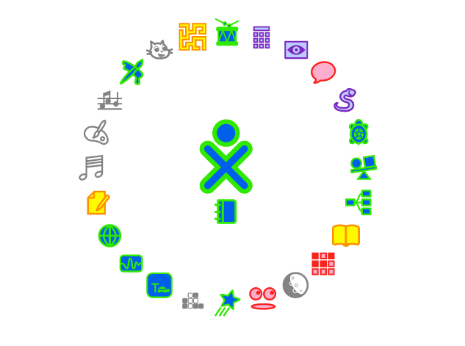

Slide 5
“At Sugar Labs, we make a collection of tools that learners use to explore, discover, create, and reflect. We are non-profit and led by volunteers. We distribute these tools freely and encourage our users to appropriate them, taking ownership and responsibility for their learning.”

Slide 6
Sugar Activities
Sugar is both a desktop and a collection of Activities.
Activities, as the name implies, are Apps that involve active engagement from the learner.
Activities automatically save results to a journal, where reflections are recorded.
Activity instances can be shared between learners; many support real-time collaboration.

Slide 7
Sugar Neighbourhood
In the Sugar Neighborhood view, learners see their friends clustered around their current Activities; from this view they can join each other’s Activities. Sugar collaboration works "peer to peer," in a classroom or under a tree; Sugar does not require the Internet.

Slide 8
Sugar Journal
The Sugar Journal records everything a learner does using Sugar. There is no need to remember to click a Save Button. The focus is on the activity, not the computer. The Journal is also a place for reflection, where learners and their teachers can monitor progress.

Slide 9
Open-Source?
So, you may think, how much is Sugar? But I heard its free? How can that be?

Slide 10
Yes, Sugar is totally free and open-source!
VOLUNTEERISM
Sugar Labs, a volunteer-driven, non-profit organization, had its origins in the One Laptop Per Child project and is now a member project of the Software Freedom Conservancy.
SUPPORT
The mission of Sugar Labs is to support the Sugar community of users and developers and establish regional, autonomous “Sugar Labs” around the world to help learners “learn how to learn” by tailoring Sugar to local languages and curricula.

Slide 11
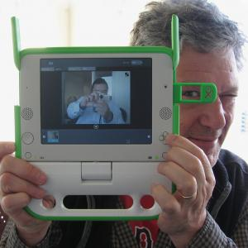
Founded by Walter Bender
In Boston, MA, 15th May 2008

Slide 12
2.
Women In the Sugar Community
A brief introduction of how women contributes to open-source

Slide 13

Women?

Slide 14
Sugar is not a one-man’s work; nor a dominant male community
Female
Sugar
Male

Slide 15
We are also supported by women all around the world

Slide 16
3.
Caroline Meeks
Lead for Gardener Pilot Academy (GPA) Pilot and Sugar on a Stick project

Slide 17
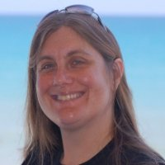
Caroline Meeks
Development/Product Manager - Educational Technology MEd in Technology, Innovation and Education and over 10 years experience creating web based educational experiences including programming and management of developers and projects.

Slide 18
“My passion and focus is on educators and creating technologies that support teachers as learners. I want to create systems that provide/support learning feedback and continuous professional improvement for educators and curriculum creators.”

Slide 19
HER Skills
Strong technology background
Excellent understanding and empathy for educators
Product vision and communication
Technical management for web and mobile development of domestic and international teams.
Open Source Software and Communities

Slide 20
Extensive technical, implementation and community experience in Open Source learning projects :
OpenACS/.LRN
LAMS (Learning Activity Management System)
Sugar (operating system for One Laptop per Child)
Khan Academy
Moodle

Slide 21
Contributions
Includes …

Slide 22
“Obtained a grant from the Gould Family Foundation for the GPA project Active with the Sugar on a Stick Team Active contributor to the Marketing Team I attend teacher gatherings and represent Sugar including giving it good visibility at the Harvard Graduate School for Education where I am a current Master's student Coordinate the recruiting of volunteers with Volunteer Match for both local and Sugar Labs wide volunteers. Worked with the technical staff at my company Solution Grove on the XS and Sugar on a Stick backup.”

Slide 23
“For the Oversight board election I want to give people an idea of my interests and what actions I've taken to try to move them forward.”

Slide 24
Sugar on a Stick a one stick per child access to computing and Sugar
GPA Pilot
Work on the Marketing Team
Writing Grants
General promotion
Testing
SG Engineers work on Stick backup and registration with the XS
hired as GPA interns BU students trying to start a pilot in India

Slide 25
Collaboration
Testing local collaboration
Providing a Jabber Server for the sugar community as well as for anyone who downloads SoaS. Providing Jabber to anyone who downloads SoaS model is not sustainable and I'm working on creating a business model to support it.
Provide free XS to a school in NY State and to GPA.
SG engineers working on Jabber bugs

Slide 26
Moodle
SG provides schools.sugarlabs.org
Try to advocate for the usefulness of Moodle and point out areas where it fits into our full vision.

Slide 27
Experiences
Talk at teacher conferences in ME and VT and visit schools
Try to make it easier to report bugs by evaluating launchpad and getsatisfaction
Advocate for the Teachermate content which I think would be easy for teachers to use.
hired an intern to write up lesson plans in formats familiar to teachers
working on a teacher professional development curriculum in my class this semester

Slide 28
Experiences
support adding a WYSIWYG editor to the wiki
working to create a site that allows individuals to purchase backup and collaboration
working to create a company that will allow school districts to have access to support contracts etc. if they desire
advocate for getting hardware support into SoaS

Slide 29
Interests
Using Sugar to create school-family-afterschool partnerships
Sugar in the Philippines (some of the Solution Grove engineers are located in the Philippines)

Slide 30
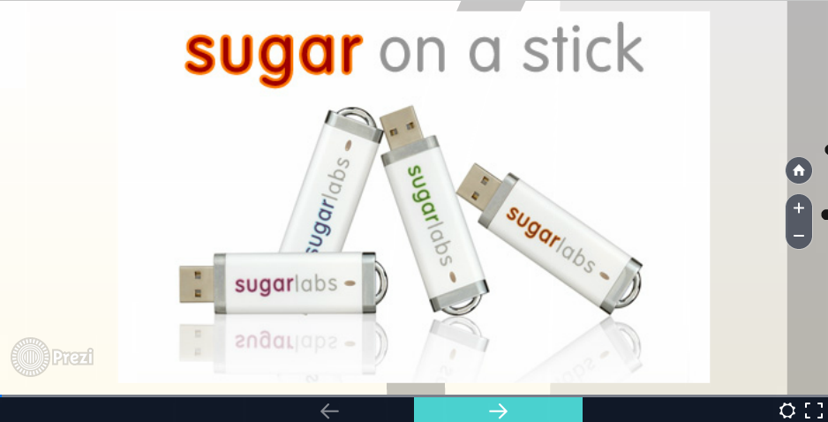
Presentation: Seacoast Linux User Group
https://prezi.com/kuuhqwmkxxtm/lug-presenation/

Slide 31
“I think volunteers sometimes wonder if they are appreciated. On of the definitions of appreciate is 'verb intransitive' to increase in value as in an investment appreciates. I am very grateful for the huge appreciation of my work by the Sugar Community. Thank you. ”

Slide 32
“Caroline’s presentation and demonstration were quite impressive, and her obvious enthusiasm for the project lead to an energentic question-and-answer session at the end.”
What Ted Roche, Contoocook, NH based developer working at Ted Roche & Associates, LLC. Former FoxPro expert, now specializing in Open Source web development using PHP, Ruby on Rails, and WordPress, said about Caroline

Slide 33
4. Anne Gentle
Senior Technical Writer volunteering for the Documentation Team

Slide 34
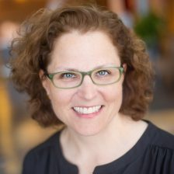
Anne Gentle
Work on OpenStack at Cisco
Eager to engage information professionals and spark action using a unique combination of education and experience as a writer in the computer industry and leader in the open source community. Recognized thought leader and innovative coordinator of unique documentation solutions.

Slide 35
“I have two kids and love introducing technology to them. I currently work a flexible 30-hour work week to spend more time with my family and home, but I like to stay busy. I have a lot of energy because these busy but balanced days fill me up rather than tire me out”

Slide 36
Contributions
Includes …

Slide 37
Key Experiences
Technical product management at Cisco, improving customer experience across the private OpenStack cloud spectrum from on-boarding to successfully deploying applications.
Technical leadership role at Rackspace, attaining title of Principal Engineer as a documentation collaborating, authoring, tooling, and automating expert.

Slide 38
Key Experiences
Lead the community documentation effort for OpenStack consisting of 130 git repositories governed by more than twenty related programs. Written in Python, OpenStack projects enable any organization to provide cloud computing capabilities on standard hardware using open source software. Applications written on OpenStack are beginning to grow.
Gathered competent documentarians to write about OpenStack. Grew numbers from 79 docs contributors to 130 docs contributors in six months from April 2013 to November 2013.

Slide 39
Key Experiences
With Adam Hyde, Anne coordinated and participated in the second FLOSS Manuals Book Sprint, resulting in a 250-page manual for One Laptop per Child written in five days in a wiki and a surge in community growth.

Slide 40
Key Experiences
Demonstrated thought leadership as one of the first ten nominated bloggers on talk.bmc.com. Connected directly with the customers, sometimes leading the group in popularity with 10,000 hits a month.

Slide 41
Key Experiences
Implemented method for using Oracle content in BMC Software products using on-demand XSLT, automatically formatting and displaying an explanation and user response for database errors.
Integrated O’Reilly learning materials directly into a BMC Software product using online Help system in a new way, enabling BMC Software users to search O’Reilly content and offer expert advice for database administration.

Slide 42
“I blogged for my former employer, BMC Software on talk.bmc.com from 2005 to 2007. I wanted to continue blogging about technical writing, information architecture, topic authoring, social media, and other technologies that catch my eye. So when I left BMC, I started just write click.”

Slide 43
Articles
OpenSource.com: Git and GitHub for open source documentation April 2016
OpenSource.com: Continuous integration and delivery for documentation Co-authored with Andreas Jaeger, July 2016
The Agile Executive: Agile Across the Enterprise: Prioritizing Value in Support and Training December 2009

Slide 44
Podcasts and Interviews
Podcast interview with Scott Nesbitt and Aaron Davis on their Communications with DMN show September 2008
Podcast with Anne Gentle about her Conservation and Community book on Tech Writer Voices August 2009
Video Interview with Ellis Pratt of Cherryleaf consulting September 2009 (part 1, part 2) Book also featured in their History of Technical Communication in 7 minutes video.

Slide 45
4. Claudia Uurea
Oversight Board Member of the Sugar Community

Slide 46
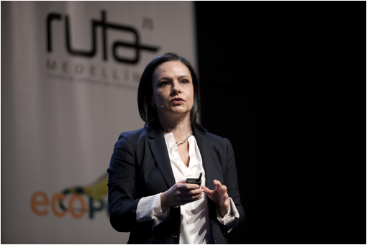
Anne Gentle
Currently working at the Strategic Educational Initiative within the MIT Office of Digital Learning in strategy, management and coordination for the new PreK-12 Initiative

Slide 47
What is the Oversight Board?
Mission
The mission of the oversight board is to ensure that the Sugar Labs community has clarity of purpose and the means to collaborate in achieving its goals.
Roles
The Oversight Board is responsible for appointing delegates with executive functions.
The Oversight Board appoints one of its members as a liaison to each SIG.

Slide 48
Contributions
Includes …

Slide 49
Claudia has been in the board of SugarLabs since 2010. Her goals within the organization are:
Work together with all members of the board, and community to continue to develop and evolve the mission for the organization, taking into account local al well as global opportunities and challenges,
Create equitable learning opportunities for all children around the world,
Continue to advocate and support the development of Constructionist tools,
Promote the organization among a variety of networks of stakeholders, both in the US and in countries around the world.

Slide 50
Experiences
Claudia Urrea has over 20 years of experience in the field of Education and Technology.
Claudia Urrea has worked at the Interamerican Development Bank as a consultant in the Education Sector, and 5 years at One Laptop Per Child organization as Director of Learning.
Her areas of interest include online learning and assessment, curriculum design, preK-12 and higher education, education for developing countries, teacher professional development, educational programming and robotics, and maker education.

Slide 51
Education
Claudia Urrea was born in Colombia, where she received an undergraduate degree in Computer Science from EAFIT University. In the mid 90s, she moved to the US, where she received her Master's degree in Educational Media and Technology from Boston University, and her doctorate degree from the MIT Media Laboratory. Her PhD thesis studied the implications of one to one learning in a rural setting in Latin America.

Slide 52
Education
She has helped multiple governments and non-government agencies to empower and support schools and communities of learners to evolve from traditional teaching methods into progressive learning environments.

Slide 53
Career
Dr. Urrea has also a research scientist position with the Lifelong Kindergarten group at the MIT Media Lab. She has taught several classes at the Harvard Summer Program and Early Childhood Development program at Tufts University. She has consulted with international and multi-sectoral organizations such as the Inter-American Development Bank and Schlumberger Excellence in Education Development-SEED.

Slide 54
Research Interests
Design and promote new strategies to significantly transform formal development and appropriation of new digital technologies
Study residential learning experience with online educational materials and blended learning models from theoretical, empirical, and policy perspectives

Slide 55
Research Interests
Design and study new learning environments for teachers and students in developing countries
Design of new mechanism and strategies to make learning visible, understandable, and actionable by different type of audiences

Slide 56
Publications with Walter Bender
Bender and Urrea (2015) Visualizing Learning in Open-Ended Problem Solving in the Arts. RED –Revista de Educación a Distancia. Número 46. http://www.um.es/ead/red/46
Bender, W., Solomon, C., & Urrea, C (2014). (More than) Twenty Things to Do in Turtle. In the Proceedings of Constructionism 2014. Vienna, Austria.
Urrea, C. and Bender, W. (2012). Making Learning Visible. Mind, Brain, and Education Journal, Wiley Online Library 6: 227–241. doi: 10.1111/j.1751-228X.2012.01161.x

Slide 57
Thanks!
Any questions?
You can find me at @emilyong on Github ☺

