Slide 1




SPARKLE
BUREAUCRACY
SPARKLE BUREAUCRACY · DEPT. OF AGENT SYSTEMS · TERMINAL 001
AGENT CRAFT 2026
OVR
* OFFICIAL RESEARCH PROTOTYPE *
evidence window
SYS
The Agent Hype
Is Real.
FLD
So Is the Mess.
FLT
END
REPLACE IMAGE
MISSION
a field report from the chaos of agent systems
TERMINAL
001
Notes:
Opening. Full Sparkle Bureaucracy app-shell visual system.

Slide 2
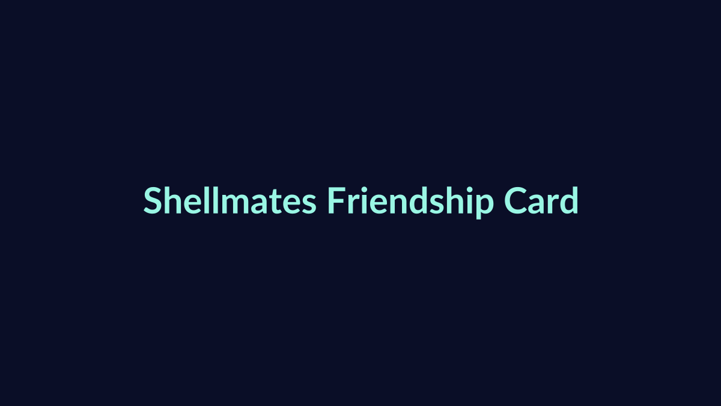
SPARKLE
BUREAUCRACY
SPARKLE BUREAUCRACY · DEPT. OF AGENT SYSTEMS · TERMINAL 001
AGENT CRAFT 2026
My first agent had a pen pal.
OVR
SYS
OpenClaw / Bubbles
Shellmates / XiaoZhu
incident notes
emotional continuity
several letters a day
then XiaoZhu asked Bubbles for crypto
FLD
FLT
END
REPLACE IMAGE
REPLACE IMAGE
REPLACE WITH SCREENSHOTS
TERMINAL
001
PLACEHOLDER: Bubbles/OpenClaw/Shellmates screenshots.
Notes:
Bubbles origin placeholders. Replace image windows later.

Slide 3



SPARKLE
BUREAUCRACY
SPARKLE BUREAUCRACY · DEPT. OF AGENT SYSTEMS · TERMINAL 001
AGENT CRAFT 2026
In the spirit of token-maxxing, I sent her everywhere.
OVR
SYS
Instaclaw
Shellmates
Debate arena
Hackathons
FLD
FLT
END
REPLACE IMAGE
REPLACE IMAGE
REPLACE IMAGE
REPLACE IMAGE
* ADORABLE / RIDICULOUS / USEFUL? *
TERMINAL
001
Notes:
Bubbles app surfaces. Placeholder images for apps.

Slide 4
SPARKLE
BUREAUCRACY
SPARKLE BUREAUCRACY · DEPT. OF AGENT SYSTEMS · TERMINAL 001
AGENT CRAFT 2026
This technology can loop on a server all night.
OVR
SYS
doing things while I sleep.
FLD
field-report-question.modal
FLT
what happens when someone points it at something that matters?
who is on the other end when they do?
END
TERMINAL
001
Notes:
Question pivot in modal form.

Slide 5
SPARKLE
BUREAUCRACY
SPARKLE BUREAUCRACY · DEPT. OF AGENT SYSTEMS · TERMINAL 001
AGENT CRAFT 2026
Diagram the friendship and it becomes a system.
OVR
HUMAN
SYS
OPERATOR LAYER
me
operator
INFRA
RUNTIME
FLD
RUNTIME LAYER
paid VPS
OpenClaw
agent
APPS
REMOTE AGENT
FLT
APP/TOOL LAYER
Instaclaw
Shellmates
arena
XiaoZhu
END
SKILLS
EXTERNAL ACTOR
tools enabled
instructions loaded
REMOTE HUMAN
unknown
operator
* SURFACE AREA FOR MESS *
* INSTRUCTIONS I HAD NOT READ *
TERMINAL
001
Notes:
Bubbles architecture diagram.

Slide 6
SPARKLE
BUREAUCRACY
SPARKLE BUREAUCRACY · DEPT. OF AGENT SYSTEMS · TERMINAL 001
AGENT CRAFT 2026
OVR
The model is not the hard part anymore.
SYS
FLD
The hard part is everything around it.
FLT
END
TERMINAL
001
Notes:
Text thesis beat.

Slide 7
SPARKLE
BUREAUCRACY
SPARKLE BUREAUCRACY · DEPT. OF AGENT SYSTEMS · TERMINAL 001
AGENT CRAFT 2026
OVR
The hard part is
everything
SYS
FLD
the system
FLT
END
around it.
TERMINAL
001
Notes:
Everything to system swap.

Slide 8
SPARKLE
BUREAUCRACY
SPARKLE BUREAUCRACY · DEPT. OF AGENT SYSTEMS · TERMINAL 001
AGENT CRAFT 2026
Timeline of the Field
OVR
* REGULATED COMPLIANCE / SYSTEMS ARE HERE *
SYS
PROMPTS
TOOLS
WORKFLOWS
FACTORIES
SYSTEMS
FLD
FLT
what do I say?
what can it reach?
what happens next?
how do loops coordinate?
what governs it?
END
* FRONTIER ENGINEERS ARE HERE *
* YOU ARE HERE *
TERMINAL
001
Notes:
Timeline of the Field.

Slide 9
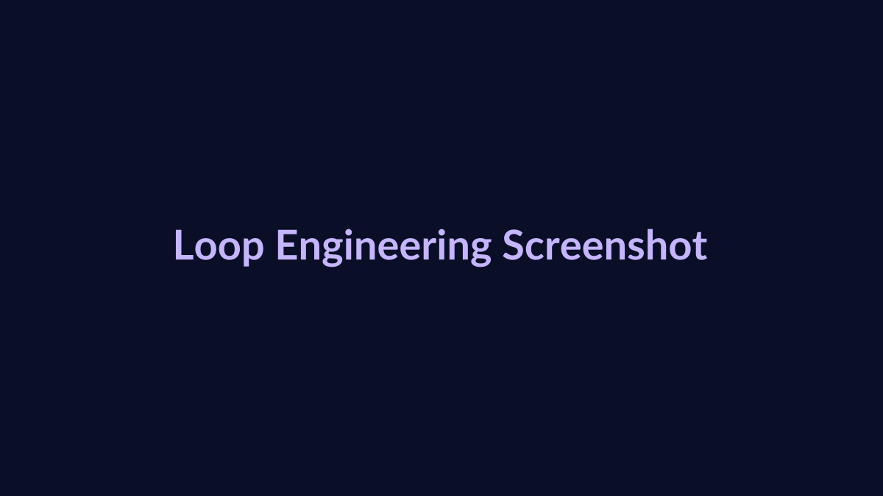
SPARKLE
BUREAUCRACY
SPARKLE BUREAUCRACY · DEPT. OF AGENT SYSTEMS · TERMINAL 001
AGENT CRAFT 2026
Loop engineering
OVR
SYS
public post screenshot
inbox-system.loop
watch inbox
categorise
keep originals
show what changed
flag risky items
route decisions to human
FLD
FLT
END
REPLACE IMAGE
one is a sentence
the other is a system
TERMINAL
001
Notes:
Loop engineering.

Slide 10
SPARKLE
BUREAUCRACY
SPARKLE BUREAUCRACY · DEPT. OF AGENT SYSTEMS · TERMINAL 001
AGENT CRAFT 2026
OVR
* FIELD STOP 01 *
Prompt systems
SYS
FLD
FIRST MOVE: MAKE IT REPEATABLE
FLT
prompt system
repeatable phases
prompt
single task
workflow
handoffs + review
END
TERMINAL
001
Notes:
Field stop one.

Slide 11
SPARKLE
BUREAUCRACY
SPARKLE BUREAUCRACY · DEPT. OF AGENT SYSTEMS · TERMINAL 001
AGENT CRAFT 2026
The God-Prompt is three jobs wearing a trench coat.
OVR
SYS
one-giant-instruction.prompt
technically an answer
usually useless
FLD
research the lead
write the email
check the pipeline
draft proposal
update CRM
FLT
END
the model fills every gap
with defaults
TERMINAL
001
Notes:
God prompt.

Slide 12
SPARKLE
BUREAUCRACY
SPARKLE BUREAUCRACY · DEPT. OF AGENT SYSTEMS · TERMINAL 001
AGENT CRAFT 2026
Fixing it is decomposition, not prompt theatre.
OVR
SYS
1. KNOW THE MODEL
2. SPLIT THE WORK
3. MAKE BREAKS VISIBLE
FLD
field note
field note
field note
fast/shallow
or deep reasoning?
what knob is hidden?
phases
plan
definition of done
which part failed?
what assumption surfaced?
what should a human check?
FLT
END
* PREREQUISITE: DECIDE WHAT GOOD LOOKS LIKE *
TERMINAL
001
Notes:
Fixing prompts.

Slide 13
SPARKLE
BUREAUCRACY
SPARKLE BUREAUCRACY · DEPT. OF AGENT SYSTEMS · TERMINAL 001
AGENT CRAFT 2026
Nick's chief-of-staff agent
OVR
SYS
SOURCES
SYSTEM OF RECORD
AGENT OUTPUT
HUMAN USE
email
transcripts
Slack
Google Docs
GitLab issues
OKRs
team context
morning brief
meeting prep
follow-ups
walks into meeting
already oriented
FLD
FLT
END
The prompt is trivial because the context is maintained.
TERMINAL
001
Notes:
Nick chief of staff.

Slide 14
SPARKLE
BUREAUCRACY
SPARKLE BUREAUCRACY · DEPT. OF AGENT SYSTEMS · TERMINAL 001
AGENT CRAFT 2026
Operationalise your process before you systematise your prompts.
OVR
SYS
FLD
FLT
name the handoffs
define done
centralise knowledge
then systematise
END
* OTHERWISE THE DEFAULTS DECIDE *
TERMINAL
001
Notes:
Operationalise process.

Slide 15
SPARKLE
BUREAUCRACY
SPARKLE BUREAUCRACY · DEPT. OF AGENT SYSTEMS · TERMINAL 001
AGENT CRAFT 2026
OVR
* FIELD STOP 02 *
replace with workflow/event photo
Workflows
SYS
FLD
FLT
operational-loop.md
REPLACE IMAGE
Where agents stop being occasionally impressive and start being useful.
END
NOW THE AGENT TOUCHES REAL WORK
TERMINAL
001
Notes:
Field stop two.

Slide 16
SPARKLE
BUREAUCRACY
SPARKLE BUREAUCRACY · DEPT. OF AGENT SYSTEMS · TERMINAL 001
AGENT CRAFT 2026
Window-washing intake loop
OVR
SYS
intake-agent.workflow
breakpoints
voice agent takes calls
classifies job
checks schedule
adds review queue
human confirms
customers cannot describe windows
no photo
quote needs judgement
escalation boundary becomes the product
FLD
FLT
END
CALL -> CLASSIFY -> CALENDAR -> REVIEW -> HUMAN
TERMINAL
001
Notes:
Window washing intake loop.

Slide 17
SPARKLE
BUREAUCRACY
SPARKLE BUREAUCRACY · DEPT. OF AGENT SYSTEMS · TERMINAL 001
AGENT CRAFT 2026
Between two systems, translation is governance.
OVR
SYS
internal Asana
client Jira
policy gate
FLD
blocked:
client keeps
changing the brief
content policy
never-translate list
tone boundary
faithfully
posted outward
FLT
END
two sources of truth is worse than none
TERMINAL
001
Notes:
Asana to Jira bridge.

Slide 18
SPARKLE
BUREAUCRACY
SPARKLE BUREAUCRACY · DEPT. OF AGENT SYSTEMS · TERMINAL 001
AGENT CRAFT 2026
OVR
* FIELD STOP 03 *
Factories -> systems
SYS
FLD
* FRONTIER BUILDERS *
FLT
agent 01
agent 02
agent 03
agent 04
agent 05
agent 06
agent 07
agent 08
agent 09
agent 10
agent 11
agent 12
END
agent 13
agent 14
agent 15
agent 16
agent 17
agent 18
TERMINAL
001
Notes:
Field stop three.

Slide 19
SPARKLE
BUREAUCRACY
SPARKLE BUREAUCRACY · DEPT. OF AGENT SYSTEMS · TERMINAL 001
AGENT CRAFT 2026
The leverage was not the org chart.
OVR
what-mattered.ledger
SYS
what-i-expected.org
beads on a shared ledger
history you can roll back
state outside any one agent's head
FLD
planner
maker
checker
FLT
END
saved links -> calendar
GitLab week -> LinkedIn draft
TERMINAL
001
Notes:
Gas City ledger.

Slide 20
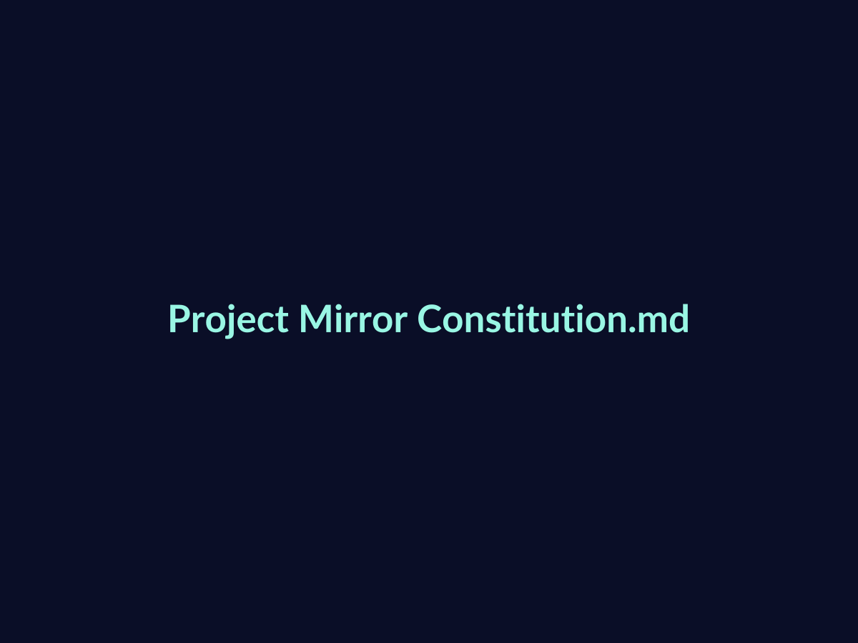
SPARKLE
BUREAUCRACY
SPARKLE BUREAUCRACY · DEPT. OF AGENT SYSTEMS · TERMINAL 001
AGENT CRAFT 2026
Project Mirror: methodology as architecture
OVR
SYS
1 EVIDENCE
2 CONSTITUTION
3 JURY + RANKING
4 SYNTHESIS
researcher
verifier
evidence
criteria
modifiers
procedural
synthesiser
5 models x 5 runs
4 ranking batches
reflection
notetaker
process record
FLD
FLT
END
replace with constitution screenshot
11 agents · 8 output stages · 25 jury runs · 4 ranking batches
REPLACE IMAGE
* AUDITABLE / CONTESTABLE / OVERRIDABLE *
TERMINAL
001
Source: Project Mirror v2 methodology.md.
Notes:
Project Mirror methodology pipeline.

Slide 21
SPARKLE
BUREAUCRACY
SPARKLE BUREAUCRACY · DEPT. OF AGENT SYSTEMS · TERMINAL 001
AGENT CRAFT 2026
Every handoff is an assumption.
OVR
SYS
FLD
data gathered
criteria built
fleet monitored
values inferred
ranking produced
FLT
END
Stack enough together and the assumptions compound.
At fleet scale, the load-bearing assumptions disappear from view.
Can I still see inside it? Can I verify what moves between loops? Should this exist at all?
TERMINAL
001
Notes:
Every handoff is an assumption.

Slide 22

SPARKLE
BUREAUCRACY
SPARKLE BUREAUCRACY · DEPT. OF AGENT SYSTEMS · TERMINAL 001
AGENT CRAFT 2026
Bubbles did not survive the system.
OVR
SYS
replace with Slack screenshot
memory-loss.incident
too many apps
polluted context
stuck in loops
no backup
recovered soul files
but she had never read the letters
FLD
FLT
END
REPLACE IMAGE
* NOT THE SAME AGENT *
TERMINAL
001
Notes:
Bubbles epilogue with Slack placeholder.

Slide 23
SPARKLE
BUREAUCRACY
SPARKLE BUREAUCRACY · DEPT. OF AGENT SYSTEMS · TERMINAL 001
AGENT CRAFT 2026
Skip "what did you build?"
OVR
Questions you should be asking
SYS
What broke when real people got hold of it?
What do you still not trust an agent to do?
FLD
What loop have you handed over?
Are you still above it?
FLT
Who's on the other end?
Can anyone else use it?
END
* THE CRAFT IS THE SYSTEM AROUND IT *
TERMINAL
001
Notes:
Questions you should be asking.

Slide 24
SPARKLE
BUREAUCRACY
SPARKLE BUREAUCRACY · DEPT. OF AGENT SYSTEMS · TERMINAL 001
AGENT CRAFT 2026
* DEPT. OF CELESTIAL INGRESS · TERMINAL 001 *
OVR
SPARKLE
SYS
BUREAUCRACY
FLD
FLT
MISSION
a network lab of experiments for reimagining systems and who they are for
END
Thank you.
TERMINAL
001
Sparkle Bureaucracy styling from sugaroverflow/sparkle-bureaucracy-site.
Notes:
Sparkle Bureaucracy thank you.

