Slide 1
CNN : Image Classifier for Vegetables
Wilfred Djumin
DAAA/FT/2B/05

Slide 2
Overview
BACKGROUND INFO
EDA & LOADING DATA
FEATURE ENGINEERING
MODELLING + MODEL IMPROVEMENT + EVALUATION
EVALUATION & SUMMARY

Slide 3

Background Info
Our task is to implement a multi-class image classifier , using CNN models
Given Color images of 224 by 224 pixels, containing 15 types of vegetables (class)
We are to build 2 models, one for input sizes 31 by 31, another for input sizes 128 by 128

Slide 4
EDA & Loading Data

Slide 5
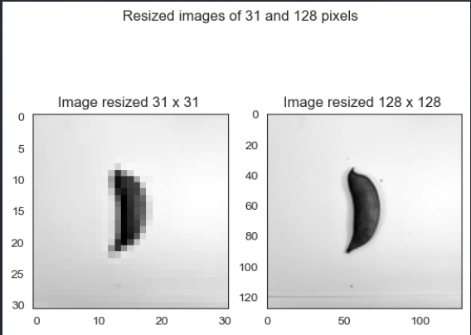
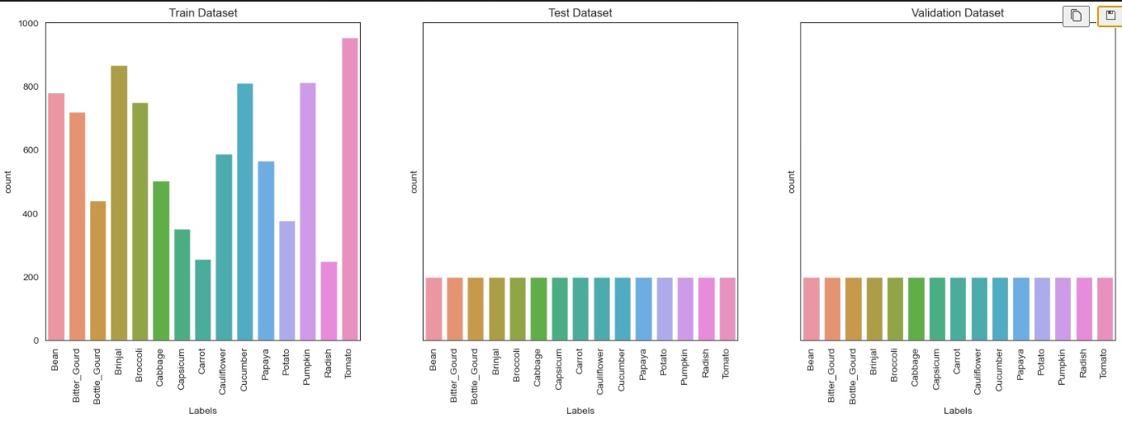
Data Loading & EDA
Data loading methods
Main transformations applied to the images are :
Convert them to grayscale
Resizing to 31 * 31 & 128 * 128
Normalizing pixels between 0 and 1
Exploratory data analysis
Looking at Class Distribution counts
Train set contained class imbalance, could impact model performance
We should try to address this using methods such as SMOTE, Oversampling, or using class weights which we will touch on later

Slide 6
Feature Engineering

Slide 7
Dealing with Class Imbalance
Main Methods that we explored:
SMOTE - generates synthetic samples using interpolation between existing minority samples
Oversampling - replicates existing minority samples to balance the dataset.
Class Weights Initialization - Estimate class weights for unbalanced datasets.
Results:
Both oversampling and SMOTE gave us new train size of 14325 compared to 9028 earlier
For class weights , minority classes like Pumpkin were given a greater weight, while majority classes were given less weights

Slide 8
Data Augmentation
Based on our dataset, we have ~9000 train images , 3000 validation and test images, which can be argued to be quite limited, given that each class would contain +-600 images on average
I tried applying augmentation techniques like:
Width and Height shifting (0.2)
Random Image rotation between -45 to 45 degrees
Random Zoom range from 75% to 125%
Used ImageDataGenerator as well as flow_from_directory for augmentation, which helps create images on the fly (during training)
Additionally, I tried applying Augmentation on top of the Oversampled Train set & SMOTE on Train set

Slide 9
Modelling

Slide 10
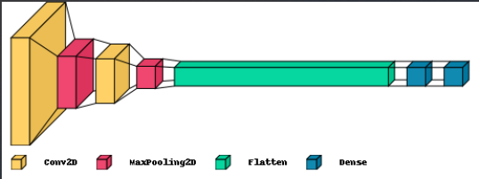
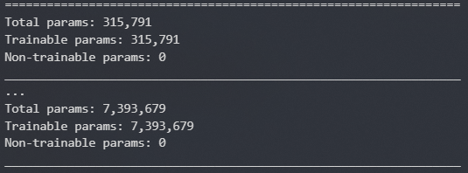
Baseline Models
Model Architecture (for both input sizes)
Conv2D + MaxPooling2D (32 nodes)
Conv2D + MaxPooling2D (64 nodes)
Flatten
Dense layer with 128 nodes
Final Dense / Output layer (15 nodes )
Activation – ReLU
Output Activation - SoftMax
Feeding Model With (both input sizes):
Original Train set
Train set + SMOTE
Train set + oversampling
Trainset + class weights
Model Params for Input B is about 23 x more than for Input A , which would mean more computationally intense / longer training times for Input B

Slide 11
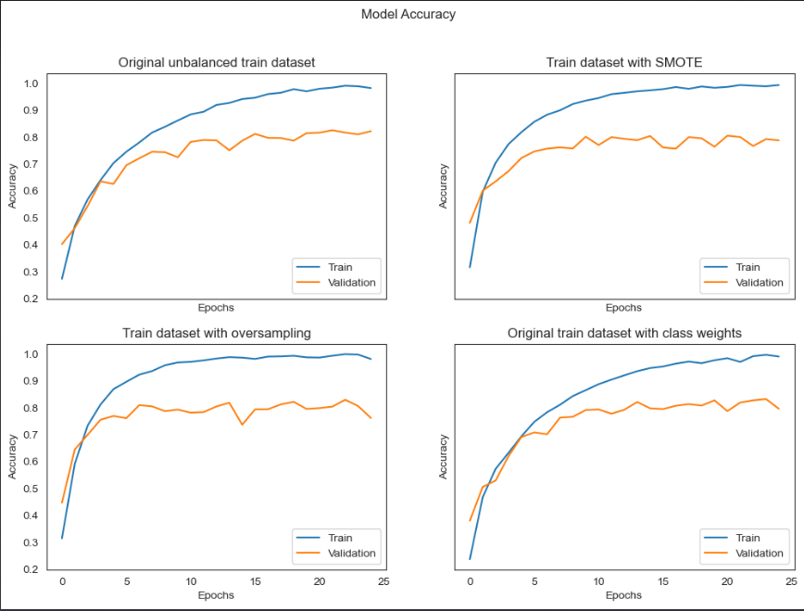
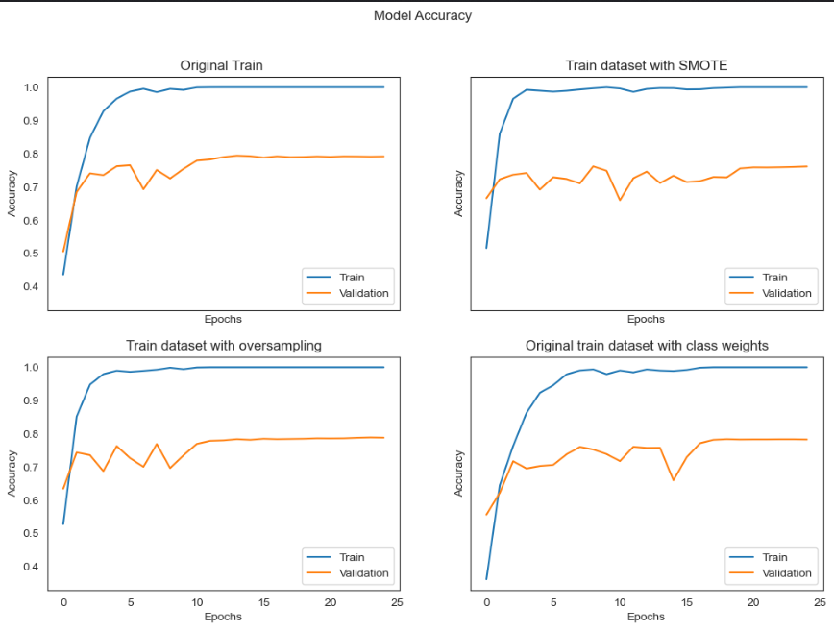
Baseline Models Results
Input Size 31 by 31
Input Size 128 by 128
In general, the Model overfits in all 4 configurations.
Class weights seems to work better compared to other techniques, in this scenario
0.82 Accuracy on test set for Model trained with original train set
In general, the Model overfits significantly as seen from the huge gap between the train and validation accuracies
0.77 Accuracy on test set for Model trained with original train set

Slide 12
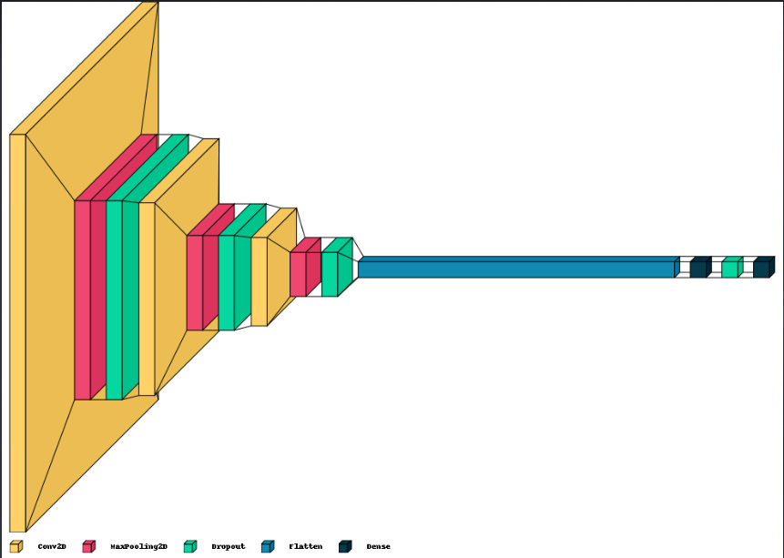
Reducing Overfit + Adding Layers
Model Architecture (for both input sizes)
3 * Conv2D & MaxPooling2D (32,64,128 nodes)
Dropout (0.3) between each layer(s)
Dense layer with 128 nodes
Final Dense / Output layer (15 nodes )
Activation – ReLU
Output Activation - SoftMax
Visual Representation of Model Architecture
Feeding Model With (both input sizes):
Original Train set
Train set + SMOTE
Train set + oversampling
Trainset + class weights

Slide 13
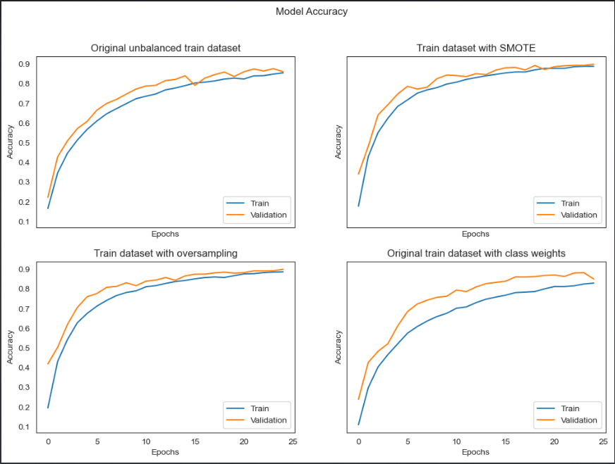
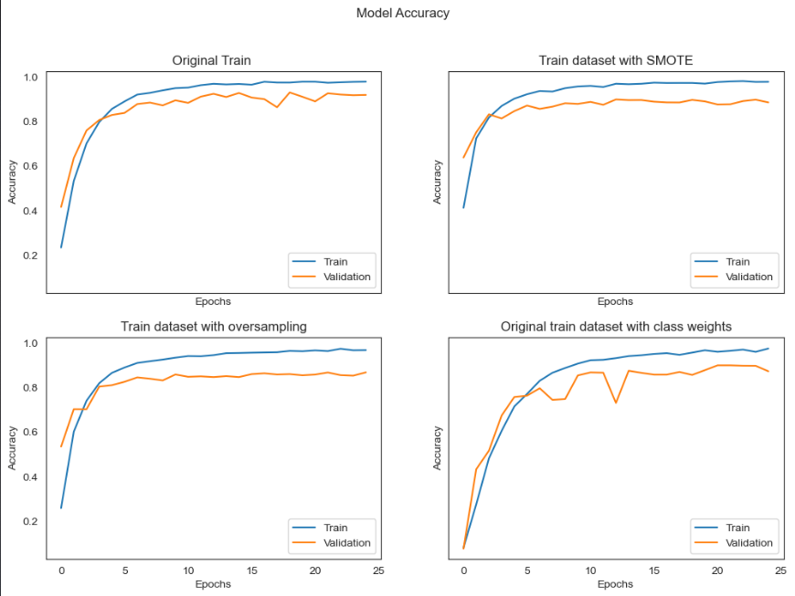
Baseline Models With Improvements
Input Size 31 by 31
Input Size 128 by 128
Model seems to be overfitting less than before which is mostly due to the dropout layers being introduced
Both SMOTE & Oversampling indeed allowed model to learn faster while not overfitting
0.89 Accuracy on test set for Model trained with original train set
In general, the Model still overfits in all 4 configurations.
It’s quite interesting to note that the Model seems to have similar/better performance without class imbalance techniques
0.93 Accuracy on test set for Model trained with original train set

Slide 14
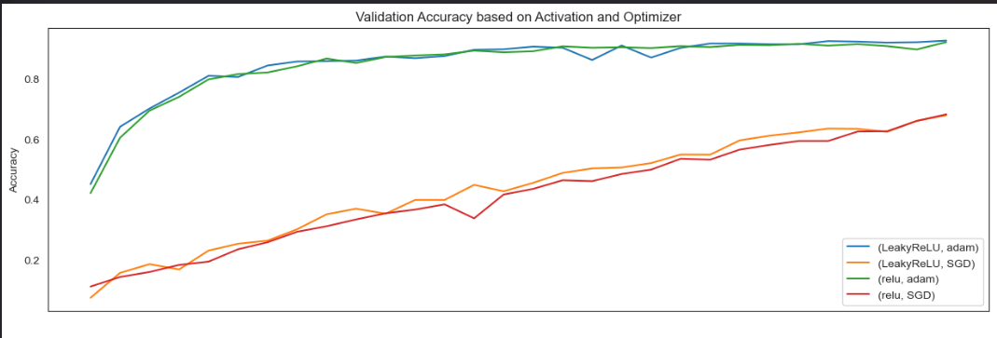
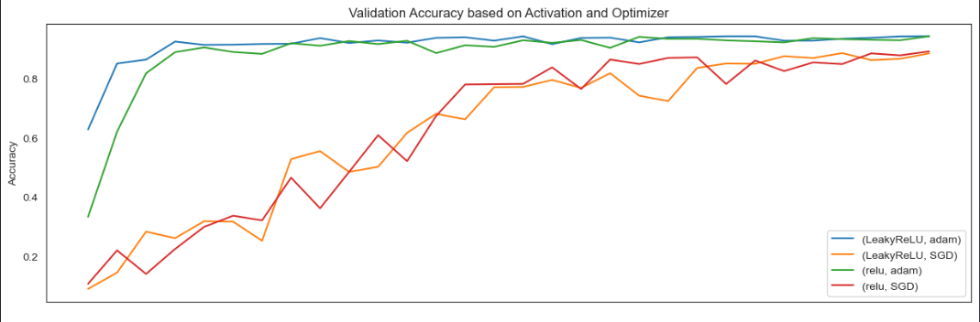
Trying Different Activations & Optimizers
Input Size 31 by 31 (Oversampled)
Input Size 128 by 128 (Oversampled)
Model(similar architecture to improved baseline) was fed with Oversampled Train set for both Inputs
Both ReLU and LeakyReLU has similar performances (expected)
Adam seems to work better than SGD
We would proceed with using LeakyReLU and Adam

Slide 15
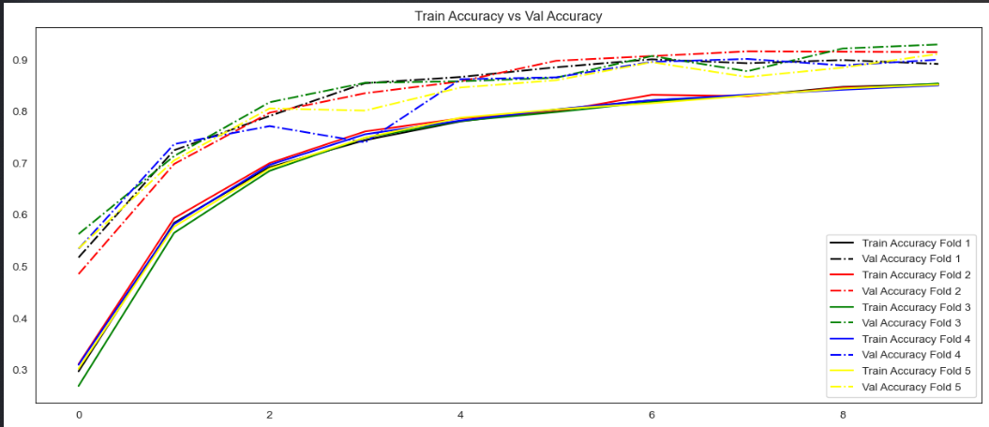
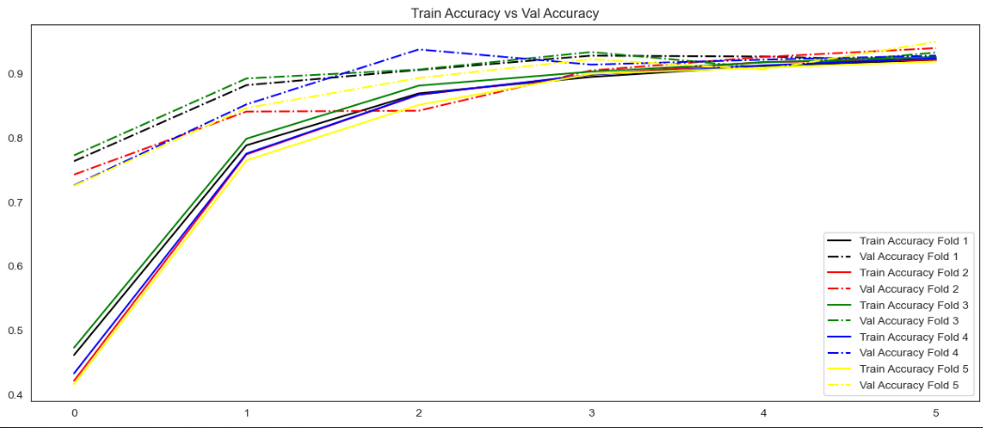
Cross-validation on Improved Baseline
Input Size 31 by 31 (Oversampled)
Input Size 128 by 128 (Oversampled)
Test Accuracy of 0.87
We notice higher validation accuracies at least for the earlier epochs; however, it should converge with the train accuracies after more epochs as seen earlier
We can say that the train and validation accuracies are quite consistent throughout the 5 folds, the 5 folds, which is a good sign that our model can generalise to unseen/new data
Test Accuracy of 0.9
We do see a ‘convergence’ faster, at about 5 epochs for Input size of 128 by 128
Again, train and validation accuracies are consistent throughout the 5 folds, which is a good sign that our model can generalise to unseen/new data

Slide 16
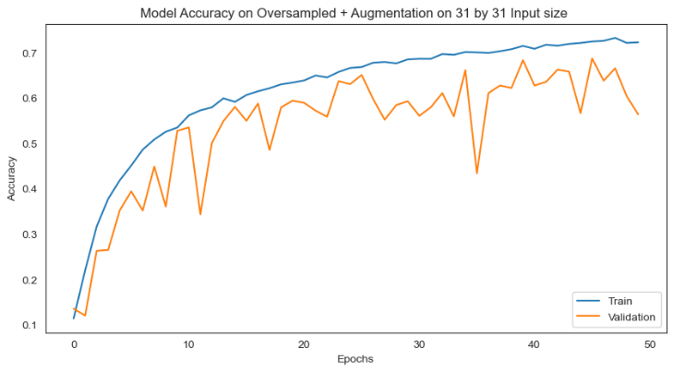
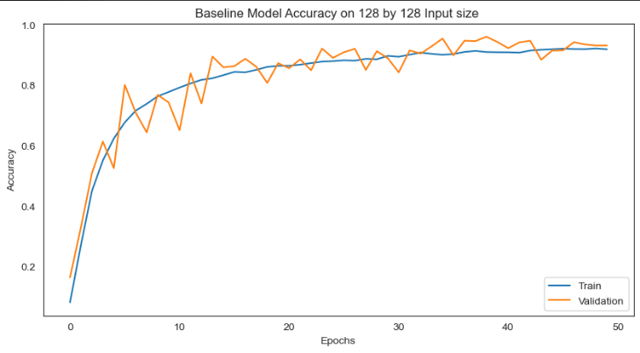
Data Augmentation Model Results
Oversampled train + Augmentation (31 Input)
Oversampled train + Augmentation (128 Input)
Data Augmentation seems to not work as well for Input size 31 by 31
We can clearly see overfitting, resulting in poor generalization of the validation set
Previously, Model seems to perform better on just Oversampled train set
Data Augmentation seems to work way better for 128 by 128 Input Size, test accuracy of 0.95
However, we can see fluctuations in model’s validation accuracy
It possible that our Augmentation techniques may be too harsh / randomness introduced

Slide 17
Hyperparameter - Tunning

Slide 18
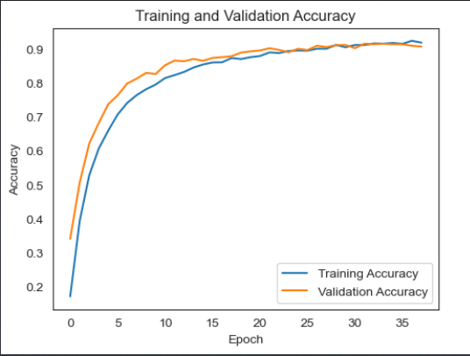
RandomSearch for 31 by 31 Inputs
Hyperparameters:
Learning Rate
Dropout Rate
Activations (LeakyReLU , ReLU )
Model Architecture
Same as what we used for our Improved Baseline Model (3 layers Conv2D + MaxPooling2D)
Trained on Oversampled train set
Results
Test Accuracy did improve by about 2% compared to Improved Baseline
Overfitting does not really seem to be occuring
The Validation accuracy again tend to be higher at earlier epochs but eventually converges

Slide 19
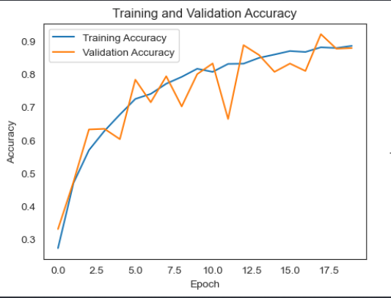
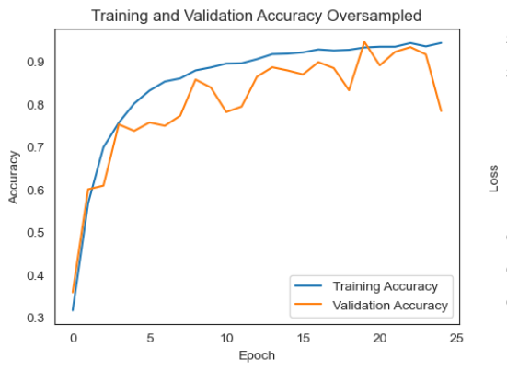
RandomSearch for 128 by 128 Inputs
Hyperparameters:
Learning Rate
Kernel regularization Rate (L1 / L2)
Activations (LeakyReLU , ReLU )
No. Of Layers
Nodes
Results
Tried RandomSearch on Augmentation + Oversampled as well as just on Augmentation
Augmentation + Oversampled : 0.96 Test Accuracy
Augmentation: 0.94 Test Accuracy
We do see more Overfitting when we perform oversampling from the image on the top right
However, fluctuations in validation accuracies are present for both, still indicating poor generalisation

Slide 20

Conclusions
Regarding Input Sizes, smaller input size takes shorter to train, has less parameters and in general, based on our 31 by 31 Input Images, was less vulnerable to overfitting as compared to 128 by 128 Images
Data Augmentation for 31 by 31 Input Images didn’t seem to work as well compared to 128 by 128 Input size, could be due to non-meaningful transformations for 31 by 31 Images since they are considered very small

Slide 21
thank you!
Wilfred Djumin

