Slide 1
ACADEMIC AI PROJECT
FROM SENSOR TO ACTION
SafeRoute AI
01
PERCEIVE
Smoke and fire evidence
Explainable evacuation planning under uncertainty
02
REASON
Bayesian edge risk
Search algorithms • Bayesian risk • Dynamic planning
Multi-agent coordination • Genetic optimization
03
PLAN
A* and live replanning
04
COORDINATE
Capacity-aware routing
Student: ____________________ Register no.: ____________________
AI course project
1 / 10
Notes:
Introduce SafeRoute AI as an explainable decision support system for emergency evacuation. State that every recommendation can be traced to search, probability, or optimization logic.

Slide 2
02
PROBLEM FORMULATION
A campus becomes a weighted state space
STATE
Library
Junction
Science Lab
Current node
ACTIONS
Move to an adjacent node
COST
Distance + risk + congestion
North Gate
South Exit
GOAL
Reach a safe exit
Graph nodes represent locations. Edges store distance and evidence-driven risk.
SafeRoute AI | Explainable evacuation planning
2 / 10
Notes:
Explain the state-space representation: a person occupies one graph node, actions traverse edges, and the goal test checks whether an exit is reached. The path cost combines distance, Bayesian risk, and optional congestion.

Slide 3
03
ALGORITHMS
Four search strategies reveal different tradeoffs
Algorithm | Guidance | Complete | Optimal | Observed role
BFS | Depth | Yes | Unit cost | Baseline
DFS | Depth | No* | No | Contrast
Greedy | h(n) | No* | No | Fast estimate
A* | g(n)+h(n) | Yes* | Yes* | Recommended
A* evaluation
f(n) = g(n) + h(n)
g(n)
cost already paid
h(n)
estimated remaining cost
A* balances measured danger with progress toward safety.
* depends on graph and heuristic conditions
4
5
20
ALGORITHMS IMPLEMENTED
SCENARIOS EVALUATED
SEARCH RUNS
SafeRoute AI | Explainable evacuation planning
3 / 10
Notes:
Briefly contrast uninformed and informed search. Emphasize that A star uses both accumulated cost and a heuristic. Mention that all four algorithms are implemented manually so the logic is visible for viva questions.

Slide 4
04
UNCERTAIN REASONING
Sensor evidence becomes a transparent risk score
EVIDENCE
BAYES UPDATE
ROUTE COST
Smoke
0.80
P(Fire | E)
edge cost
= P(E | Fire) P(Fire)
——————————————
P(E)
distance
+ λ × risk
Heat
0.65
Alarm
0.90
The risk weight λ lets the operator choose how strongly danger influences the route.
Posterior is recalculated
Explainability: every risky edge shows its probability, evidence and contribution to total cost.
SafeRoute AI | Explainable evacuation planning
4 / 10
Notes:
Use the Bayes rule equation to explain why the model does not treat a sensor as perfect. Multiple observations update the probability of danger, and that posterior probability becomes a path cost component.

Slide 5
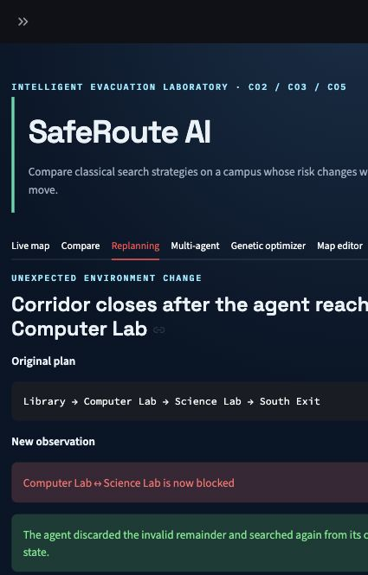
05
DYNAMIC PLANNING
When an edge becomes unsafe, the plan changes
REPLAN LOOP
1
Observe
Read the latest sensor state
2
Update
Recalculate affected edge risk
3
Search
Run A* from the current node
4
Explain
Show why the route changed
SENSE → PLAN → ACT
SafeRoute AI | Explainable evacuation planning
5 / 10
Notes:
Demonstrate the Replanning tab. Select an edge, increase its hazard probability, and apply the event. The system replans from the current position and displays both the old and new recommendations.

Slide 6
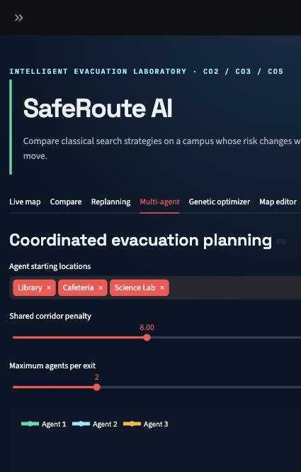
06
MULTI-AGENT PLANNING
Joint assignment reduces bottlenecks
Agent | Assigned exit | Cost
Library | North Gate | 3.6
Cafeteria | North Gate | 5.2
Science Lab | South Exit | 4.8
13.6
0
JOINT OBJECTIVE
SHARED CORRIDORS
The optimizer tests exit combinations, capacity limits and corridor overlap before choosing a joint plan.
SafeRoute AI | Explainable evacuation planning
6 / 10
Notes:
Explain that planning agents independently can overload the same route. This module evaluates joint exit assignments and penalizes shared corridors while respecting exit capacity.

Slide 7
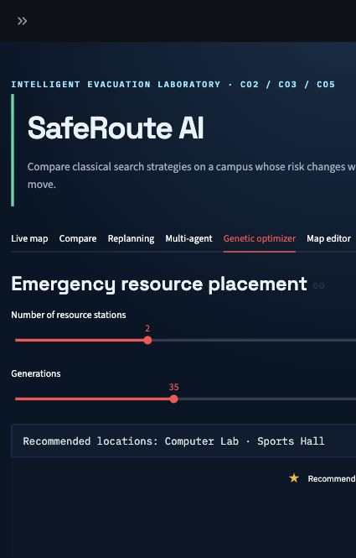
07
LOCAL SEARCH
A genetic algorithm places scarce resources
FITNESS IMPROVEMENT
Computer Lab
Sports Hall
Selected resource locations
SafeRoute AI | Explainable evacuation planning
7 / 10
Notes:
Describe the chromosome as a set of selected locations. Fitness measures weighted response distance. Selection, crossover, mutation, and elitism produce better placements across generations.

Slide 8
08
ARCHITECTURE
The system separates evidence, algorithms and explanation
Streamlit UI
Scenario controls, map editor, visual explanations
DESIGN PRINCIPLES
01
Deterministic
Seeds make experiments repeatable
Planning services
Search comparison, replanning, multi-agent coordination
02
Inspectable
Manual algorithms expose decisions
Reasoning engines
Bayesian risk and genetic optimization
03
Editable
Custom maps can be entered as tables
04
Tested
Nine automated checks protect behavior
Domain model
Nodes, edges, hazards, exits, agents and resources
9 / 9
AUTOMATED TESTS
SafeRoute AI | Explainable evacuation planning
8 / 10
Notes:
Walk from the interface down to the domain model. Emphasize modularity: each algorithm is independent and tested, while the UI only coordinates inputs and visualizes outputs.

Slide 9
09
EVALUATION
Experiments make the tradeoffs measurable
LIBRARY FIRE SCENARIO
KEY FINDINGS
A*
lowest risk-aware cost
DFS
few expansions, weak route
Multi-agent
zero shared corridors
Genetic
fitness improved 5.8%
20 search runs • 5 scenarios • fixed seeds • CSV evidence
SafeRoute AI | Explainable evacuation planning
9 / 10
Notes:
Use the chart to show that the fewest expanded nodes does not necessarily mean the best route. In the fire scenario, A star accepts a longer physical route to obtain the lowest combined distance and risk cost.

Slide 10
010
CONCLUSION
A complete, explainable AI course project
SEARCH
REASON
HONEST LIMITS
BFS, DFS, Greedy and A*
Bayesian hazard probability
• Simulated sensor inputs
• Small graph model
• No crowd physics
• Decision support only
PLAN
OPTIMIZE
Dynamic and multi-agent routing
Genetic resource placement
Core message
READY FOR LIVE DEMO
SafeRoute AI links course theory to a working system whose decisions can be demonstrated, measured and defended.
Questions?
SafeRoute AI | Explainable evacuation planning
10 / 10
Notes:
Close by mapping the project to the syllabus and stating the limitations honestly. Then invite the evaluator to choose a scenario for a live demonstration.

