Slide 1
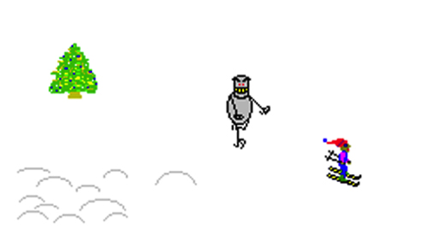
Ski Free
Using easel.js and other things …
Sugendran Ganess @sugendran

Slide 2
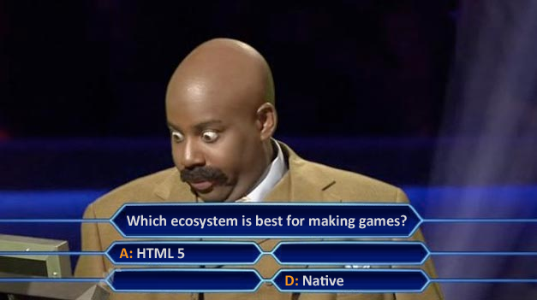
Who wants to get rich?

Slide 3
The libraries
EASELJS – the canvas library
PRELOADJS – asset preloader
TWEENJS – animation library
SOUNDJS – sound library
http://www.createjs.com/

Slide 4



Meet the sprites
The Person
The Rock
The Tree

Slide 5
Lets look at code
Create a stage to draw on
canvasElement = document.getElementById(canvasElementId);
var stage = new Stage(canvasElement);
// allows touches to work
Touch.enable(stage);
Add some containers
stage
bgContainer
var bgContainer = new Container();
var skierContainer = new Container();
stage.addChild(bgContainer);
stage.addChild(skierContainer);
skierContainer

Slide 6
Layout some sprites
Skier is stationary in the middle of the screen
Rocks and Trees fly past
World wraps around itself

Slide 7
Actually drawing something on screen
var skier = new Bitmap(“images/person.png”);
skier.regX = HALF_TILE_EDGE;
skier.regY = TILE_EDGE;
skier.x = (stageWidth * 0.5);
skier.y = (stageHeight * 0.5);
skierContainer.addChild(skier);

Slide 8
Start up the game loop!
Ticker.addListener(world);
Ticker.useRAF = true;
Ticker.setFPS(60);
Every 13-ish ms call world.tick()
.useRAF →use requestAnimationFrame
On every loop we do the following:
Update the position of the rocks and trees
Check for collisions
Update the score

Slide 9

Collision Detection
+
=
Simple detection using .getObjectUnderPoint
Animate between Person and Crash sprites
Tween.get(skier).to({alpha: 0}, 200).set({visible: false}); Tween.get(crash).set({visible: true}).to({alpha: 1}, 200);
setTimeout(function() {
Tween.get(crash).to({alpha: 0}, 200).set({visible: false});
Tween.get(skier).set({visible: true}).to({alpha: 1}, 200);
}, 2300);

Slide 10
What’s my score?
Add to container
var scoreDisplay = new Text();
scoreDisplay.textAlign = “right”;
scoreDisplay.x = stageWidth - 10;
scoreDisplay.y = 24;
scoreDisplay.font = “bold 24px monospace”;
skierContainer.addChild(scoreDisplay);
Simple to update
scoreDisplay.text = “1,000,000”;

Slide 11
Touch/Mouse interaction
stage.onMouseDown
stage.onMouseMove
stage.onMouseUp
localToGlobal and globalToLocal to transform co-ordinates
Next version is supposed to have gestures and multi-touch

Slide 12
To the <device>™!
PhoneGap (aka. Apache Cordova)
Command line tool to create hello world project
Test on device
Possible limitiations
Game Center / Scoreboard
In-app purchase
Documentation may not match release
May need to tweak plists and xml files

Slide 13
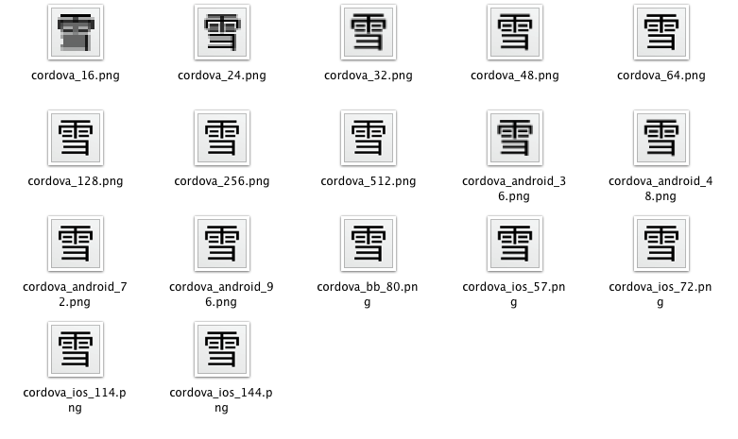
All of the icons

Slide 14
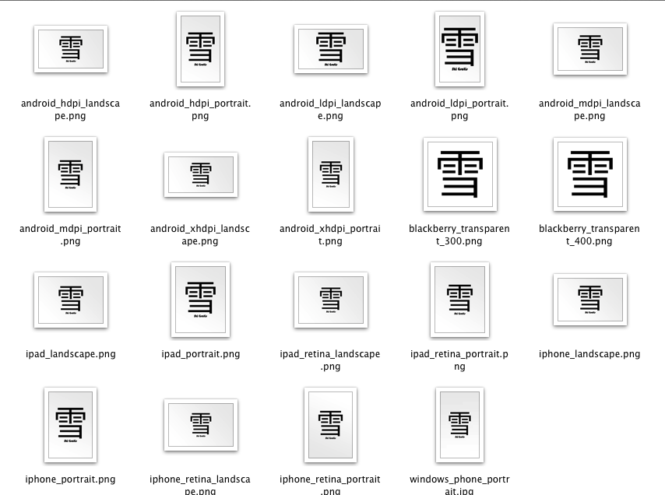
And some splash screens

Slide 15
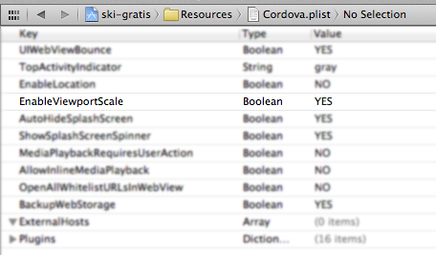
Spend many hours fixing layout

Slide 16
Stick it on the App Store
(for free of course)

Slide 17
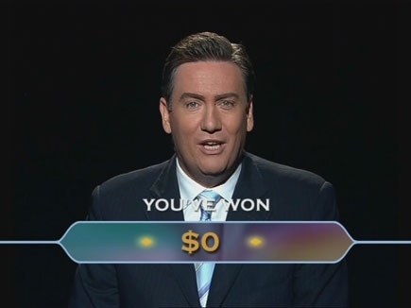

Slide 18
All Source code over here:
https://github.com/sugendran/ski-gratis/
Presentation here:
https://dl.dropbox.com/u/22949074/skifree/ski-free.pdf
https://dl.dropbox.com/u/22949074/skifree/ski-free.pptx

