Slide 1

By Group 6
Sugetha Kalyanaraman Chandhrasekar
Sakti Aishwarya Arunachalam

Slide 2
TABLE OF CONTENTS
About the project
Back end design
Front end design
Languages Used
Demo Slides
Testing and Difficulties Faced

Slide 3
About the Project
Metube - Online Multimedia Database, analogous to the present day YouTube system.
Major Functionalities
User Account
Data Sharing
Media Organization
User Interaction
Search

Slide 4
Back End Design
Tools and Language Used – MySQL on the back end. Phpmyadmin was used to monitor the database.
Determining the data and tables required – a total of 22 tables were used.
Drawing relationships among entities – defining foreign keys and relationships between the tables.
Building E-R Diagram and Schema – MySQL workbench used to draw ER diagrams.

Slide 5
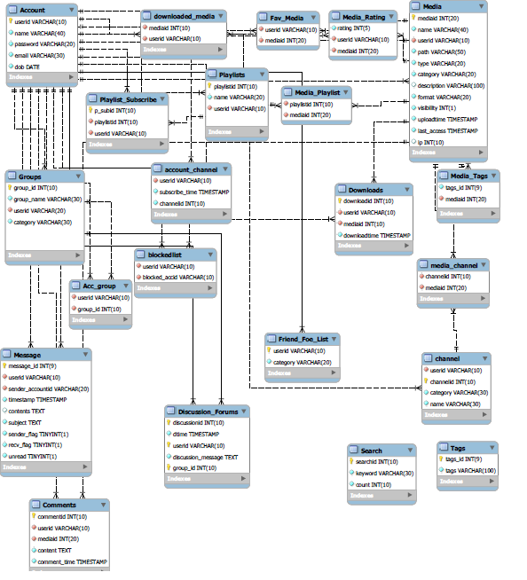
E-R DIAGRAM

Slide 6
Front-end Design
Language Used
PHP used in most places. JAVASCRIPT was used to validate inputs. Ajax and jQuery used on a few other places.
HTML and CSS used to make the page presentable.
Demo Slides

Slide 7
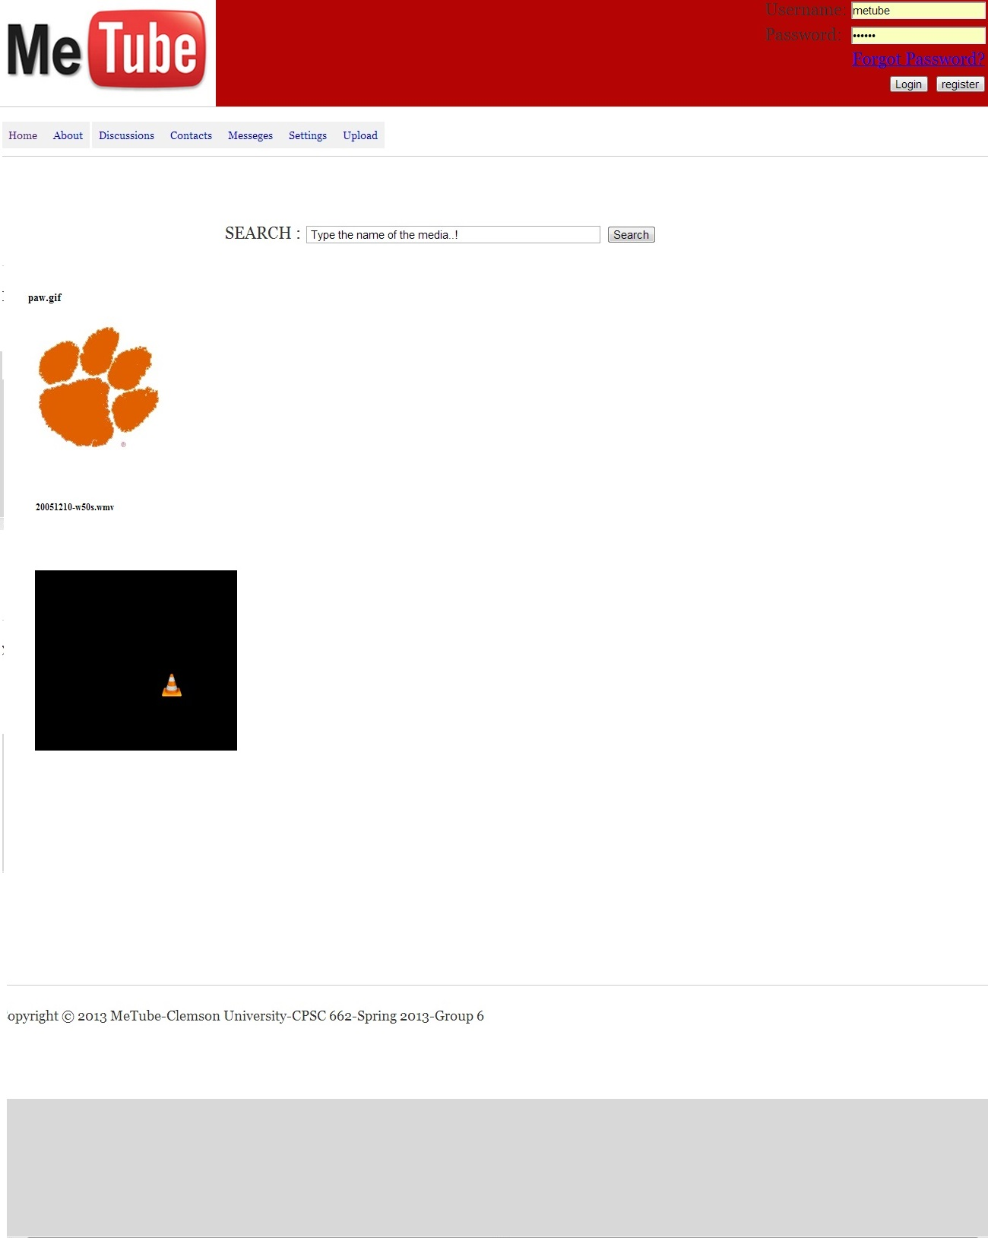

Slide 8
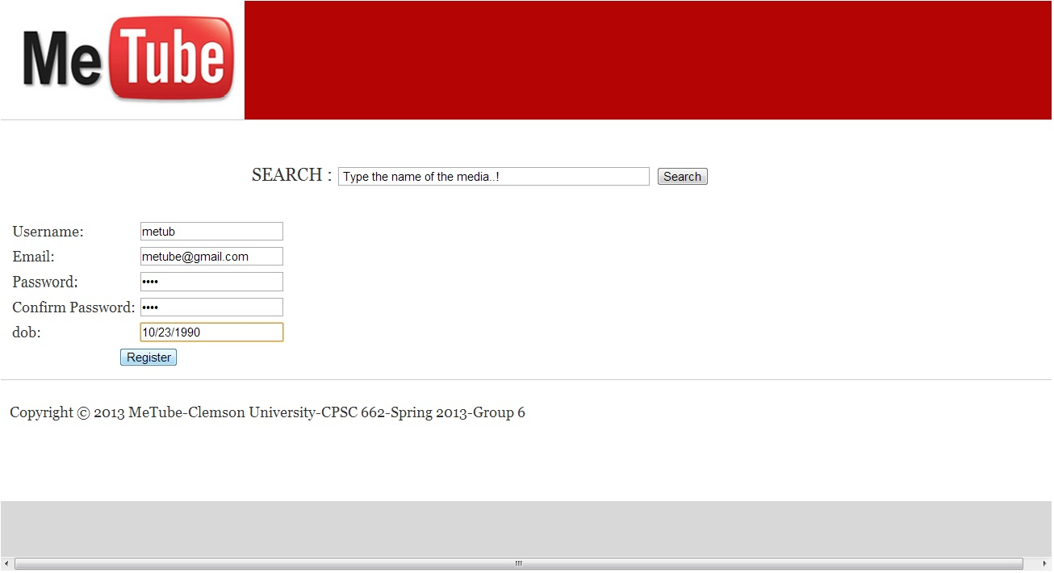

Slide 9
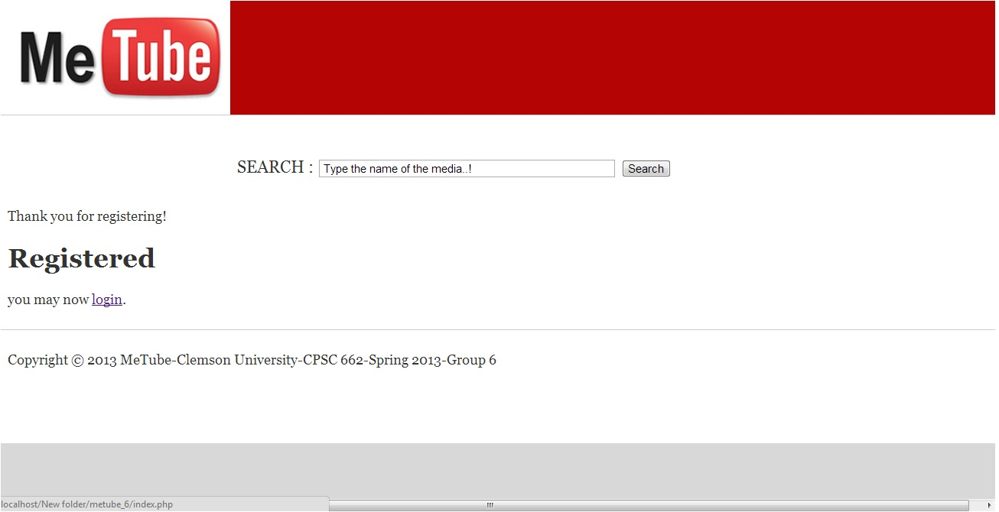

Slide 10
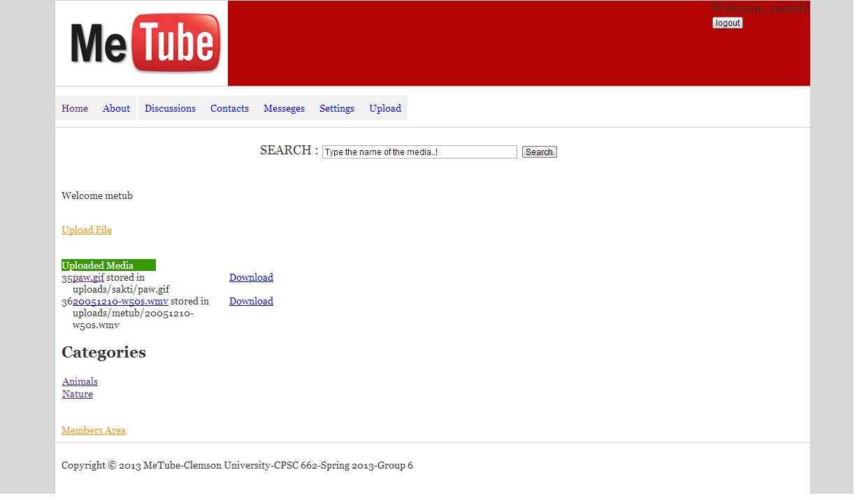

Slide 11
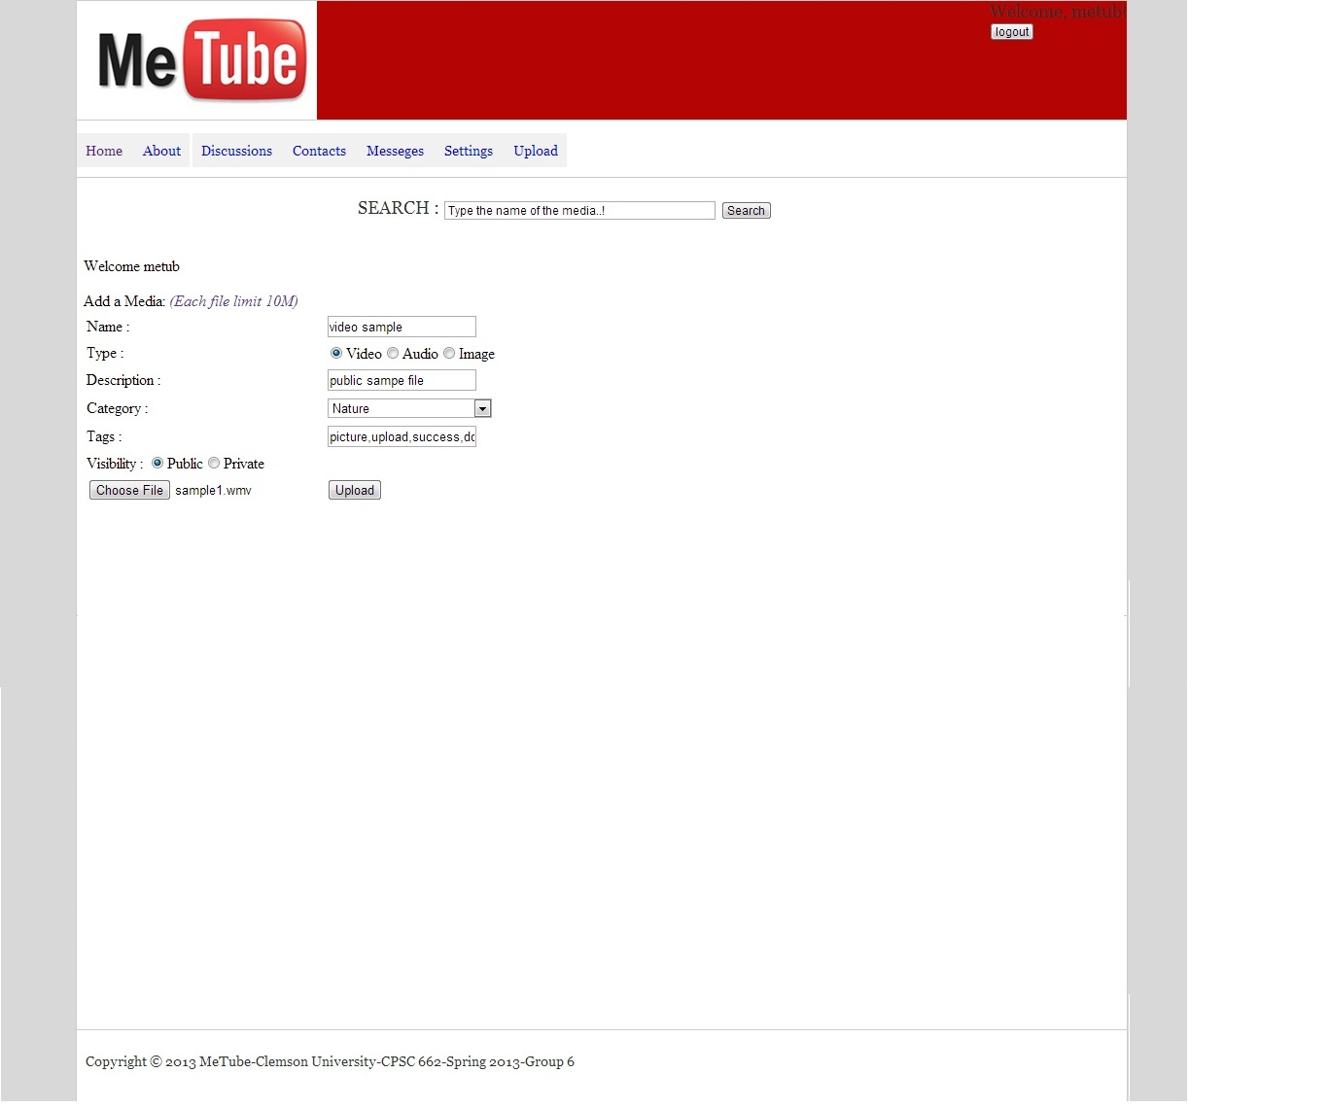

Slide 12
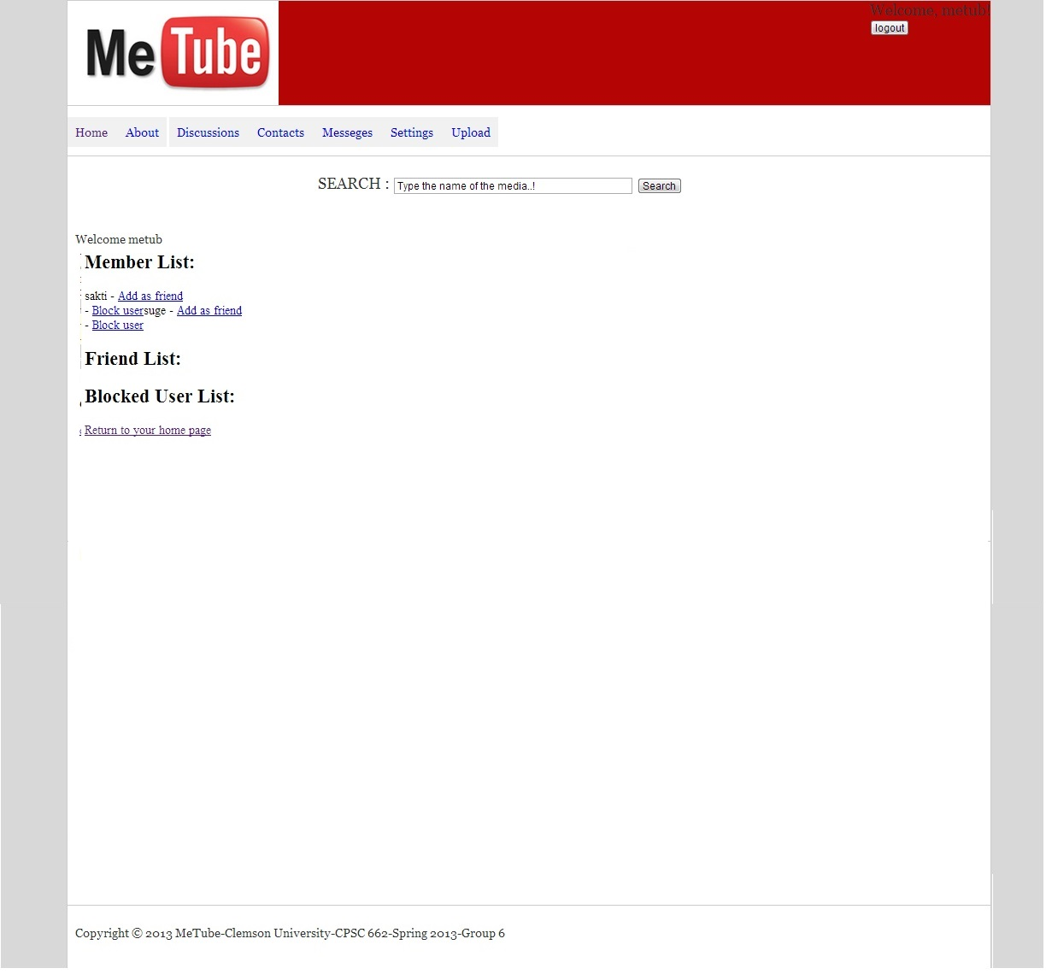

Slide 13


Slide 14
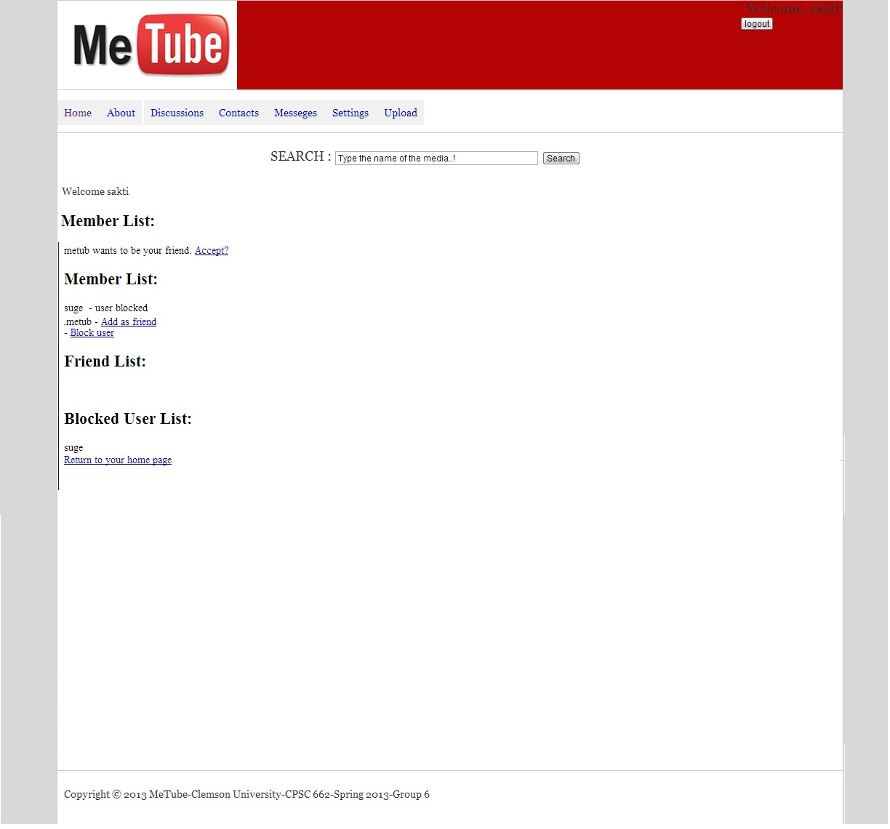

Slide 15


Slide 16
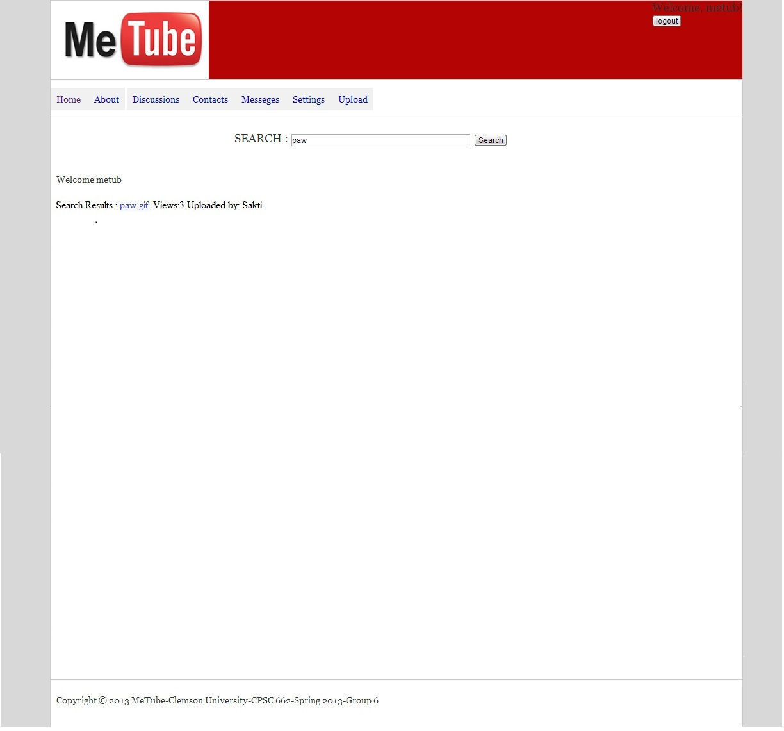

Slide 17
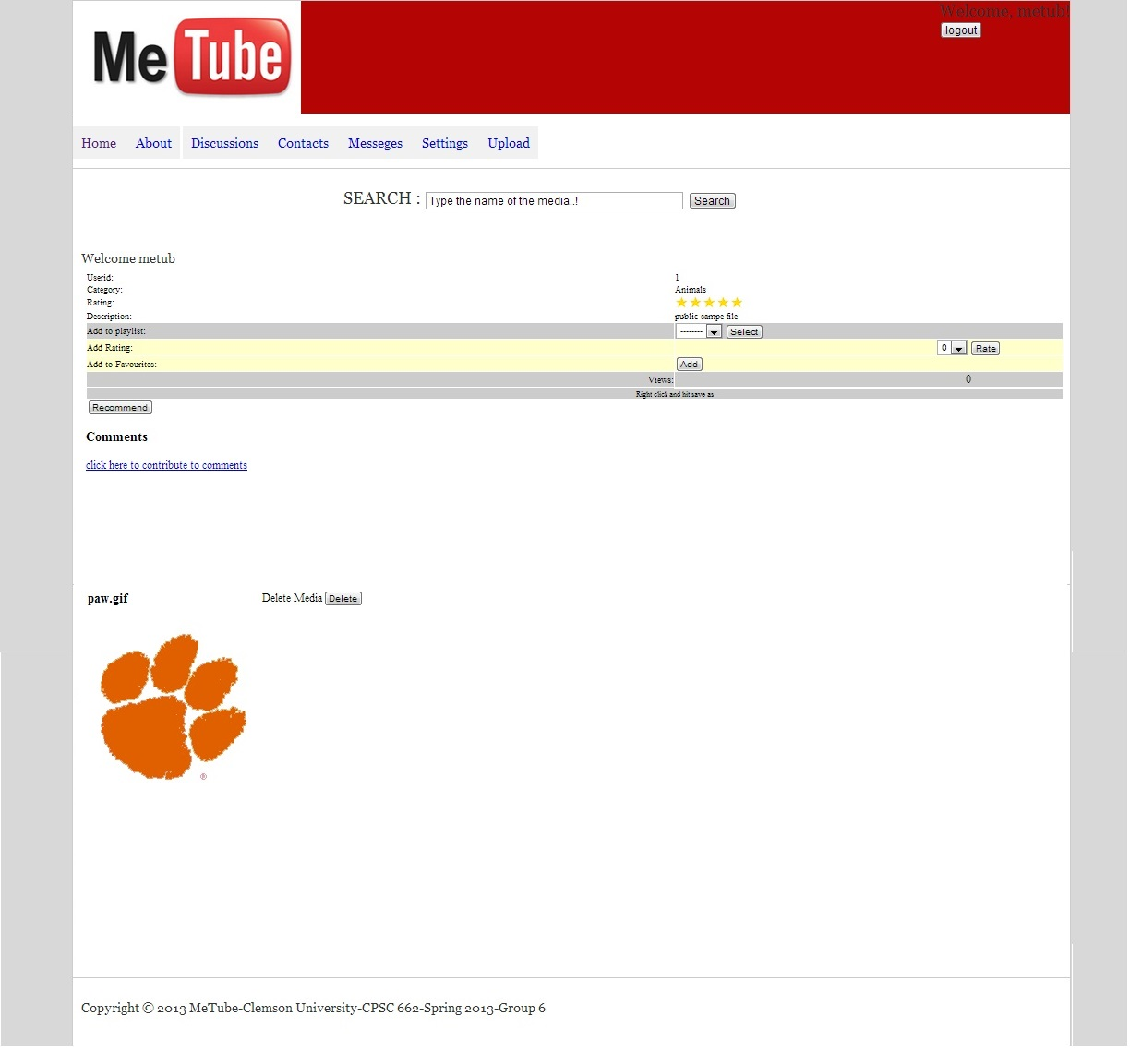

Slide 18
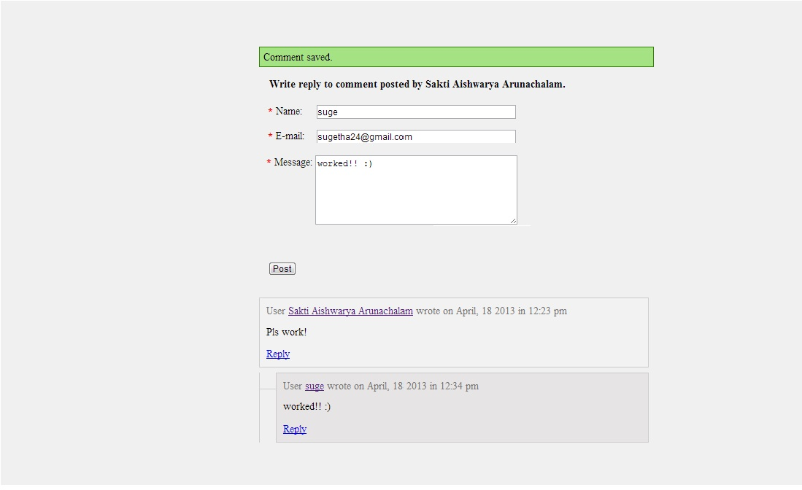

Slide 19
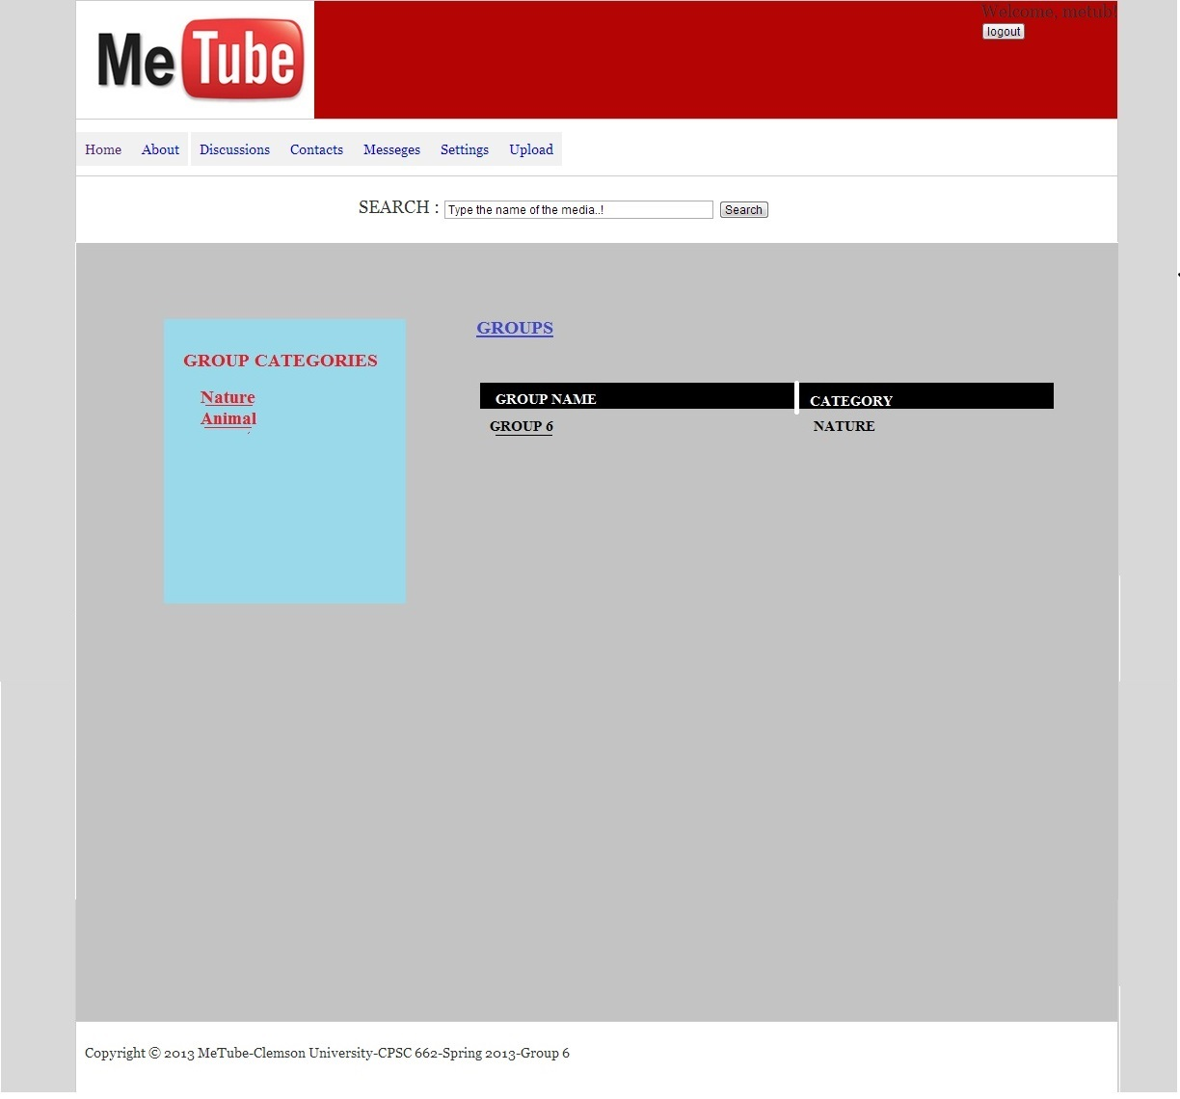

Slide 20
TESTING AND DIFFICULTIES
Problems with browser compatibility.
Foreign key constraint problem in the back end.
Problems in the MySQL workbench when drawing the ER diagram

