Slide 1

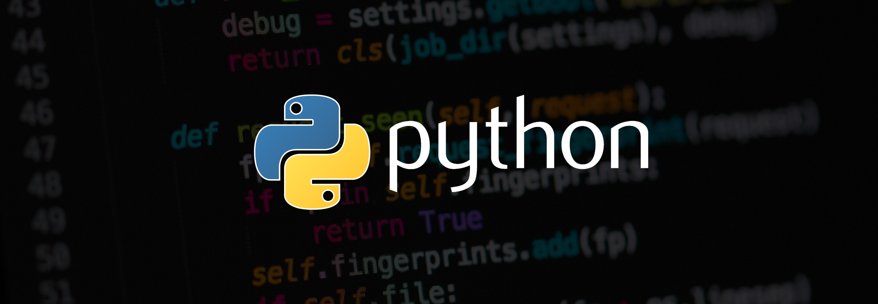
Building a Chatbot using Chatterbot in Python
BY :- sughosh deshpande (209309046)

Slide 2

CONTENTS
Introduction
Literature Review
Features of Project
Work done till date
Future Work
Conclusion
References

Slide 3


Introduction :
A chatbot also known as a chatterbot, bot, artificial agent, etc is basically software program driven by artificial intelligence which serves the purpose of making a conversation with the user by texts or by speech. Famous examples include Siri, Alexa, etc.
These chatbots are inclined towards performing a specific task for the user. Chatbots often perform tasks like making a transaction, booking a hotel, form submissions, etc. The possibilities with a chatbot are endless with the technological advancements in the domain of artificial intelligence.
Almost 30 percent of the tasks are performed by the chatbots in any company. Companies employ these chatbots for services like customer support, to deliver information, etc. Although the chatbots have come so far down the line, the journey started from a very basic performance.
Chatbots are nothing but software applications that have an application layer, a database, and APIs. To simplify the working of the chatbot, we can say it works on pattern matching to classify text and produce a suitable response for the questions/queries addressed by the user. The chatbot responds to the user as per the program that has been fed in it.
Rule-Based Chatbot: This is the basic chatbot made, the user interacts with this kind of bot by using predefined options. To get answers from these bots, users need to click on certain options. These kinds of bots collect the user's request, analyze it, and then offer results in the form of buttons. These bots are commonly used to replace frequently asked questions when it comes to complex queries; they aren't always the best solution.

Slide 4
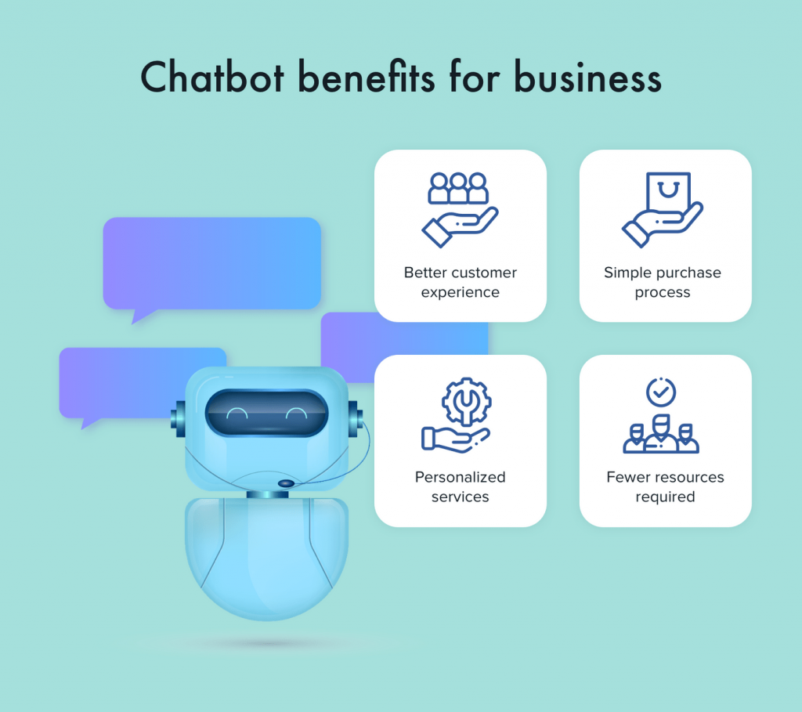

Literature review
Chatbots helps any business/organization in accomplishing the following goals:
Increases operational efficiency.
Automating customer request fulfillment.
Handling basic queries, which in turn free employees to work for complex & higher value inquiries.
Offers Multi-language support.
Saves time & effort by automating customer support.
Improves the response rate as well as customer engagement.
Personalization of communication

Slide 5
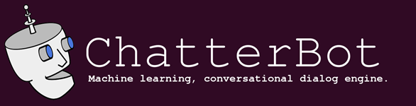
Features of project
ChatterBot is a Python library that makes it easy to generate automated responses to a user’s input. ChatterBot uses a selection of machine learning algorithms to produce different types of responses. This makes it easy for developers to create chat bots and automate conversations with users.
The language independent design of ChatterBot allows it to be trained to speak any language. Additionally, the machine-learning nature of ChatterBot allows an agent instance to improve it’s own knowledge of possible responses as it interacts with humans and other sources of informative data
ChatterBot is a Python library designed to make it easy to create software that can engage in conversation.
An untrained instance of ChatterBot starts off with no knowledge of how to communicate. Each time a user enters a statement, the library saves the text that they entered and the text that the statement was in response to. As ChatterBot receives more input the number of responses that it can reply and the accuracy of each response in relation to the input statement increase.
The program selects the closest matching response by searching for the closest matching known statement that matches the input, it then chooses a response from the selection of known responses to that statement.

Slide 7

Import the modules:
Import the modules:

Slide 8
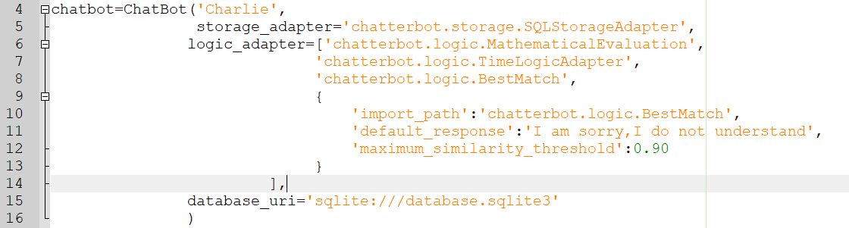
Create Chatbot:
Storage Adapters allows you to connect to a particular storage unit or network. Here we are using SQL Storage Adapter, which permits chatbot to connect to databases in SQL. By using the database parameter, we will create a new SQLite Database. Logical Adapter regulates the logic behind the chatterbot, i.e., it picks responses for any input provided to it.

Slide 9

Create Object For Text to Speech Conversion using pyttsx3:

Slide 10

Train The Chatbot:

Slide 11
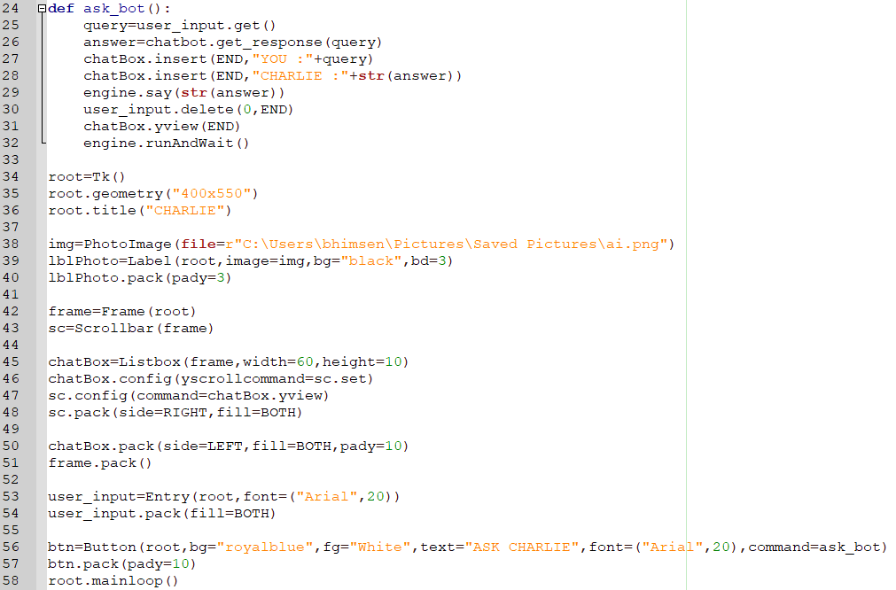
Build The GUI using Tkinter:

Slide 12
Results

Slide 13
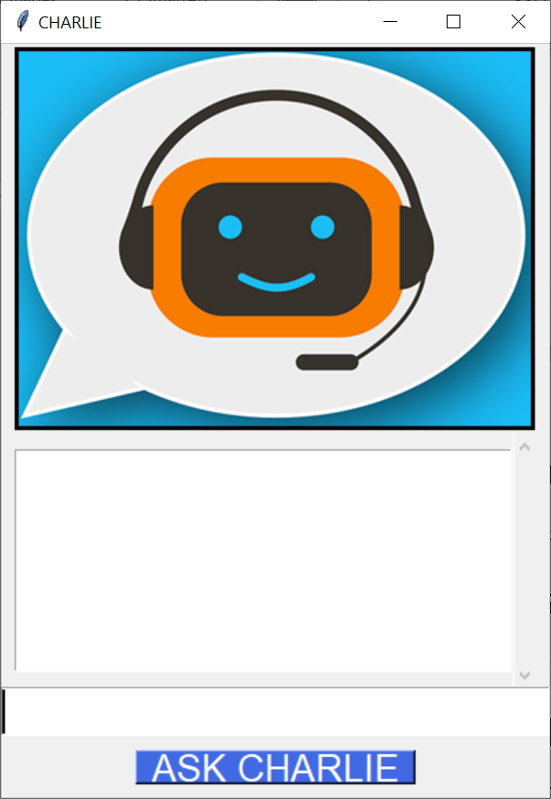
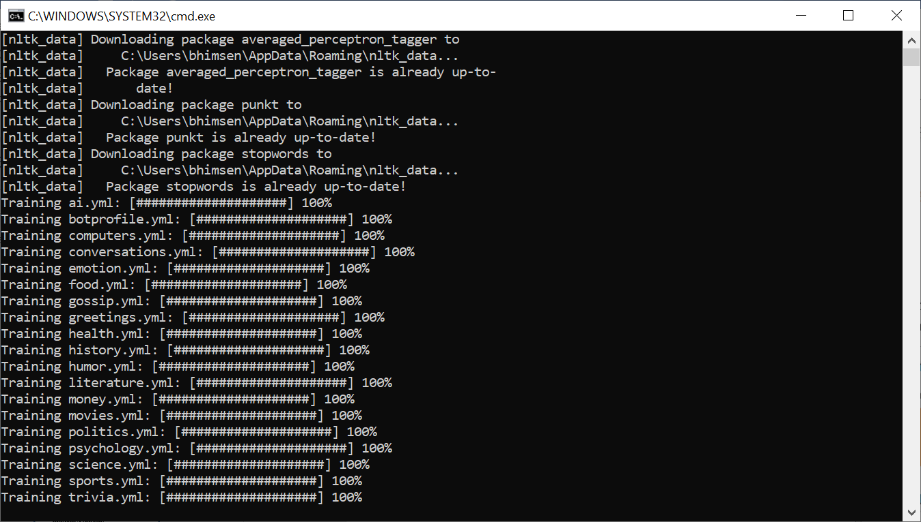
On execution of the program the packages are downloaded, the chatbot data is trained according to the English corpus
and the following prototype is made as follows:

Slide 14
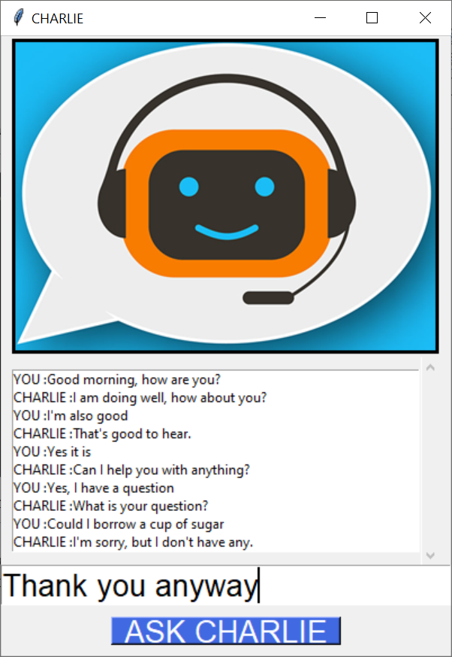
The user provides his input and then hits the ask button upon which the bot responds to the user in a written text in the list box
and also converts the text to speech.
According to the corpus data conversations can be done regarding any of the data categories with the chatbot which will not
only provide a written but also an audio reply as follows:

Slide 15
Conclusion:
although what we learned here is a very basic chatbot in Python having hardly any cognitive skills, it should be enough to help us understand the anatomy of chatbots.

Slide 16
REFERENCES :
Data camp
Read the Docs
Edureka
Upgrad Blog

