Slide 1
FRAUD DETECTION
SUGHOSH DESHPANDE

Slide 2

GOAL AND APPROACH
Data Preprocessing
Hyperparameter Tuning
Model Training and Validation
Model Improvement

Slide 3
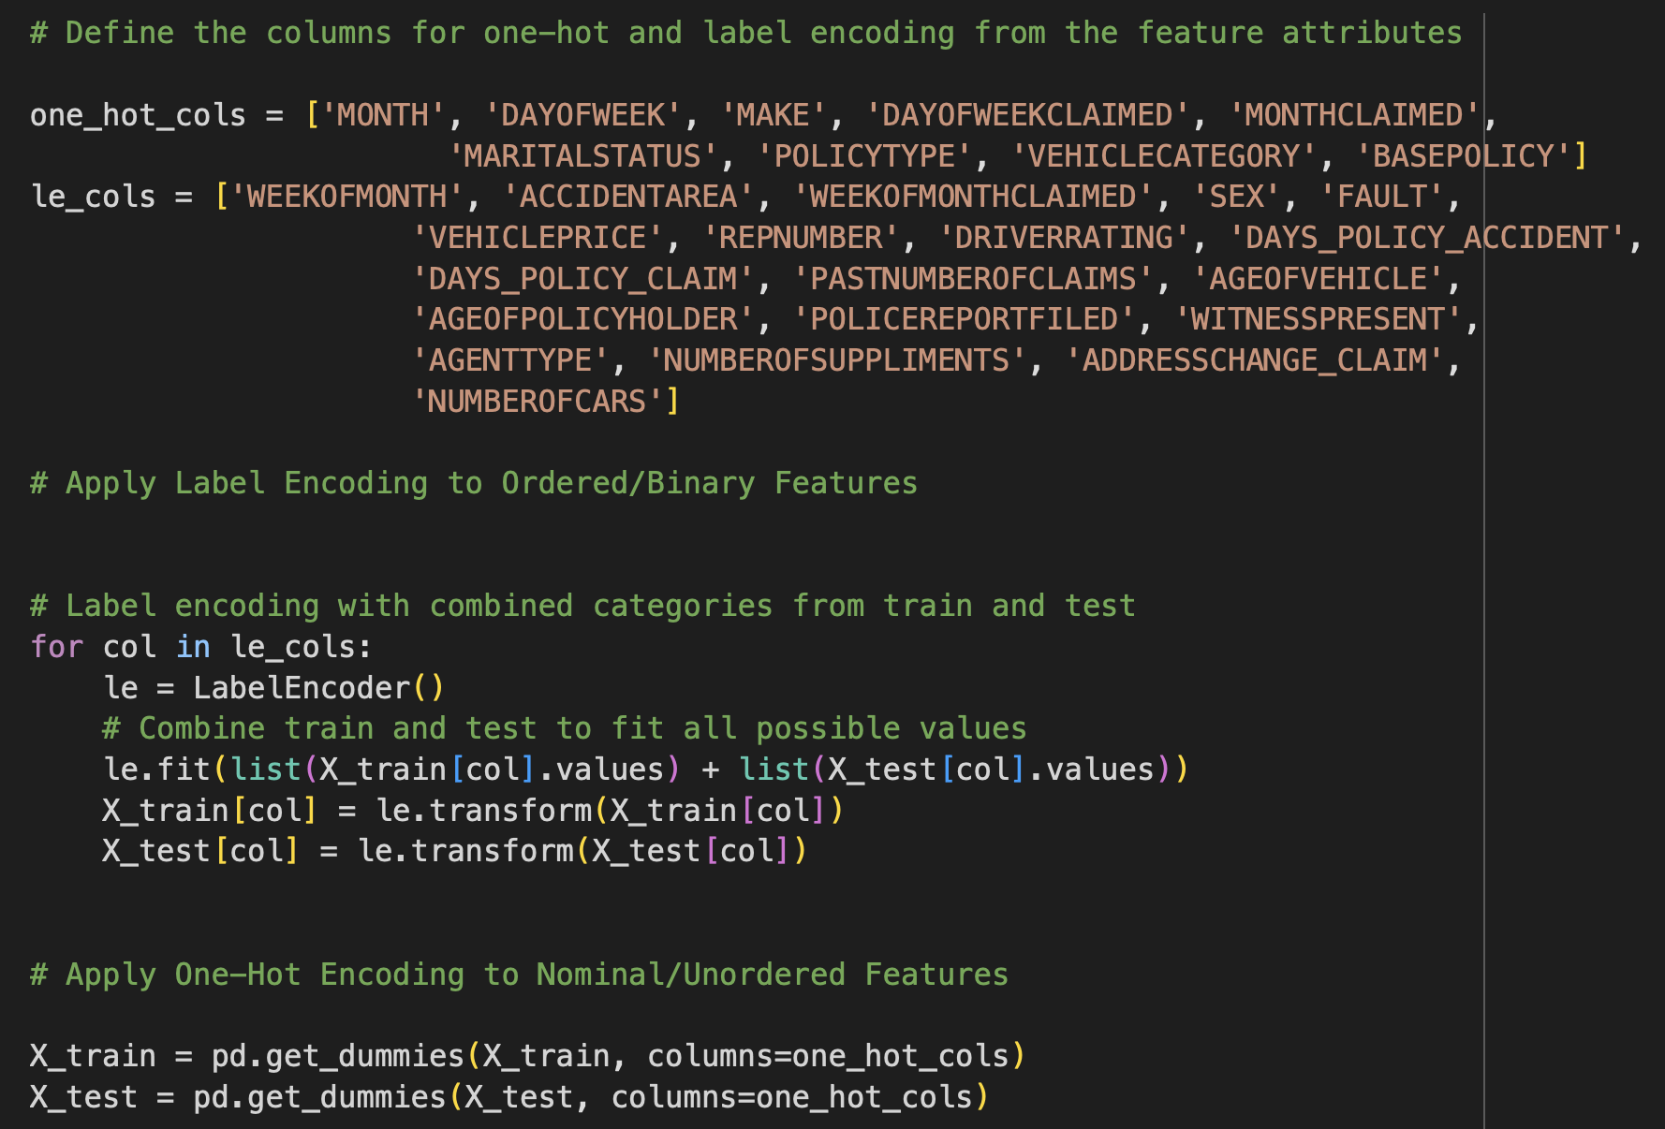
Data Preprocessing
First we separate the feature and target variables
To build our model, we have to convert categorical to numerical features. As our dataset has both ordered and unordered features, we use a combination of Label and One-Hot encoding for better model performance.
We encode our target variable by label encoding to convert yes/no values to 0 and 1.
We then align training and test sets to avoid any inconsistent categories after one-hot encoding and fill any missing column with 0.

Slide 4
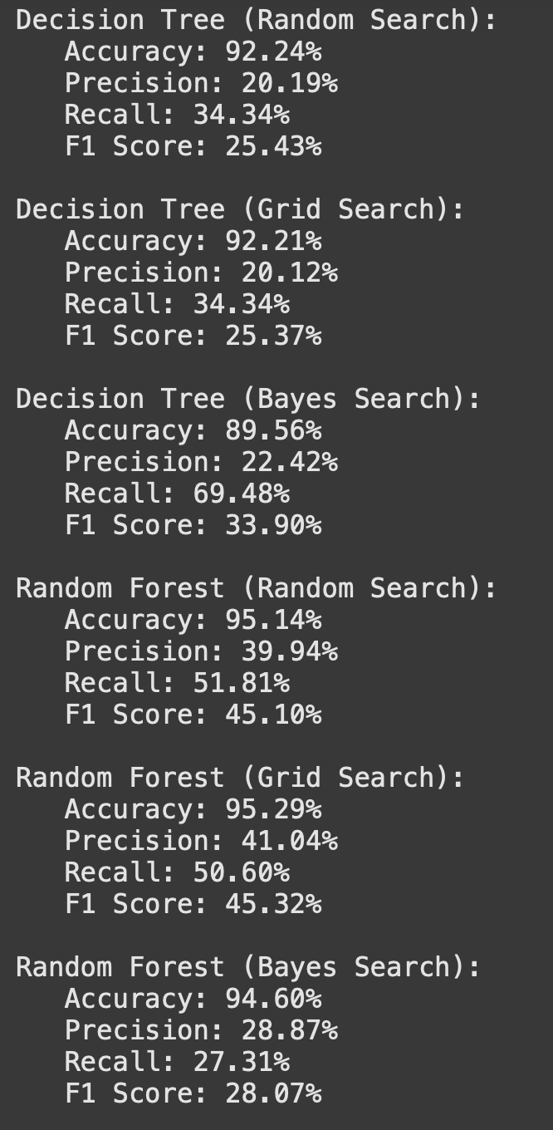
Hyperparameter Tuning and Model Building
We define a hyperparameter grid with 3 parameters to tune and use random, grid and bayes search with a 5- fold cross validation to find the best parameters for a Decision Tree and Random Forest Model
We then train 3 new models each on the best parameters for the decision tree and random Forest classifier.
Though we have an acceptable accuracy we can still improve precision and recall. We use Random Forest from Randomized search as it gives best metrics.
To improve our model we use SMOTE and an XGBoost Model with class imbalance weight adjustment to give priority to minority class as it performs better than Random Forest for complex structured data.

Slide 5
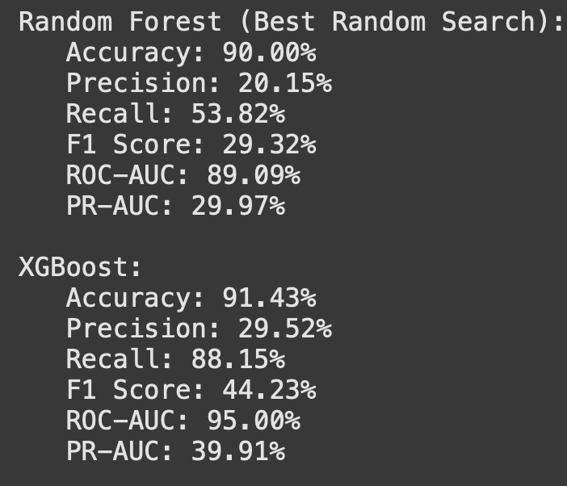
We perform threshold tuning with a custom threshold of 0.4 to improve our recall and precision and then again perform a 5 fold cross validation.
We then evaluate XGBoost Model and Randomized search Random Forest Model. We still get a low precision. Though we affectively capture all fraud cases (high recall), we can still improve our model’s capability to avoid flagging non-fraud cases as fraud cases(precision.)
To further improve our model, we again perform a Bayes search with 5 fold cross validation on the XGBoost model to find best parameters and then again train the model on custom threshold of 0.3 to 0.7

Slide 6
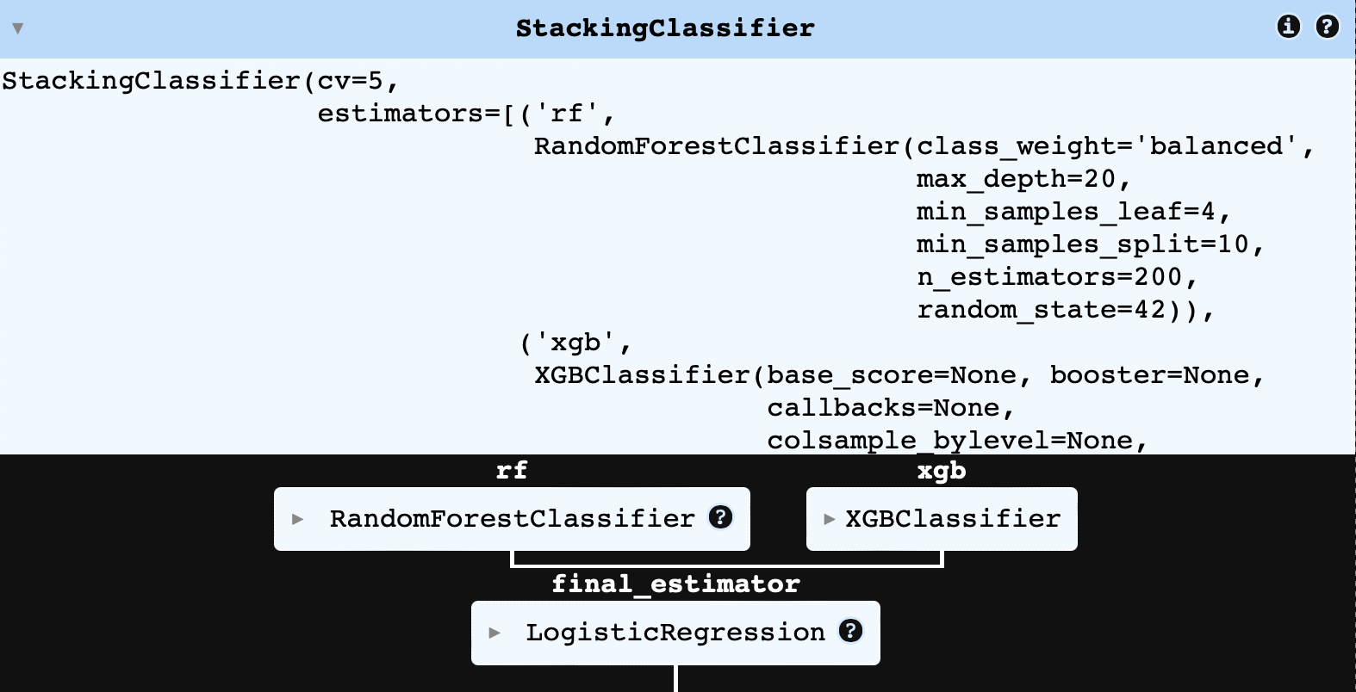
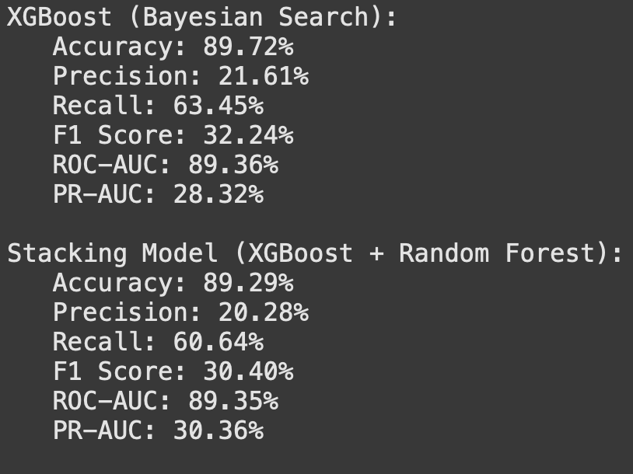
Stacking Model
Since we still get a very low tradeoff, we use an ensemble model where we take inputs of both random forest and xgboost and use logistic regression as the final model for classification.
However, on analysis of results, we still get a very low tradeoff and Accuracy and ROC-AUC are very close to those of XGBoost alone, suggesting that the stacking model offers no major improvements in overall classification.

Slide 7
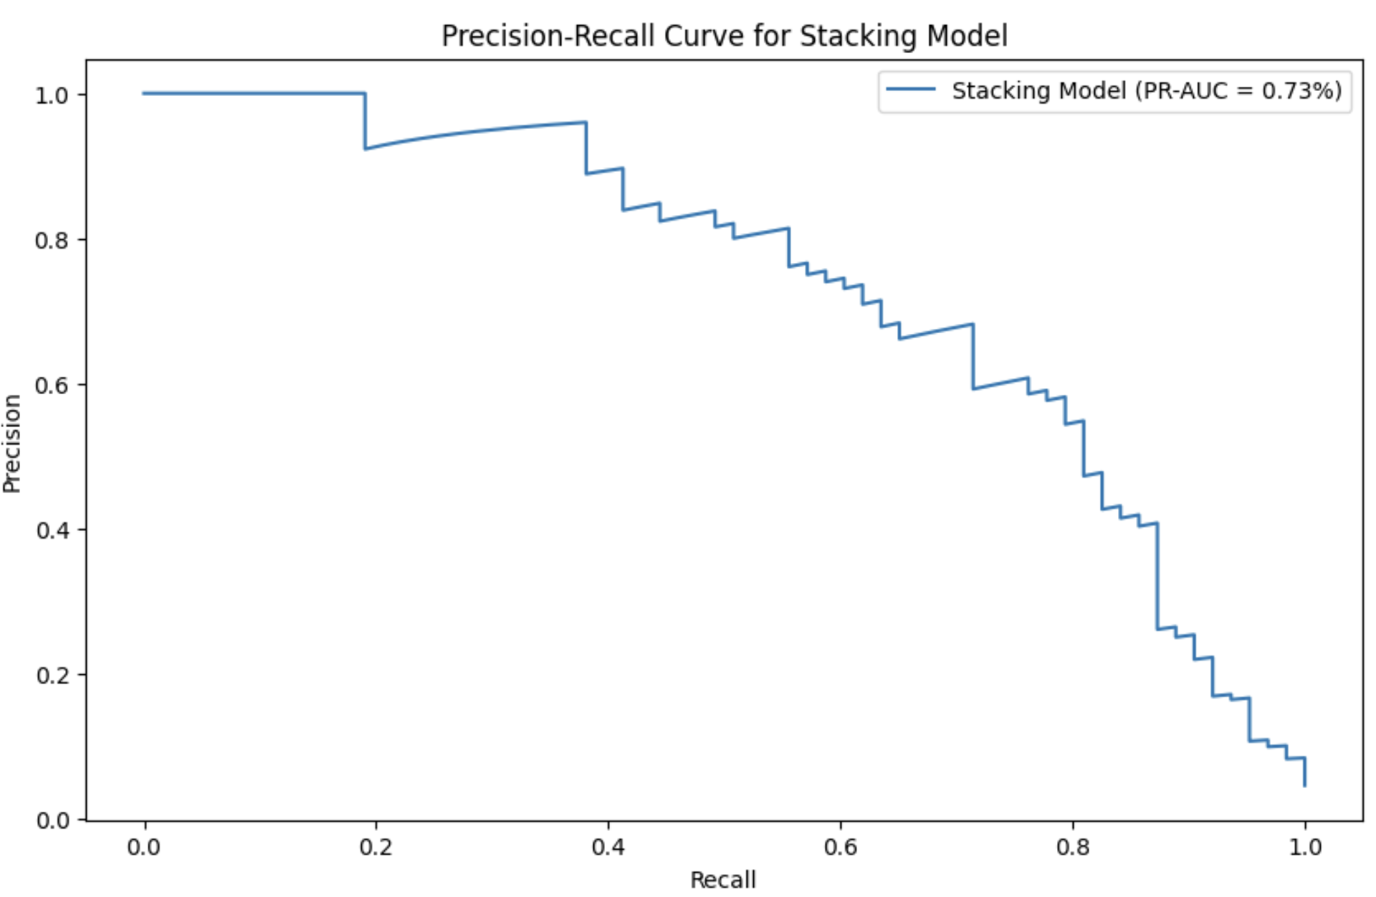
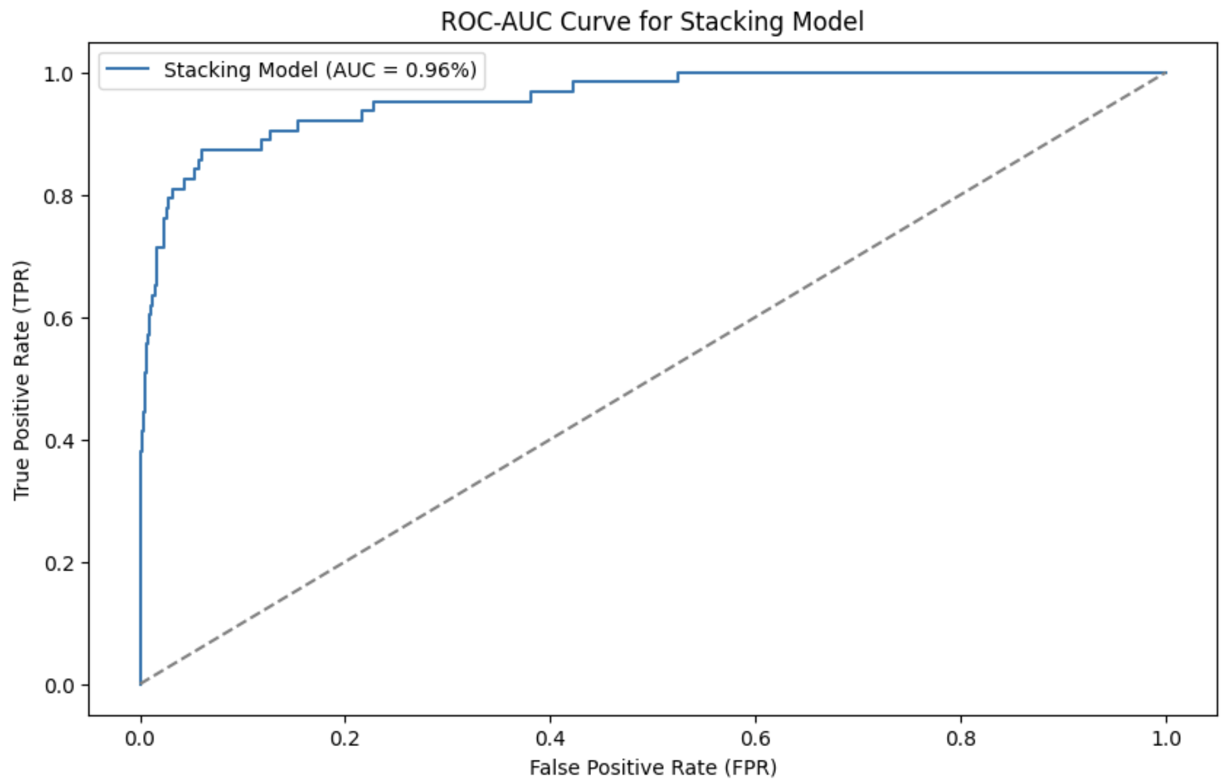
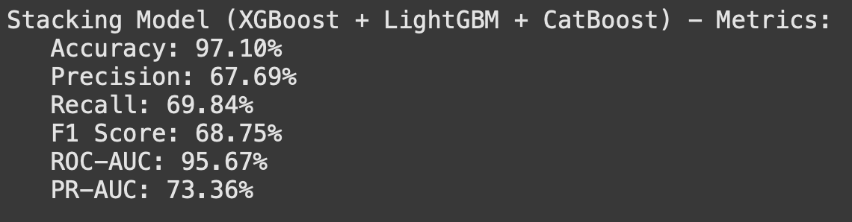
Reducing False Positives
Finally, We calibrate our XGBoost model using a calibrated classifier with isotonic regression.
An Isolation Forest Model identifies anomalies in the dataset. By using this as a pre-processing step, we filter out cases that are very likely non-fraud, allowing the classifier to focus more on ambiguous cases.
We identify and isolate outliers or anomalous cases in a dataset, which are assumed to represent potential fraud. By training a separate XGBoost model on only these anomalies, the model becomes specifically focused on detecting fraud patterns, improving its effectiveness in fraud detection .
By isolating the anomalies first, we ensure that the calibrated XGBoost model is trained specifically on features and patterns present in the fraudulent cases, making it better at identifying true frauds without mistaking too many normal cases as fraudulent. This targeted approach helps improve the model’s precision
We then use another Stacking models of ensemble with XGBoost, LightGBM, and CatBoost with logistic regression as the meta-model to improve performance by combining multiple classifiers. After training, evaluate the stacking model on the anomaly-filtered test set.
Now, we not only get a High Accuracy of 97% but also favourable precision and recall of nearly 70%

Slide 8
How Fraud Detection problem is different from Santander Classification?
Fraud detection requires more advanced feature engineering and complex model building as customer behaviour prediction dataset is anonymous and mostly numeric with no interpretation required.
The Santander classification is relatively simpler as it focuses on accurate predictions whereas in fraud detection the focus is on reducing prediction errors. So, NOT ONLY ROC Curve but even the Precision Recall Curve is important.
The Dataset in terms of fraud detection is highly imbalanced as compared to the Santander dataset. So more advanced Gradient Boosting or ensemble models are required. Though Santander dataset also requires it, simpler models can also be effective in customer behaviour prediction.
Very frequent re-training of model is required fraud cases have changing patterns real-time and also the business problem has more higher stakes than behaviour prediction.

