Slide 1
Santander Customer Satisfaction Classification
SUGHOSH DESHPANDE

Slide 2
GOAL AND APPROACH
We need to predict customer satisfaction using Santander dataset.
Approach:
Exploratory Data Analysis (EDA)
Feature selection and analysis
Model building with different configurations
Model evaluation and comparison

Slide 3
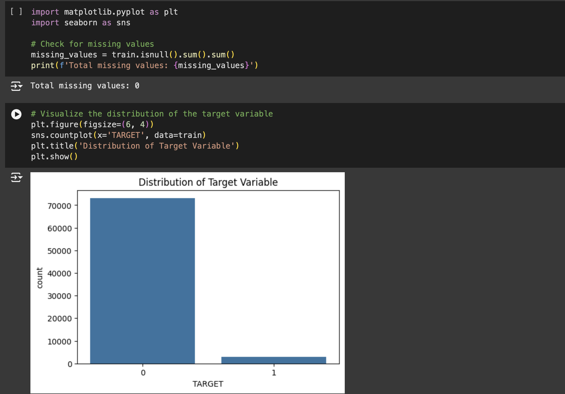
Data Exploration
On initial exploration of data, we see that there are no missing values.
However, on visualization the dataset we find that it is imbalanced.

Slide 4
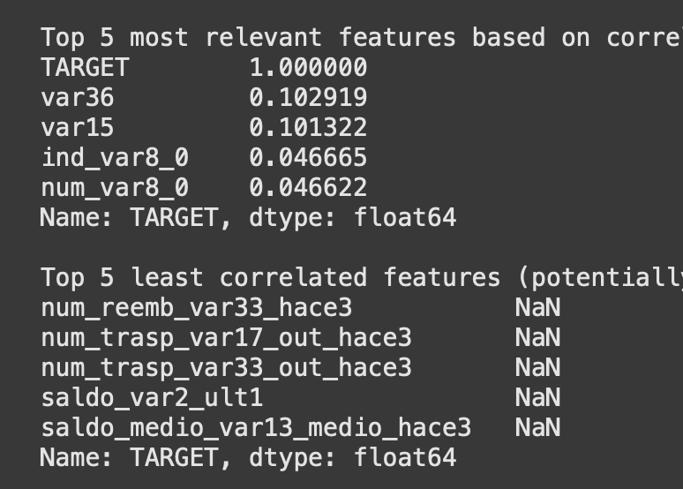
Correlation Analysis
We now visualize correlation matrix between the target and other features. We keep the threshold at 0.01, which means that any feature below this correlation would be irrelevant for our prediction.
We also see that the least correlated features show a NAN value which means they either have constant or sparse data that does not provide information for prediction.
Such features often add noise rather than useful information
The relevant variables for us are the features with the top correlation with the target. Though it is not very high, being the highest indicates that they are useful in distinguishing between satisfied and dissatisfied customers

Slide 5
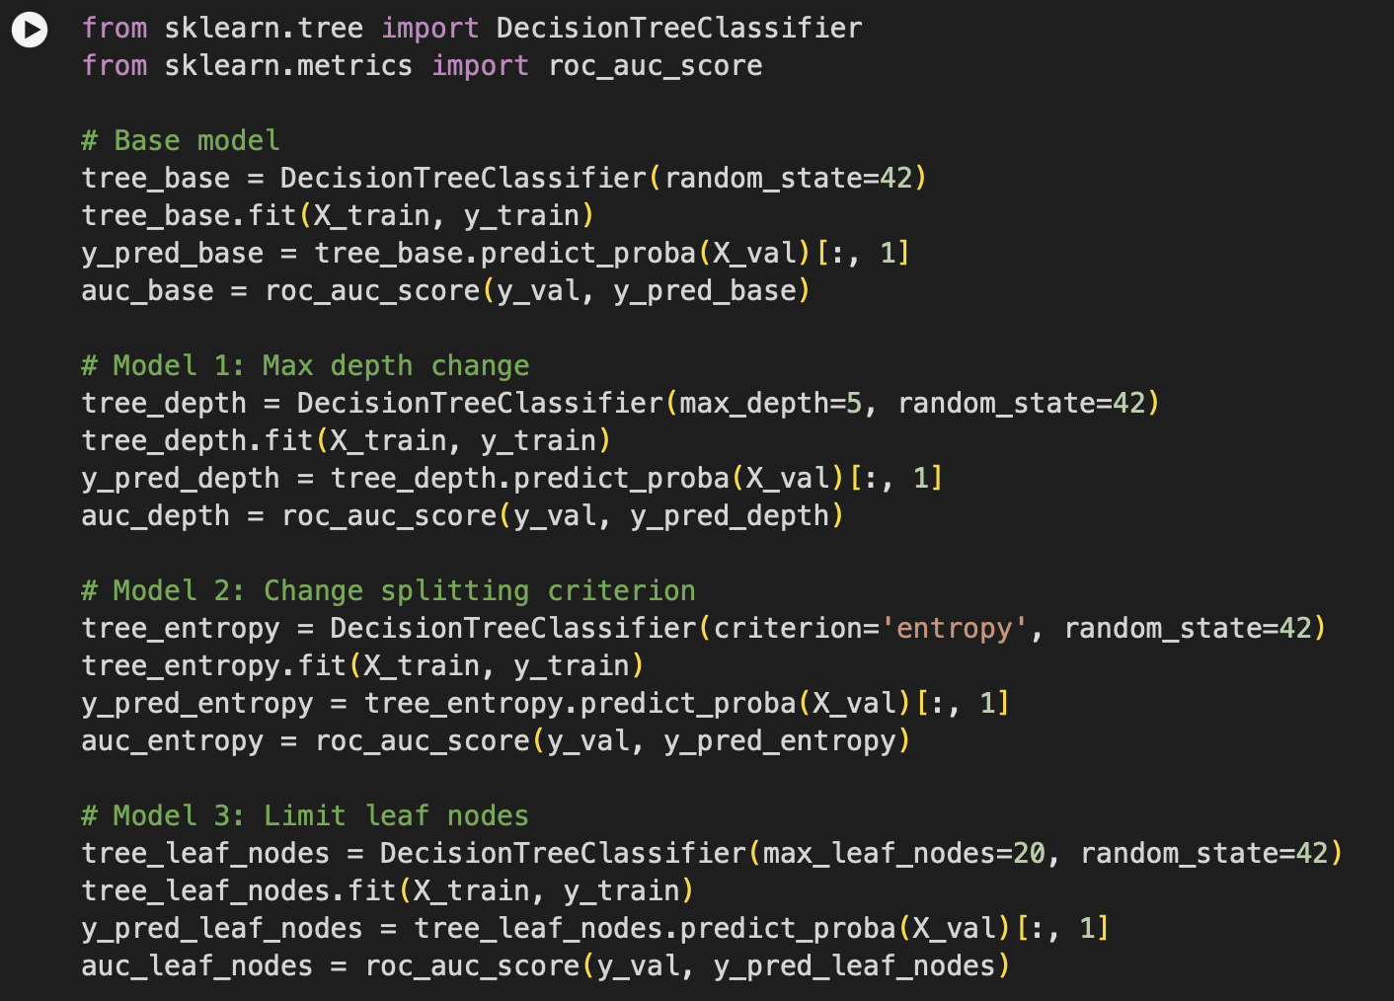
Decision Tree Classifier
Base Model: This is the simplest model without any optimization. The AUC score would be very less.
Model 1: Here the depth has been limited to 5 to prevent the tree from growing too complex, to reduce overfitting and improving generalization.
Model 2: An entropy splitting criteria uses information gain for splitting, which may lead to different splits compared to the default. This can improve model performance .
Model 3: The leaf nodes has been limited to 20 to prevent overfitting by avoiding complexity. This ensures that the tree cannot grow too granular and overly fit the training data. A model with a controlled number of leaf nodes should have a better balance between bias and variance, potentially improving the AUC score.

Slide 6
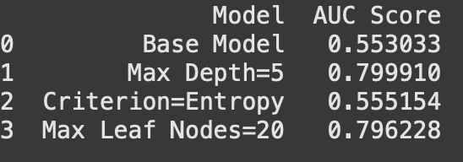
Analysis of Results
the AUC score of Model 1 (with max_depth=5) is the highest among the models, it indicates that limiting the depth effectively improved generalization.
Model 2 has a lower AUC score compared to others, it suggests that gini was a better fit for this dataset.
Model 3 has provided an improvement in AUC by limiting the complexity of the tree and maintaining generalization.
The model with max depth=5 appears to be the best solution as it strikes a balance between simplicity and performance, yielding a higher AUC score. This parameter change likely prevented overfitting while capturing essential patterns in the data.
Limiting Tree Depth helps maintain a simpler structure that generalizes better to unseen data, improving the AUC score compared to more complex models that may overfit.

Slide 7
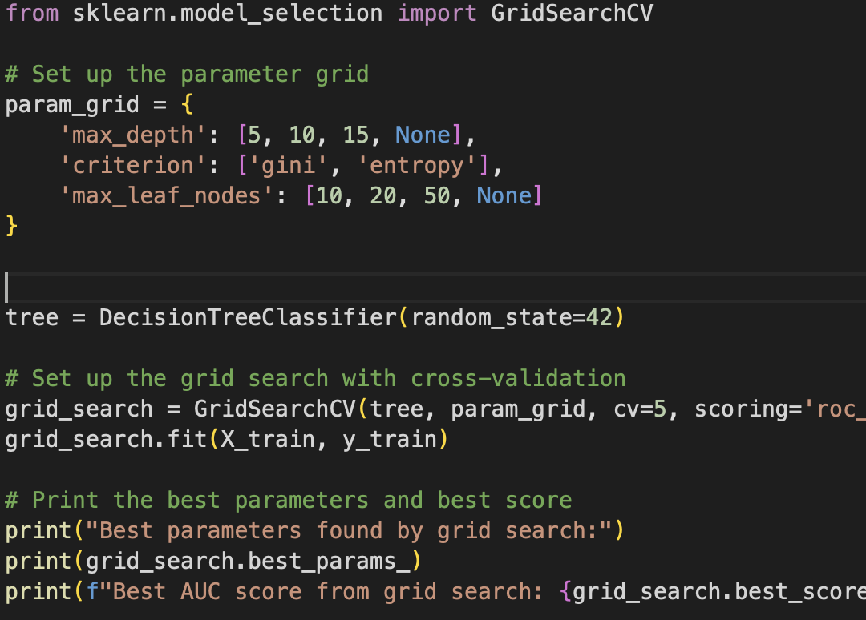
Hyperparameter Tuning
As our AUC score is still low, we use Grid Search with Cross Validation to find the best parameters for our Decision Tree Classifier.
We specify a set of hyperparameters in the parameter grid to search over. Then we perform a comprehensive search over the parameter grid, using 5-fold cross-validation. This ensures that the model's performance is evaluated across multiple data splits.
By searching for the best combination of parameters, this step helps find a model configuration that maximizes the AUC score, improving predictive power.
The use of cross-validation ensures that the selected parameters work well across different subsets of the data, reducing the risk of overfitting.

Slide 8
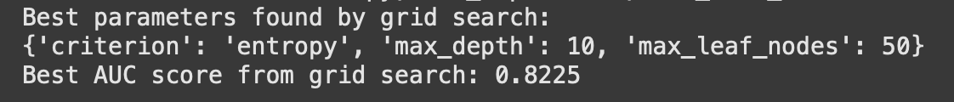
Stratified K Fold Cross Validation
We get a grid search score of 0.8 but on performing cross validation on base model, our AUC score is just 0.5 indicating that our model may be overfitting to the data used in the grid search and not generalizing well on new subsets due to it being imbalanced.
To improve our model we use stratified K fold cross validation in the grid search which ensures that each fold has the same class distribution as the entire dataset, which is particularly important for imbalanced data. This can prevent the model from overfitting to specific folds with skewed distributions.

Slide 9
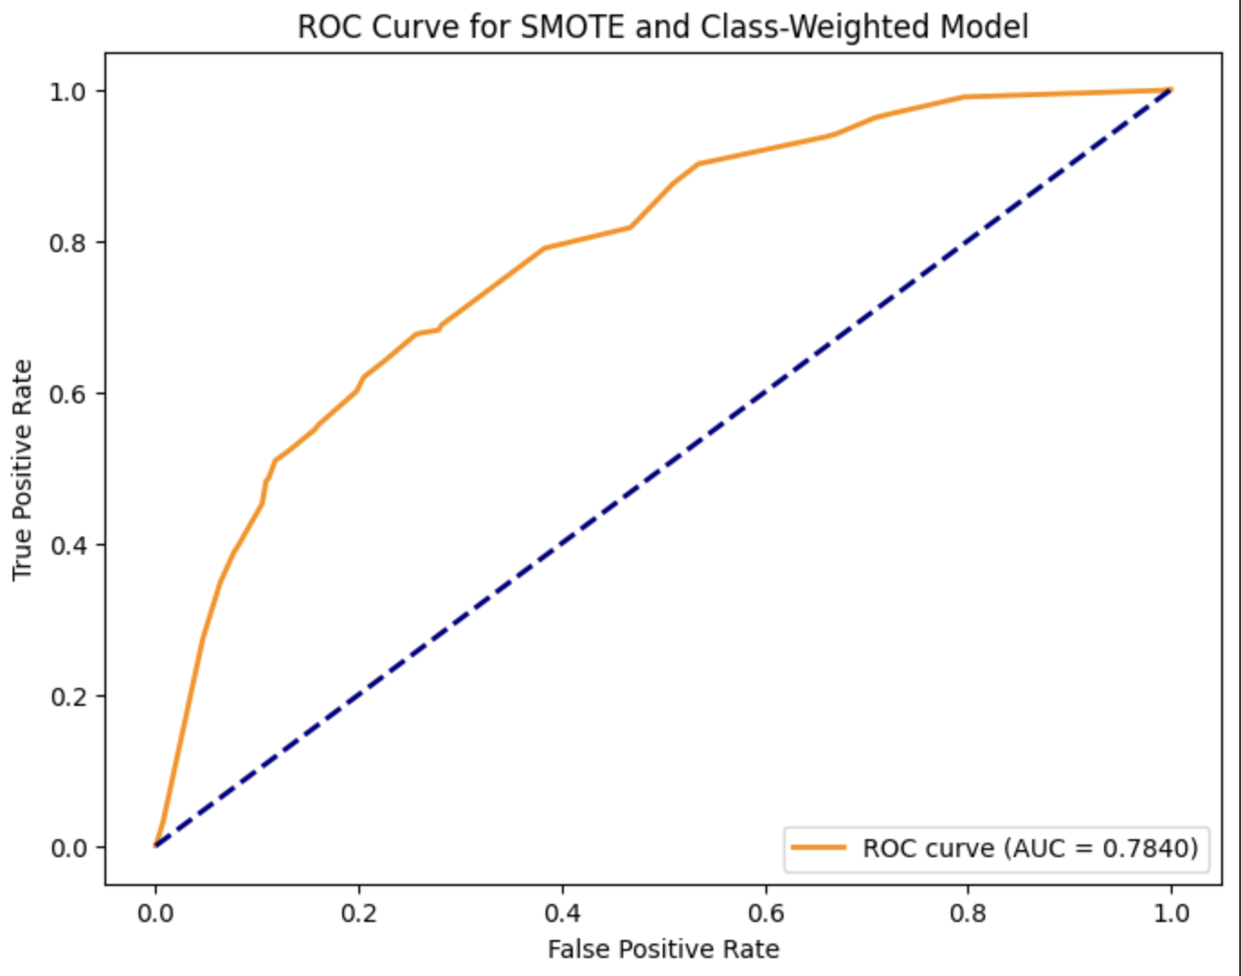
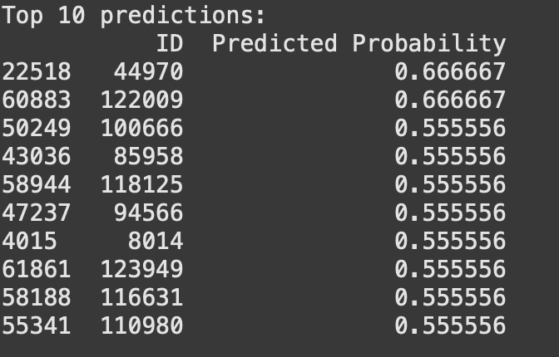
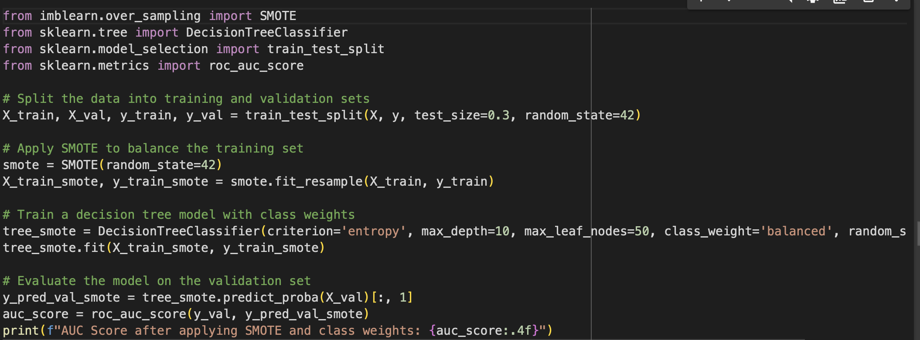
SMOTE
We Now get a good AUC score but on making predictions on the test set for the entire data our maximum probability of prediction is only 66%. We need to further handle imbalance in the dataset to improve our model.
Now we apply SMOTE (Synthetic Minority Over-sampling Technique) to balance the training set and train a Decision Tree Classifier with class weights to further handle class imbalance.
SMOTE Balances the training set by oversampling the minority class. This helps prevent the model from being biased towards the majority class. Using class weights in the model ensures that any remaining imbalance after SMOTE is accounted for during training, giving equal importance to both classes. The combination of SMOTE and class weights helps the model generalize better and make more accurate predictions on unseen data, improving AUC.

Slide 10
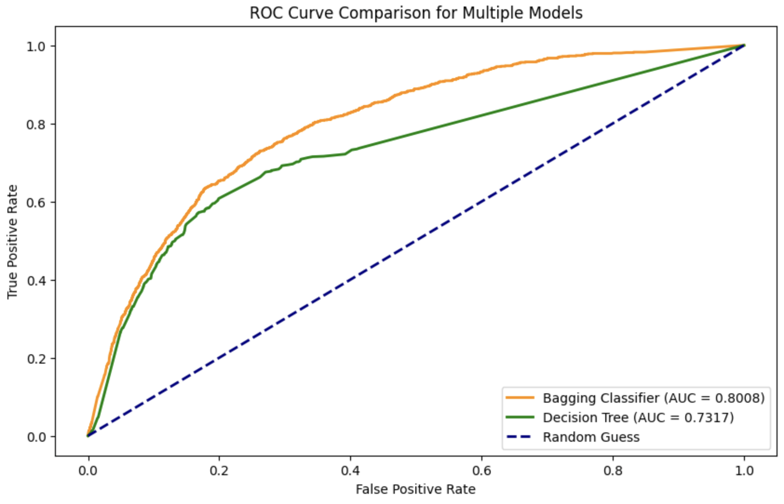
Bagging Classifier
Now, we again perform Grid Search with Cross-Validation to fine-tune hyperparameters on a SMOTE-balanced dataset and then evaluate the best model on the validation set. But Since our AUC Score reduced we use a bagging classifier with our decision tree to improve model performance.
Bagging (Bootstrap Aggregating) is an ensemble technique that trains multiple models on random subsets of the training data and combines their predictions to improve accuracy and stability. We specify a base model in our code and train the bagging classifier on the smote-adjusted training data.
By aggregating multiple decision trees, bagging reduces the variance of the model and mitigates the risk of overfitting compared to using a single decision tree. Ensemble models like bagging perform better on unseen data by leveraging the strengths of multiple decision trees trained on different subsets of the data.
Our AUC score has significantly improved from 73% to 80%.

Slide 11
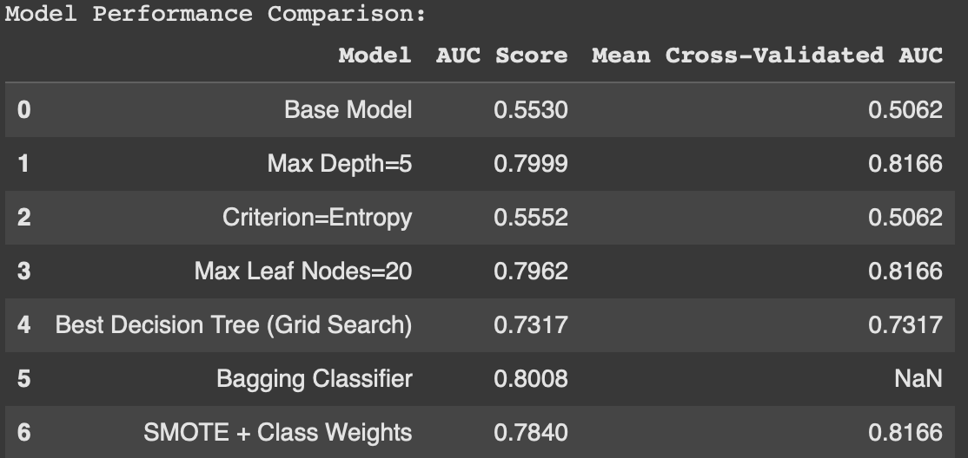
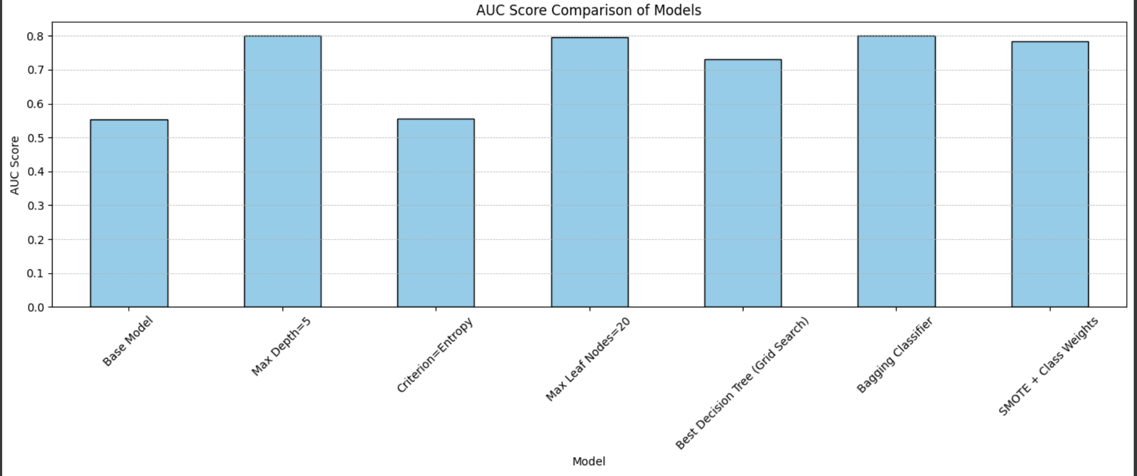
Model Performance Comparison
The Bagging Classifier achieved the highest AUC score of 0.8008, indicating that ensemble learning improved performance and robustness.
The Max Depth=5 and Max Leaf Nodes=20 models performed very well with cross-validated AUCs of 0.8166, demonstrating that simpler models with controlled complexity can yield strong results.
SMOTE + Class Weights approach maintained high AUC scores across validation, suggesting effective handling of class imbalance without complex tuning can yield a good model

Slide 12
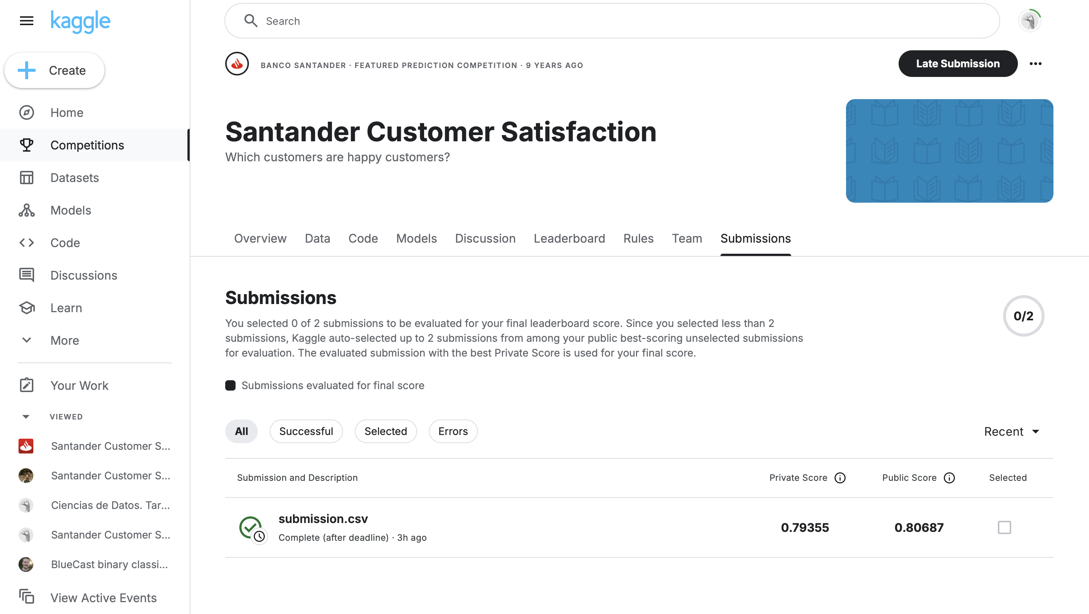
We select the Bagging Classifier as our final model to predict the test set as it has highest AUC Score

Slide 13
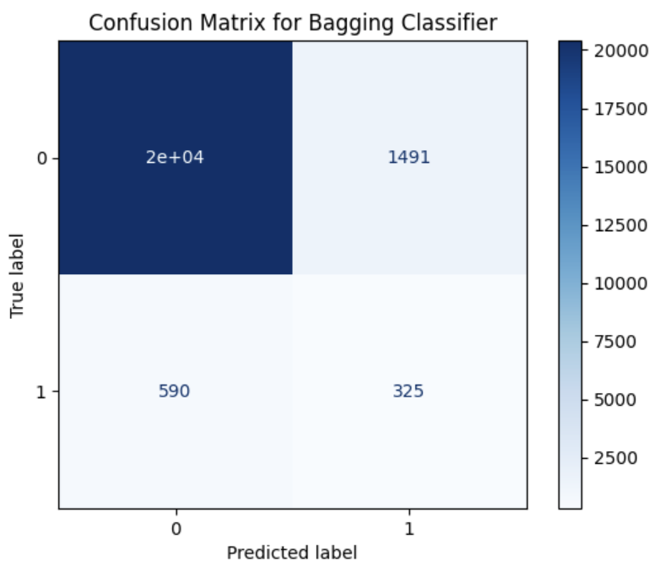

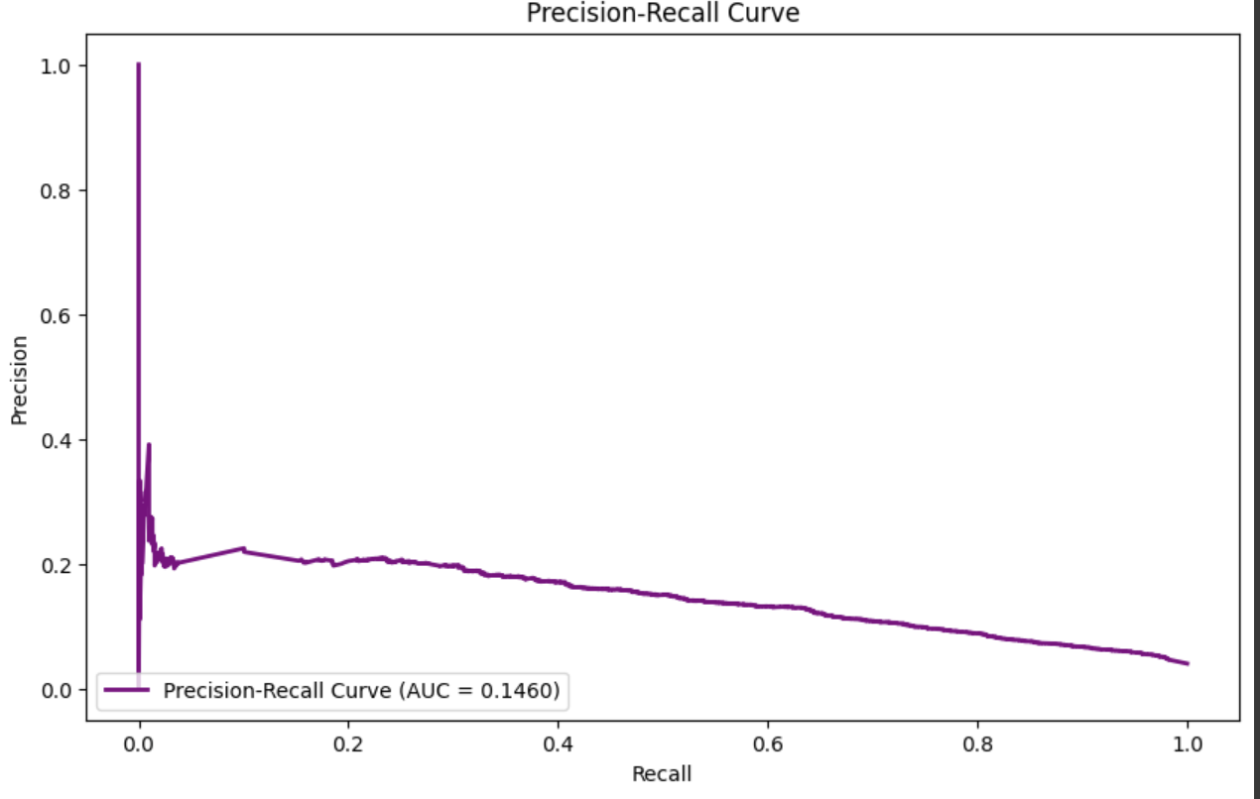
Why this is a hard problem from an ML Perspective?
Imbalanced Dataset: majority of customers are satisfied, and only a small percentage are unsatisfied. This imbalance leads to models that are biased towards predicting the majority class, resulting in poor performance on the minority class. Standard accuracy can be misleading as a performance metric. For instance, a model that always predicts the majority class will have a high accuracy but will fail to identify the minority class, leading to low recall and F1-scores for the unsatisfied class.
When we visualize the confusion matrix for our model, it depicts the model's difficulty in correctly classifying the minority class
We have also very low metrics that prove achieving a high-performance model is challenging.
The relatively low precision and recall indicate that while the model is able to identify some unsatisfied customers, it struggles with high false positives and negatives.

Slide 14
High Dimensionality: The dataset typically contains a large number of features, many of which may be irrelevant or redundant. This can lead to models that overfit the training data and perform poorly on unseen data. Identifying which features are truly important for the prediction task can be difficult due to the presence of noisy features that add complexity but not predictive power.
Weak Correlations: Many features have low correlations with the target variable. This means that simple feature selection or correlation-based techniques are not effective in identifying the most predictive variables.
Overfitting and Complexity: Models like decision trees are prone to overfitting if not properly tuned (e.g., excessive depth or too many leaf nodes). Ensuring the model generalizes well requires careful tuning of hyperparameters, which can be computationally intensive. While ensemble methods like bagging and boosting can help mitigate overfitting, they come with increased computational costs and complexity, making model training and validation more challenging. Implementing techniques like SMOTE or class weighting to handle class imbalance is essential but adds additional processing steps. SMOTE generates synthetic samples for the minority class, which can help, but also risks introducing noise or overfitting if not carefully managed.

