Slide 1
Margin (side 3)
Margin (side 2)
Plot Region
Margin (side 4)
pin[2]
fin[2]
pin[1]
Margin (side 1)
fin[1]

Slide 2
> state.x77[state.x77[ , "Area"] > 80000 , "Income" ]
Select rows
Select column(s)
Select rows
Select
column(s)

Slide 3
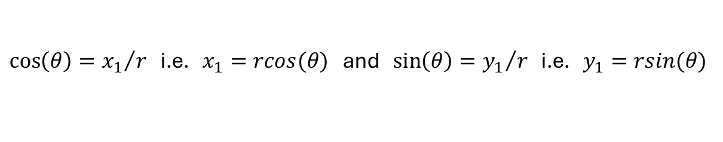



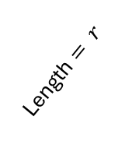


Cartesian coordinates for referencing a point P
Polar coordinates for referencing a point P
y
y
$$P=c(x_{1},y_{1})$$
$$P=c(rcos(θ),rsin(θ))$$
$$y_{1}$$
Length $= r$
$$θ$$
0
$$x_{1}$$
x
0
x
$\cos\left(θ\right)={x_{1}}/r$ i.e. $x_{1}=rcos(θ)$ and $\sin\left(θ\right)={y_{1}}/r$ i.e. $y_{1}=rsin(θ)$

