Slide 1
Margin (side 3)
Margin (side 2)
Plot Region
Margin (side 4)
pin[2]
fin[2]
pin[1]
Margin (side 1)
fin[1]

Slide 2
> state.x77[state.x77[ , "Area"] > 80000 , "Income" ]
Select rows
Select column(s)
Select rows
Select
column(s)

Slide 3
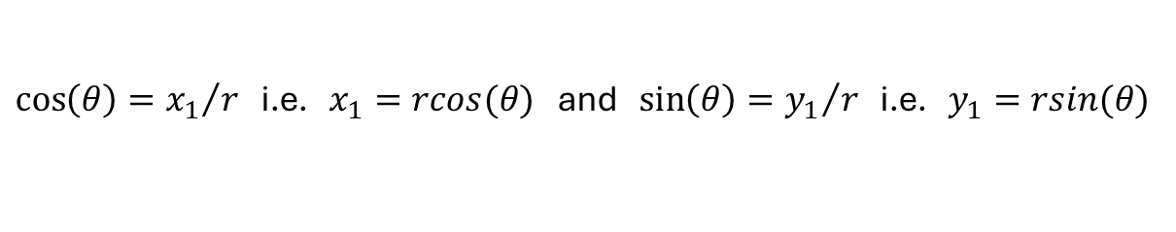



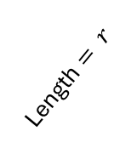


Cartesian coordinates for referencing a point P
Polar coordinates for referencing a point P
y
y
$$P=c(x_{1},y_{1})$$
$$P=c(rcos(θ),rsin(θ))$$
$$y_{1}$$
Length $= r$
$$θ$$
0
$$x_{1}$$
x
0
x
$\cos\left(θ\right)={x_{1}}/r$ i.e. $x_{1}=rcos(θ)$ and $\sin\left(θ\right)={y_{1}}/r$ i.e. $y_{1}=rsin(θ)$

Slide 4
MATHEMATICAL EXPRESSION
CHARACTER STRING
> 3 + 4
> "John Brown"
> "3 + 4"
Expression
Text
> out <- parse (text = "4 + 7")
> out
expression (4 + 7)
> eval (out)
[1] 11
Note the text has been converted to an expression but it is kept unevaluated.
Expression
Text
Note the expression has first been evaluated and then the result is converted to text.
> deparse (3 + 4)
[1] "7"
> substitute (3 + 4)
3 + 4
> deparse (substitute (3 + 4))
[1] "3 + 4"
Note the expression is being returned as an unevaluated expression.
Using functions deparse and substitute together converts original expression into text.

Slide 5
ifelse (arg1 = logical vector / matrix of TRUEs and FALSEs, arg2, arg3)

Slide 6
(a)
(b)
THEMES
LAYER
FACETS
Data + Mapping
Statistics
COORDINATES
[Mapping]
Geometry
SCALES
Position
LAYER
LAYER

Slide 7
$$Y_{ij}=μ+α_{i}+β_{i}x_{ij}+ε_{ij}$$
STEP I
$$H_{01}:β_{1}=…=β_{k}$$
reject
not reject
$$Y_{ij}=μ+α_{i}+βx_{ij}+ε_{ij}$$
STEP II
$$H_{02}:β=0$$
not reject
$$Y_{ij}=μ+α_{i}+ε_{ij}$$
ANOVA
reject
$$Y_{ij}=μ+α_{i}+βx_{ij}+ε_{ij}$$
STEP III
$$H_{01}:α_{1}=…=α_{k}$$
reject
not reject
$$Y_{ij}=μ^{∗}+βx_{ij}+ε_{ij}$$
$$μ^{∗}=μ+α_{i}$$

Slide 8
x
x
f
f
(
(
b
b
)
)
y =
y =
f
f
(
(
x
x
)
)
f
f
(
(
p
p
)
1
)
1
x
p
x
a = a
p
a = a
p
p
p
p
p
p
b = b
3
b = b
1
3
1
2
2
1
1
1
1
f
f
(
(
p
p
)
2
)
2
f
f
(
(
a
a
)
)
p
p
b
a
b
a
1
1
1
1
1
1
b
a
b
a
p
p
2
2
2
2
2
2
p
p
b
a
b
a
3
3
3
3
3
3

Slide 9









$$Gradient=f^{′}\left(p_{1}\right)=\frac{0−f(p_{1})}{p_{2}−p_{1}}$$
$$y=f(x)$$
$$\left(p_{1},f\left(p_{1}\right)\right)$$
$$Gradient=f^{′}\left(p_{0}\right)=\frac{0−f(p_{0})}{p_{1}−p_{0}}$$
$$p_{0}$$
$$p_{2}$$
0
$$p$$
$$p_{1}$$
$$\left(p_{0},f\left(p_{0}\right)\right)$$

