Slide 1

DSALGO
VIDHYA MANICKARAJ
SUGANYA NESAPPAN
MADHAVI PATIL
DIVYA BHARATHI RAGI

Slide 2
Project Scope
Checking functionality of https://dsportalapp.herokuapp.com/ website.
Automated application using Selenium, Cucumber, GIT, testng, Jenkins, and Jira.
Generated Allure report, html report and cucumber reports with pass/fail.
Reported bugs for failed use cases using Jira.
Time taken to complete the project-3 sprints

Slide 3
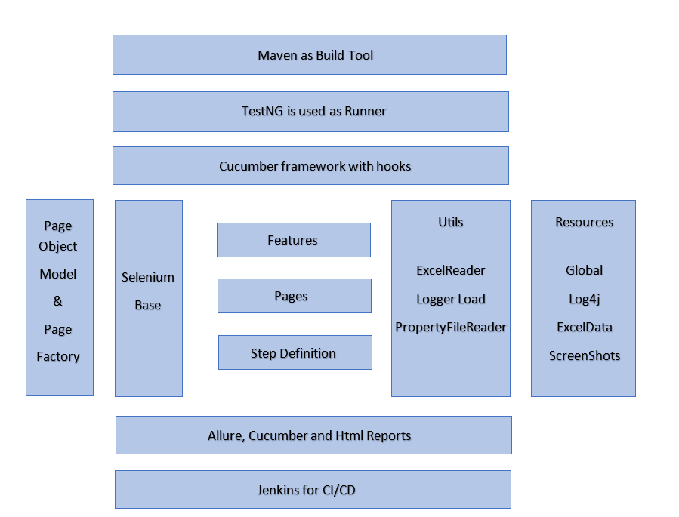
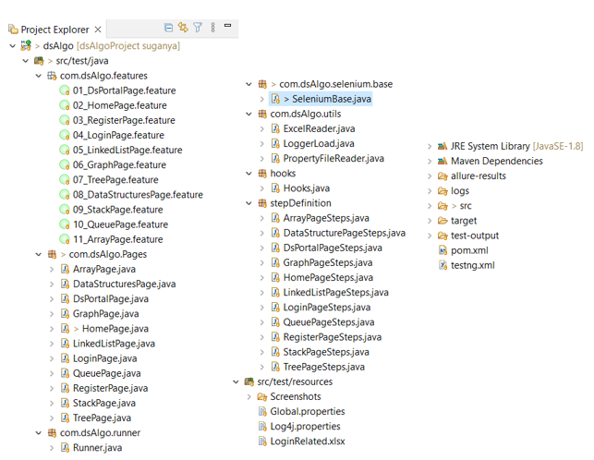
Framework Architecture And Project Folder Structure

Slide 4
Achievements
Page Object model
Page factory
Data Driven
Behavioral Driven
Hybrid framework
Found bugs and added to jira board
Allure, cucumber and html reports
Followed agile methodology : daily stand up and regular review and code enhancement.

Slide 5
Difficulties faced and Solutions
Initial designing of the framework was challenging due to frequent improvements in the design.
Data driven using cucumber framework.
Integrating our code to common git repository was challenging.
Over came several merge conflicts during push and pull request.
Integrating with jenkins was really challenging.

Slide 6
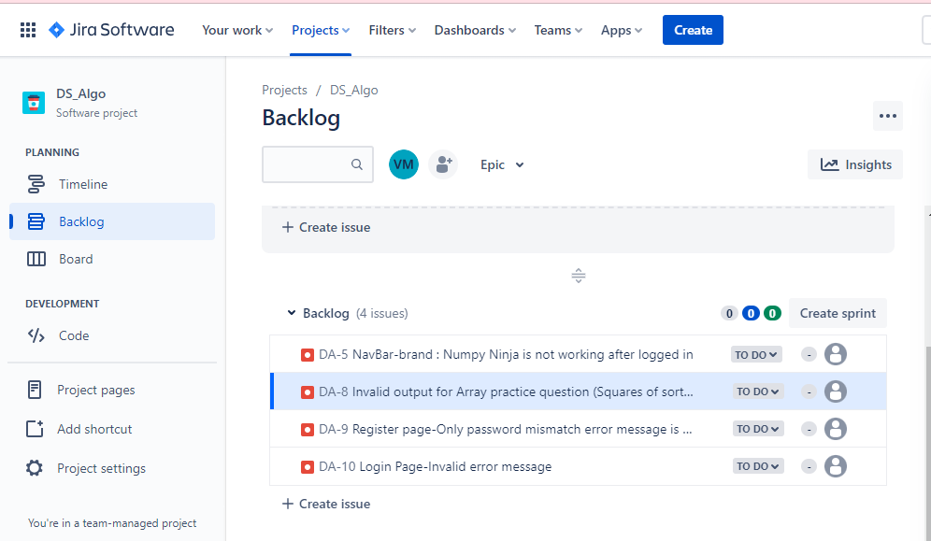
Screenshots-Jira dashboard bugs

Slide 7
Learnings
Team Work
Sharing existing and new knowledge gained.
Supporting each other to perform the given task while facing difficulties
Time Management

Slide 8
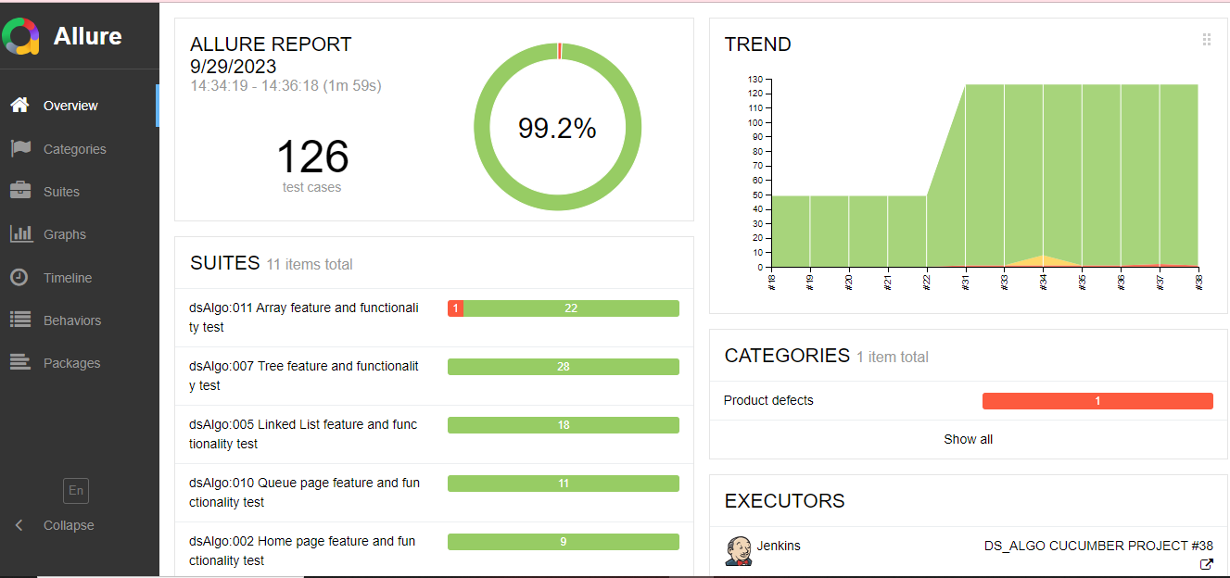
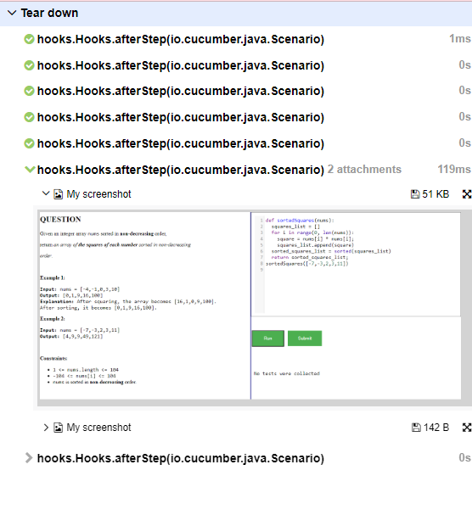
Reporting Screenshots-Allure report

Slide 9
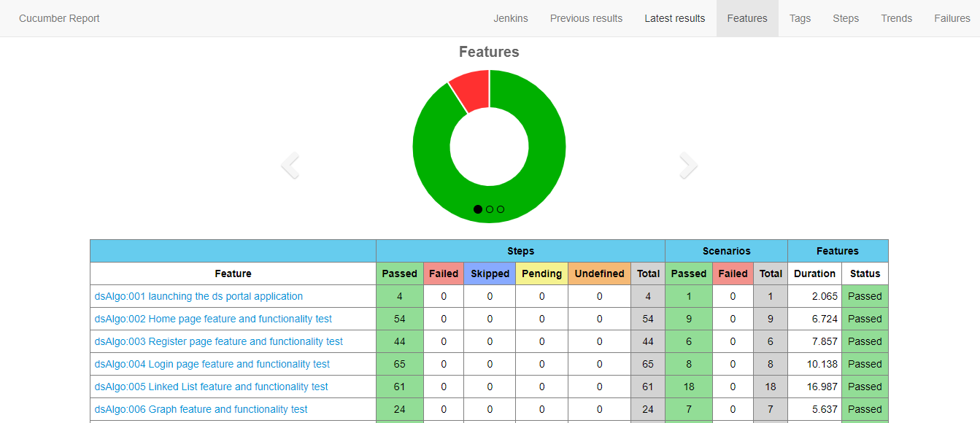
Reporting Screenshots-Cucumber report

Slide 10
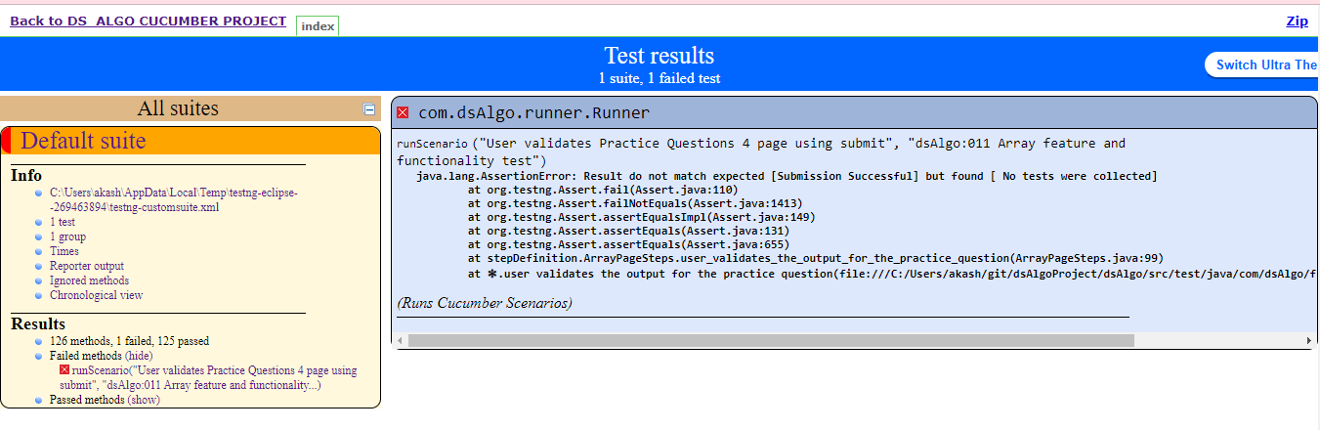
Reporting Screenshots-HTML report

Slide 11

THANK YOU

