Slide 1
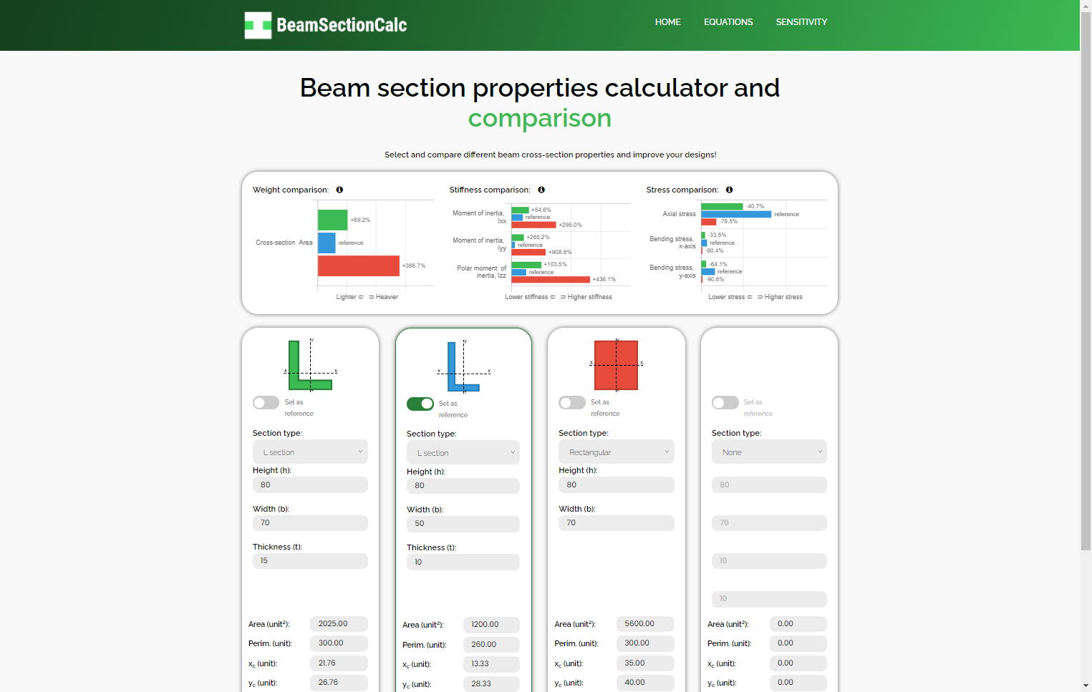


Start here!
Choose one or more cross-sections to calculate
See in the plots the the properties of the cross-sections
Results are shown below each section!

Slide 2
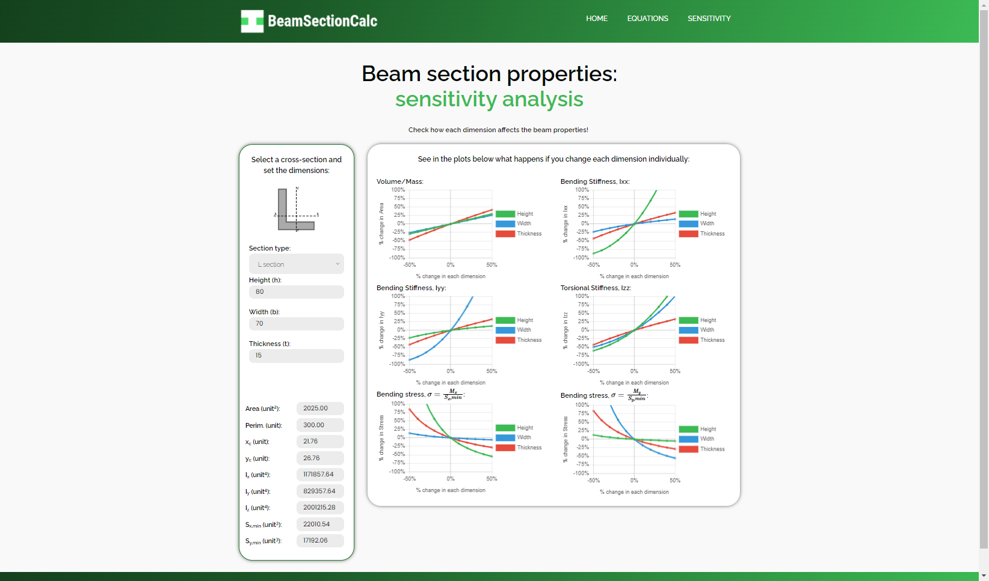
Start here!
Choose a cross-sections to calculate
The plots will show how each dimension affects each result!
Results are shown below!

