Slide 1
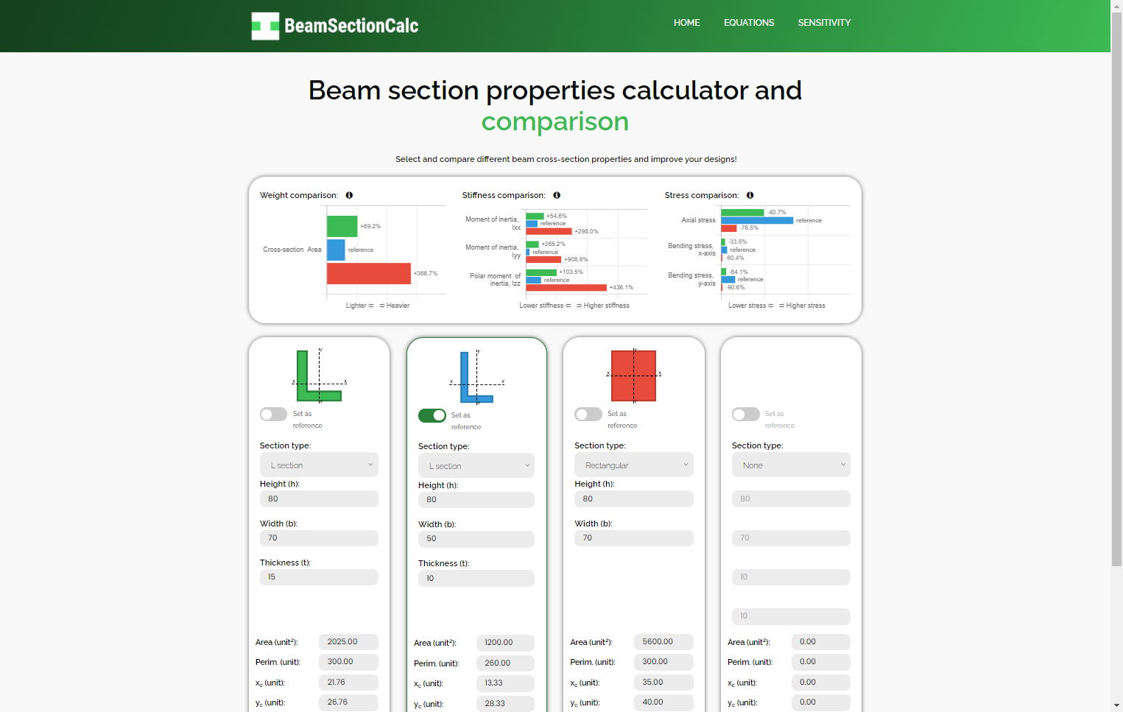


Start here!
Choose one or more cross-sections to calculate
See in the plots which cross-section performs better for your application!
Results are shown below each section!

Slide 2
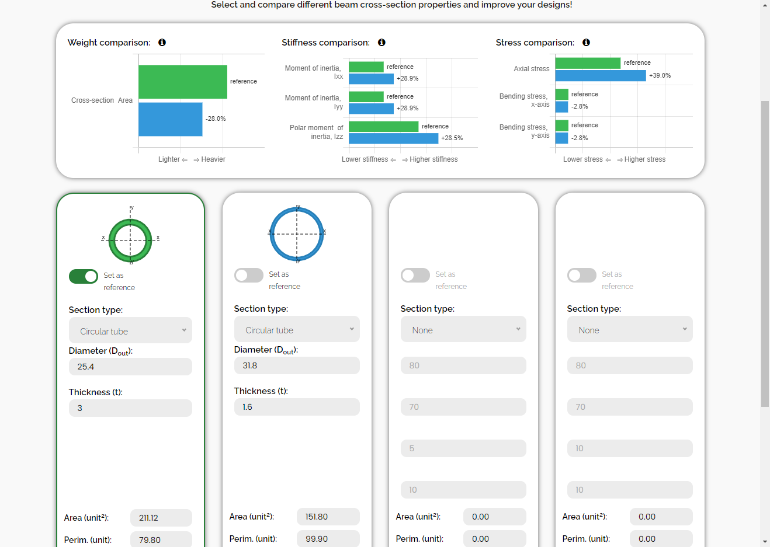
Properties comparison
User input
Results

Slide 3
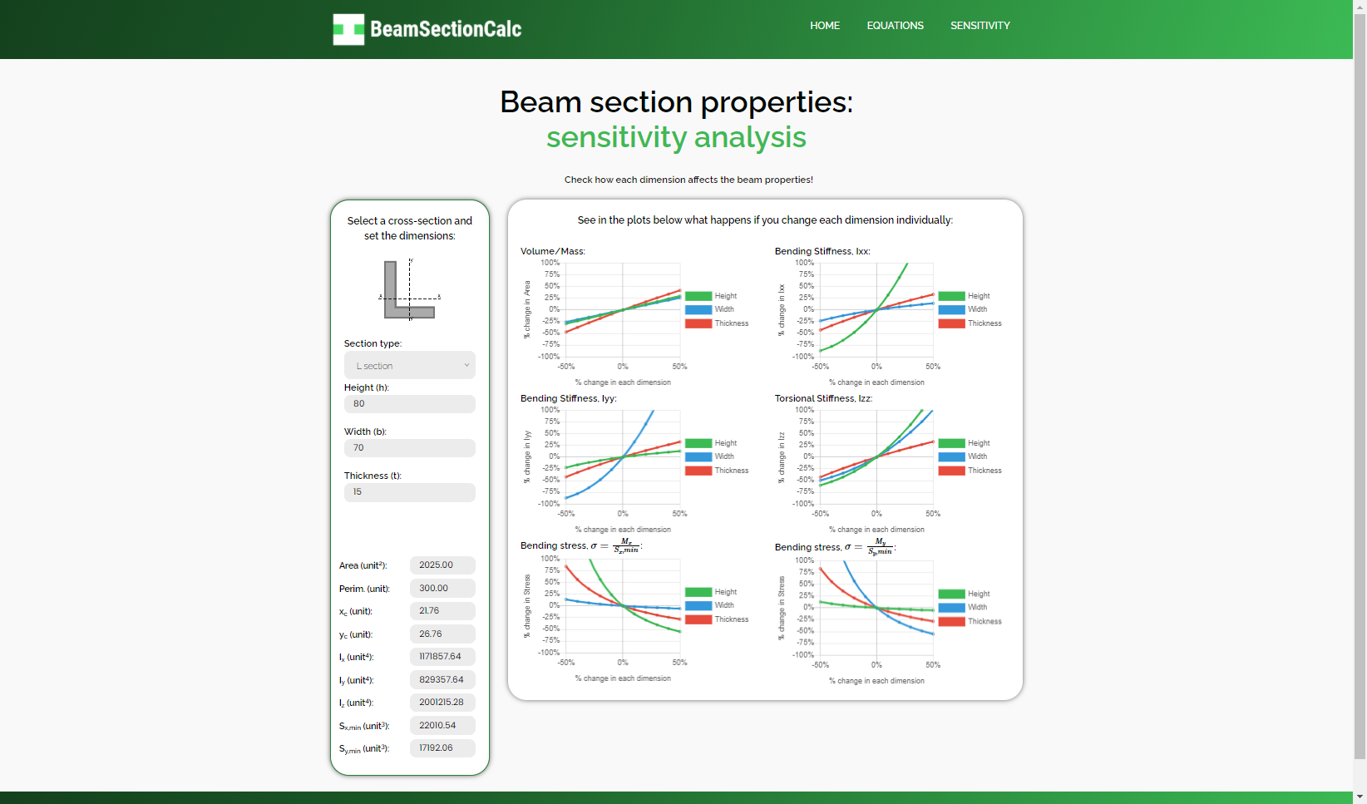
Start here!
Choose a cross-sections to calculate
The plots will show how each dimension affects each result!
Results are shown below!

Slide 4
Side view, y-z plane :
Axial stress:
_{σ}
z
F
F
Bending stress, x-axis:
_{σ}
y
c_{x}
x
M_{x}
x
M_{x}
z
y
Front view, x-y plane :
Top view, x-z plane:
T
y
Torsion
Bending stress, y-axis:
_{σ}
x
x
c_{y}
M_{y}
M_{y}
y

Slide 5
Y
x
dA
y
X

Slide 6

?
Area
Inertia
. . .
. . .

