Slide 1
Job Portal
Guided By: Mr.Aditya Nagodra
Developed By: Paghadar Sanjay
Dangar Vijay
Joshi Vishal

Slide 2
Overview
Company Profile
Introduction
Software Specification
Analysis phase
Design Phase
Data Dictionary
Implementation
Limitation & future improvement
Conclusion

Slide 3

Company Profile
Version System Pvt.Ltd. Started providing D.P. & Company. with software solutions for its various business activities. this relationship has extended to providing all sorts of IT services making Version System Pvt.Ltd. and all time preferred software provider for D.P.& Company.
This extends to providing all sorts of software consulting, application development,maintaince and training.

Slide 4
Introduction
“Job portal” is a web-based application, which helps end user to find a job with searching criteria like preferred skill and location and work profile.
It also helpful to “post job” and “search candidate” based on jobseeker profile. Job provider can download resume of job seeker.
Job provider can make discussion with job seeker and also send mail to job seeker.
It is developed in order to reduce the gap between Industry and Industry needed resources.
One can post his/her details on this portal with all relative information.

Slide 5
Purpose:-
This system tends to replace the existing manual system for the recruitment process which is a time consuming, less interactive and highly expensive.
The main features of this system will be creating vacancies, storing Applicants data, Interview process initiation for the applicant and finally Hiring of the applicant.
Scope:-
The Online job Portal System that is to be developed provides the members with jobs information, online applying for jobs and many other facilities.
The job seeker can apply for the match jobs and search job as per his/her requirement.

Slide 6
System Description
The website provides both the Job seekers and the Employer his User Id which is unique.
The main stakeholders of this system are:
Job Seekers
Employer
Administrator

Slide 7
System Requirement Specification
Hardware Requirement
Processor: Any Pentium IV or compatible
RAM: Minimum 512 MB
Hard disk: Minimum 20 GB
Software Requirement
Operating System: Windows XP, Windows 7
Browser: Mozilla Firefox, Chrome, Internet Explore
Front End: ASP.NET 4.0 (MVC3) With code behind C#
Back End : SQLServer2008(R2), IIS

Slide 8
Analysis Phase
First we have started analyzing the task to be performed. the next step is to analyze the problem and understand its context.
Then we have observer existing system ..
www.careers.stackoverflow.Com
www.shine.com
From we have understanding the properties and requirements of a new system .
It is more difficult and requires creative thinking and understanding of existing running system is also difficult, improper understanding of present system can lead diversion from solution.

Slide 9
Rapid Application Development Model
Reason for Choosing RAD Model
Work can be divided in modules.
Can be done independently and later on all modules will be integrated.
Comparatively system is large…..
9

Slide 10
Use case Diagram
Approve Posted job
Approve Candidate Profile
Remove Candidate Profile
Admin
Remove Posted jobs
Search for Vacancies
<<Extend>>
Upload Resume
<<Extend>>
Change Resume
Create Profile Register
Visitor
View Match Vacancies
<<Extend>>
<<Include>>
<<Extend>>
Update Profile
Log in
<<Extend>>
Search for Vacancies
<<Extend>>
<<Extend>>
Apply for Job
<<Extend>>
Job Seeker
Change Password
Add Favorite Job
Delete Vacancies
<<Extend>>
<<Extend>>
Add New Vacancies
Log in
Search Candidate
<<Extend>>
<<Include>>
Download Resume
Employers
Create Discussion
Send Mail

Slide 11
Activity Diagram
Admin
Application
Database
Request for membership
Membership info.
Approve membership
Return membership info
Request for approve job
Approve job
Display approve job
Return approve job
Request to remove jobs
Remove jobs
Return remove successful
remove successful
Request for candidate profiles
get candidate profiles
Display candidate profiles
Return candidate profiles
Request candidate profile detail
Get profile In detail
Display candidate profile
Candidate profile in detail
Request remove profile
Remove profile
Successful remove profile
Remove candidate profile

Slide 12
Activity Diagram
Admin Activity
Enter admin user name & password
Get data
submit
valid
no
yes
Job post info
Job seeker info
data
data
wait
Remove
valid
valid
Remove
show
show
successfully done

Slide 13
Activity Diagram
Job provider Activity
Get data
Enter user name & password
submit
valid
no
yes
Post job
Candidate search
View applied candidate
submit
no
Get detail
Get applied candidate
valid
remove
valid
yes
valid
no
yes
Download resume
Download resume
Send mail
Successfully done

Slide 14
Data Dictionary
Table name: User Master
Field Name | Data Type | Constrain |  | Description
MasterId | Numeric(18,0) | PrimaryKey |  | UserID
UserName | varchar(20) | UniqueKey |  | User Name
Password | varchar(20) | UniqueKey |  | Password
Table name: Candidate Education
Field Name | Data Type | Constrain |  | Description
EducationId | Numeric(18,0) | PrimaryKey |  | Education Id
CandidateEId | Numeric(18,0) | Forign Key |  | Candidate Master Id
QualificationLevel | varchar(50) | NotNull |  | Qualification Level
EducationSpecification | varchar(50) | NotNull |  | Candidate’s Stream & Degree
PassingYear | Numeric(10) | NotNull |  | Passing Year

Slide 15
Table name: Candidate Skill
Field Name | Data Type | Constrain |  | Description
Skill_Id | Numeric(18,0) | PrimaryKey |  | Skill Id
CandidateSId | Numeric(18,0) | Forign Key |  | Candidate Master Id
Skills | varchar(100) | NotNull |  | Specific Skills
Experience Year | Numeric(10) | NotNull |  | Candidate Experience Years
Experience Months | Numeric(10) | NotNull |  | Candidate Experience Months
Table name: Candidate Work Experience
Field Name | Data Type | Constrain |  | Description
Experiance_Id | Numeric(18,0) | PrimaryKey |  | Experiance Id
CandidateWEId | Numeric(18,0) | Forign Key |  | Candidate Master Id
CandidateType | varchar(100) | NotNull |  | Fresher OR Experience
JobTitle | Varchar(50) | Null |  | JobTitle
Experience Year | Numeric(10) | Null |  | Experience Years
Experience Months | Numeric(10) | Null |  | Experience Months
AnnualSalary | Varchar(10) | Null |  | Annual Salary
Functional Area | Varchar(50) | NotNull |  | Functional Area

Slide 16
Table name: Candidate Personal Detail
Field Name | Data Type | Constrain |  | Description
PersonalDetail_Id | Numeric(18,0) | PrimaryKey |  | Personal Detail Id
CandidatePId | Numeric(18,0) | Forign Key |  | Candidate Master Id
FullName | varchar(100) | NotNull |  | Candidate First Name
Email | Varchar(100) | NotNull |  | Candidate Last Name
ContectNumber | Numeric(10,0) | NotNull |  | Candidate Contect No
City | Varchar(50) | NotNull |  | Candidate City
Country | Varchar(50) | NotNull |  | Candidate Country
DateOfBirth | Datatime | NotNull |  | Candidate Date of Birth
CreatedOn | Datetime | NotNull |  | Candidate Create Profile
UpdatedOn | Datetime | NotNull |  | Candidate Updated Profile

Slide 17
Table name: Applied Candidates
Field Name | Data Type | Constrain |  | Description
AppliedJob_Id | Numeric(18,0) | PrimaryKey |  | Skill Id
CandidateApplyId | Numeric(18,0) | Forign Key |  | Candidate Master Id
JobId | Numeric(18,0) | Forign Key |  | Job Master Id
CoverLetter | Ntext | NotNull |  | Candidate Cover letter
Table name: Candidate Resume
Field Name | Data Type | Constrain |  | Description
Resume_Id | Numeric(18,0) | PrimaryKey |  | Resume Id
CandidatCVId | Numeric(18,0) | Forign Key |  | Candidate Master Id
FileName | Varchar(50) | NotNull |  | File Name
File Date | Varbinary(MAX) | NotNull |  | Candidate Resume
FileExtention | Varchar(50) | NotNull |  | File Extension

Slide 18
Table name: Employer Detail
Field Name | Data Type | Constrain |  | Description
Employer_Id | Numeric(18,0) | Forign Key |  | Resume Id
CompanyName | Varchar(50) | NotNull |  | Company Name
Company URL | Varchar(50) | NotNull |  | Company URL
Owner Name | Varchar(50) | NotNull |  | Owner Name
About Company | Ntext | Null |  | About Company
Table name: Favorite Jobs
Field Name | Data Type | Constrain |  | Description
FavoriteJob_Id | Numeric(18,0) | PrimaryKey |  | Resume Id
JobId | Numeric(18,0) | ForignKey |  | Job Master Id
CandidateId | Numeric(18,0) | ForignKey |  | Candidate Master Id
JobTitle | Varchar(50) | NotNull |  | Job Title
Location | Varchar(50) | NotNull |  | Job Location

Slide 19
Table name: Posted Job Detail
Field Name | Data Type | Constrain |  | Description
PostedJob_Id | Numeric(18,0) | PrimaryKey |  | Resume Id
EmployerId | Numeric(18,0) | ForignKey |  | User Master Id
JobTitle | Numeric(18,0) | ForignKey |  | Candidate Master Id
TargetType | Varchar(50) | NotNull |  | Job Title
Telecommunicate | Varchar(50) | NotNull |  | Job Location
Relocation | Numeric(10) | Null |  | Relocation Job
PostedDate | Datetime | NotNull |  | Data of Job Posted
SkillRequire | Ntext | null |  | Requirement’s for job
JobDescription | Ntext | Null |  | Description about job
KeyTerms | Varchar(200) | Not null |  | Specific skill require
Country | Varchar(50) | NotNull |  | Located in Country
State | Varchar(50) | NotNull |  | Located in State
City | Varchar(50) | NotNull |  | Located in City
ZipCode | Numeric(6) | null |  | Zip Code
MinimumExperiance | numeric | null |  | Required Experience
Status | Varchar(10) | NotNull |  | Status for Display

Slide 20
Implementation
Admin Panel
Job Provider
Job Seeker

Slide 21
Admin Panel

Slide 22
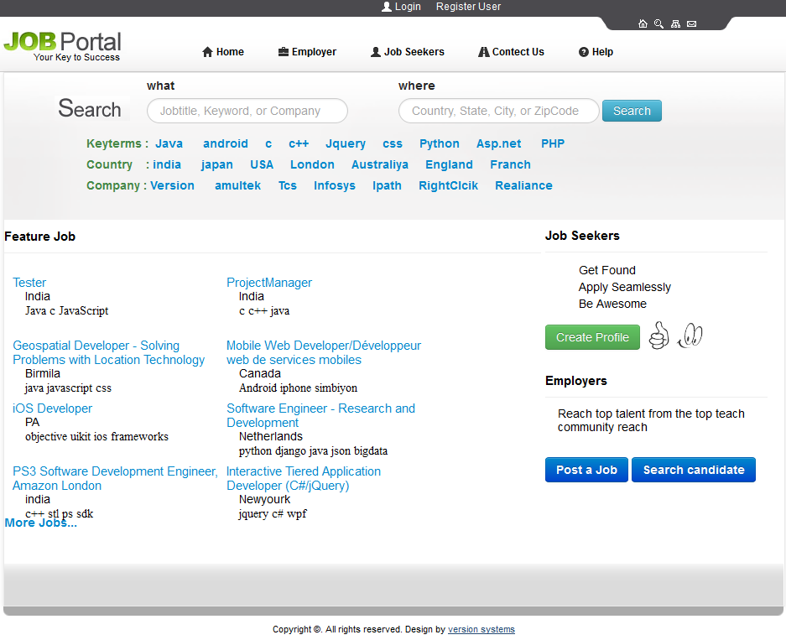
Job Detail:
Home Page

Slide 23
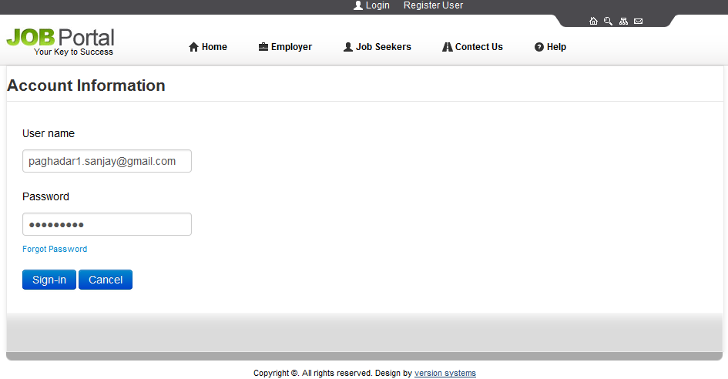
Admin Login Page:

Slide 24
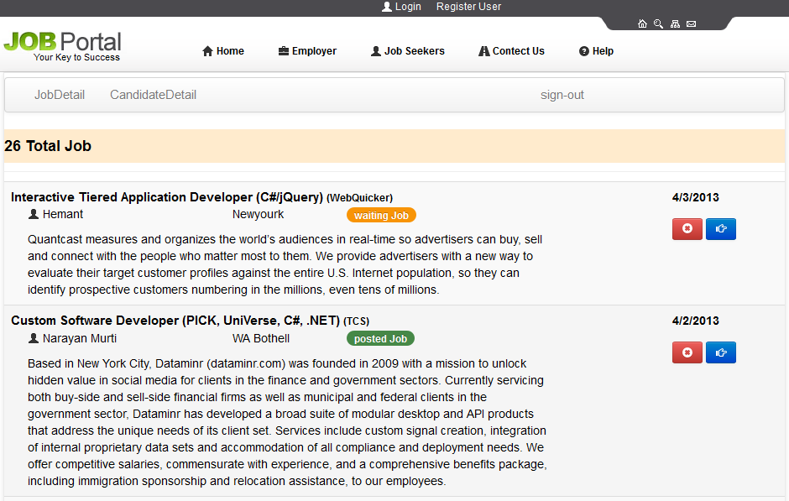
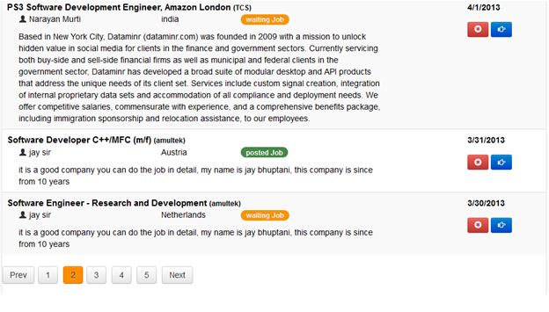
Operation for Posted job:

Slide 25
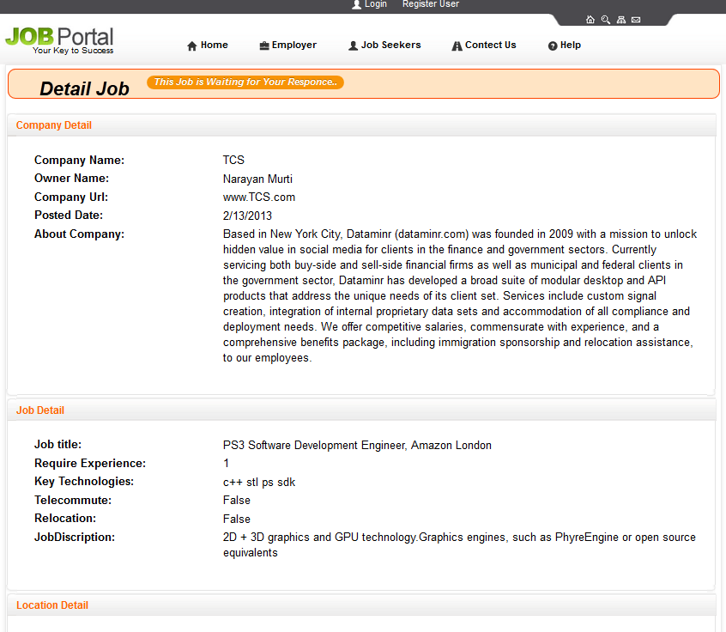
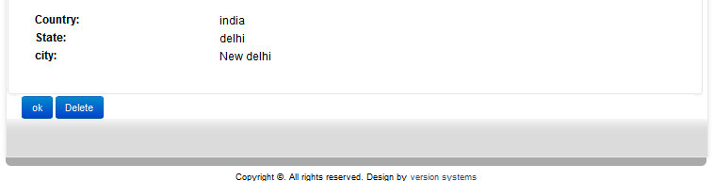
Job Detail:

Slide 26
Job Seeker

Slide 27
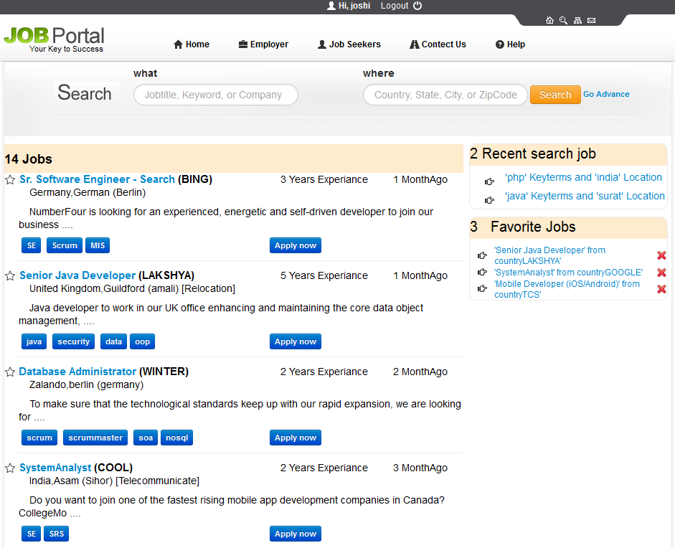
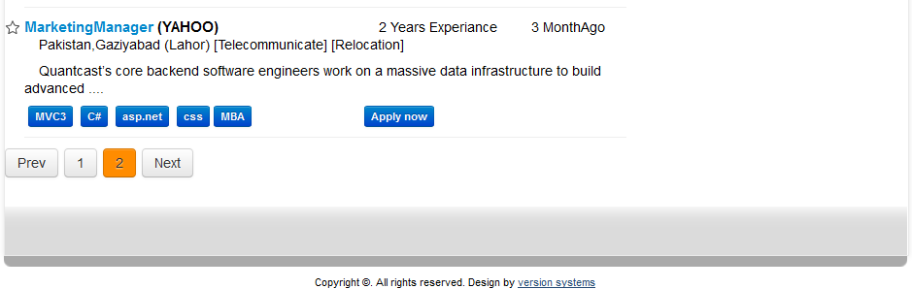
Search Job

Slide 28
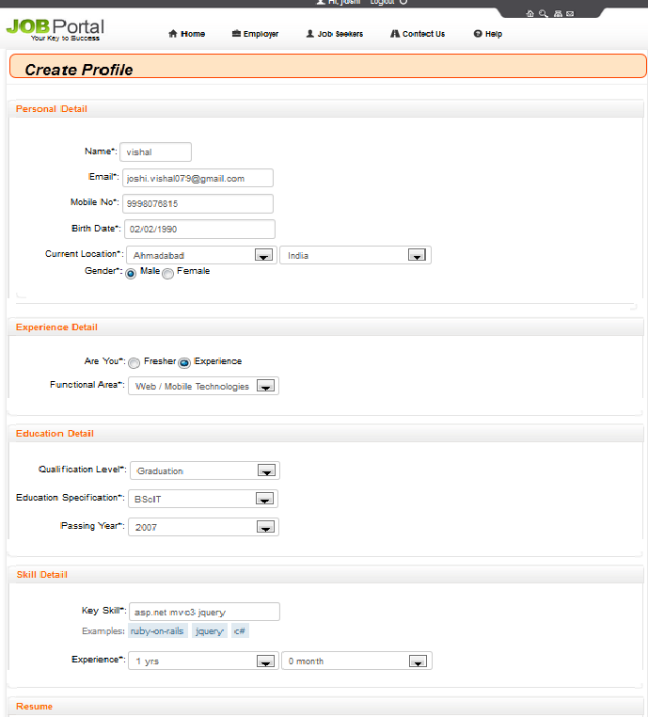
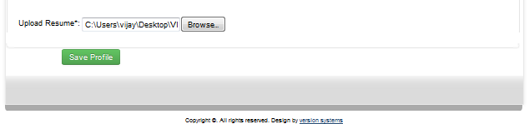
Create Candidate Profile

Slide 29
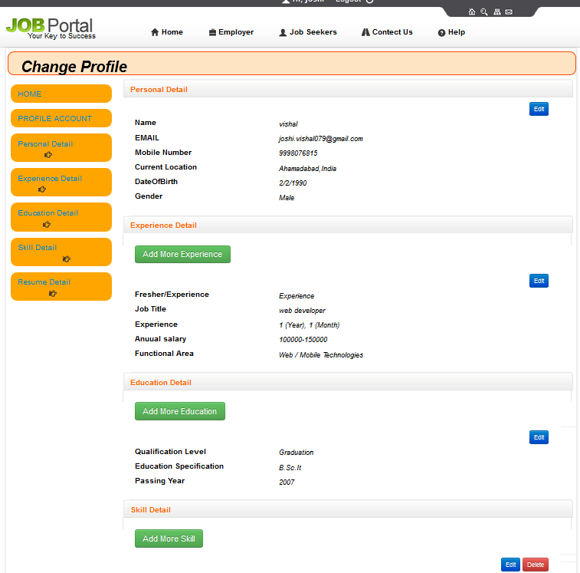
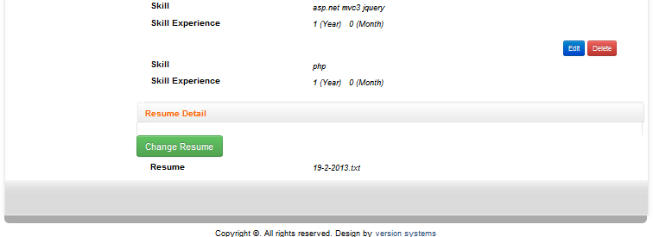
Candidate Profile

Slide 30
Job Provider

Slide 31
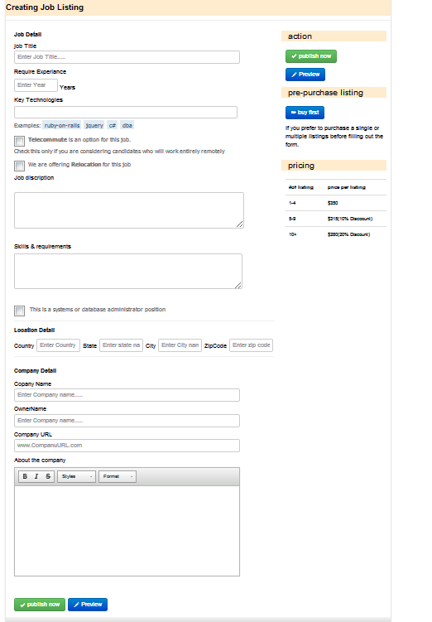
Post Job

Slide 32
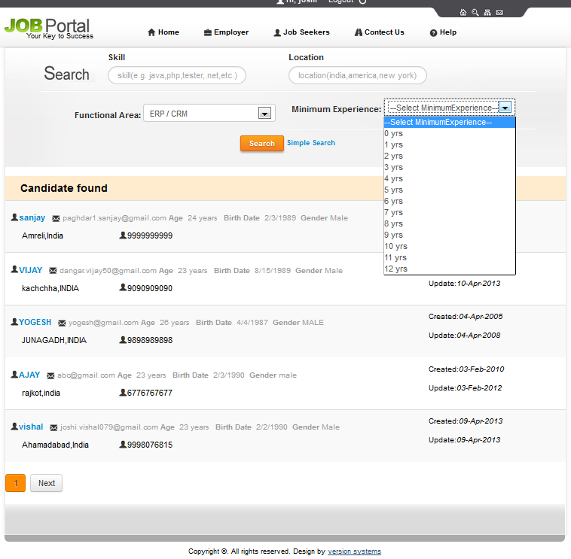
Candidate Search

Slide 33
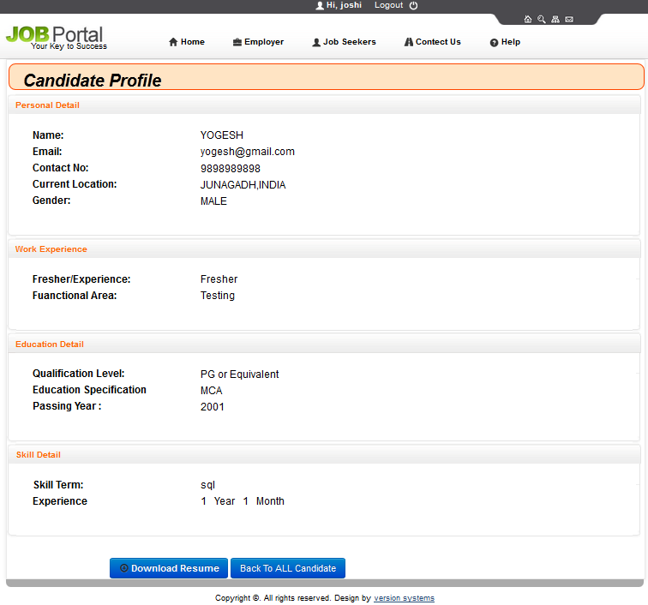
Candidate Profile Detail

Slide 34
Limitations
The size of the database increases day-by-day, increasing the load on the database back up and data maintenance activity.
The big players like careers.stackoverflow.com and shine.com could not be approached directly and thus were studied on the basis of secondary data.
Write now Our web-application is only for I.T sector candidates.

Slide 35
Future Improvement
This System being web-based and an undertaking of Cyber Security Division, needs to be thoroughly tested to find out any security gaps.
Moreover , it is just a beginning ;further the system may be utilized other then I.T sector.

Slide 36
Conclusion
The wider areas of job searching facilitate the quick and easy access to opportunities. The increasing job opportunities and changing scenario of the business environment today has made more people to search for better career and employers to search for better potential.
This situation has prompted many to move to job portals to look for the ways that has been widely accepted and fully useful in job searching. In this sense the job portals assumes greater importance and we could develop such an efficient system which is used by lot many job hunters and employers.

Slide 37
Thank You
?

