Slide 1
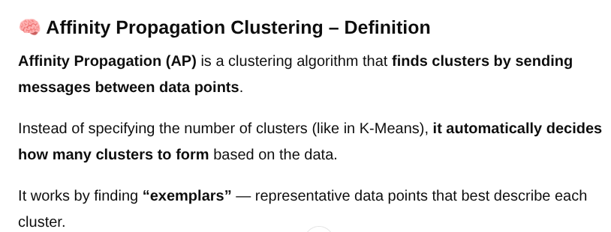
1

Slide 2
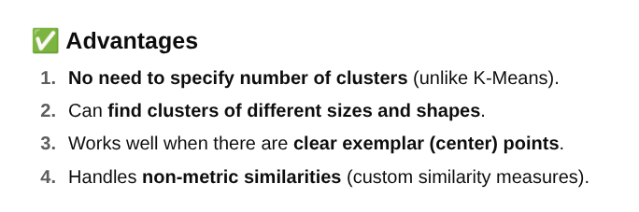

Slide 3
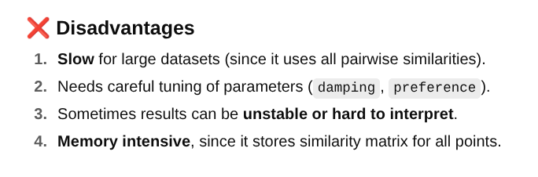

Slide 4
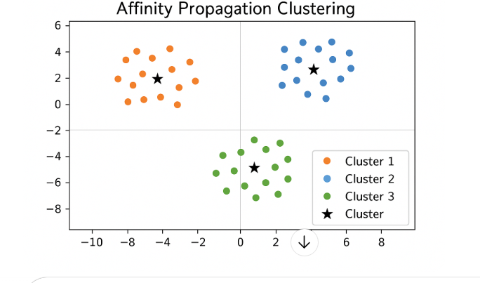
From sklearn.cluster import AffinityPropagation

Slide 5
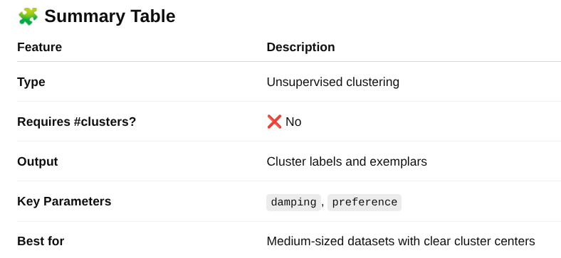

Slide 6
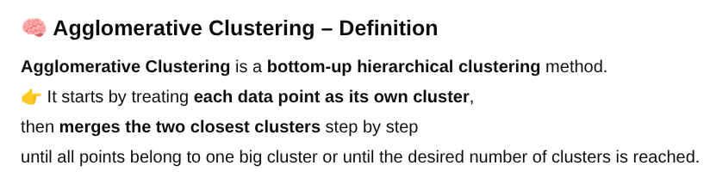
2

Slide 7
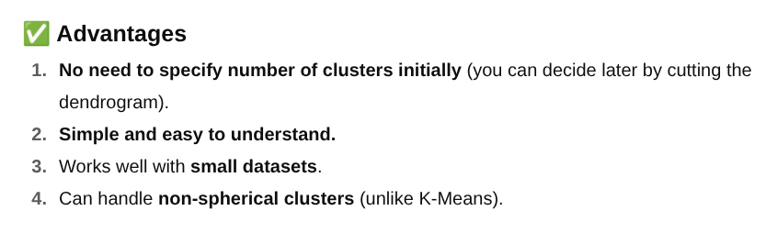

Slide 8
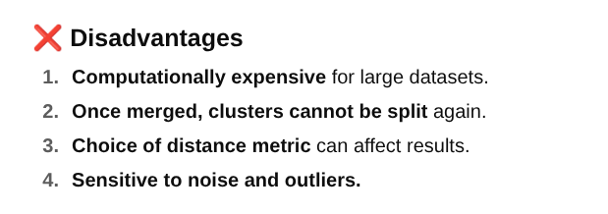

Slide 9
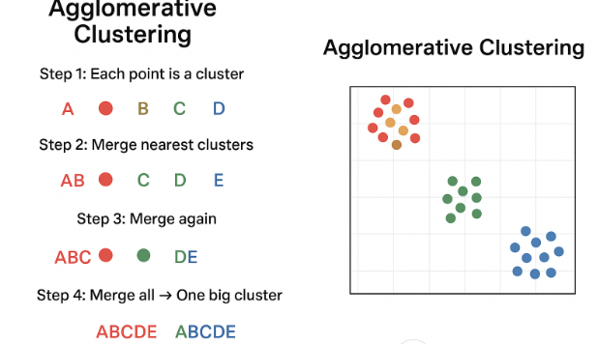
from sklearn.cluster import AgglomerativeClustering

Slide 10
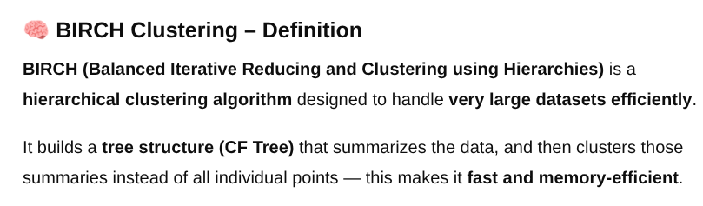
3

Slide 11
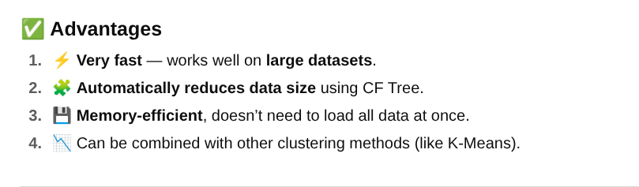

Slide 12
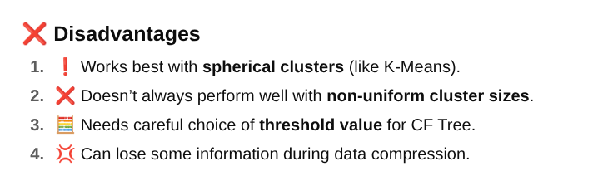

Slide 13
from sklearn.cluster import Birch
📊 Summary Table
Feature | Description
Full Form | Balanced Iterative Reducing and Clustering using Hierarchies
Type | Hierarchical + Summarization
Handles Large Data? | ✅ Yes
Best for | Large datasets with spherical clusters
Output | Cluster labels
Key Parameter | threshold (controls cluster size)

Slide 14
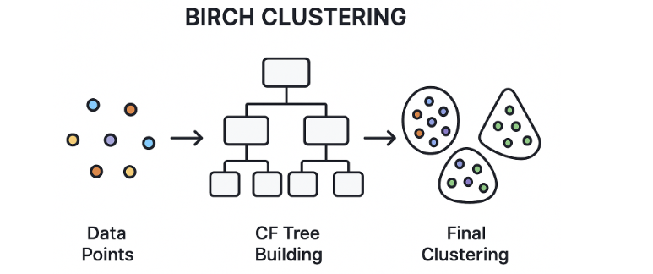

Slide 15
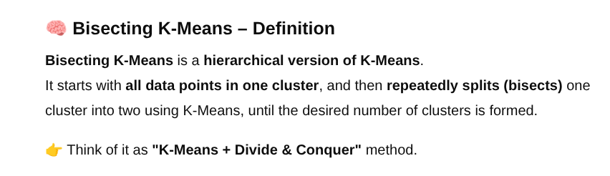
4

Slide 16
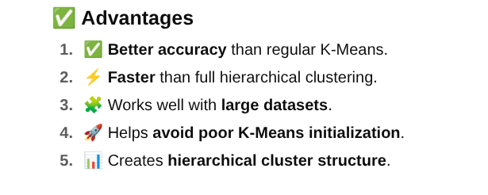

Slide 17
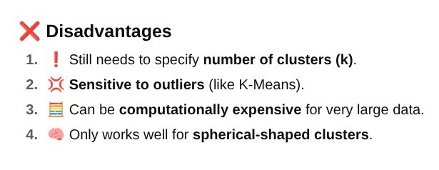

Slide 18
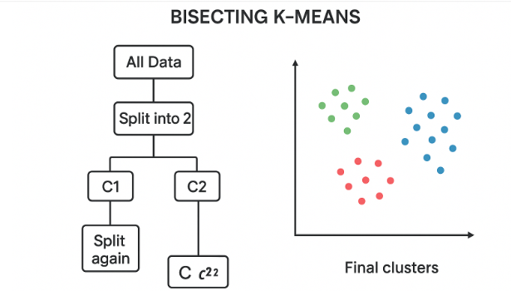
from sklearn.cluster import BisectingKMeans

Slide 19
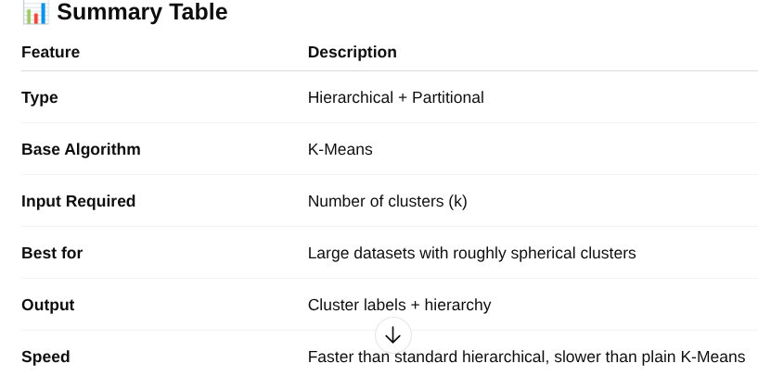

Slide 20
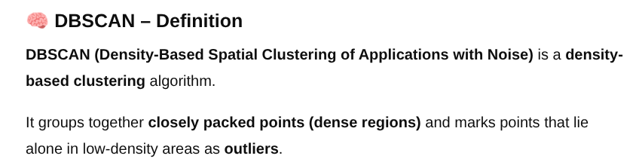
5

Slide 21
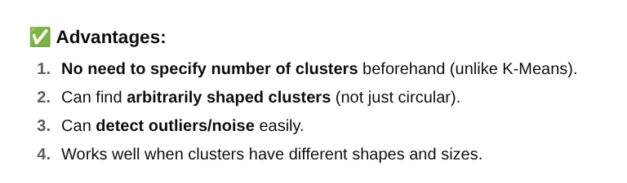

Slide 22
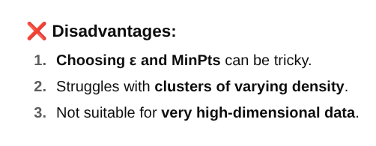

Slide 23
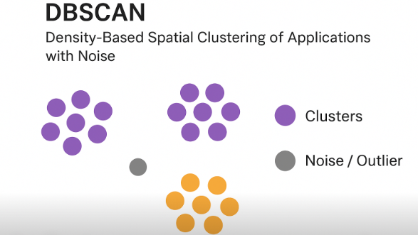
from sklearn.cluster import DBSCAN

Slide 24
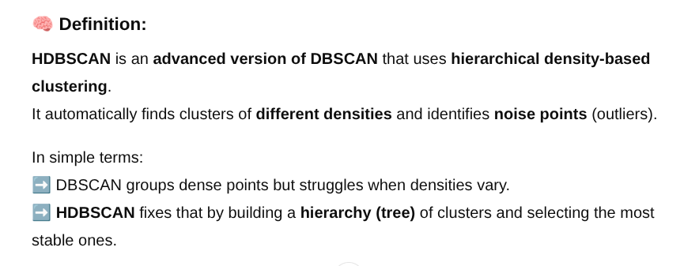
6

Slide 25
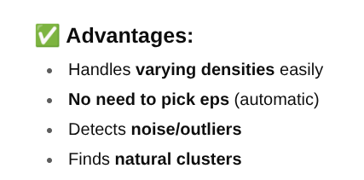

Slide 26
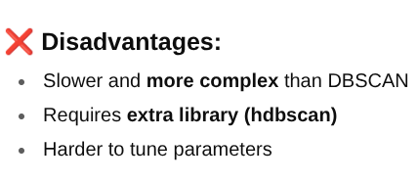

Slide 27
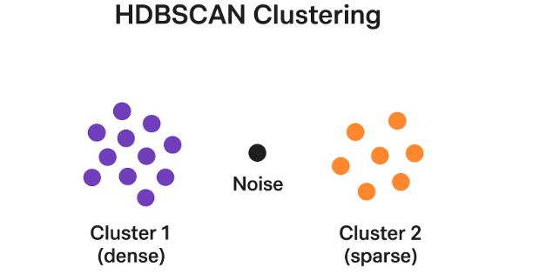
from sklearn.cluster import HDBSCAN

Slide 28
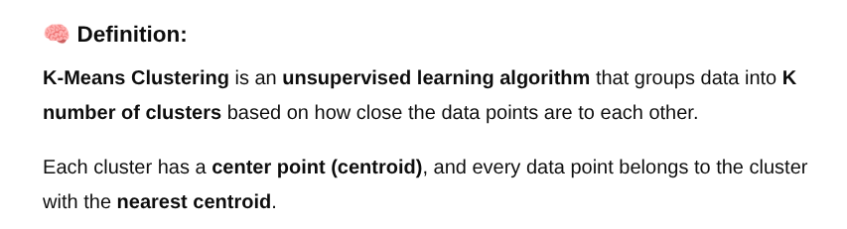
7

Slide 29
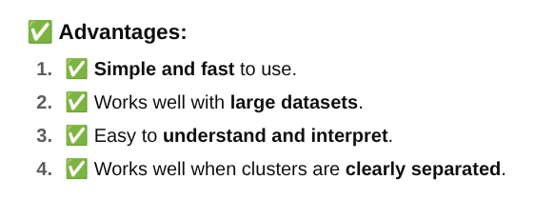

Slide 30
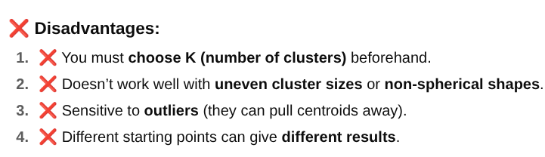

Slide 31
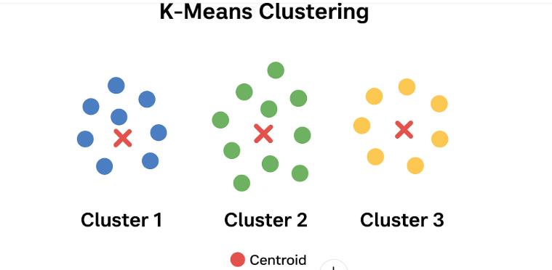
from sklearn.cluster import KMeans

Slide 32
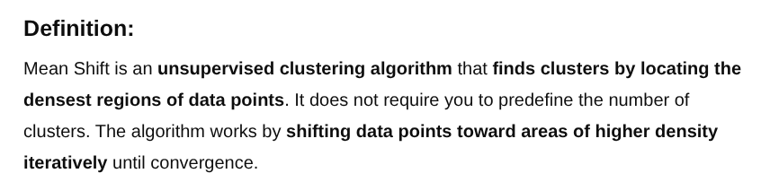
8

Slide 33
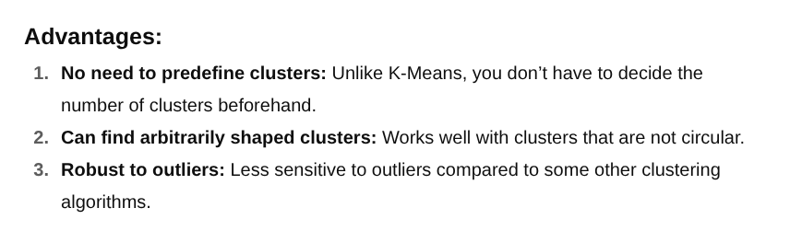

Slide 34
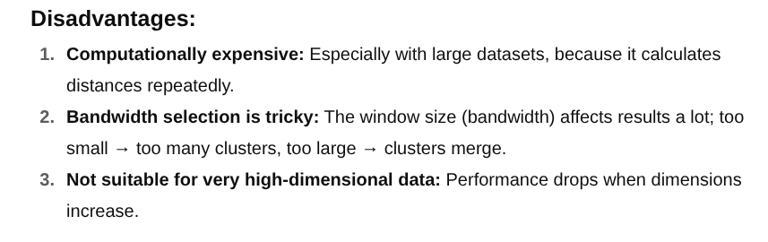

Slide 35
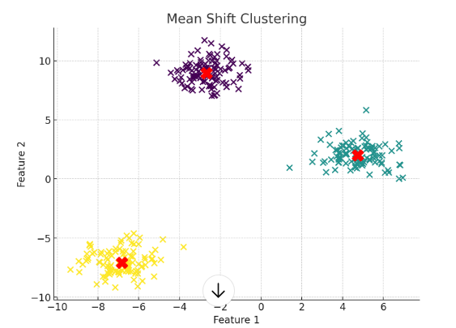
from sklearn.cluster import Mean Shift Clustering
Colored points represent the data points.
Different colors show different clusters discovered by the algorithm.
Red Xs are the cluster centers found by Mean Shift.

Slide 36
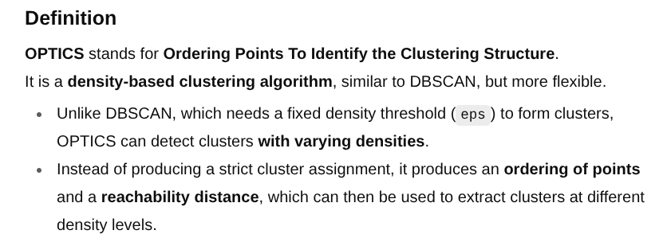
9

Slide 37
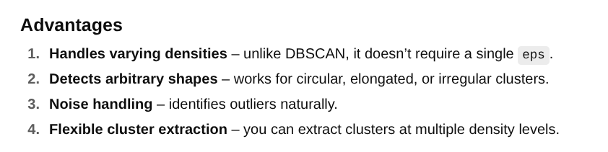

Slide 38
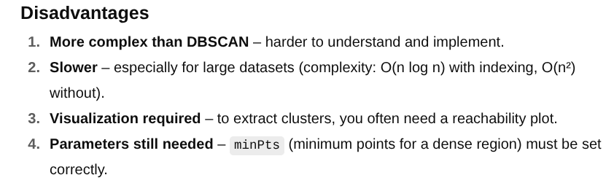

Slide 39
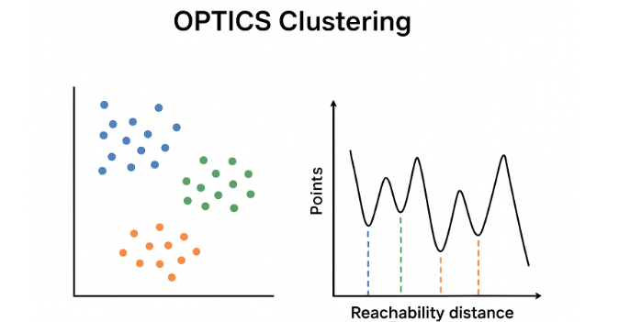
from sklearn.cluster import OPTICS

Slide 40
10

Slide 41
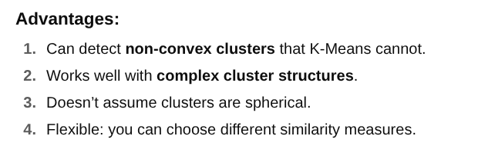

Slide 42
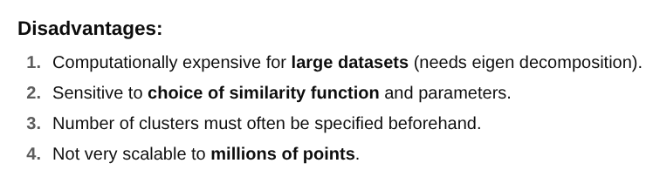

Slide 43
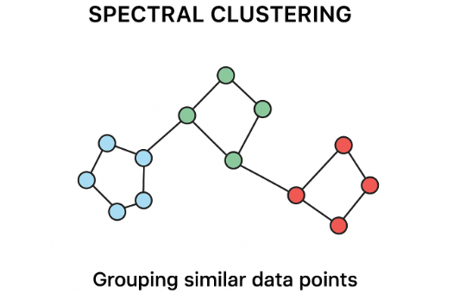
from sklearn.cluster import
SpectralCustering

Slide 44
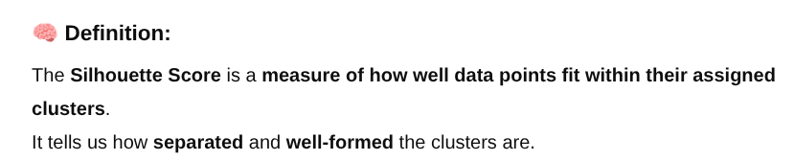
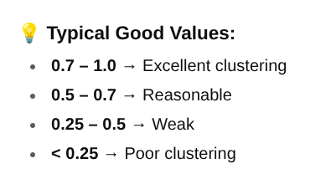

Slide 45
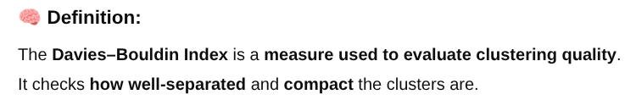
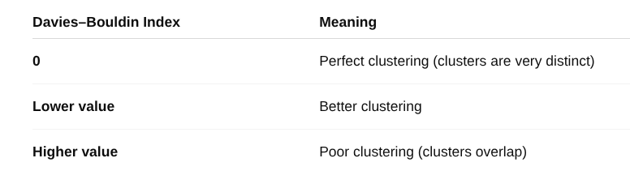

Slide 46
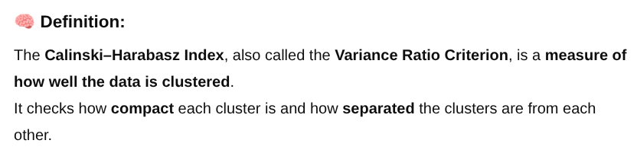
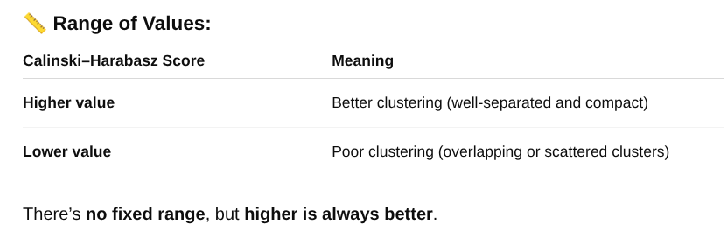

Slide 47
Clustering Name | Silhouette Score | Davies-Bouldin Index | Calinski-Harabasz Index | Better_Clustering?
AffinityPropagation_clustering | 0.432 | 0.753 | 264.4707125
Agglomerative_Clustering | 0.553 | 0.578 | 243.0714289
Birch_clustering | 0.323 | 0.288 | 1050.99371
BisectingKMeans_Clustering | 0.446 | 0.823 | 136.2364581
DBSCAN_Clustering | 0.096 | 6.71 | 2.020445139
HDBSCAN_Clustering | 0.405 | 1.794 | 57.35299571
MeanShift_Clustering | 0.271 | 0.216 | 1378.828452 | Better_Clustering
Optics_Clustering | 0.292 | 1.623 | 14.29378177
SpectralClustering | 0.340 | 1.333 | 18.96466618

