Slide 1
CAPSTONE PROJECT AI INTERVIEW PREPARATION ASSISTANT
Presented By:
Student Name: Neela Suguna College Name: A.V college of arts science & commerce Department: Master Of Computer Applications

Slide 2
PROBLEM STATEMENT
The interview preparation process can be challenging for students due to a lack of personalized guidance and instant feedback. Many candidates struggle to identify their strengths and weaknesses while practicing interview questions. The proposed AI Interview Preparation Assistant helps users prepare effectively by generating interview questions and evaluating answers automatically.
Objective:
• Develop an AI-based Interview Preparation Assistant that generates interview questions and evaluates candidate answers. • Provide instant feedback, strengths, weaknesses, and improvement suggestions to help users improve their interview performance.
Key Challenges:
• Lack of proper interview preparation resources. • Difficulty in evaluating answers without expert guidance. • Limited access to personalized feedback. • Lack of confidence in technical interviews. • Time-consuming manual interview practice. • Inability to identify areas that need improvement.

Slide 3
PROPOSED SOLUTION
The proposed system is an AI Interview Preparation Assistant designed to help students and job seekers improve their interview skills through automated question generation and answer evaluation.
Interview Question Generation
• Generate role-based interview questions. • Support multiple domains such as QA Testing, Java, Python, and Data Analytics. • Provide practice questions for technical interview preparation.
Answer Evaluation
• Analyze candidate responses automatically. • Generate scores based on answer quality. • Identify strengths and weaknesses in the response.
Feedback & Suggestions
• Provide instant feedback to users. • Suggest improvements for better interview performance. • Help candidates improve communication and technical skills.
Expected Outcome
• Improve interview readiness and confidence. • Reduce dependency on manual evaluation. .

Slide 4
System approach
System Requirements
• Windows Operating System • Python 3.x • Visual Studio Code (VS Code) • Internet Connection
Technologies Used
• Python Programming Language • Streamlit Framework • Git & GitHub
Libraries Required
• Streamlit • Requests • Pandas • NumPy

Slide 5
ALGORITHM & DEPLOYMENT
Algorithm Selection
• A rule-based answer evaluation algorithm is used to analyze user responses. • The system generates interview questions based on the selected job role.
Data Input
• Job Role Selection (QA Tester, Java Developer, Python Developer, Data Analyst) • Interview Question • Candidate Answer
Processing
• User selects a job role. • System displays relevant interview questions.
• User enters the answer. • Answer evaluation module analyzes the response based on content quality and completeness.
Evaluation Process
• Generate score out of 10. • Identify strengths and weaknesses. • Provide improvement suggestions. • Display evaluation report to the user.
Deployment
• Developed using Python and Streamlit. • Executed on Local Host environment. • Source code maintained using GitHub Repository. • Future deployment can be done through Streamlit Cloud or cloud platforms.

Slide 6
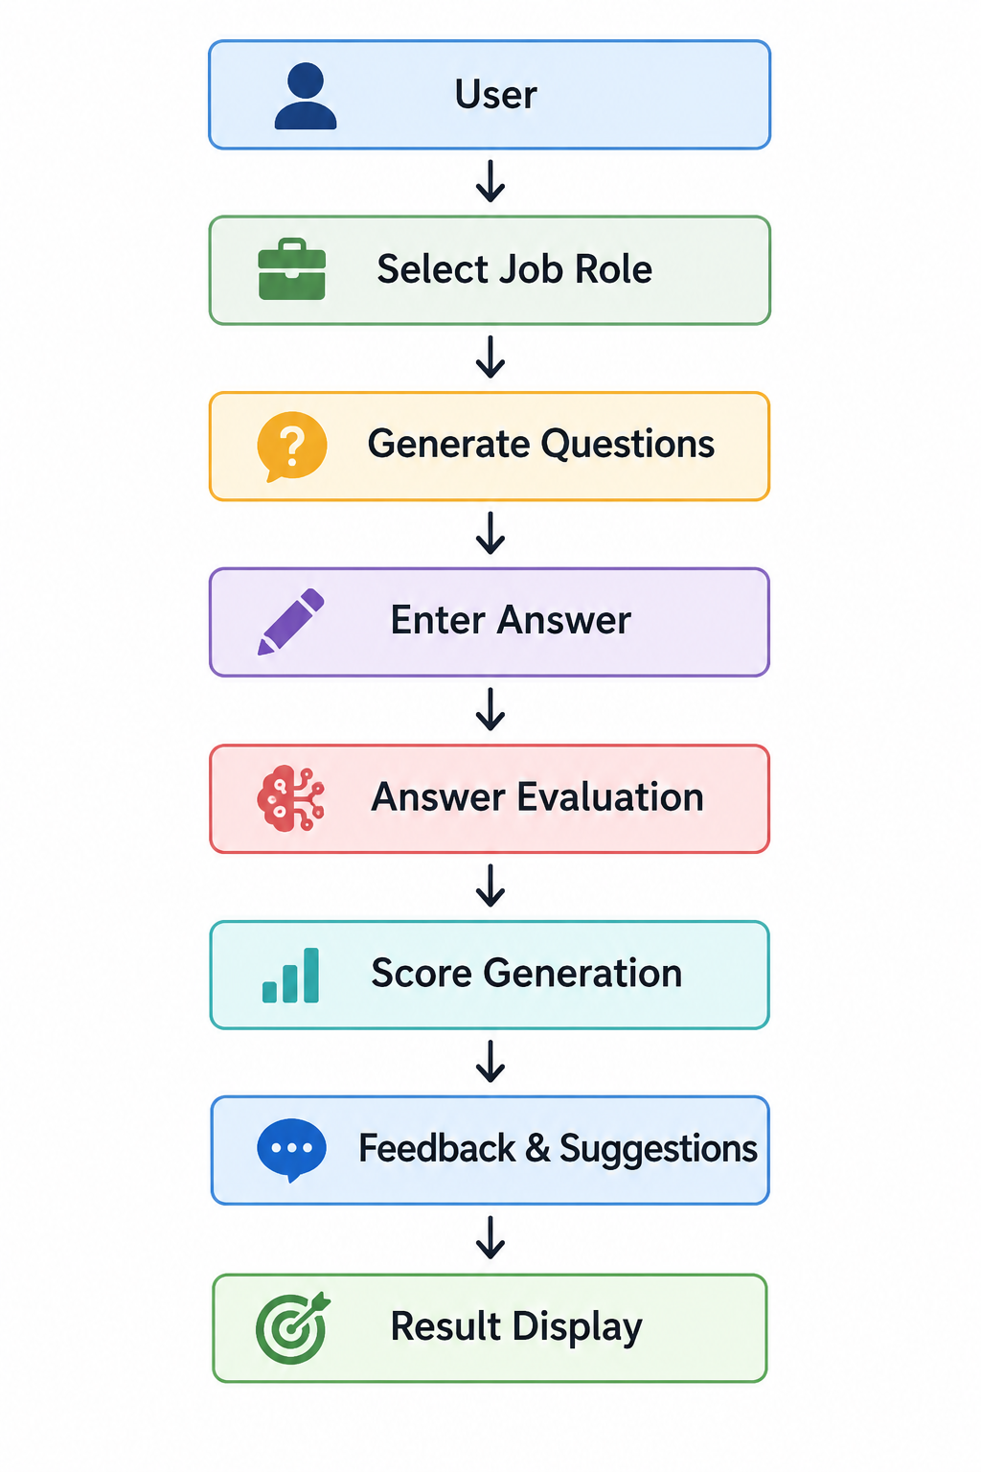
Workflow

Slide 7
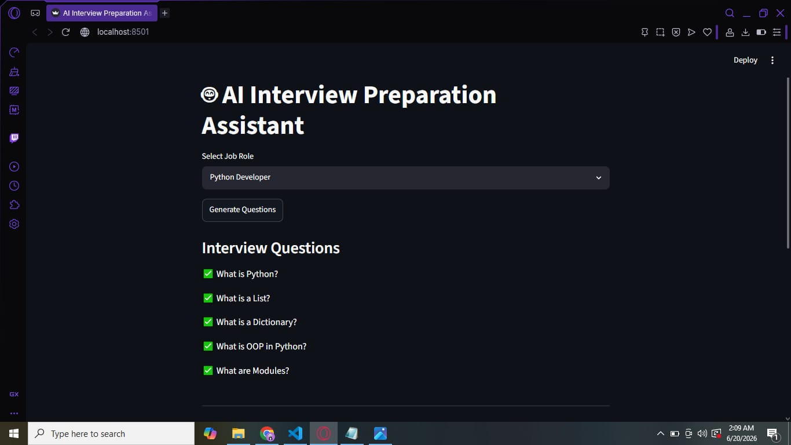
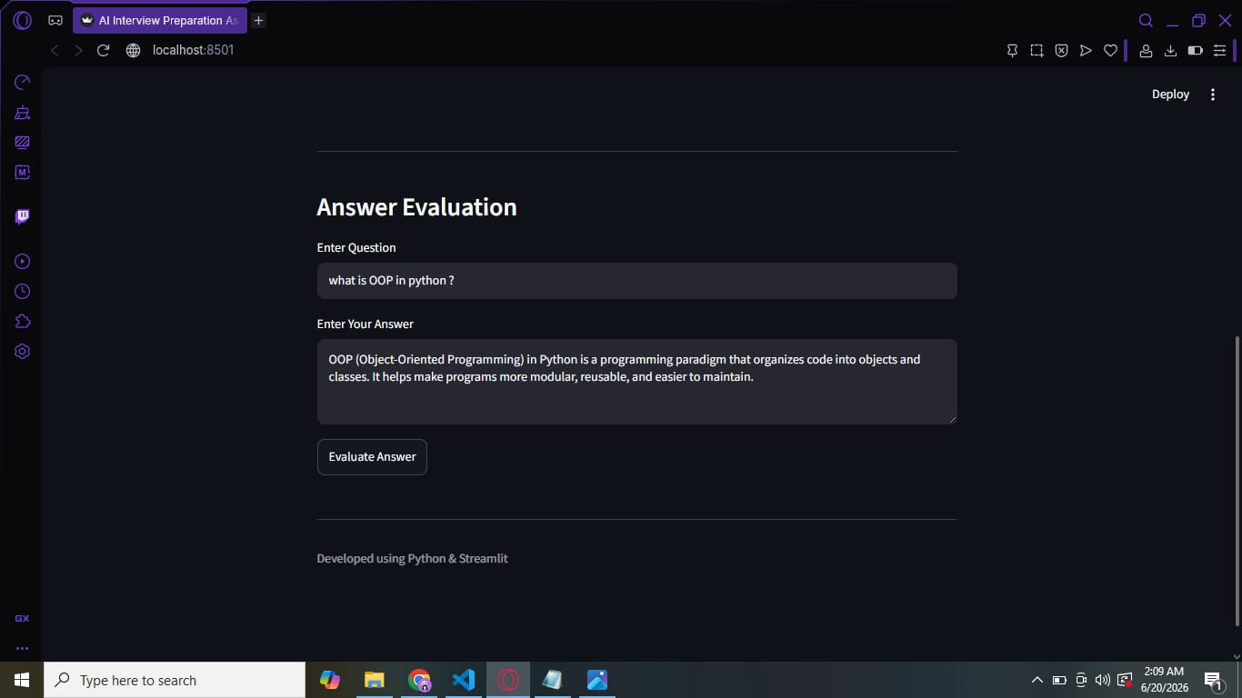
Result
Interview Questions Generation
Answer Evaluation Interface

Slide 8
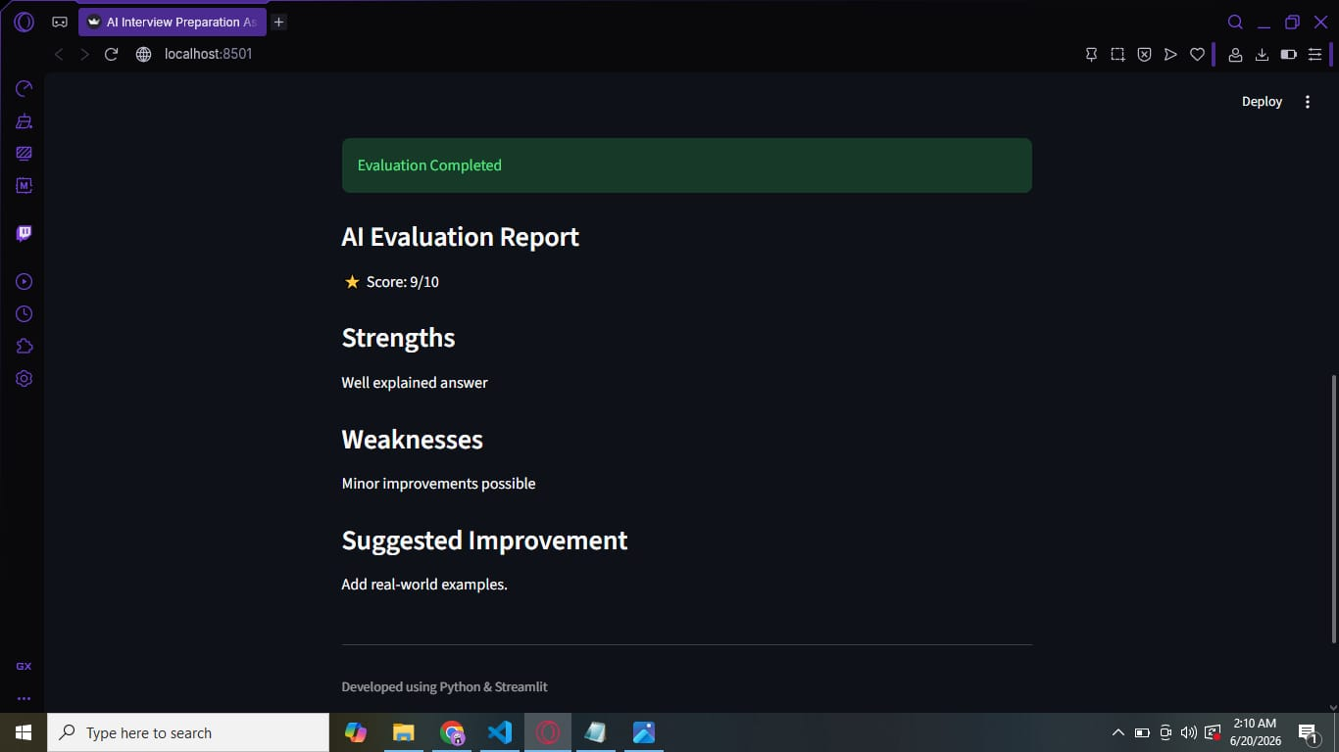
Successfully generated role-based interview questions.
Evaluated candidate answers automatically.
Generated score and feedback.
Identified strengths and weaknesses.
Provided improvement suggestions.
Developed a user-friendly Streamlit application.
Evaluation Report with Feedback

Slide 9
Conclusion
The AI Interview Preparation Assistant was successfully developed using Python and Streamlit.
The system generates role-based interview questions for various job profiles such as QA Tester, Java Developer, Python Developer, and Data Analyst.
It enables users to practice interview questions and evaluate their answers effectively.
The application provides scores, strengths, weaknesses, and improvement suggestions to enhance interview performance.
The project offers a simple, interactive, and user-friendly platform for interview preparation.
This solution helps candidates improve their technical knowledge, communication skills, and confidence before attending interviews.

Slide 10
Future Scope
Integrate advanced AI models such as Gemini AI, IBM Granite, or OpenAI GPT for more accurate answer evaluation.
Add mock interview simulations with real-time AI-generated questions and responses.
Implement speech-to-text and voice-based interviews to improve communication skills.
Provide personalized learning recommendations based on user performance.
Generate detailed performance analytics and progress reports.
Support additional job roles and technical domains for broader interview preparation.
Deploy the application on cloud platforms for easy online access.
Add resume analysis and interview question generation based on uploaded resumes.
Integrate certification and placement preparation modules to enhance career readiness.

Slide 11
References
Python Documentation https://docs.python.org/3/
Streamlit Documentation https://docs.streamlit.io/
Hugging Face Documentation https://huggingface.co/docs
Hugging Face Models https://huggingface.co/models
Visual Studio Code https://code.visualstudio.com/
GitHub https://github.com/

Slide 12
GitHub Link /Deployment Link
GitHub Link : https://github.com/suguna-44/AI-Interview-Preparation-Assistant
Deployment Link: https://ai-interview-preparation-assistant-g2devvrpzkwhq2l8j6jyap.streamlit.app/

Slide 13
THANK YOU!

