Slide 1
Title : Coupon Recommendation System using CatBoost ML model: Coupon Accepted Vs Rejected
Problem Statement:
This data was collected via a survey on the Ecom website Mechanical Turk. The survey describes different driving scenarios including the user’s destination, current time, weather, passenger, coupon attributes, user attributes, and contextual attributes, and then asks the user whether he/she will accept the coupon or not.
Objective/Goal:
The goal of the Coupon Recommendation System project is to build a machine learning model that can accurately predict whether a user will accept a coupon offer, based on their personal attributes, lifestyle habits, and driving context.
Business Impact: Helps optimize targeted promotions and improve redemption rates.

Slide 2
Will a Customer Accept the Coupon?
Context
Imagine driving through town and a coupon is delivered to your cell phone for a restaurant near where you are driving.
Would you accept that coupon and take a short detour to the restaurant?
Would you accept the coupon but use it on a subsequent trip?
Would you ignore the coupon entirely?
What if the coupon was for a bar instead of a restaurant?
What about a coffee house?
Would you accept a bar coupon with a minor passenger in the car?
What about if it was just you and your partner in the car?
Would weather impact the rate of acceptance? What about the time of day?
Obviously, proximity to the business is a factor on whether the coupon is delivered to the driver or not, but what are the factors that determine whether a driver accepts the coupon once it is delivered to them? How would you determine whether a driver is likely to accept a coupon?

Slide 3
Problem Definition
Businesses often distribute promotional coupons to attract customers, but many of these offers go unused, leading to wasted marketing efforts and lost revenue. The challenge is to predict whether a customer will accept a coupon based on their demographic profile, behavioral patterns, and contextual driving conditions.
This project aims to build a machine learning model that can:
Analyze customer attributes (e.g., age, income, marital status)
Understand behavioral habits (e.g., frequency of visiting bars, coffee houses, restaurants)
Factor in travel context (e.g., weather, direction, driving time)
Predict the likelihood of coupon acceptance
By accurately forecasting coupon acceptance, businesses can:
Target the right customers with relevant offers
Increase redemption rates
Optimize marketing spend
Enhance customer engagement and satisfaction
2. Data collection – Simulated driving scenarios where users were offered coupons
Captured demographics (age, income, education, marital status)
Logged behavioral habits (visits to bars, coffee houses, restaurants)
Included contextual data (weather, direction, travel time)
Recorded whether the coupon was accepted or rejected
Purpose: To build a predictive model that understands how personal traits and driving context influence coupon acceptance.
ML Model Life cycle
Problem Definition
Data Collection
Data Preprocessing
Model Selection
Model Training
Model Evaluation
Model Deployment

Slide 4
3.Data Preprocessing Steps
1.Duplicate Removal
Removed 291 duplicate rows
Final dataset: 12,393 rows
2.Missing Value Handling
Dropped car column (99% missing)
Imputed remaining missing values:
  Mode for categorical features
  Median for numerical features
3. Feature Cleaning
Dropped toCoupon_GEQ5min (only 1 unique value)
Income Cleaning
Converted messy strings like:
  "37500-49999", "Lessthan12500", "100000 or More"
Used clean_income() function to extract and standardize numeric values
4.Outlier Detection
Applied IQR method to numerical features
No significant outliers found
5. Categorical Encoding
For models like Logistic Regression & KNN:
  Used Label Encoding
For CatBoost:
  Passed raw categorical columns directly
6 Feature Scaling
Applied StandardScaler only to models that require it:
  Logistic Regression
  KNN
Goal: Prepare clean, consistent, and model-ready data for accurate predictions

Slide 5
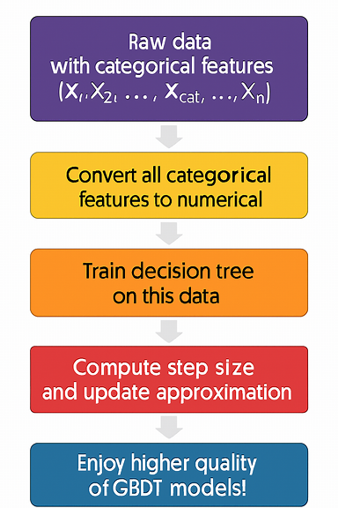
4.Model Selection: Reason for choosing CATBOOST Algorithm
Handles categorical features natively → No need for manual encoding
High accuracy with minimal preprocessing → Outperforms traditional models on mixed data
Robust to overfitting → Uses ordered boosting and regularization
Built-in feature importance → Helps interpret model decisions
Fast and scalable → Efficient even on medium-sized datasets
CatBoost Workflow (Step-by-Step)
Raw Data Input → Includes both numerical and categorical features
Categorical Feature Conversion → Uses ordered statistics to convert categories
to numeric values
Train Decision Trees → Builds trees using gradient boosting framework
Compute Step Size & Update Approximation → Optimizes predictions iteratively
Final Model Output → High-quality predictions with built-in feature importance

Slide 6
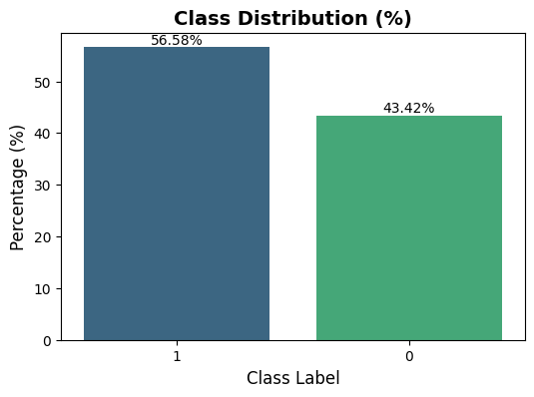
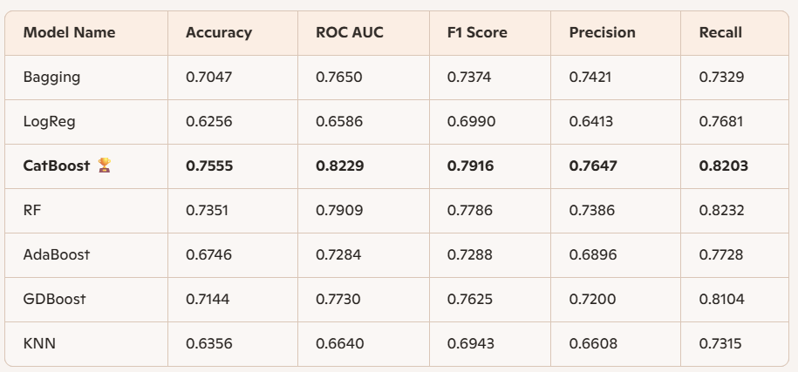
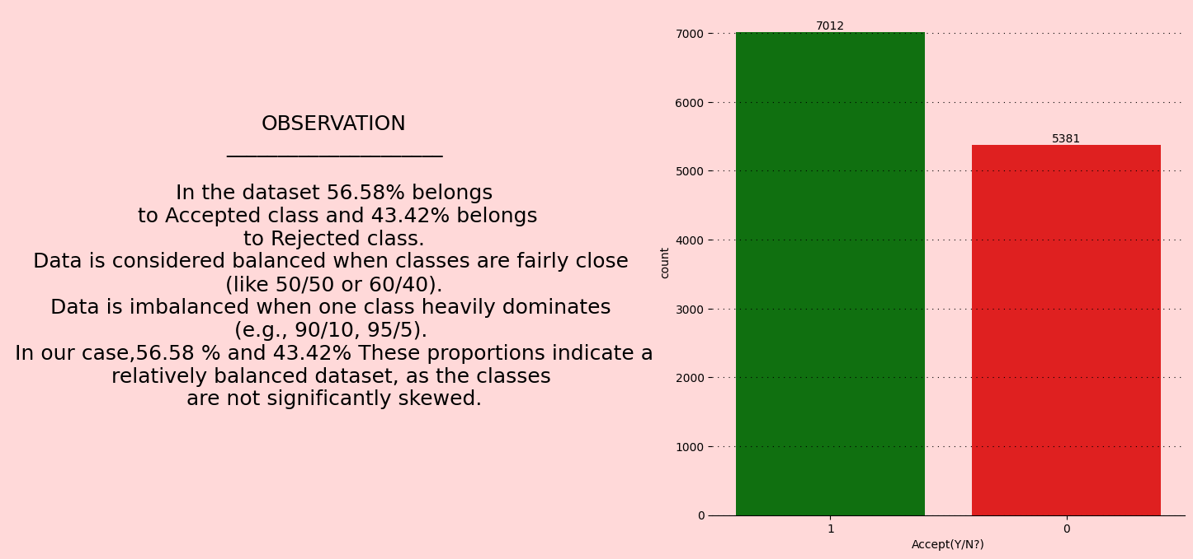
5.Model Training
Logistic Regression
Random Forest
CatBoost
KNN
AdaBoost
Gradient Boosting
6. Model Evaluation
Evaluate using:
Accuracy
ROC AUC
F1 Score
Precision
Recall

Slide 7
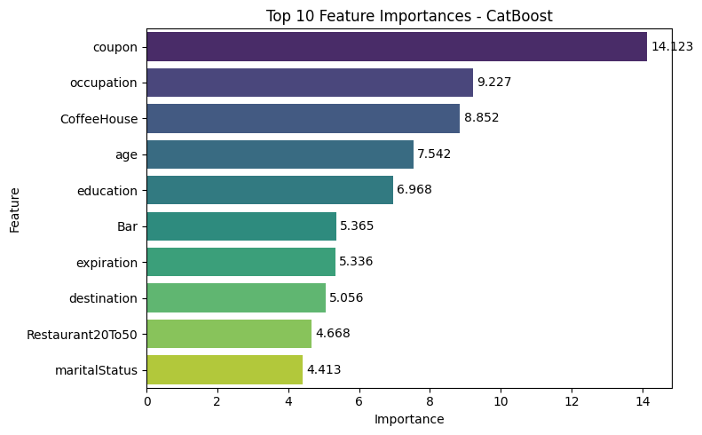
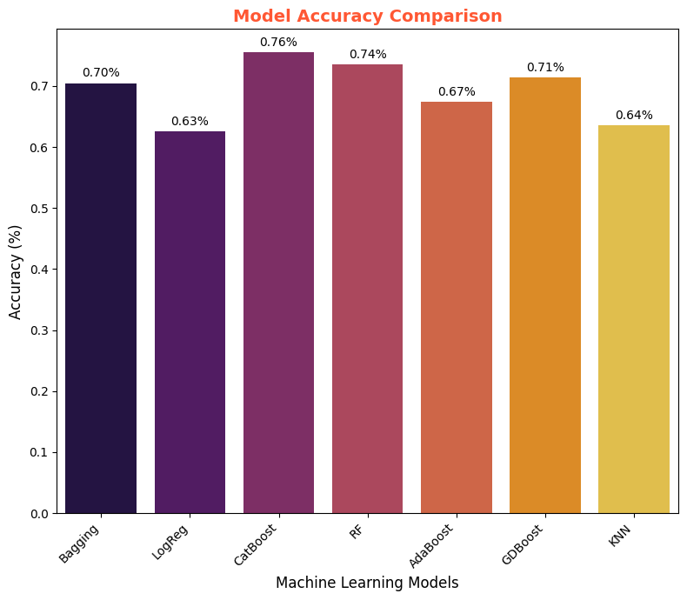

Slide 8
Key Observations from CatBoost Model
Superior Performance
Highest Accuracy: 75.55%
Best ROC AUC: 82.29%
Strong F1 Score: 79.16%
Outperforms all other models across key metrics
Balanced Precision & Recall
Precision: 76.47%
Recall: 82.03%
Indicates strong ability to correctly identify
both accepted and rejected coupons
Feature Importance Insights
Top predictors of coupon acceptance:
Coupon type
Occupation
CoffeeHouse visits
Age
Education
Bar visits
Expiration
Destination
Restaurant20To50 visits
Marital Status
Efficient Training
Minimal preprocessing required
Handled categorical features natively
GridSearch tuning improved model generalization
CatBoost is the most reliable and interpretable model for predicting coupon acceptance in this dataset.

