Slide 1
Marketing to decrease the predicted churn
Optimization & Proc. Analytics
Team: Suprajah Suresh, Yang Liu, Jiawei Xue,
Sucharitha Batchu, Suguna Bontha
Instructor: Alkiviadis Vazacopouls
Dec 3rd,2018

Slide 2
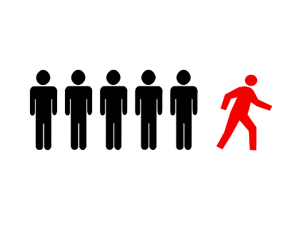




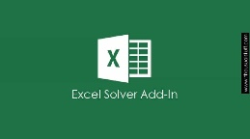
Introduction
Motivation
Technologies
Processing
Data Understanding
Machine Learning
Optimization
Demo

Slide 3
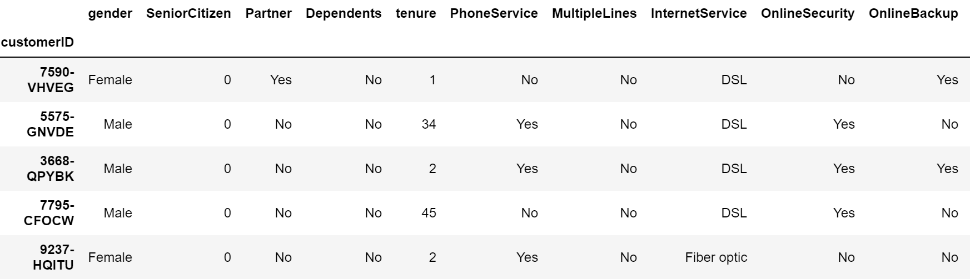
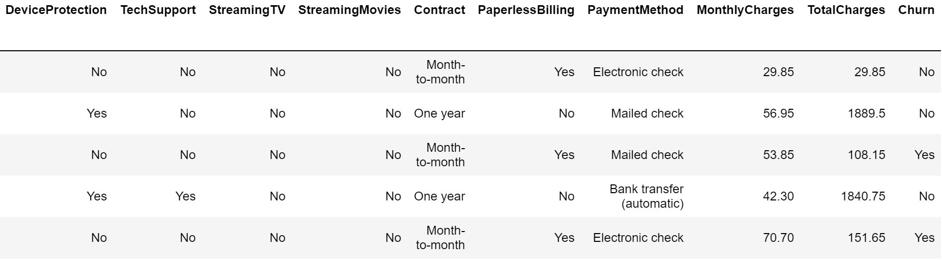
Dataset Overview
Part 1
Part 2

Slide 4
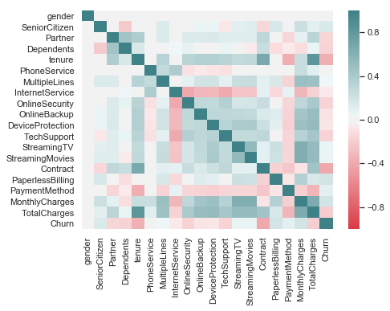
Data Understanding
Correlation Matrix

Slide 5
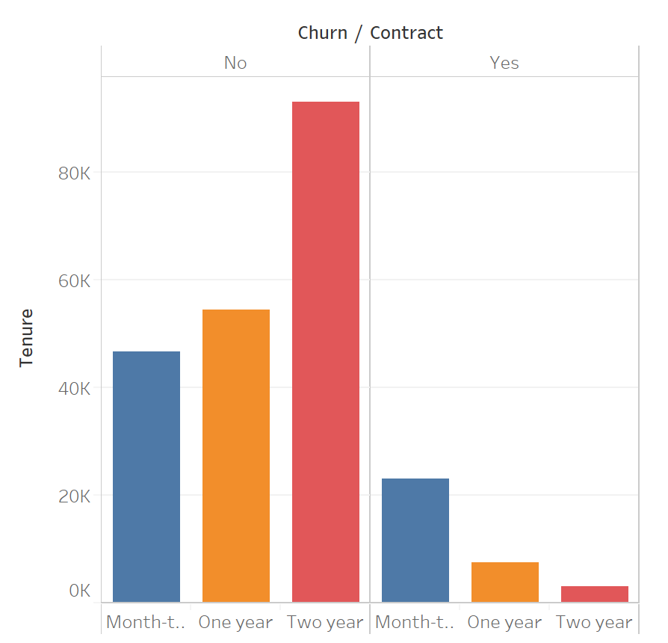
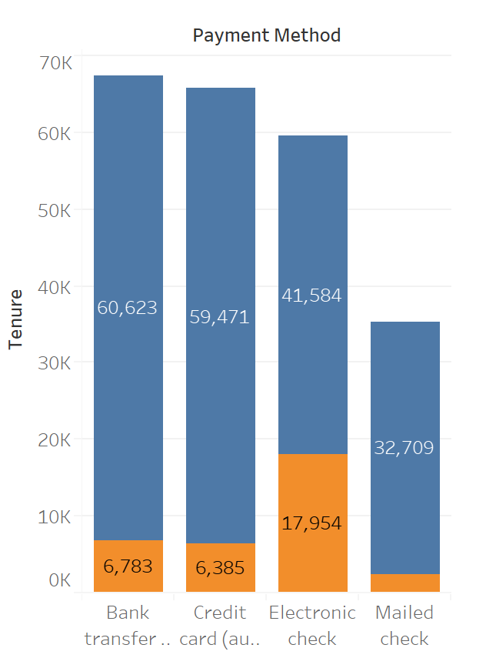
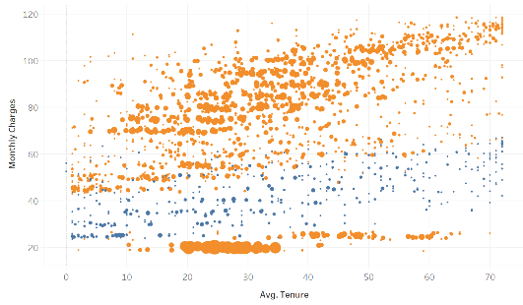
Identifying Relationships

Slide 6

Identifying Relationships

Slide 7
Churn Prediction Modeling
Model Preparation
Classification Algorithm
Split data
Training set : Testing set=4:1
Fit model
Validation
Algorithm
KNN
Logistic Regression
Random Forest
AdaBoost
Naïve Bayes
LDA

Slide 8
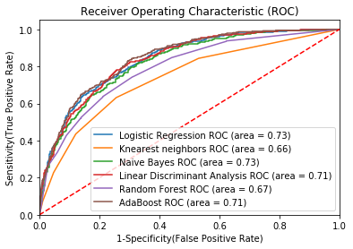
Modeling Results

Slide 9
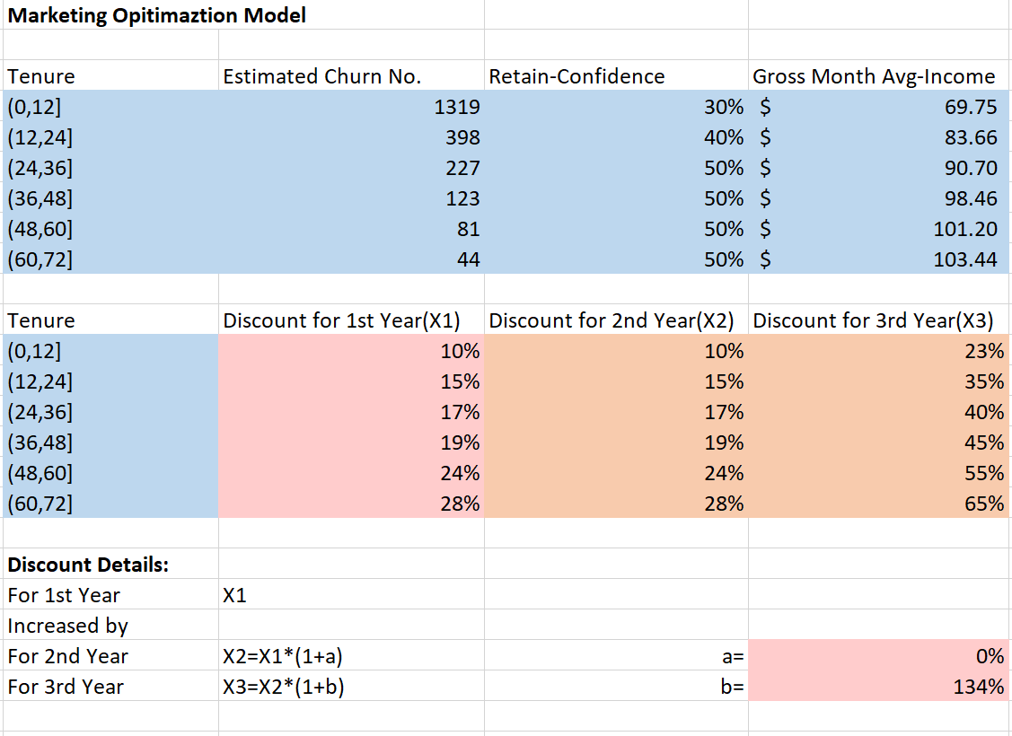
Optimization

Slide 10
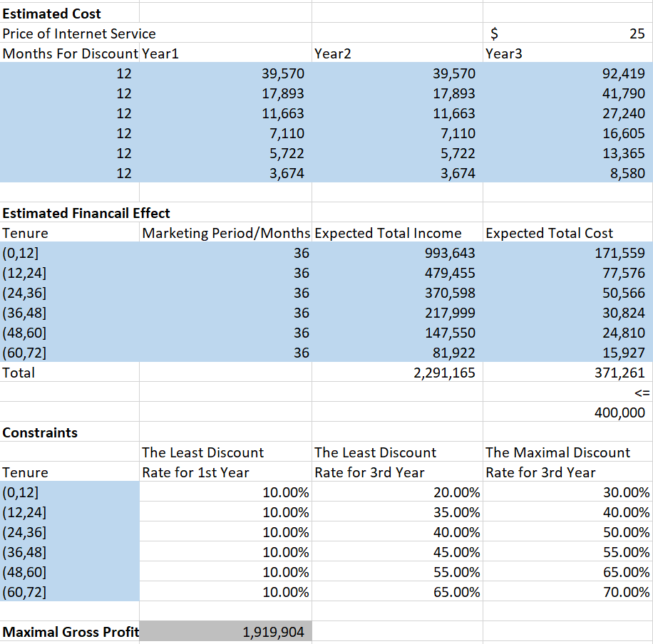
Optimization

Slide 11
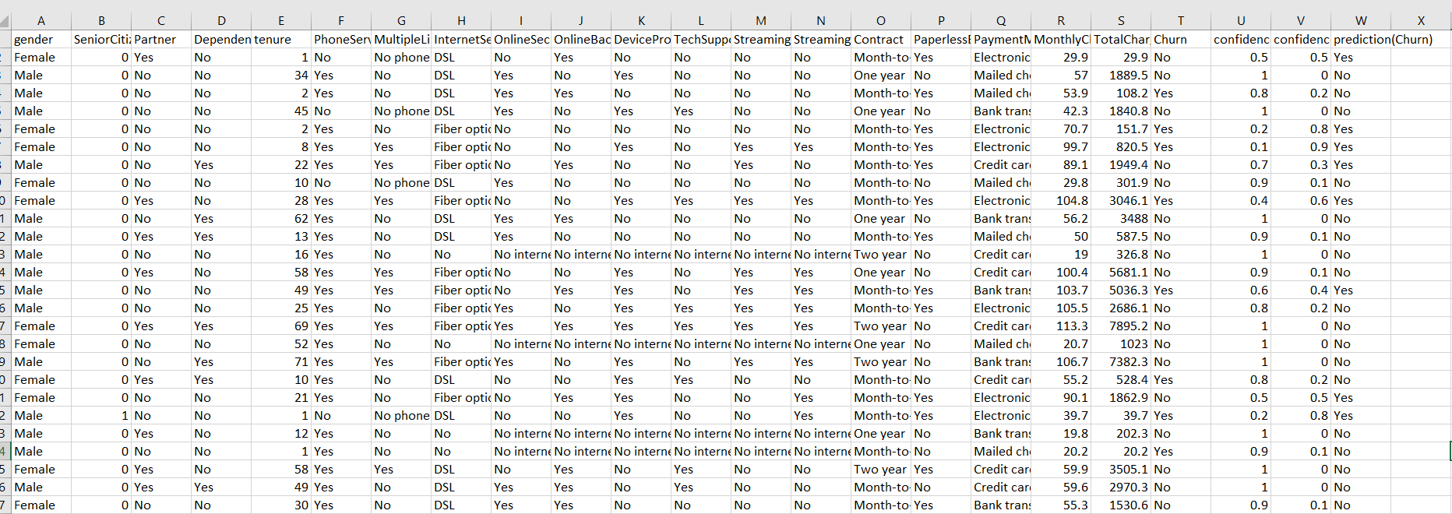
Churn probability prediction

Slide 12
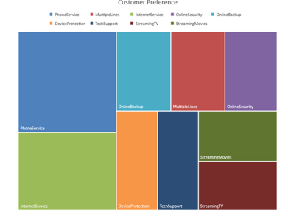
Services Visualization
Internet and Phone Services are the most widely used.
Aimed to advertise to internet services

Slide 13
Demo

Slide 14
Conclusion & Future Work
Use of realistic retention probabilities to obtain more accurate profits.
Include different marketing strategies based on clustering.
Create graphs based on varying input budget and cost per advertisement
Customizable retention probabilities to get best case and worst case scenarios.

Slide 15
Thank you!

Slide 16
Yang Liu, yliu249@stevens.edu
Jiawei Xue, jxue4@stevens.edu
Suprajah Suresh,
Sucharitha Batchu,
Suguna Bontha

