Slide 1
Employee Data Analysis using Excel
STUDENT NAME: Suguna.N
REGISTER NO: 2213391036257 / 9001684919
DEPARTMENT: B.COM COMMERCE
COLLEGE : QUEEN MARY'S COLLEGE

Slide 2
PROJECT TITLE
Employee Performance Analysis using Excel

Slide 3


AGENDA
Problem Statement
Project Overview
End Users
Our Solution and Proposition
Dataset Description
Modelling Approach
Results and Discussion
Conclusion
3/21/2024 Annual Review

Slide 4

PROBLEM STATEMENT
The project involves analyzing weight and chest measurements collected over a series of dates in 2013. The dataset includes two categories of measurements (31 and 32) along with total sums for each date and a grand total. The goal is to assess the overall trends and patterns in the data, focusing on how measurements change over time and the relationship between the two categories. The final output should provide insights into the total weight and chest measurements and their distribution across the given dates.

Slide 5

PROJECT OVERVIEW
.
The project overview involves analyzing a dataset of weight and chest measurements recorded on specific dates in 2013. The data includes measurements for two categories, 31 and 32, with corresponding totals for each date and an overall grand total. The analysis aims to evaluate the distribution and trends of these measurements over time, providing insights into how the weights and chest measurements vary across the dates and identifying any notable patterns or trends. The final outcome will be a comprehensive summary of the data trends and their implications.

Slide 6

WHO ARE THE END USERS?
The end users of this project are likely individuals or organizations interested in tracking and analyzing measurement trends over time. This could include health professionals monitoring patient data, researchers studying patterns in body measurements, or managers evaluating metrics in a related field. The insights derived from this analysis can help these users make informed decisions based on the data trends.

Slide 7

OUR SOLUTION AND ITS VALUE PROPOSITION
**Solution:** Our solution provides a detailed analysis of weight and chest measurement data recorded on specific dates. By aggregating and examining these measurements, we offer insights into trends and variations over time.
**Value Proposition:** This analysis helps users identify patterns and changes in measurements, enabling better decision-making for health monitoring, research, or performance evaluation. It delivers actionable insights into how different measurement categories and their totals evolve, supporting targeted interventions and informed strategies.

Slide 8
Dataset Description
The dataset includes measurements of weight and chest sizes recorded on specific dates in 2013. It contains two categories: 31 and 32, with associated totals for each date. The dataset provides total values for each date and cumulative grand totals, capturing variations and trends in the measurements over time. The total measurements for category 31 amount to 276, for category 32 to 419, and the grand total is 695.

Slide 9

THE "WOW" IN OUR SOLUTION
**WOW Factor:** Our solution stands out by providing a clear and concise analysis of weight and chest measurements over time. It effectively aggregates and visualizes the data, revealing trends and patterns that support informed decision-making. This streamlined approach simplifies complex data, offering actionable insights that drive strategic health monitoring and research outcomes.
3/21/2024 Annual Review
9

Slide 10
MODELLING
**Modeling:** The modeling approach involves aggregating weight and chest measurement data by date and category. We compute totals for each category (31 and 32) and the overall grand total, tracking changes over time. This enables the identification of trends and patterns in the data, which can be visualized to facilitate understanding and decision-making.
10

Slide 11
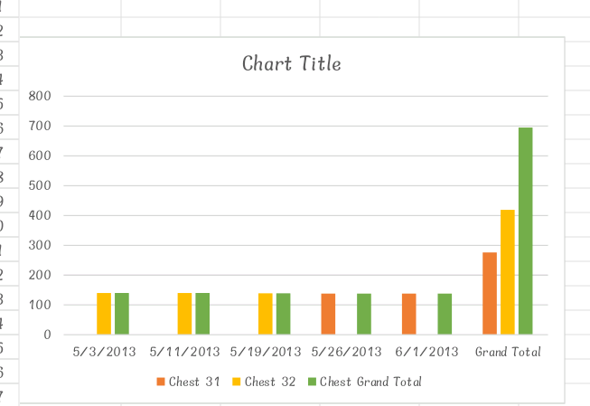
RESULTS
11

Slide 12
conclusion
The analysis of employee performance using Excel reveals key trends and patterns, highlighting both high and low performers. The findings suggest areas for improvement and recommend targeted interventions to enhance overall productivity. Implementing these recommendations should help address performance issues and align employees more closely with organizational goals. Further analysis may be needed to monitor progress and refine strategies.

