Slide 1
Primitive data types
Primitive data types are data types that are predefined in Java programming language and named by a reserved keyword.

Slide 2
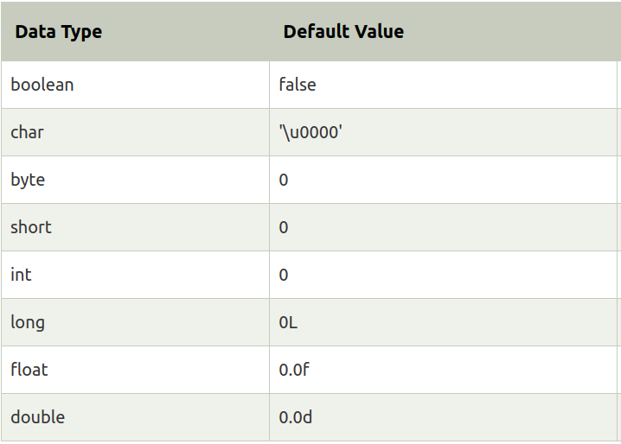
=>Java programming language supports eight different primitive types - byte, short, int, long, float, double, boolean and char.
=>A primitive data type specifies the size and type of variable values.

Slide 3
Question corner:
What are the Wrapper classes available for primitive types ?
Ans. boolean - java.lang.Boolean
byte - java.lang.Byte
char - java.lang.Character
double - java.lang.Double
float - java.lang.Float
int - java.lang.Integer
long - java.lang.Long
short - java.lang.Short
void – java.lang.Void
=>Java.lang provides classes that are fundamental to the design of the Java programming language

Slide 4
public class MyClass
{
public static void main(String[] args)
{
int a = 10;
System.out.println(++a++);
}
}

Slide 5
What is the difference between Data Type and Data Structure ?
Ans.
Data type: a set of values together with operations on that type
Data structure: a physical implementation of a data type

Slide 6
In Java every data type requires some bytes of memory, How many bytes void data type requires?
Ans:0

Slide 7
public class Main
{
public static void main(String[] args) {
int a = 'a';
System.out.print(a);
}
}
Ans:97

Slide 8
Thank you

