Slide 1
MINI PROJECT
Name | Suhaas D Gayana KO Siddharth AK
Registration Numbers | 251100610033 | 251100610004 | 251100610010
Branch | CSE-5
Project Title | Fraud Detection Using Machine Leaning
Guide | Dr. Keerthana Prasad.

Slide 2
CONTENTS
Introduction
Literature Review
Objective
Operational Flow
Functional Requirements
Implementation
Work Done
8. Future work
9. References

Slide 3
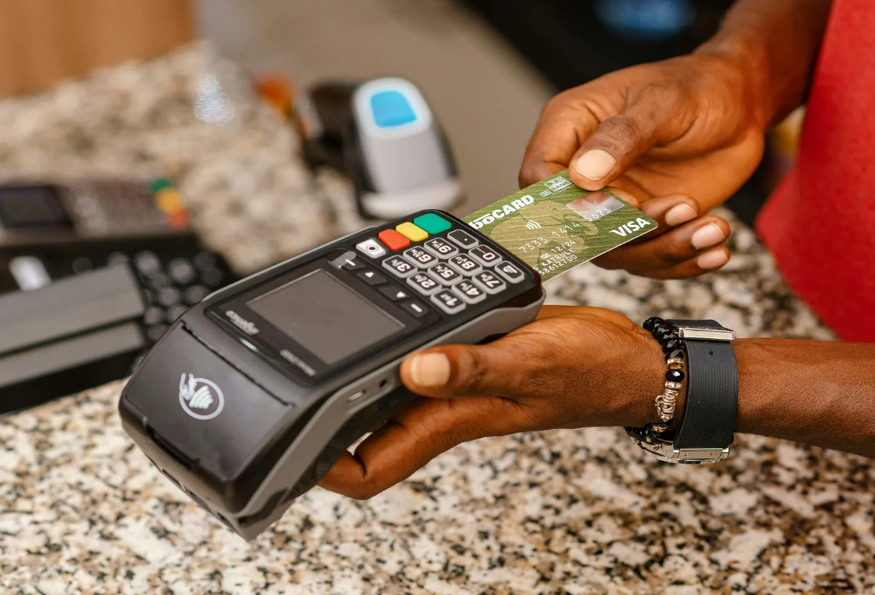
INTRODUCTION
Rapid digitalisation has increased online transactions.
With this growth, financial fraud has become a major concern.
Fraud detection ensures security, trust, and the prevention of financial loss.
Machine Learning helps detect suspicious patterns automatically and efficiently.

Slide 4
LITERATURE REVIEW
Authors and Title | Dataset | Purpose of Study | Key Findings
Aman Negi, Deepak Kumar. "Fraud Detection in Financial Transactions Using Machine Learning Techniques“(1985–2003) | Anonymized financial transaction dataset; public and proprietary sources | Evaluate machine learning models (Random Forest, XGBoost) for financial fraud detection and address data imbalance | XGBoost outperformed others (accuracy: 97.3%, F1-score: 0.95); Feature selection and SMOTE improved results; Ensemble models best for real-time detection
Petr Hajek, Mohammad Zoynul Abedin, Uthayasankar Sivarajah. "Fraud Detection in Mobile Payment Systems using an XGBoost-based Framework“ (2024) | PaySim (simulated mobile transaction data, 6M+ entries | Develop an XGBoost framework for mobile payment fraud detection, addressing class imbalance and financial impact | Semi-supervised XGBoost integrating outlier detection and under-sampling achieved best results and highest cost savings; Outperformed traditional ML methods
P. Nagarajan, Kamali B. "Fraud Detection in Online Transaction using Hybrid CNN and XGBOOST“ (2025) | Kaggle credit card fraud dataset (24,000 transactions, 30 features) | Compare Hybrid CNN-SVM and XGBoost for online transaction fraud detection | Hybrid CNN-SVM outperformed XGBoost in reliability, F1-score, AUC; Effective feature extraction with CNN; Model suitable for imbalanced data
Hongwei Chen, Lun Chen. "An application of XGBoost algorithm for online transaction fraud detection based on improved sailfish optimizer“ (2025) | Kaggle credit card fraud dataset | Improve XGBoost using Improved Sailfish Optimizer (ISFO) for hyperparameter tuning in online fraud detection | SFO-XGBoost achieved top accuracy and metrics, beating other models; SMOTE improved results.

Slide 5
OBJECTIVE
Build an efficient fraud detection model using supervised ML algorithms.
Identify fraudulent transactions based on transaction features.
Achieve high accuracy and minimise false positives.
Analyse model performance using standard metrics (Accuracy, Precision, Recall, F1-score).

Slide 6
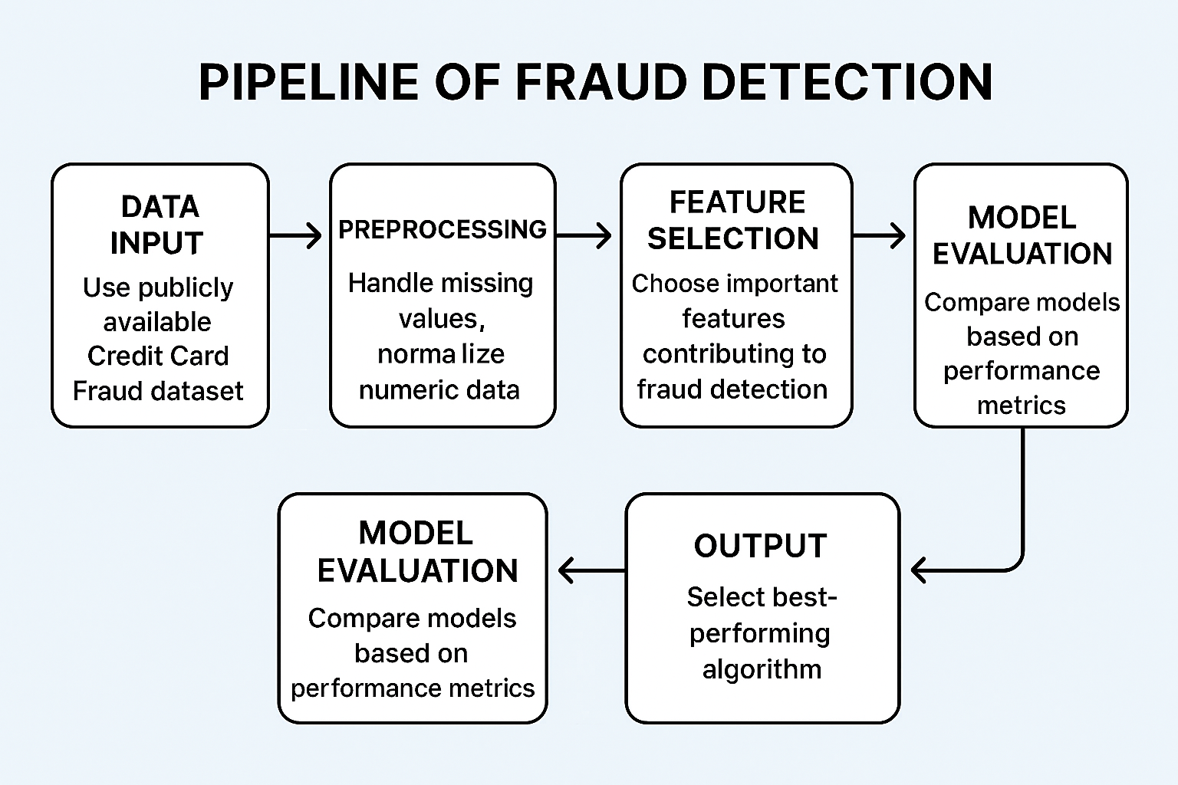
OPERATIONAL FLOW
Flow Steps:
Data Collection: Use publicly available Credit Card Fraud dataset.
Data Preprocessing: Handle missing values, normalise numeric data.
Feature Selection: Choose important features contributing to fraud detection.
Model Training: Apply algorithms like Logistic Regression, Decision Tree, and Random Forest.
Model Evaluation: Compare models based on performance metrics.
Result Analysis: Select the best-performing algorithm.

Slide 7
FUNCTIONAL REQUIREMENTS
Category | Description
Input | Transaction dataset .
Processing | Data cleaning, feature selection, model training
Output | Prediction – Fraudulent or Legitimate transaction
Performance | High accuracy and low error rate
Software Used | Python, NumPy, Pandas, Scikit-learn, Matplotlib
Hardware Used | Standard PC/Laptop with Python environment

Slide 8
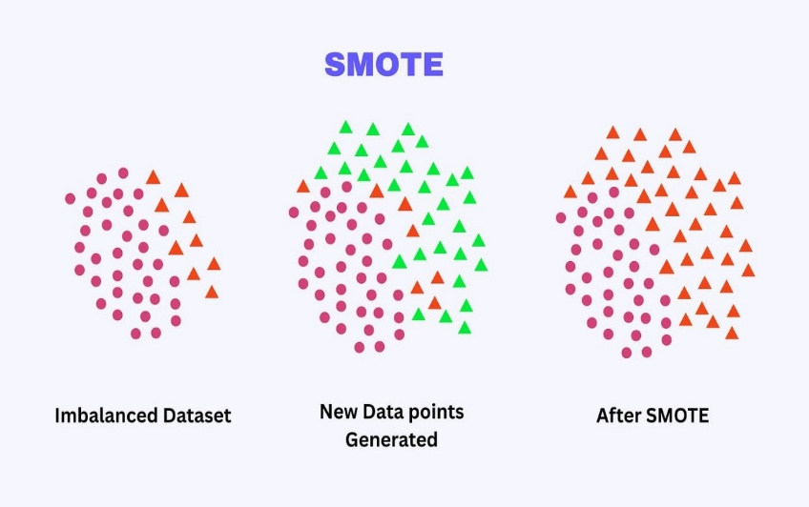
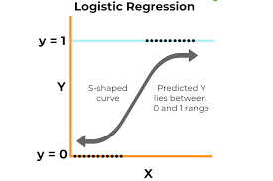
IMPLEMENTATION
Dataset: Credit Card Fraud Detection dataset from Kaggle.
Programming Language: Python
Handling imbalance using SMOTE
Libraries Used:
NumPy, Pandas (data handling)
Matplotlib (visualisation)
Scikit-learn (model building)
Algorithms Applied:
Logistic Regression

Slide 9
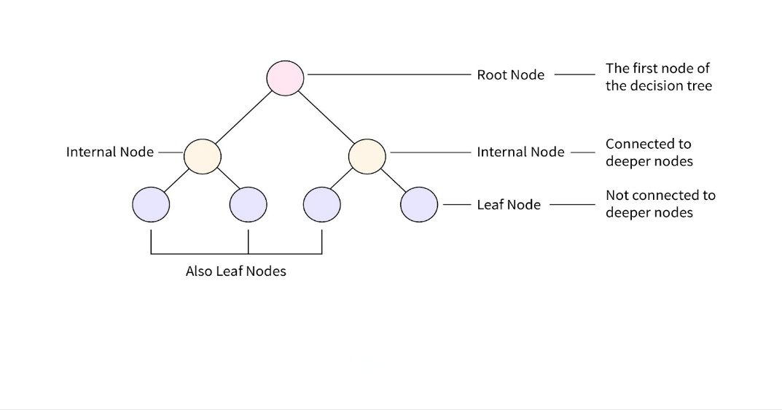
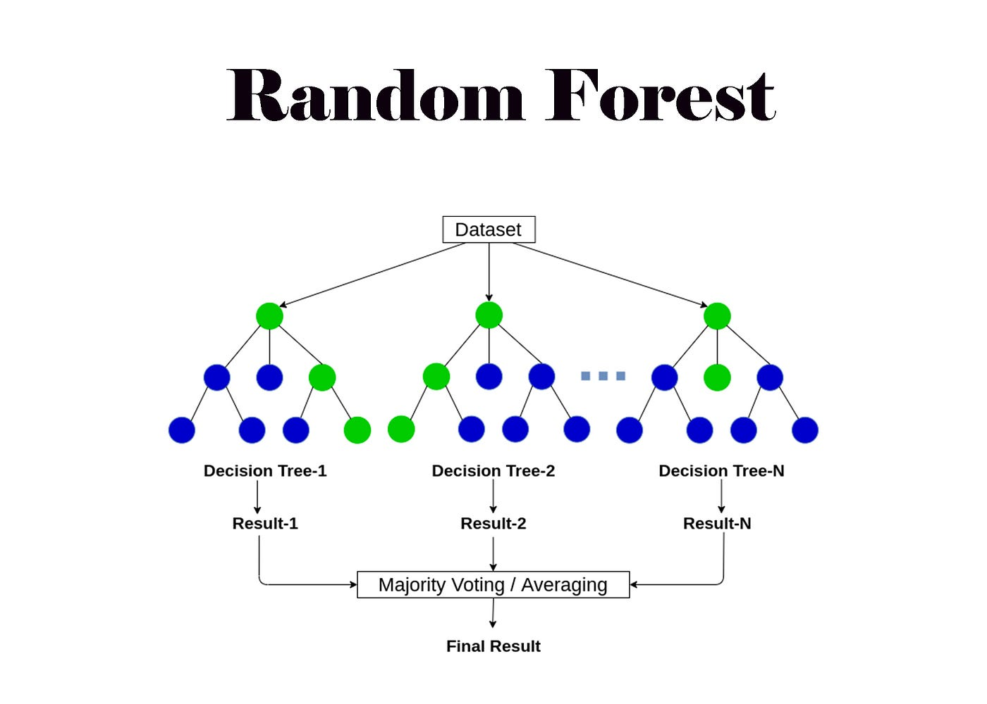
IMPLEMENTATION
Decision Tree
Random Forest

Slide 10
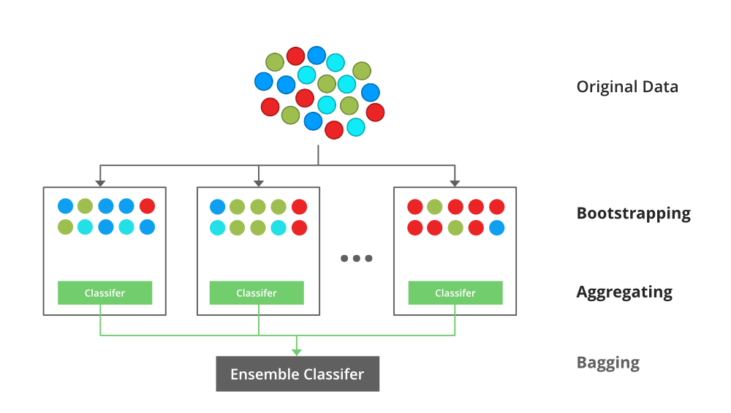
IMPLEMENTATION
XGBoost
Evaluation Metrics: Accuracy, Precision, Recall, F1-score, Confusion Matrix

Slide 11
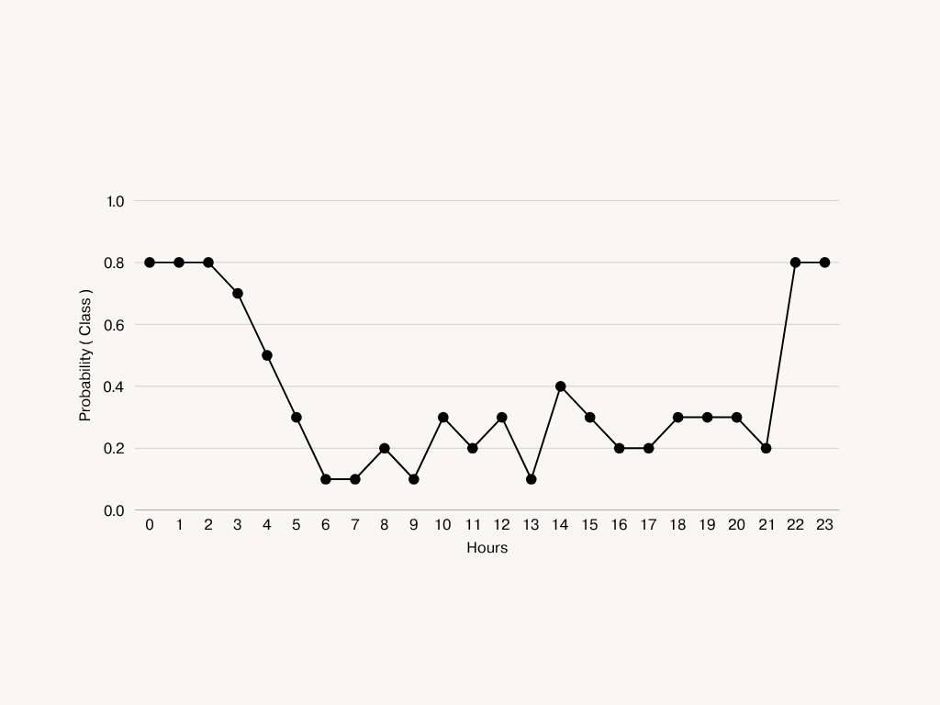
Linear representation of time

Slide 12
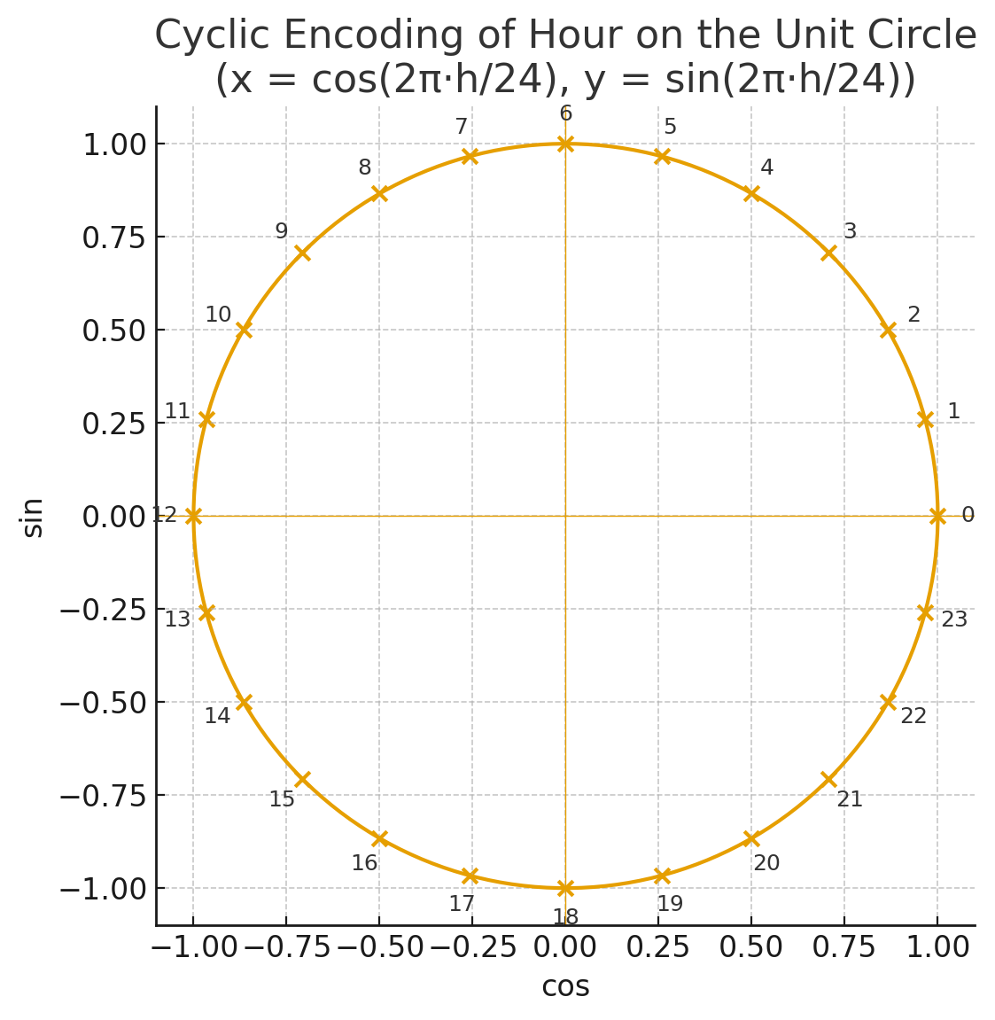
IMPLEMENTATION
Cyclic representation of time

Slide 13
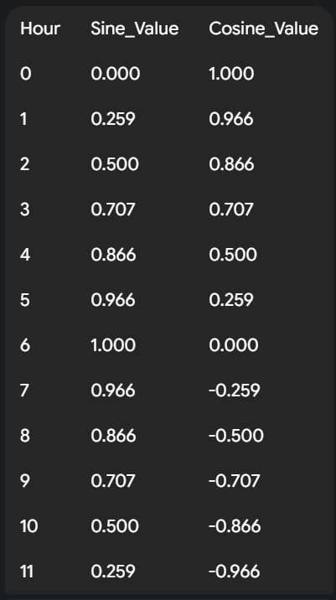
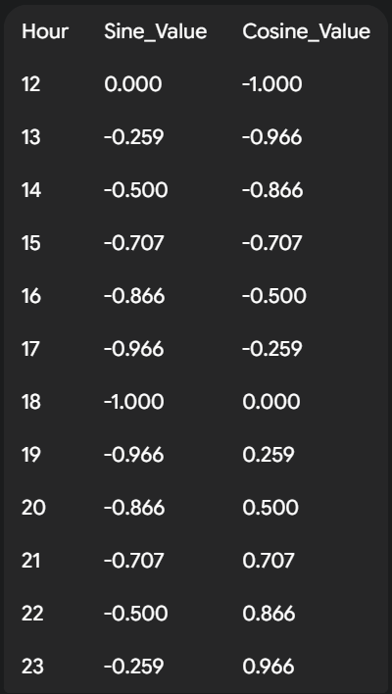
IMPLEMENTATION

Slide 14
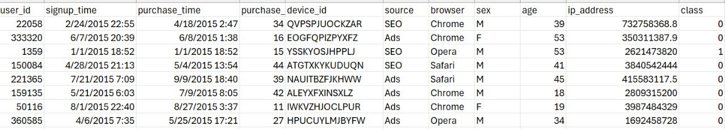
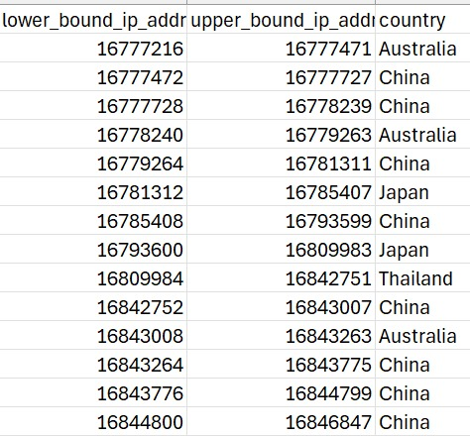
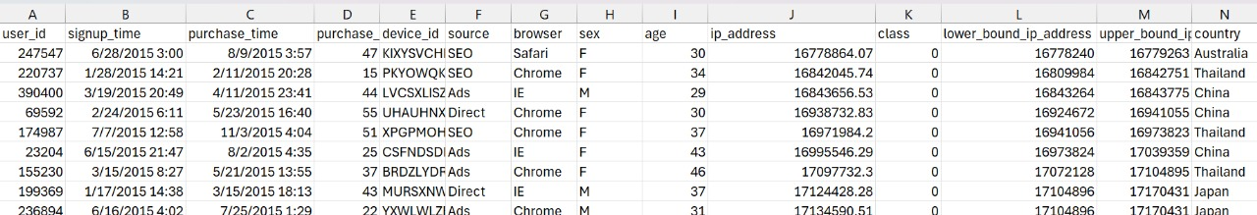
WORK DONE
Collected and analysed credit card transaction dataset.
Datasets 1 Datasets 2
Combined Dataset

Slide 15
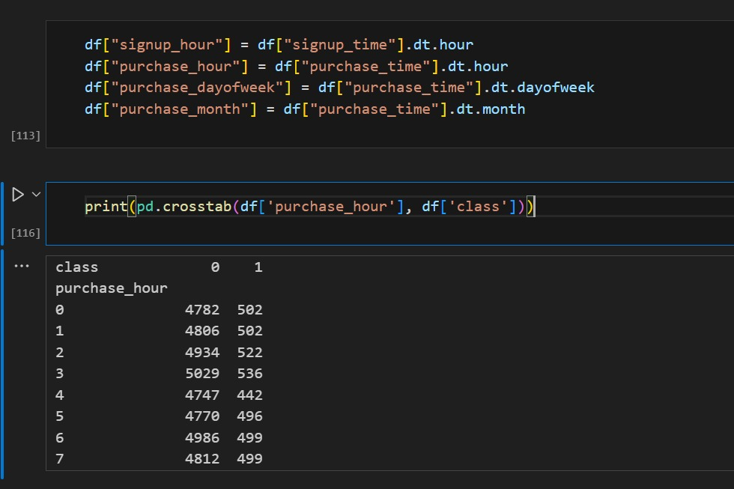
WORK DONE
Preprocessed and cleaned the data.
Feature Extraction - extracting purchase, signup hour, day of week and month
Applied different machine learning algorithms
Logistic Regression
Decision Tree
Random Forest
XG Boost

Slide 16
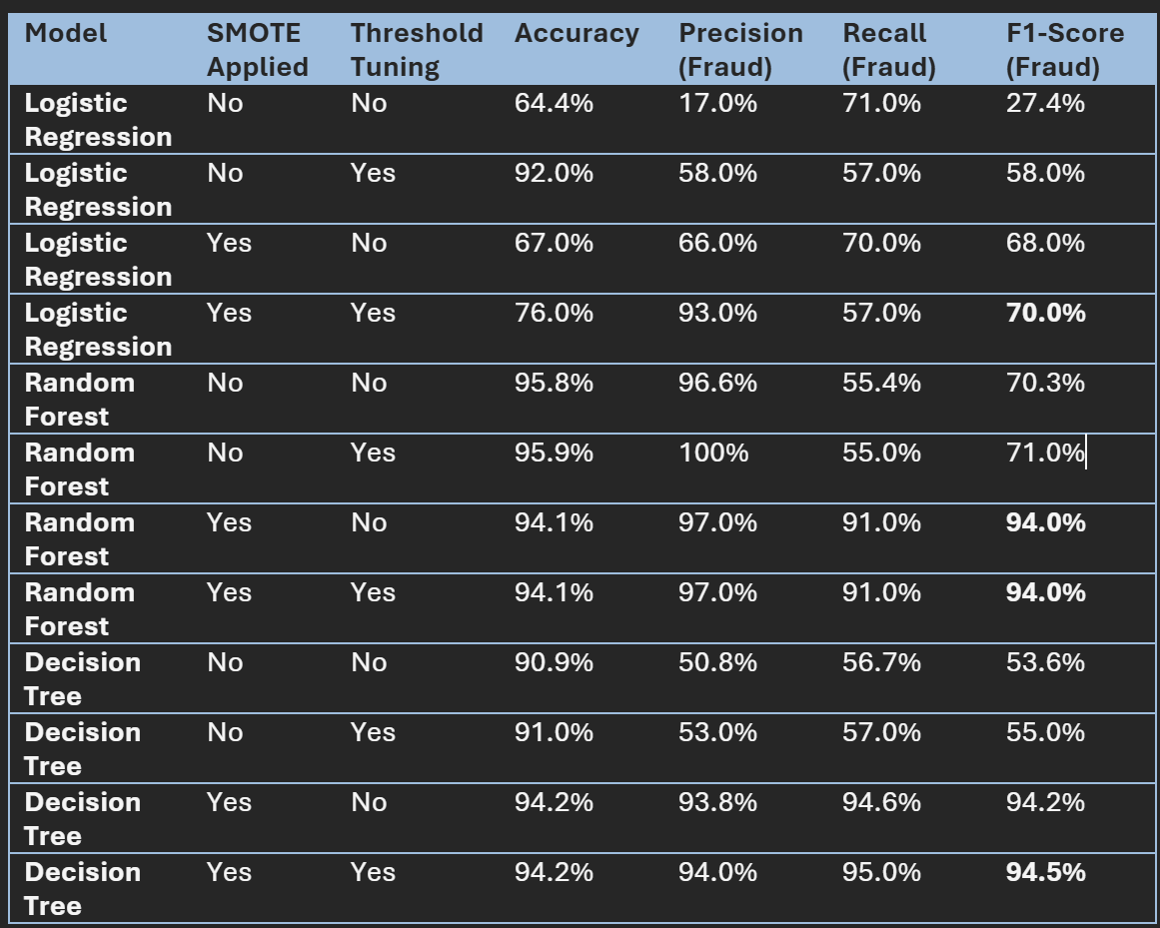
WORK DONE
Compared their performance

Slide 17
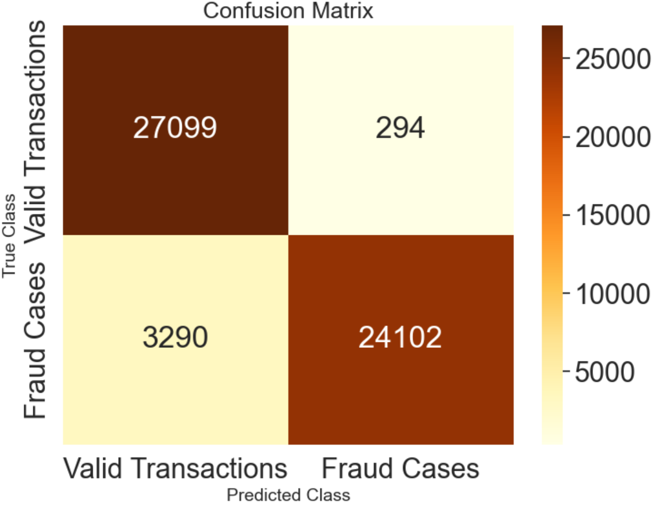
WORK DONE
Visualised and analysed the results for better understanding.

Slide 18
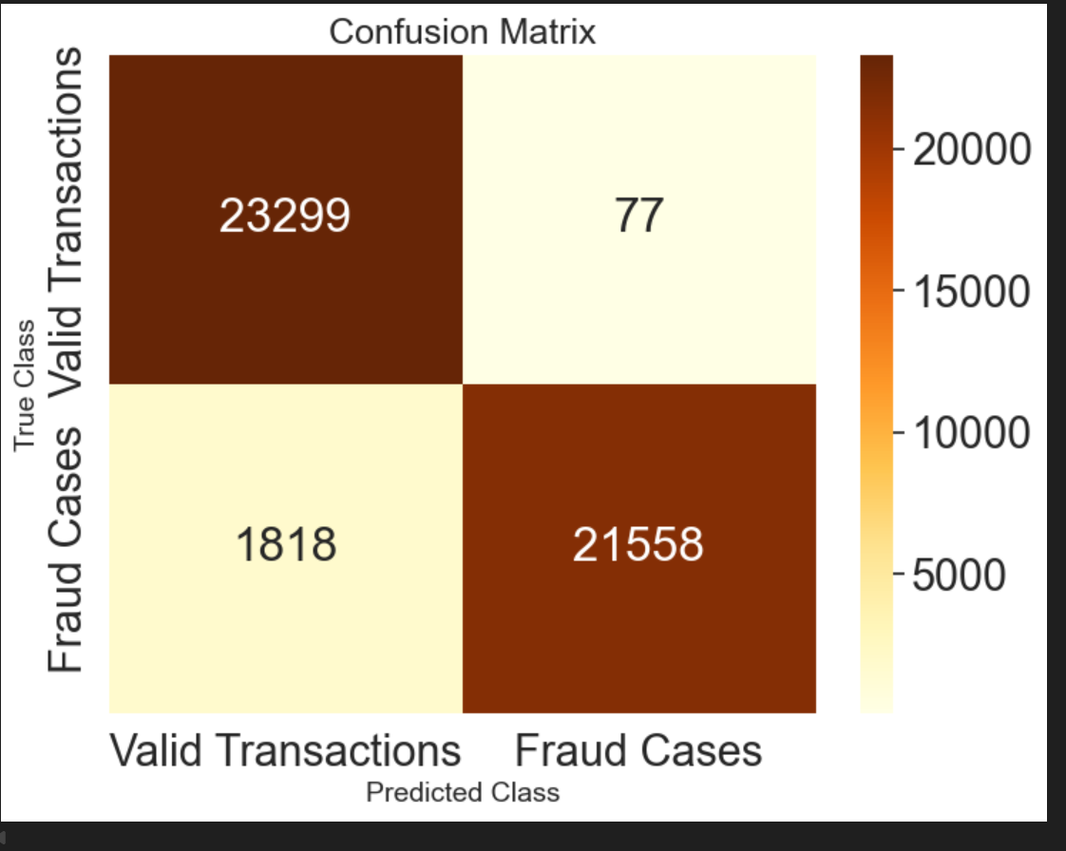
WORK DONE
Visualised and analysed the results for better understanding.

Slide 19
WORK DONE
Visualised and analysed the results for better understanding.

Slide 20
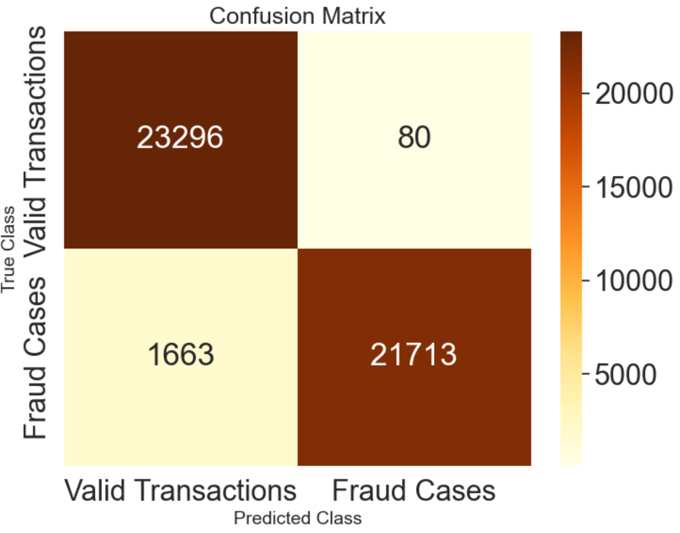
WORK DONE
Visualised and analysed the results for better understanding.

Slide 21
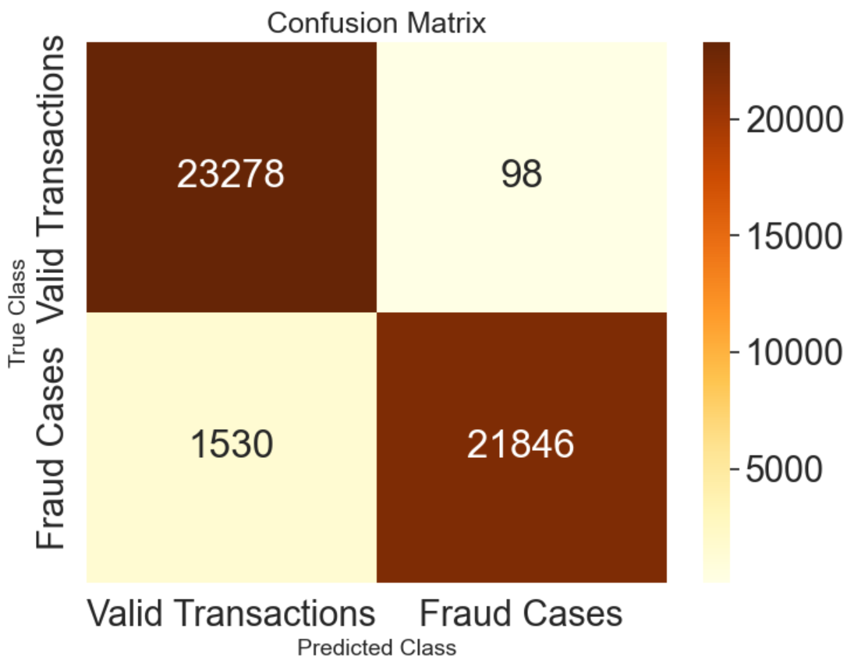
WORK DONE
Visualised and analysed the results for better understanding.

Slide 22
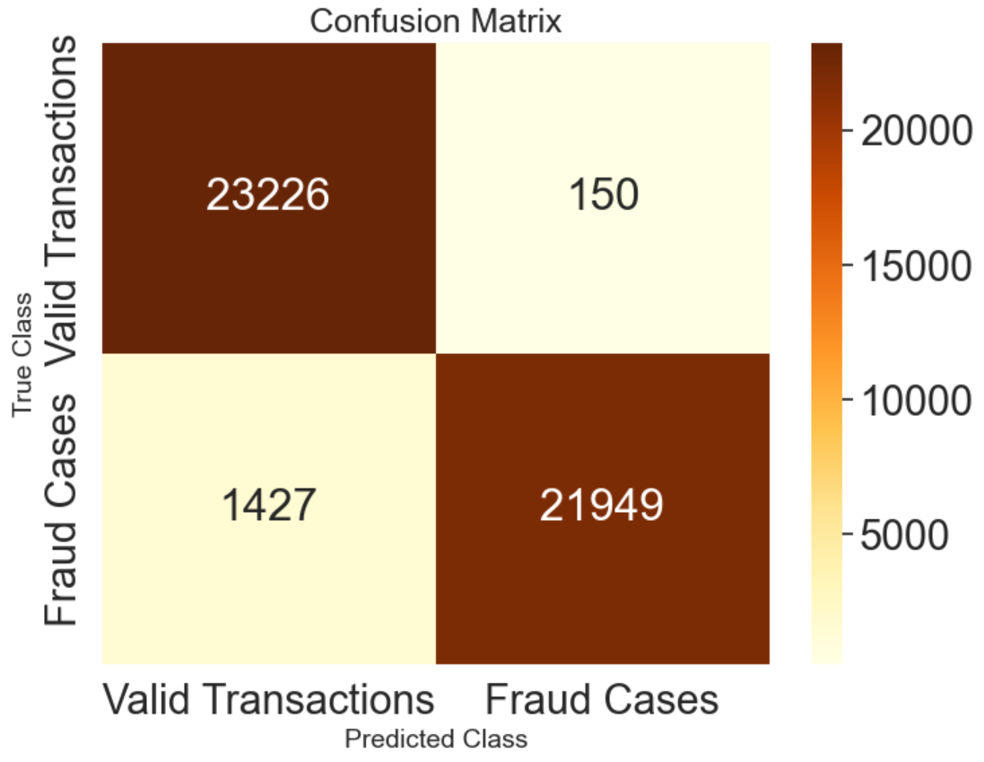
WORK DONE
Visualised and analysed the results for better understanding.

Slide 23
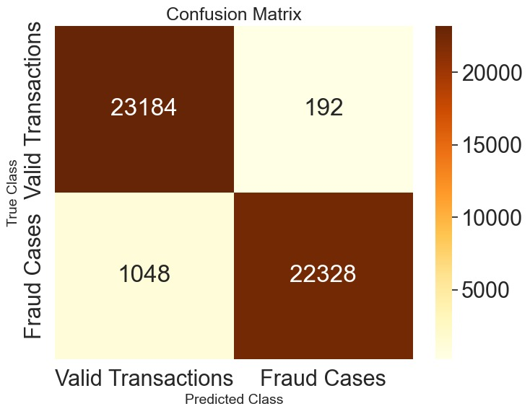
WORK DONE
Visualised and analysed the results for better understanding.

Slide 24

WORK DONE
Visualised and analysed the results for better understanding.

Slide 25
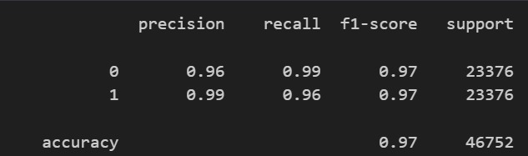
WORK DONE
Identified the most accurate model for detecting fraud.
Classification report of XG Boost

Slide 26
Future work
Hyperparameter tuning
Threshold tuning – Precision Recall Curve
Stacking/Bagging classifier
Pickle models

Slide 27
REFERENCES
[1]. Hajek, P., Abedin, M.Z., & Sivarajah, U. (2023). Fraud Detection in Mobile Payment Systems using an XGBoost-based Framework. Information Systems Frontiers, 25, 1985–2003.
[2].Nagarajan, P., & Kamali, B. (2024). Fraud Detection in Online Transactions using Hybrid CNN and XGBOOST. Proceedings of the 2024 International Conference on Emerging Research in Computational Science.
[3].Negi, A., & Kumar, D. (2025). Fraud Detection in Financial Transactions Using Machine Learning Techniques. Proceedings of the 2025 International Conference on Networks and Cryptology.
[4]Chen, H., & Chen, L. (2022). An application of the XGBoost algorithm for online transaction fraud detection based on an improved sailfish optimiser. Proceedings of the 4th International Conference on Machine Learning, Big Data and Business Intelligence.

Slide 28
THANK YOU

