Slide 1
Reward Center
Suhasini Chakka
@suhasinichakka on GitHub

Slide 2
Description
REWARD CENTER is a web based application , allow users to manage their cash back offers and benefits on each card they have it. This application helps the user to earn maximum rewards.

Slide 3
Features
Application Authentication
User Session Management
CRUD feature for User, Cards, Categories, Departments, Offers.
Masked Card Number for security.

Slide 4
Planning - User Stories
User has to create an account and login to the site.
Once users are logged in
Add Card details, Categories, Departments, Offers
View, Edit and Delete the Card details, Categories, Departments, Offers

Slide 5
Planning - Database
Tables/Models
User – maintains user details like Name, Phone#, Email, Password
Cards – maintains the card info like Card Number, Brand, type, Exp Date
Categories – holds the category name and departments allowed.
Departments – holds the department details like Name, Description
Offers – joins all the above tables with Many-To-One relationship. Holds details like Cash back, qualified amount, mode, exp date, coupon code.

Slide 6
Technology Stack
Java 8.0
Spring Boot with Thyme leaf
Bootstrap 4.2
HTML5
Hibernate
MySQL database

Slide 7
Demo

Slide 8
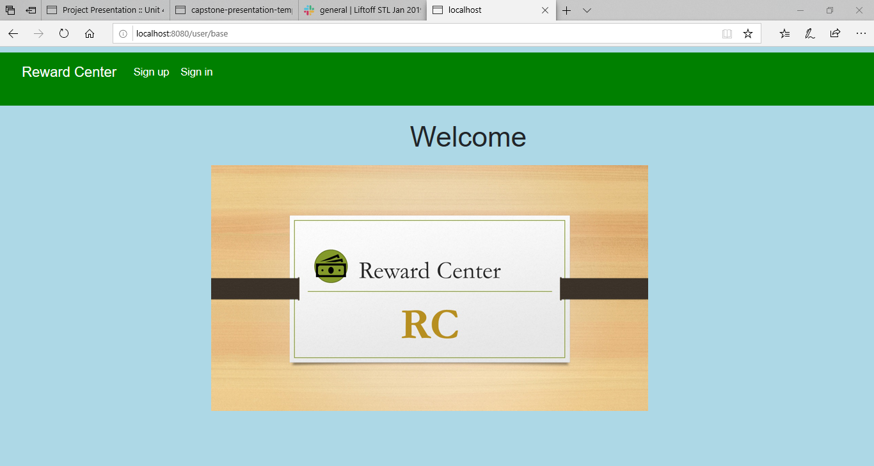

Slide 9
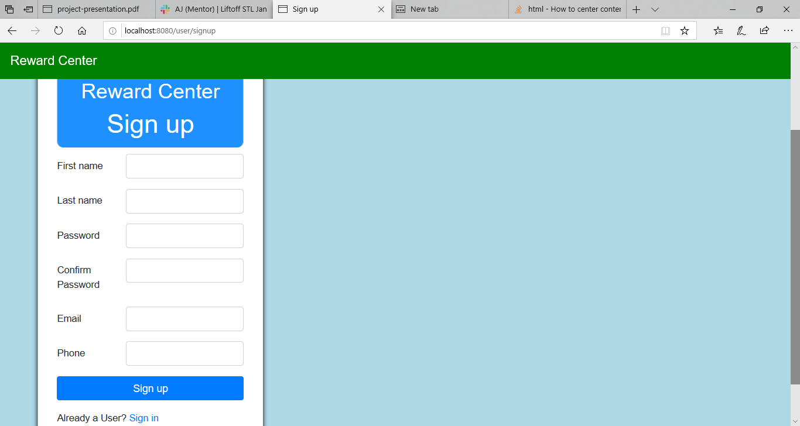

Slide 10
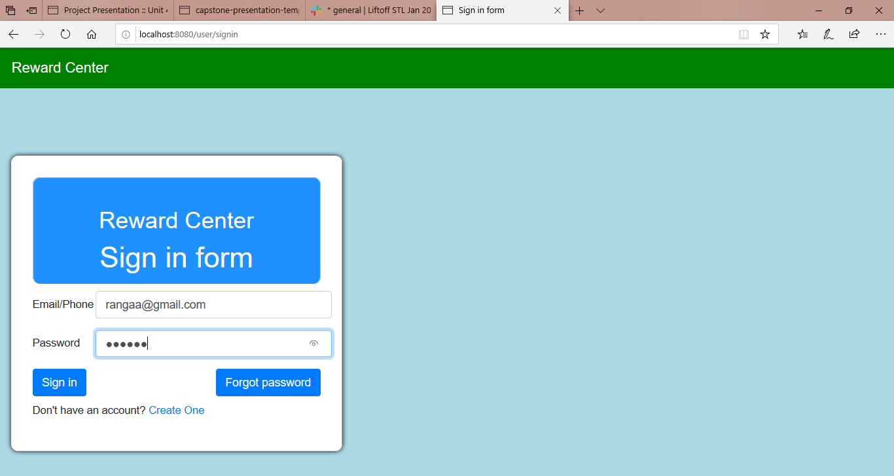

Slide 11
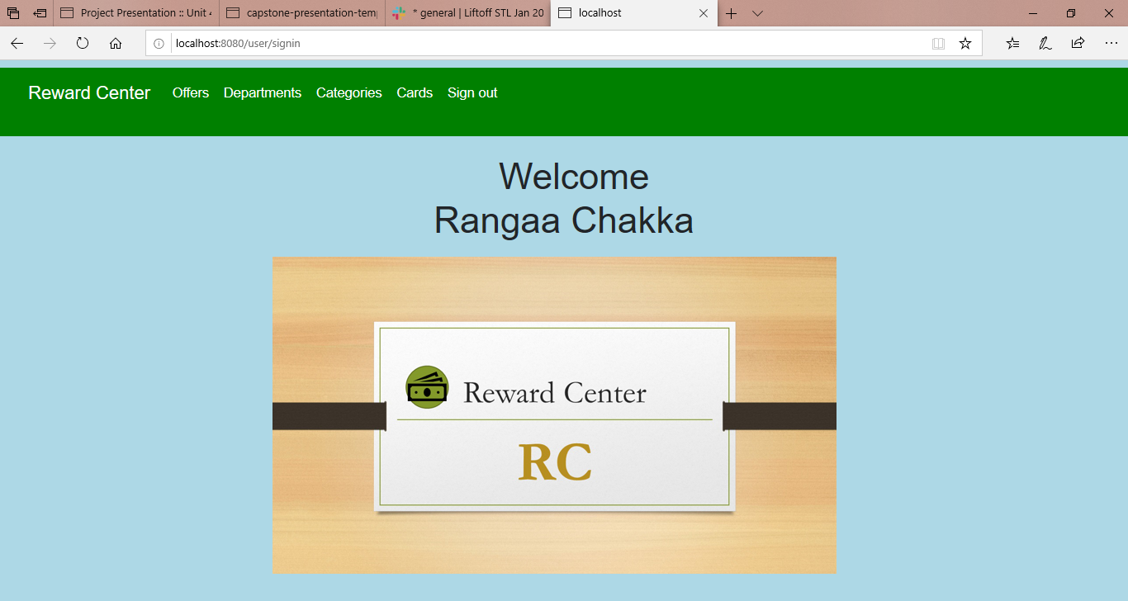

Slide 12
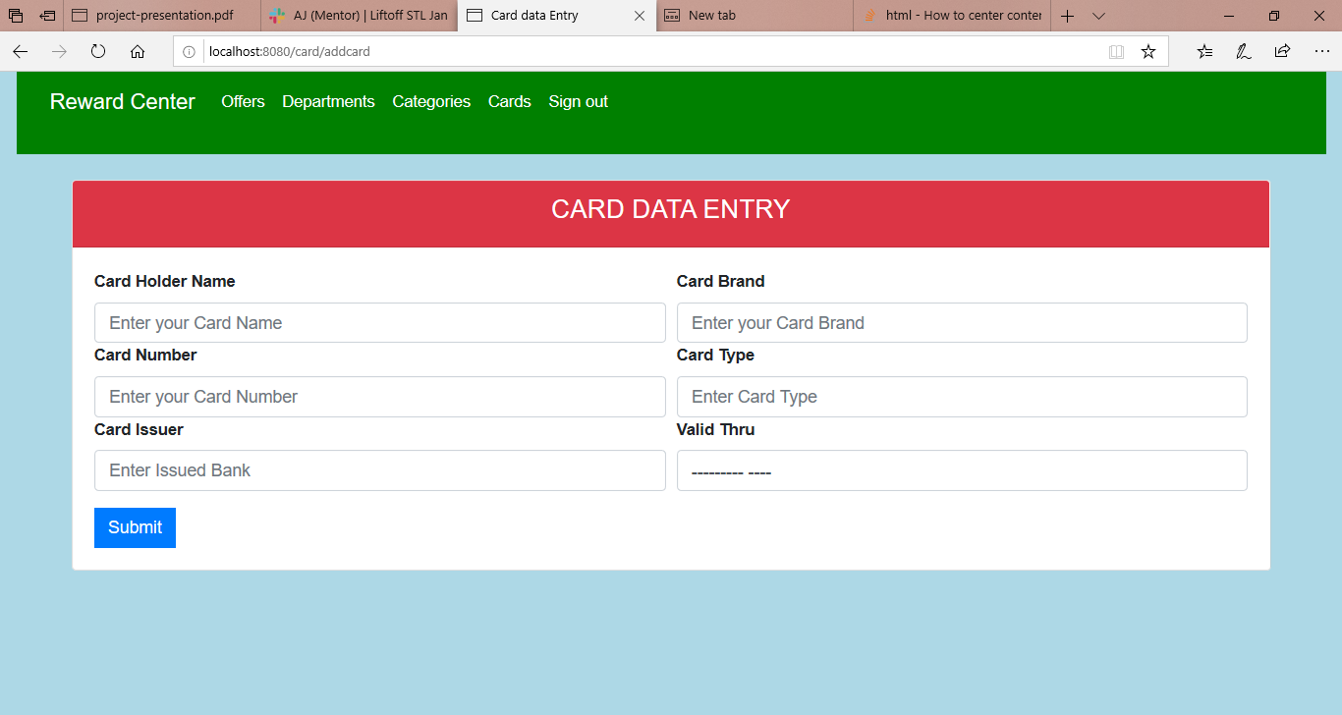

Slide 13
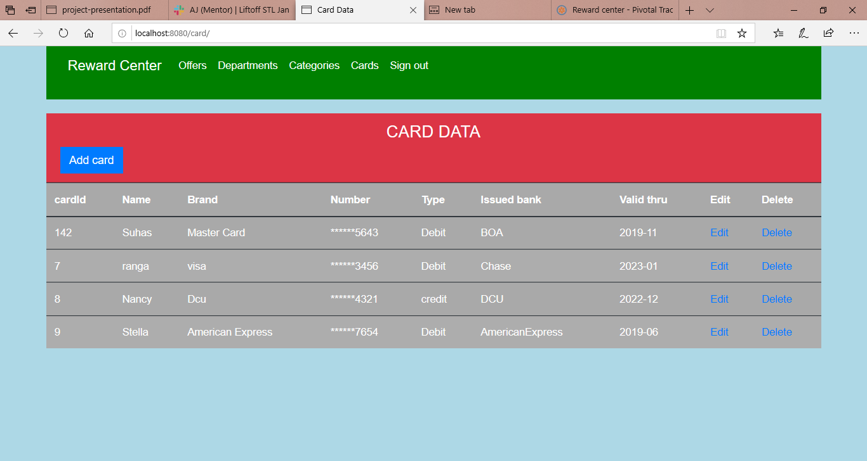

Slide 14
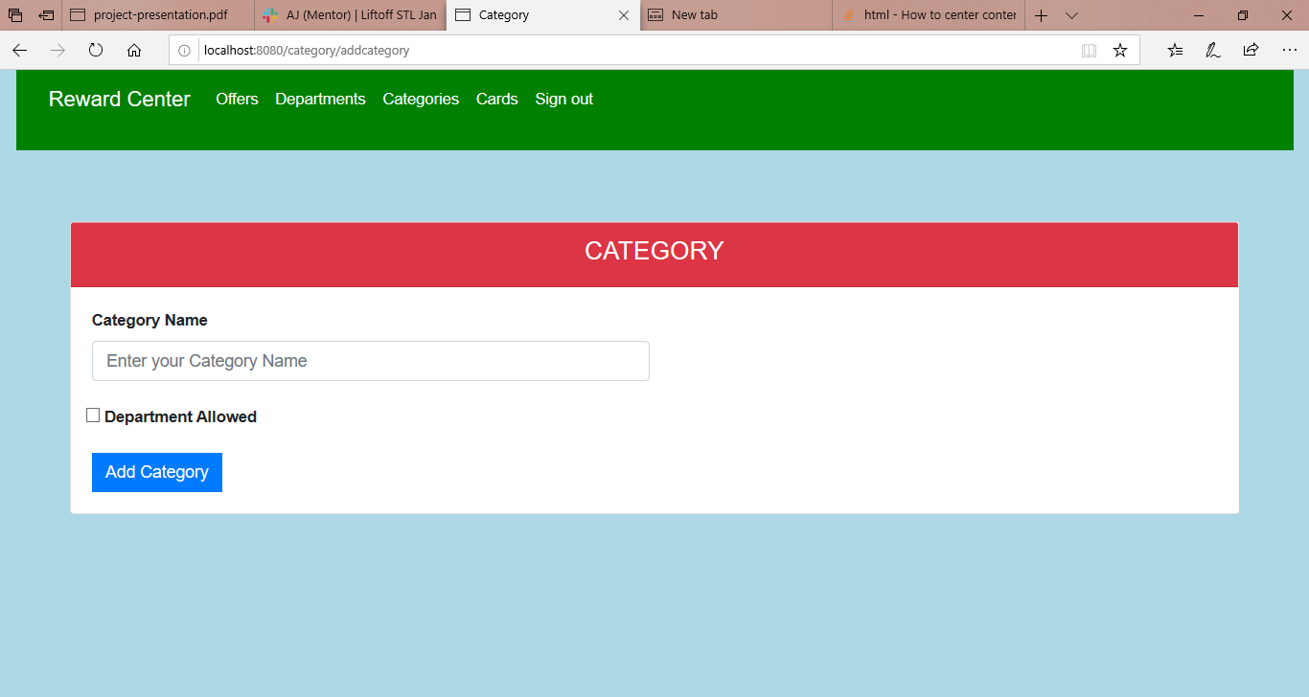

Slide 15
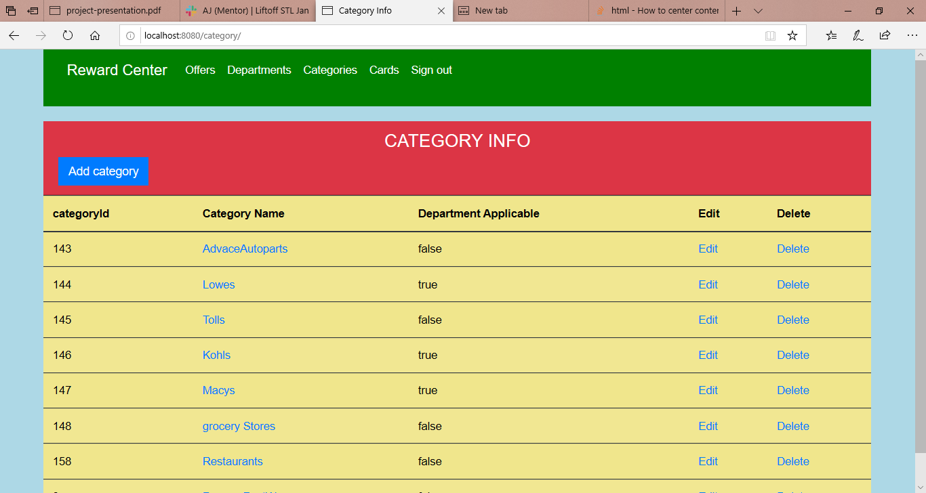

Slide 16
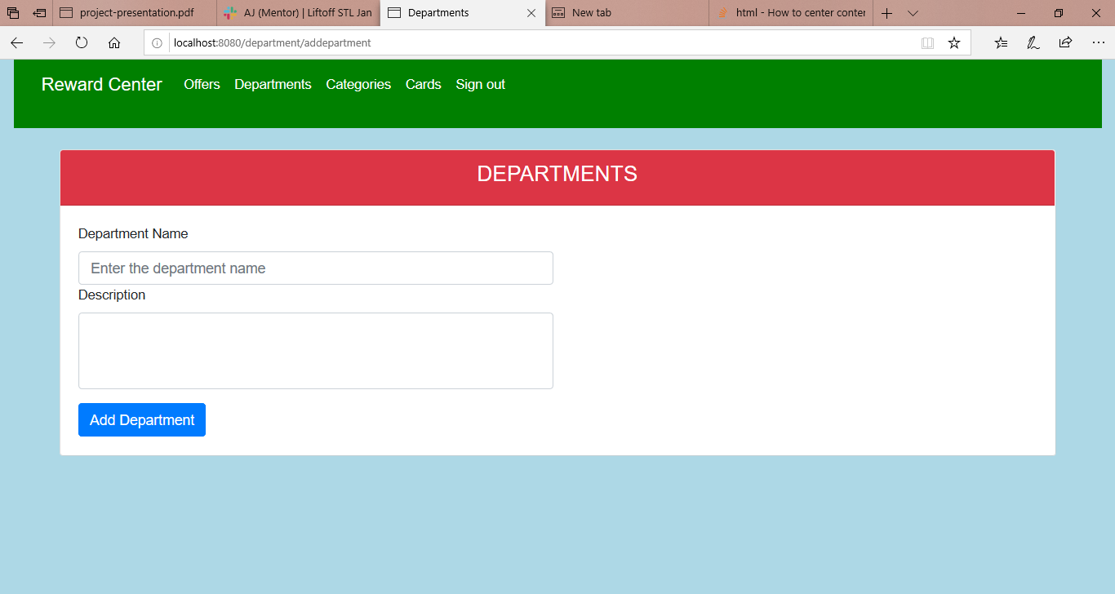

Slide 17
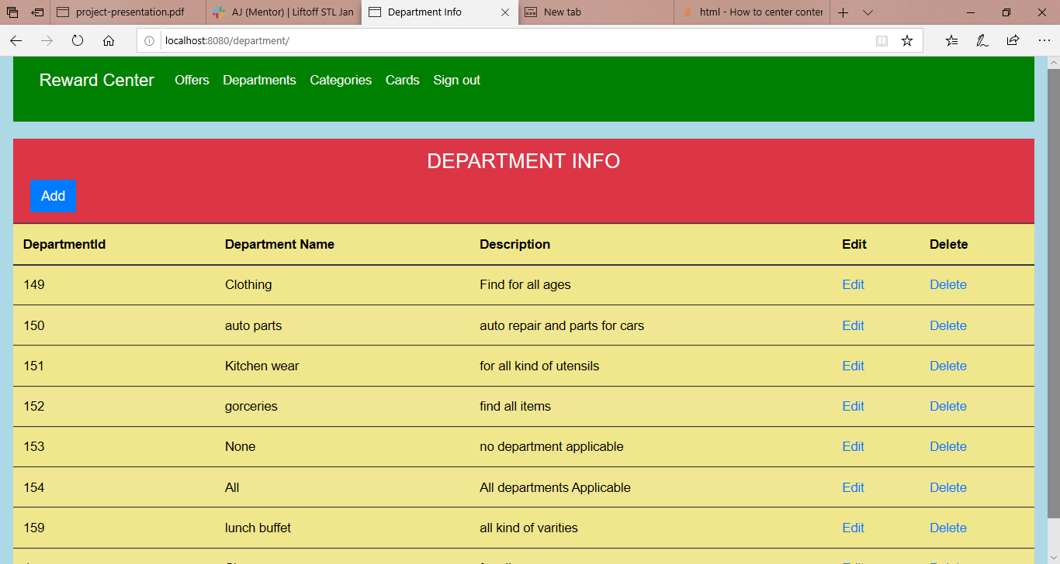

Slide 18
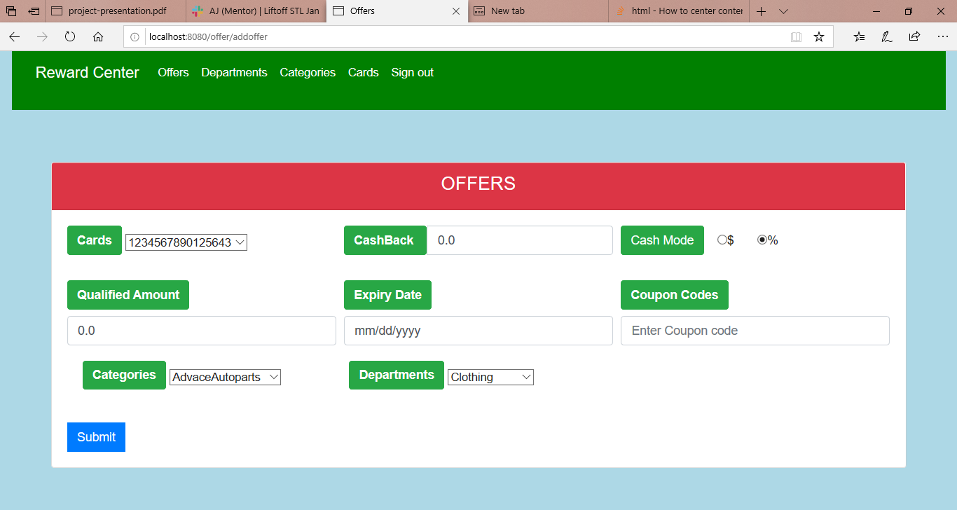

Slide 19
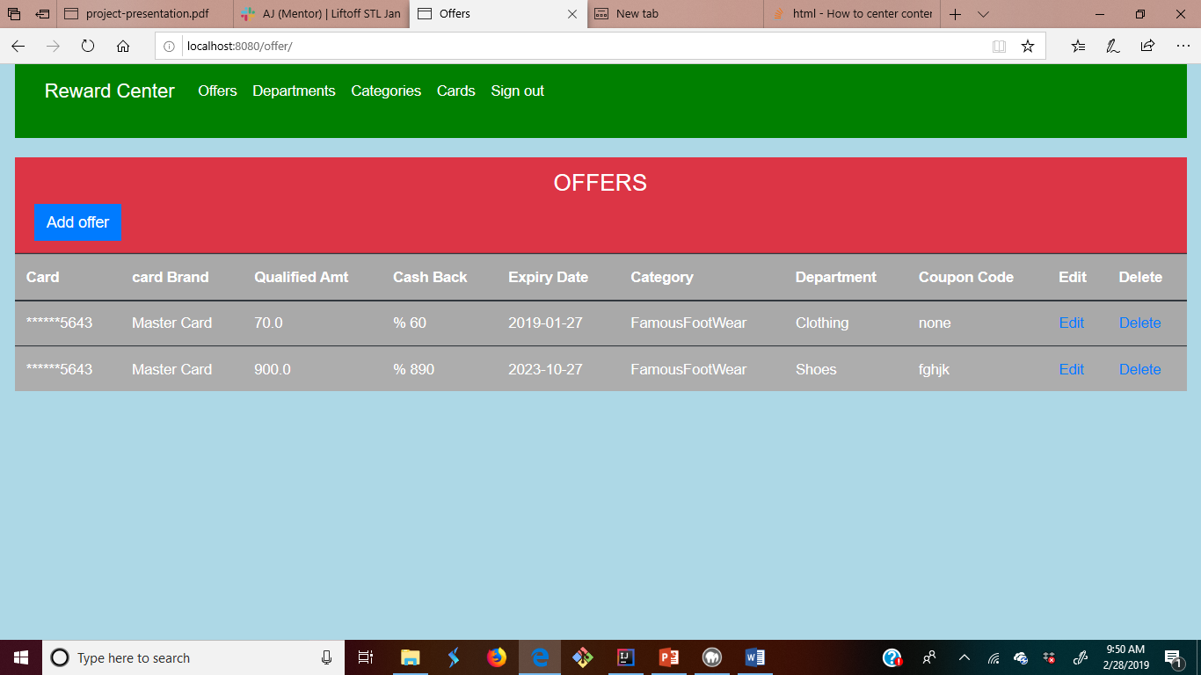

Slide 20
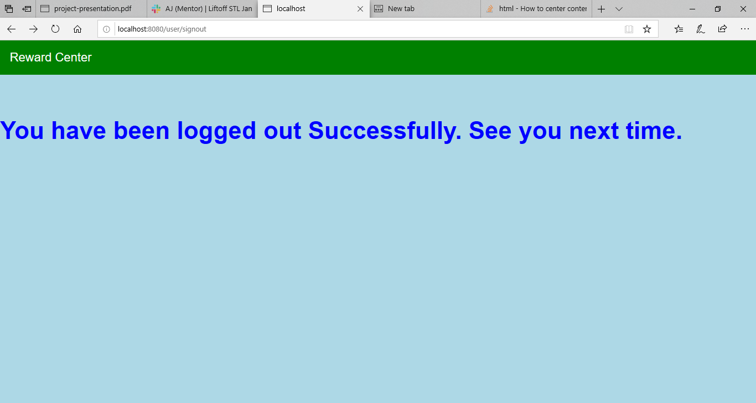

Slide 21
What I Learned
Bootstrap version 4
Session management
Using multi-selects to enable many-to-one relationship
User Authentication
Date conversions, Annotations, Custom methods in DAO classes.

Slide 22
What’s Next
Spring Security with OAuth2
Currency Conversion using Micro Services
Pagination, Sorting
Internationalization/Translation feature
Notes:
Be specific! If you mention another feature describe why that features is necessary, or what problem it solves. If you mention changing the UI mention specific technologies, or libraries you will use to do that. If you mention a technology, or feature you don’t know yet tell them how you plan on learning it.

