Slide 1
IGNISENSE
Smart engine
health diagnostic
A digital twin that finds engine faults, names the failing part, and says how long is left, using nothing but sensor readings.
TEAM REVORA
Physics-informed engine digital twin · runs entirely in the browser
Notes:
Welcome. IgniSense is a digital twin of a petrol engine that finds faults from sensor data alone. Everything you'll see runs live in this browser, with no server behind it.

Slide 2
01 · THE PROBLEM
Engines fail. Schedules don't know when.
FIXED-INTERVAL SERVICE
CONDITION MONITORING
Changes parts that are still good.
Misses the part that fails early.
Says nothing about what is wrong, only that it is time.
Watches the engine's own sensors.
Notices a fault while it is small.
Names the part, and estimates the time left.
IgniSense shows how, from sensor readings alone.
IGNISENSE · TEAM REVORA
02 / 17
Notes:
Service on a fixed schedule either replaces parts that are still good or misses a part that fails early. Condition monitoring watches the engine itself. Our project shows how a monitor can do that from sensors alone.

Slide 3
02 · THE IDEA
Two engines. One rule.
TWIN
PLANT
SENSORS
TELEMETRY
what the sensors
should read
the "real" engine
hidden faults live here
noise, drift,
spikes, dropouts
one common format
for every source
ANALYTICS
gap → fault, health, time left
THE RULE THAT MAKES IT HONEST
The analytics only ever receive sensor telemetry. The fault lives in a part of the code they are not allowed to import, and a lint rule enforces it. The system cannot cheat by reading the answer.
The gap between what the sensors read and what a healthy engine would read is the evidence.
IGNISENSE · TEAM REVORA
03 / 17
Notes:
Two engines run side by side. The Plant is the real engine and holds the hidden fault. The Twin is a healthy copy of the same physics that only sees the sensors. The gap between what the sensors read and what the twin expects is the evidence. The analytics can't see the fault, and a lint rule enforces that.

Slide 4
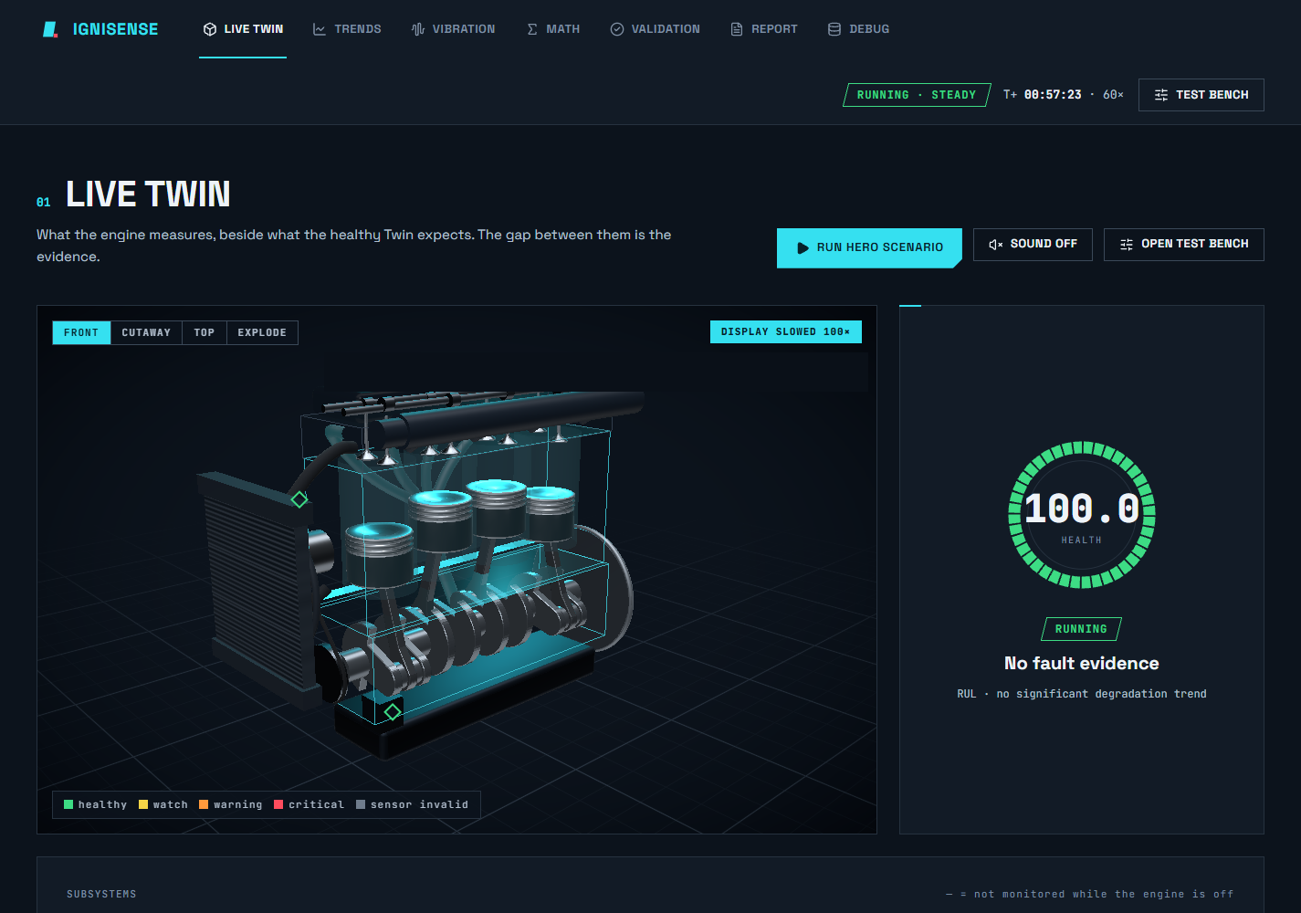
03 · SEE IT LIVE
A 3D engine on the same physics
Pistons, rods and crank move by the slider-crank equation, not an animation loop.
Cylinders flash in firing order 1-3-4-2.
Health ring and six subsystem scores update live.
Click any part for its sensors and its math.
IGNISENSE · TEAM REVORA
04 / 17
Notes:
This is the live twin page. The 3D engine is procedural and moved by the same slider-crank equation as the numbers; it is slowed 100 times so you can see it. On the right the health ring and the six subsystem scores.

Slide 5
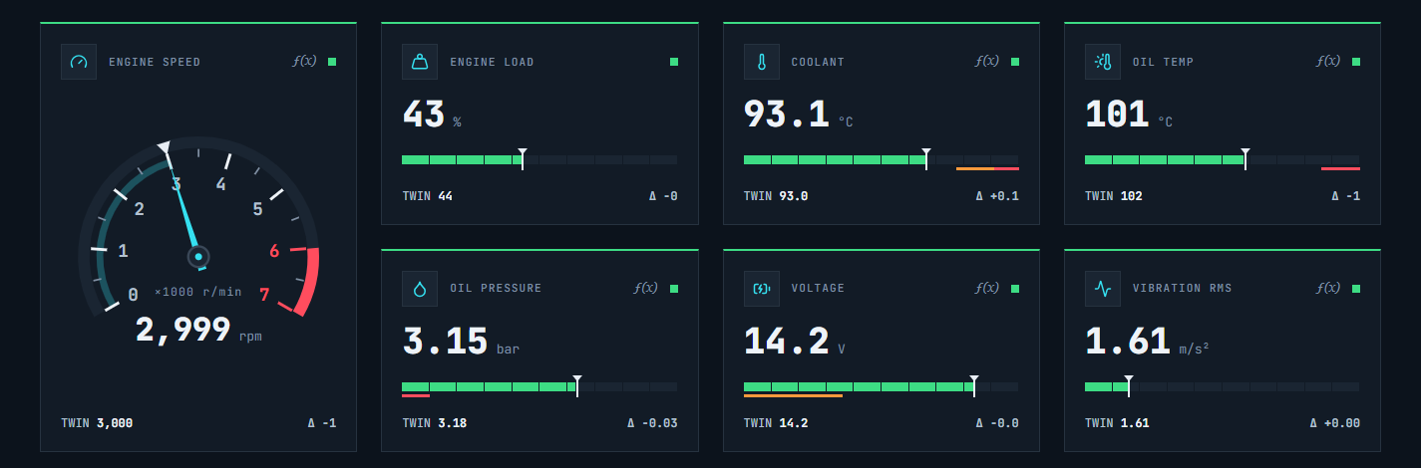
04 · THE SIGNALS
Every gauge has a ghost
White tick = what a healthy engine would read right now.
Δ turns coloured once the gap leaves the noise band.
A dead sensor shows — —, never zero.
Click any value to see the equation behind it.
IGNISENSE · TEAM REVORA
05 / 17
Notes:
Every gauge carries a ghost: the white tick is what a healthy engine would read right now, at the same speed, load and ambient. The delta turns coloured once it leaves the noise. The tachometer is a car-style dial. Click any number and you get the equation.

Slide 6
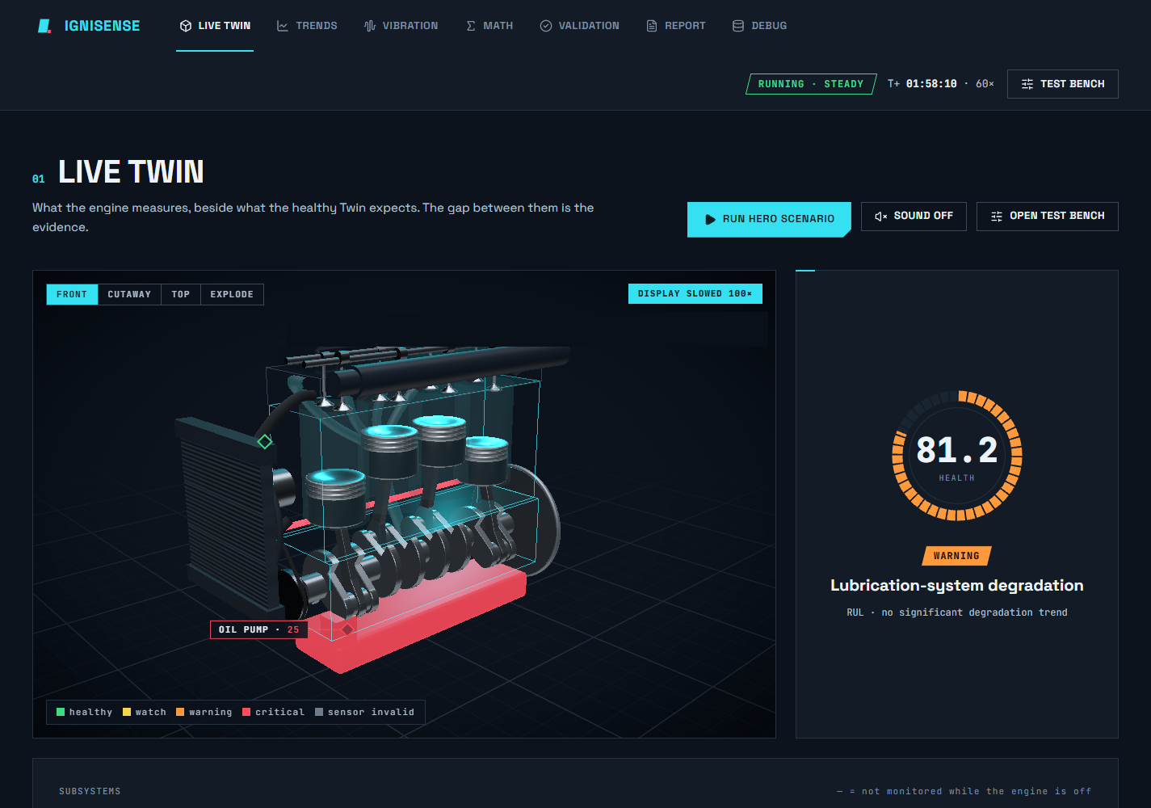
05 · BREAK IT, AND IT SHOWS
Inject a fault. Watch it show.
Oil-pump wear injected from the test bench.
The sump and oil gallery pulse red; the health ring drops and turns orange.
The monitor names Lubrication-system degradation from the sensors alone.
Repair, and everything settles back.
IGNISENSE · TEAM REVORA
06 / 17
Notes:
Inject any fault from the test bench. The sump and oil gallery pulse red, the ring drops and turns orange, and the card names the fault. Nothing on screen told the monitor which fault we chose. It found it in the sensors.

Slide 7
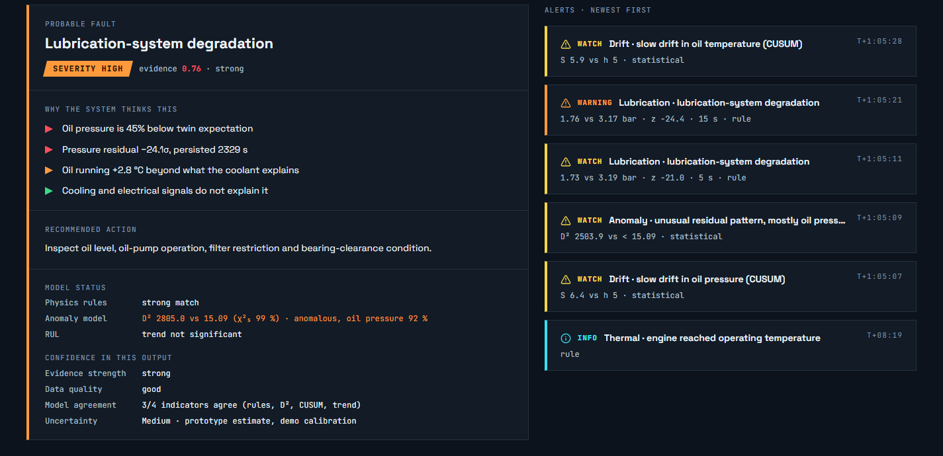
06 · DIAGNOSIS
It names the fault, and shows its evidence
Probable fault, severity, and a diagnostic evidence score.
"Why the system thinks this": named symptoms, each colour-coded.
A recommended action and the model's own confidence.
Alerts escalate WATCH → WARNING → CRITICAL, with hysteresis.
IGNISENSE · TEAM REVORA
07 / 17
Notes:
When we inject an oil-pump fault, the monitor names it and lists the evidence. Notice we call it an evidence score, never a confidence percentage, because it is a weighted sum, not a calibrated probability.

Slide 8
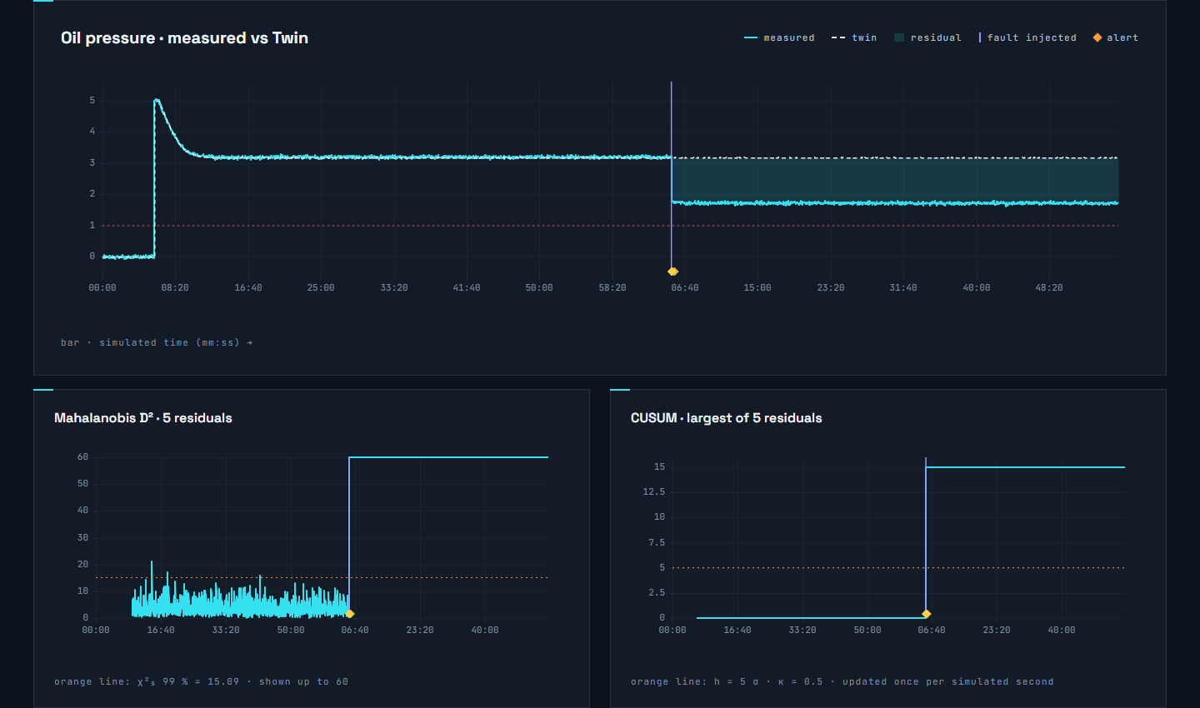
07 · EARLY WARNING
It warns before any limit trips
CUSUM adds up small, persistent shifts.
A gap of 1σ never crosses a 3σ limit. CUSUM crosses its limit in about 11 samples.
D² flags an unusual combination of residuals (χ² limit 15.09).
Violet lines mark injections. Diamonds mark alerts.
IGNISENSE · TEAM REVORA
08 / 17
Notes:
CUSUM adds up small persistent shifts. A residual that sits at one sigma never crosses a three-sigma limit, but CUSUM passes its limit in about eleven samples. So the monitor warns before any fixed threshold trips.

Slide 9
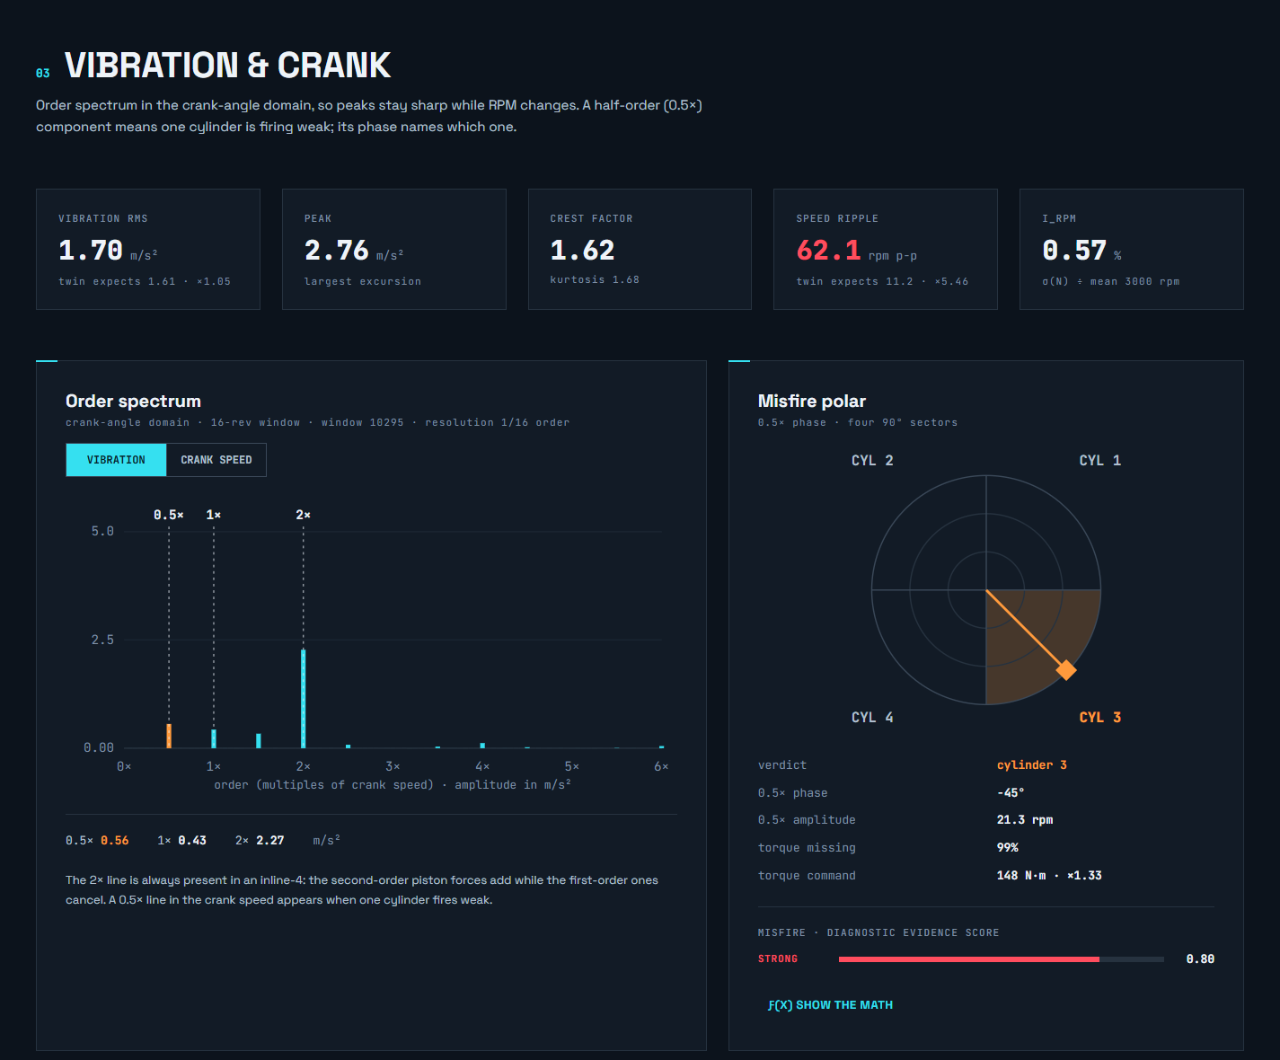
08 · WHICH CYLINDER?
One missing pulse points at its cylinder
A misfire repeats every two revolutions: a 0.5× line.
That line's phase names the cylinder.
Torque command rises by exactly 4/3: three cylinders do four's work.
0.5× PHASE → CYLINDER
C1
+45°
C2
+135°
C3
−45°
C4
−135°
IGNISENSE · TEAM REVORA
09 / 17
Notes:
A misfire removes one power pulse every two revolutions. That repeats at half the crank frequency. The cylinders fire 180 degrees of crank apart, which is 90 degrees of phase at half order, so the phase of that half-order line points at the cylinder. And the torque command rises by exactly four thirds.

Slide 10
09 · SENSOR FAULTS
When a sensor lies, physics catches it
0.8 K/s
250 K/s
300×
the fastest coolant can possibly heat: all coolant heat at full load, no cooling
what the reading implied: +25 °C in 0.1 s
over the physical limit, so the sensor failed, not the engine
dT/dt|max = Q_cool,max / C_th = 81 500 W / 100 000 J/K ≈ 0.8 K/s
THE VERDICT ON SCREEN
Coolant sensor fault. The cooling system is not blamed: the other sensors and the Twin agree with each other, and the bad readings are left out of the diagnosis.
IGNISENSE · TEAM REVORA
10 / 17
Notes:
If the coolant reading jumps 25 degrees in a tenth of a second, either the engine did something impossible or the sensor failed. The fastest the coolant can heat is all the coolant heat at full load with no cooling: 81.5 kilowatts into 100 kilojoules per kelvin, so 0.8 K per second. The reading beat that by over 300 times. So we blame the sensor, not the engine.

Slide 11
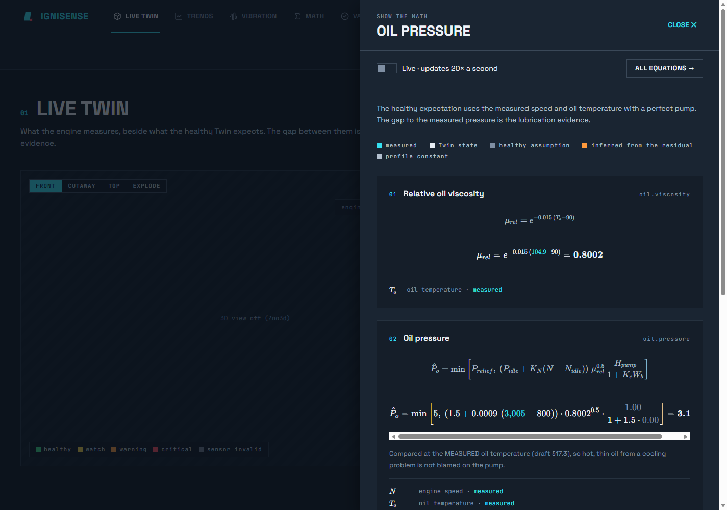
10 · SHOW THE MATH
Click any number. See the equation.
28 registered equations, each with symbols and units.
Live numbers substituted into the LaTeX.
A check table proves it: ✓ EQUAL to the gauge.
Tested in six engine states.
IGNISENSE · TEAM REVORA
11 / 17
Notes:
Every number has an equation behind it, and you can click it. The drawer shows the chain with today's live numbers, and a check table that proves the result equals the gauge. We test that in six different engine states.

Slide 12
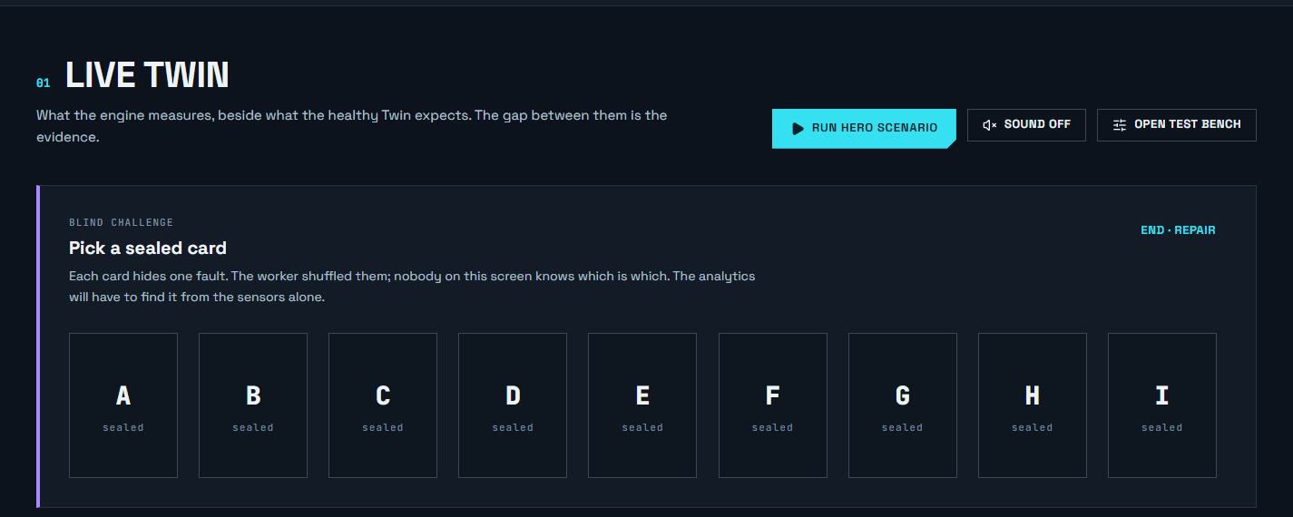
11 · BLIND CHALLENGE
Don't trust us. Pick a card.
Nine sealed fault cards, shuffled inside the simulation.
The page never sees what is on the card.
The monitor names the fault from sensors alone.
Reveal → ✓ CORRECT or not.
IGNISENSE · TEAM REVORA
12 / 17
Notes:
This is the proof it isn't reading the injected fault. A visitor picks a sealed card; the fault is chosen inside the worker, and the page never learns what's on it. The monitor has to name it, and then we reveal.

Slide 13
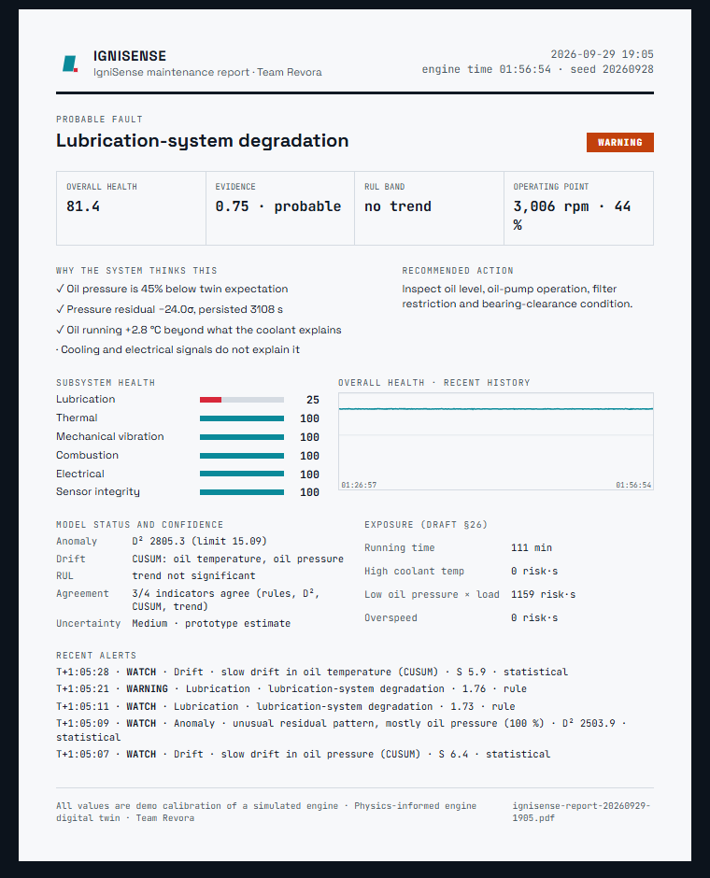
12 · HOW LONG IS LEFT?
Remaining life, with an honest band
A trend line with a ±2 standard-error band.
Shown only when the trend is significant.
Higher load wears faster, so the life shrinks.
One-click, one-page maintenance report as a PDF.
IGNISENSE · TEAM REVORA
13 / 17
Notes:
The remaining-life estimate is a straight-line trend with a plus or minus two standard error band, shown only when the slope is statistically real. Raise the load and the wear speeds up, so the remaining life shrinks. The one-page report prints to PDF.

Slide 14
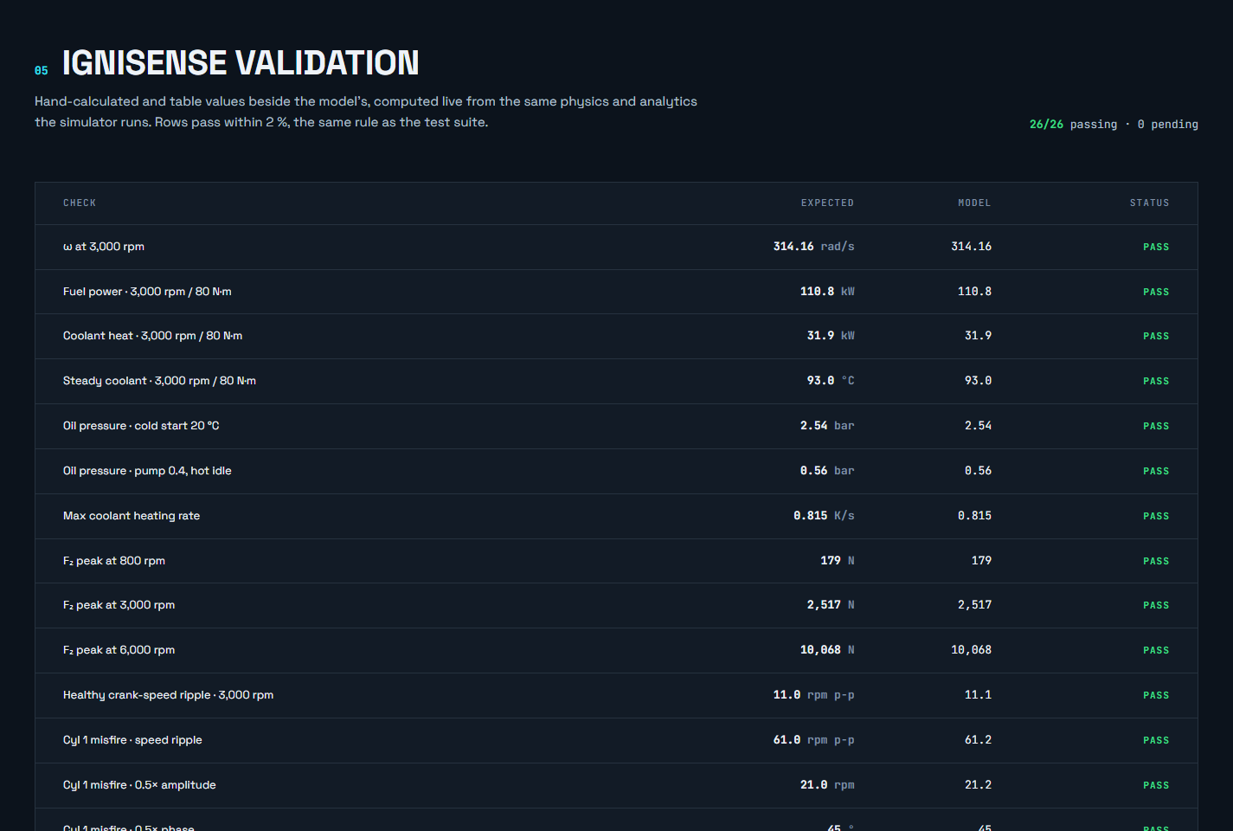
13 · CHECKED, NOT JUST CLAIMED
Every number is checked against hand calculation
363
automated tests, all passing
26
live checks on the Validation page
2%
tolerance on every review value
IGNISENSE · TEAM REVORA
14 / 17
Notes:
We don't just claim the physics is right. The Validation page recomputes hand-calculated values live in the browser, and every one passes. There are also 363 automated tests, and every golden number from the research review reproduces within two percent.

Slide 15
14 · FROM SIMULATOR TO A REAL ENGINE
Same analytics, any source
SIMULATOR
built-in plant
TWIN
TELEMETRY
healthy reference
CSV REPLAY
recorded runs
one common
format
ANALYTICS
ESP32
USB, real sensors
unchanged for every source
OBD-II
a real car
Green = tested end to end. Yellow = built and tested on parsers and simulated streams; real hardware is the next step.
PHONE
accelerometer
IGNISENSE · TEAM REVORA
15 / 17
Notes:
Every source emits the same telemetry object, so adding real hardware means adding one adapter file. Replay of a recorded CSV is tested end to end and reproduces the diagnosis. ESP32 and OBD-II are tested against parsers and simulated streams, not yet real hardware.

Slide 16
15 · HONEST LIMITS, CLEAR NEXT STEPS
What it is not, and what comes next
LIMITS, STATED PLAINLY
NEXT
Synthetic telemetry; every value is demo calibration.
Heat-balance run on the college engine rig, to replace demo calibration with measured values.
Lumped thermal model: one coolant, one oil temperature.
ESP32 with DS18B20, MAX31855, a pressure transducer and an ADXL345.
Evidence scores are weighted sums, not probabilities.
Log real failure data, then evaluate machine learning against our statistics.
Remaining life assumes the load continues.
IGNISENSE · TEAM REVORA
16 / 17
Notes:
We would rather state the limits ourselves. The values are demo calibration, and the data is synthetic. The next step is a heat-balance run on a real engine rig to replace demo calibration with measured data.

Slide 17
IGNISENSE
Pick a card.
We'll prove it.
Ask us to inject any fault: the monitor only ever sees the sensors.
TEAM REVORA
IgniSense — Smart Engine Health Diagnostic · all values are demo calibration
Notes:
Invite them to pick a card, or to name a fault for you to inject.

