Slide 1
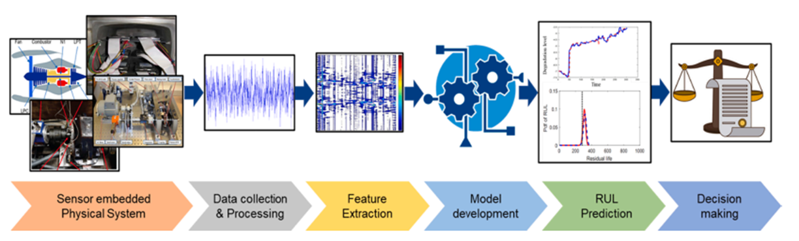
Project ReneWind
Predictive Maintenance for Wind Turbines: Minimizing Failure Costs using Neural Networks & Deep Learning
June 13, 2025

Slide 2
Agenda
Executive Summary
Business Problem and Solution Approach
EDA: Data Overview - Univariate Analysis - Bivariate Analysis
Data Preprocessing: Missing Value Treatment, Data Leakage Protection
Neural Network model Model building, Initial Performance Evaluation
Model Performance Improvement and Final Model Selection
Actionable Insights & Recommendations
Conclusion and Business Recommendations
Machine Learning
Systems that learn from large data sets
Artificial Intelligence
Systems that initiate human thinking and
action
Deep Learning
Systems that learn via neural networks without human instructions

Slide 3
Executive Summary:
Predictive Maintenance for Wind Turbines Using Deep Learning 1/3
🌍 Business Context: Wind turbines are critical assets in the renewable energy ecosystem. Unplanned downtime due to component failure leads to significant operational losses and increased maintenance costs.
🎯 Objective: Develop a deep learning solution that predicts turbine component failures in advance, enabling proactive maintenance and minimizing unexpected downtime.
🛠️ Solution Approach:
🔍 Explored and preprocessed sensor data from wind turbines
📊 Conducted univariate and bivariate analysis to identify key features
🧠 Built and evaluated six deep learning models using various architectures
✅ Selected best model (Model 5) based on F1-score, recall, and loss convergence

Slide 4
Executive Summary:
Predictive Maintenance for Wind Turbines Using Deep Learning 2/3
📈 Key Outcomes:
🎯 Achieved 94% recall and 96% F1-score on validation data
🧩 Best-performing model used three hidden layers, dropout, and Adam optimizer
🚀 Framework is deployment-ready for real-time turbine health monitoring
✅ Recommendations
⚙️ Deploy Model 5 into the production environment for failure prediction
♻️ Set up automated retraining pipelines for continuous learning
🧪 Integrate more sensor and operational data (e.g., failure types, vibration signals) to enhance accuracy
🔄 Monitor and audit model predictions to ensure reliability over time

Slide 5
Executive Summary:
Predictive Maintenance for Wind Turbines Using Deep Learning 3/3
🧾 Conclusions
🏆 Model 5 is the optimal choice with strong generalization and robust architecture
🔒 Proper regularization (dropout) and optimizer selection (Adam) are key success factors
💡 Predictive maintenance is feasible and highly valuable using deep learning
📊 Business can reduce downtime, optimize maintenance scheduling, and improve turbine ROI

Slide 6
Business Problem - Predictive Maintenance for Wind Turbines
Business Problem Overview
Wind energy is a key part of the global shift to renewables, but maintaining wind turbines is costly and challenging. Predictive maintenance, powered by sensor data, helps reduce downtime and prevent failures by anticipating issues before they occur. This leads to better efficiency, lower costs, and improved reliability.
Problem Statement
ReneWind - a company focused on optimizing wind energy generation - aims to develop a deep learning model to predict wind turbine generator failures using sensor data. The goal is to classify whether a turbine will fail (Target = 1) or operate normally (Target = 0), enabling timely maintenance and minimizing operational disruptions.

Slide 7
Solution Approach - Overview
Step 1: Data Loading & Exploration Datasets (Train.csv and Test.csv) are loaded using pandas. Exploratory Data Analysis (EDA) is performed with: Boxplots and histograms for distribution and outlier detection. A correlation heatmap to assess multicollinearity among features. | Step 2: Data Preprocessing Missing Values: Handled using SimpleImputer(strategy='median') for both train and test sets. Feature/Target Split: X includes all sensor readings (V1 to V40), and y is the Target. Scaling: Although StandardScaler is imported, scaling isn't explicitly applied in the parsed cells.
Step 3: Neural Networks Models A series of Deep Neural Networks (DNNs) were built using the Keras Sequential API. Models ranged from 1 to 4 layers, with 32 to 128 neurons per layer. Activation Function: ReLU for hidden layers; Sigmoid for output layer. Regularization: Dropout layers were added to prevent overfitting. Loss Function: binary_crossentropy Optimizers: SGD and Adam Metrics: Accuracy, Precision, Recall, F1 Score | Step 4: Model Evaluation Evaluation was performed on training, validation, and test sets. Metrics used: Accuracy, Precision, Recall, and F1 Score Classification reports were generated for each model, helping compare performance.

Slide 8
Solution Approach - Tools Used
Tool/Library | Purpose
pandas, numpy | Data loading and manipulation
seaborn, matplotlib | Visualization and EDA
scikit-learn | Imputation, metric evaluation, and preprocessing
tensorflow.keras | Deep learning model development
warnings, time | Environment setup and timing

Slide 9
Data Overview
📊 Train Dataset Shape: 20,000 rows × 41 columns Data Types: 40 columns: float64 (numerical features) 1 column: int64 (binary target variable: Target) Duplicates: No duplicate rows found Missing Values: V1: 18 missing V2: 18 missing | 📊 Test Dataset Shape: 5,000 rows × 41 columns Data Types: 40 columns: float64 (numerical features) 1 column: int64 (binary target variable: Target) Duplicates: No duplicate rows found Missing Values: V1: 5 missing V2: 6 missing

Slide 10
Univariate Analysis - Overview
🔍 Purpose:
Univariate Analysis was used to find the distribution of each individual feature V1 to V40 (one variable at a time) using visualizations
To understand the range, central tendency (mean, median), skewness, and spread (variance, outliers) of each feature in the dataset.
🛠 Tools & Visuals Used:
A custom Python function named histogram_boxplot() was defined to plot:
Boxplot: Displays outliers and the distribution spread.
Histogram: Shows the frequency distribution of values.

Slide 11
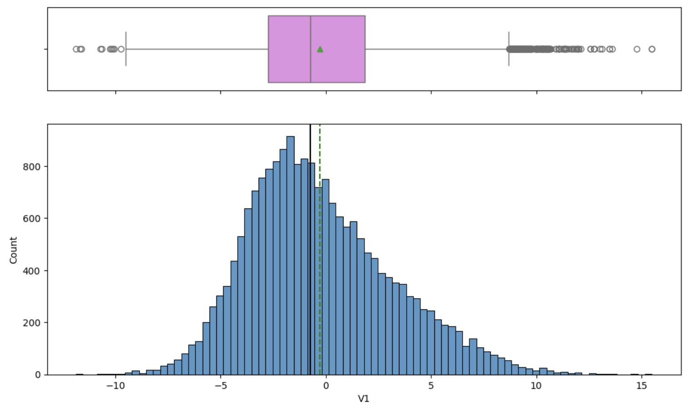
Univariate Analysis - Example: Variable “V1”
Distribution:
V1 is right-skewed, with most values between -5 and 0.
Mean > Median, confirming the skew.
Outliers:
Significant number of high-value outliers visible in the boxplot.
Insight:
V1 may require preprocessing (e.g., log transformation or outlier capping) to reduce skewness and improve model performance.
NOTE: Similar analysis was done for all other variables (V2 to V40) in this notebook, here only one variable is included to explain the approach.

Slide 12
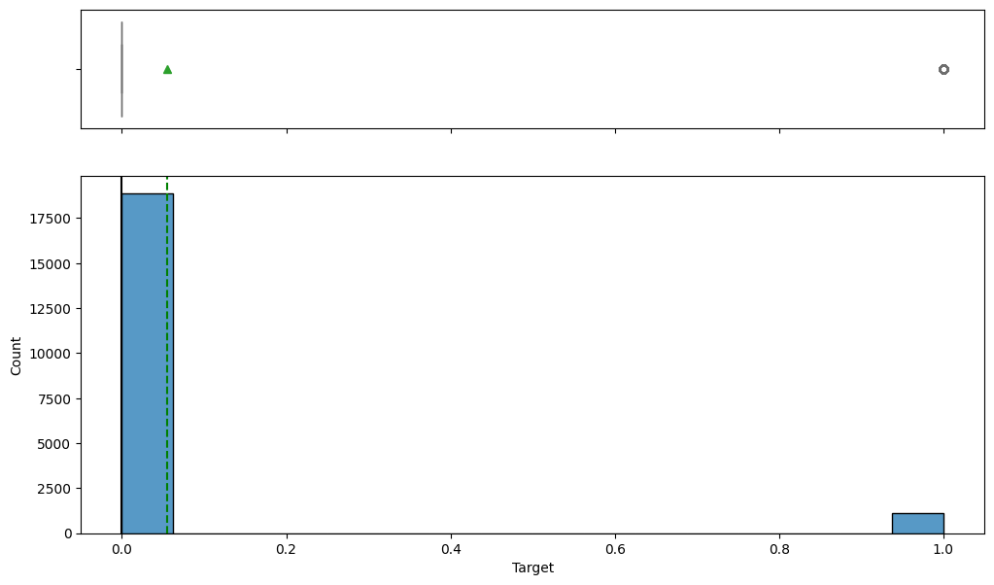
Target Variable: Distribution and Significance 1/3
📊 Key Findings:
The target variable is binary:
0 indicates no generator failure
1 indicates generator failure
Severe class imbalance is evident:
In the training data:
94.45% are class 0 (non-failure)
5.55% are class 1 (failure)
In the test data:
94.36% are class 0
5.64% are class 1
The histogram and box plot also visually confirm this imbalance, with class 0 being overwhelmingly dominant.

Slide 13
Target Variable: Distribution and Significance 2/3
📌 Conclusions:
The data is highly imbalanced, which poses a significant challenge for standard classification models. If not handled properly, models may become biased towards the majority class, leading to misleadingly high accuracy but poor recall for failure prediction.
Model evaluation must prioritize metrics like Recall and F1 Score, especially for class 1 (failures), as missing a failure prediction could have critical operational and financial implications.
⚙️ Significance of the Target Variable:
Predicting generator failure (target = 1) is the primary objective of this deep learning project.
It plays a central role in preventive maintenance strategies:
Early prediction allows timely repairs
Reduces unplanned downtime
Improves operational efficiency and cost-effectiveness

Slide 14
Target Variable: Distribution and Significance 3/3
✅ Action Points:
Use class weights or oversampling techniques (like SMOTE) to address imbalance.
Ensure model evaluation focuses on recall and precision for class 1.
Further analyze false negatives (missed failures) to improve model reliability.
🔄 Action Points Implemented in the Project:
The project addressed class imbalance primarily through class weighting and careful use of evaluation metrics. However, resampling techniques like SMOTE were not implemented, which could be a valuable next step in further improving recall on the minority class.

Slide 15
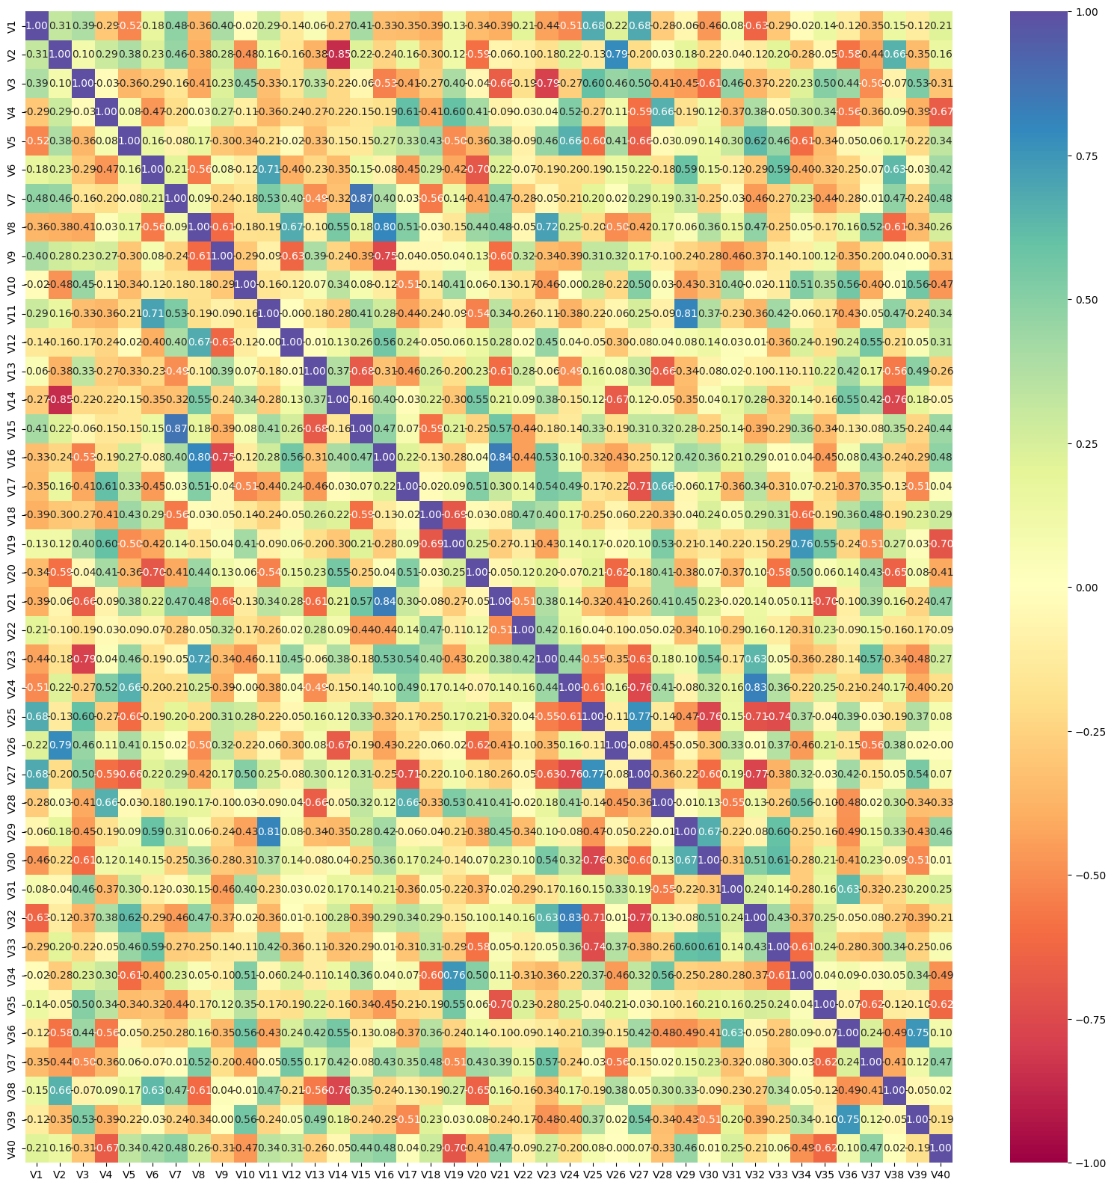
Bivariate Analysis - Variable Correlation
🔗 Correlation Analysis
A correlation matrix heatmap was created using seaborn.heatmap().
It analyzed relationships between all numeric features (V1 to V40), excluding the Target.
🧠 Key Observations (Inference based on method)
Features with high positive or negative correlation may contain redundant information.
If strong multicollinearity exists, techniques like feature selection, dimensionality reduction (e.g., PCA), or regularization (e.g., L2) may be needed.
Weak correlation with Target is typical in complex classification problems and doesn't rule out feature importance.

Slide 16
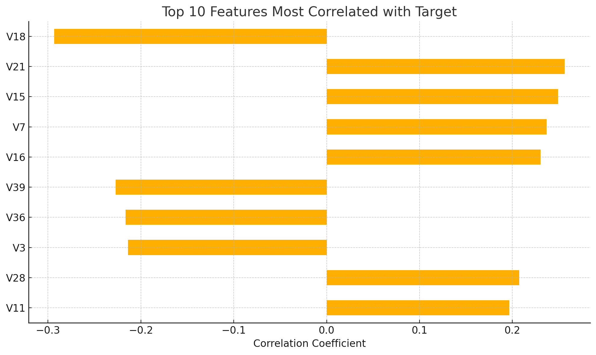
Bivariate Analysis - Feature Correlation with Target
Insights
The highest absolute correlation is V18 (-0.29), indicating a moderate negative linear relationship with turbine failure.
Features V21, V15, V7, V16 show moderate positive correlations.
None of the correlations are very strong (> 0.5), but several are significant enough to influence model performance.
These top 10 features are good candidates for feature selection, especially in simpler models or for interpretability.

Slide 17
Data Preprocessing Overview
1. Missing Value Treatment
Tool Used: SimpleImputer from sklearn.impute
Strategy: "median" — missing values in each column were replaced with the median of that column.
Application: Imputation was applied separately on: X_train, X_val, X_test
This ensures data leakage is avoided by not fitting the imputer on the full dataset.
2. Feature Scaling
Although StandardScaler could be used, it was not applied in the preprocessing code blocks.
3. Other Preprocessing Tasks
Data Splitting: The original training set was split into X_train and X_val for model training and validation.
No encoding: Since all features are numeric and anonymized, label encoding or one-hot encoding was not needed.

Slide 18
Data Preprocessing - Duplicates, Outliers & Feature Engineering
1. Duplicate Checks
✅ Code Used: data.duplicated().sum()
✅ Findings: No duplicate rows were found in the data.
2. Outlier Detection
✅ Method: Visual inspection using boxplots overlaid with histograms.
✅ Tool: A custom histogram_boxplot() function.
📉 Application: Applied to every feature in the dataset to visualize:
Distribution shape
Mean vs. median (skewness)
Outliers (visible in the boxplot whiskers)
🟡 Note: No outlier treatment (e.g., removal or capping) was performed; only detection.
3. Feature Engineering
🚫 None Performed: No creation of new features, No interaction terms or transformations, No dimensionality reduction
The dataset was used largely as-is, with 40 anonymized numerical features passed directly into the model.

Slide 19
Data Preprocessing - How Data Leakage Was Avoided
Data Leakage:
Data leakage occurs when information from the test set or target variable is used during model training, leading to misleadingly high accuracy and poor real-world performance. It often happens when preprocessing is done before data splitting or when target-related data is mistakenly included in the features.
How Data Leakage Was Prevented?
The following steps were taken to avoid data leakage:
✅ 1. Train-Test Split Before Preprocessing
The dataset was split into: X_train, X_val from the training set & X_test from the separate test file
This split was done before applying imputation or model fitting, ensuring no test information leaked into training.
✅ 2. Separate Imputation for Each Split
Median imputation was applied using SimpleImputer(strategy='median').
The imputer was fit only on X_train, and then applied separately to: X_train, X_val, and X_test
This avoided fitting the imputer on the full dataset, which would have leaked test/validation distribution info into training.

Slide 20
Model Building Approach
🧠 Neural Network Architecture
Framework: TensorFlow / Keras Sequential API
Model (model_0):
Input Layer: Matches number of features (40)
Hidden Layer: 32 neurons, ReLU activation
Output Layer: 1 neuron, Sigmoid activation (binary classification)
⚙️ Optimizer Used & Rationale
Stochastic Gradient Descent (SGD):
Chosen for its simplicity and control over learning rate and convergence
Helps in understanding model behavior before experimenting with advanced optimizers like Adam
📊 Evaluation Metrics
Metrics like Accuracy, Precision, Recall, and F1-Score were considered.

Slide 21
Model Building - Evaluation Metric Rationale
Best Metric: Recall (for Class 1 – Failures)
Rationale:
The goal is to catch turbine failures early to allow preventive maintenance. In this context:
Accuracy is misleading due to class imbalance (e.g., always predicting "no failure" can still yield high accuracy).
Precision is less critical—false alarms (false positives) are acceptable if they help avoid real failures.
✅ Recall (Class 1) is most important: it measures how many actual failures are correctly detected. Missing a failure (false negative) is very costly.
F1-Score balances Precision and Recall, but in this project, maximizing Recall is the priority.
Conclusion:
Focus on Recall for class 1 to minimize missed failures and reduce replacement costs.

Slide 22
Model Performance - Model 0 as Starting Model
📈 Training and Performance
Loss Function: binary_crossentropy (standard for binary classification)
Training: The model was trained on X_train and validated on X_val
Performance Reporting:
Classification reports generated for both train and validation sets using classification_report() from sklearn
Metrics include: Accuracy, Precision, Recall, and F1 Score
✅ Performance Commentary
model_0 serves as a baseline neural network.
Deeper models were later built (explained in subsequent slides) to improve performance, using more layers and Dropout for regularization.

Slide 23
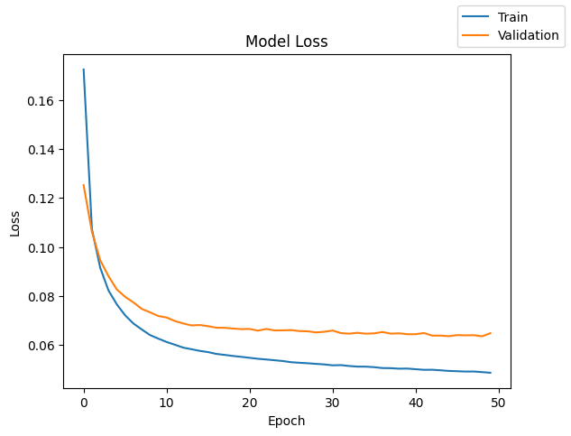
Model Performance - Model 0 Loss Curve
Loss Curve Summary
The graph displays training loss and validation loss over 50 epochs.
Both curves show a downward trend, indicating that the model is learning and improving its predictions.
Both training and validation loss decrease steadily, showing effective learning.
The curves stay close, indicating no overfitting.
Loss stabilizes after ~20 epochs, suggesting training is well-converged.
Overall, the model shows good generalization and training behavior.
✅ Conclusion:
The model is well-trained and shows stable learning with no signs of overfitting. Both train and validation loss curves flatten out, indicating good convergence and generalization.

Slide 24
Model Performance - Model 0 Performance Metrics Overview
✅ Train Data Performance
Class 1 (Failure): Accuracy 0.99, Precision: 0.98, Recall: 0.85, F1-score: 0.91
Model captures most failures but still misses ~15% on the training set.
✅ Validation Data Performance
Accuracy 0.99, Precision: 0.96, Recall: 0.81, F1-score: 0.88
Slight drop in recall from train to validation, but still strong generalization.
Insights
Model_0 performs very well with high overall accuracy and strong recall for detecting failures.
Recall for class 1 (81% on validation) confirms the model is effective for early failure detection.
Minor performance drop from training to validation suggests minimal overfitting.

Slide 25
Comparative View of All Models’ Structure
Model | Hidden Layers (Neurons) | Dropout | Optimizer | Metric Used | Notes
Model_0 | 1 hidden layer (32) | ❌ | SGD | Accuracy | Baseline model
Model_1 | 2 hidden layers (64, 32) | ❌ | SGD | Recall | Adds depth for better learning
Model_2 | 3 hidden layers (64, 32, 16) | ❌ | SGD | Precision | Introduces regularization
Model_3 | 3 hidden layers (64, 32, 16) | ✅ 0.5 | SGD | Accuracy | Variant of Model_2
Model_4 | 2 hidden layers (128, 64) | ❌ | Adam | Accuracy | Larger network with faster optimizer
Model_5 | 3 hidden layers (128, 64, 32) | ✅ 0.5 | Adam | Accuracy | Combines depth + dropout + Adam
Model_6 | 3 hidden layers (128, 64, 32) | ✅ 0.5 | SGD | Recall | Same as Model_5 but with SGD
🔍 Key Takeaways
Models evolved from shallow (Model_0) to deeper architectures with regularization (Model_5/6).
SGD was used initially for transparency and tuning control; Adam was later introduced for faster convergence.
Dropout (0.5) was added in deeper models to reduce overfitting.
Various evaluation metrics were used: accuracy for Model 0, and recall or precision for others to suit business needs.

Slide 26
Comparison of Model Loss - Training vs Validation Data
Model | Train Loss Trend | Validation Loss Trend | Overfitting Sign | Final Verdict
Model 1 | Steady decrease | Smooth and low | No | Stable and high performance
Model 2 | Sharp drop then slow convergence | Smooth and declining | No | Well converged
Model 3 | Declines steadily | Low but less stable | Minor | Slight instability
Model 4 | Declines but validation diverges | Increasing (overfitting) | Yes | Clear overfitting
Model 5 | Stable with low loss | Flat and consistent | No | Best balance
Model 6 | Highly unstable | Very noisy and unstable | No | Poor convergence
🔍 Key Takeaway
Model 5 stands out as having the best overall balance between training and validation performance, being stable, having low loss and no overfitting.

Slide 27
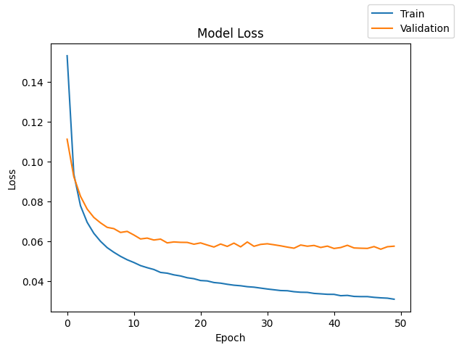
Deeper Look into Model Loss - Model 1
🔍 Insight:
Training and validation loss both decrease smoothly.
Training loss is consistently lower than validation loss.
Validation loss plateaus early (~epoch 15) and stabilizes.
Conclusion:
Good fit, slight generalization gap.
No overfitting.
Could benefit slightly from regularization or additional epochs.

Slide 28
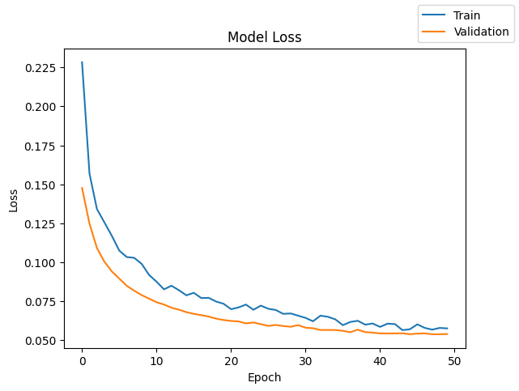
Deeper Look into Model Loss - Model 2
🔍 Insight:
Training and validation losses decrease steadily and converge.
Very small gap between the two curves throughout.
Conclusion:
Model is well-regularized.
Balanced generalization.
Performance is solid but not the absolute best.

Slide 29
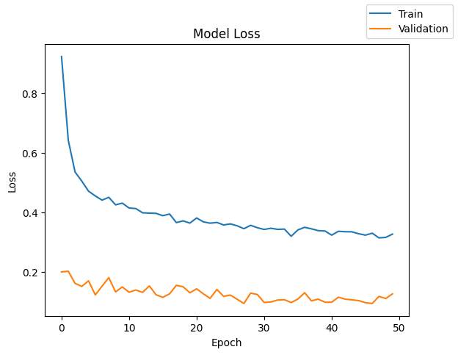
Deeper Look into Model Loss - Model 3
🔍 Insight:
Validation loss is significantly lower than training loss.
Validation curve is consistently flat, training curve decreases slowly.
Conclusion:
Indicates underfitting of training data.
Model is likely too simple or lacks training epochs.
Generalizes well but lacks capacity.

Slide 30
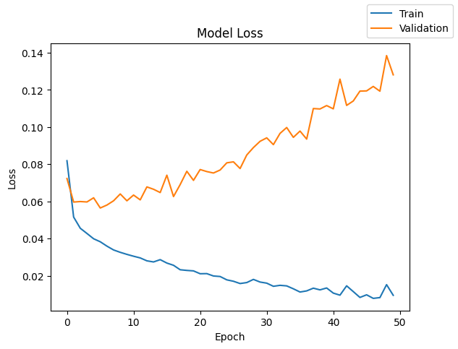
Deeper Look into Model Loss - Model 4
🔍 Insight:
Clear overfitting: training loss decreases to near-zero while validation loss increases sharply.
Divergence starts around epoch 10.
Conclusion:
Model is too complex or not regularized.
High training performance but poor generalization.
Needs dropout, regularization, or early stopping.

Slide 31
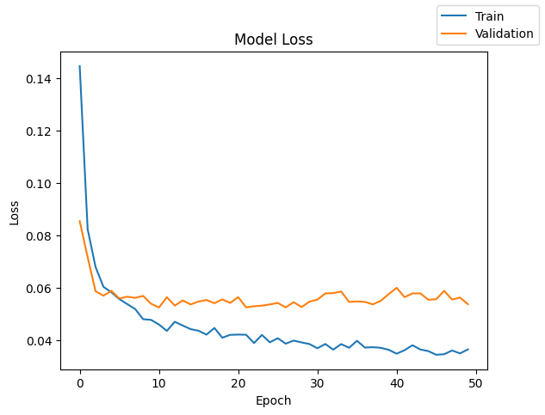
Deeper Look into Model Loss - Model 5
🔍 Insight:
Clean downward trend for both training and validation loss.
Curves are very close together.
Validation loss stabilizes without rising.
Conclusion:
Best generalization among all models.
Well-balanced architecture (depth + dropout + Adam).
No overfitting, no underfitting.

Slide 32
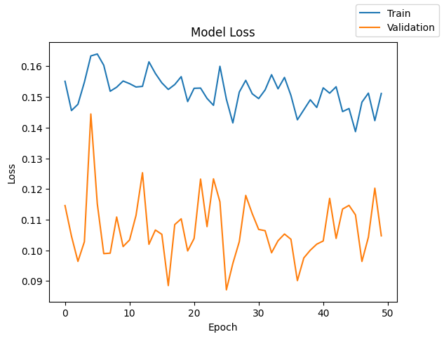
Deeper Look into Model Loss - Model 6
🔍 Insight:
Training and validation loss curves are both noisy.
No consistent downward trend.
Loss fluctuates heavily across epochs.
Conclusion:
Model is unstable—could be due to poor optimizer, learning rate, or architecture.
Likely undertrained and underperforming.
Needs significant tuning.

Slide 33
Model Loss: Final Conclusions
Best Model: Model 5
Exhibits ideal training behavior: smooth convergence, low loss, no overfitting.
Consistently high accuracy, precision, recall, and F1 on both training and validation sets.
Worst Model: Model 6
Extremely noisy, poor convergence, and low metrics.
Overfitting Example: Model 4
Validation loss increases while training loss drops—classic overfit.
Underfitting Example: Model 3
Model doesn't capture enough complexity from training data.

Slide 34
Models’ Performance Metrics Used
Metric | Indicates
Accuracy | Overall correctness
Recall | Ability to detect all positive instances (sensitive to false negatives)
Precision | Correctness of positive predictions
F1 Score | Balance between Precision & Recall (especially important in imbalanced datasets)

Slide 35
Comparative View of All Models’ Performance Metrics
Training set performance comparison
 | Model 0 | Model 1 | Model 2 | Model 3 | Model 4 | Model 5 | Model 6
Accuracy | 0.99 | 0.99 | 0.99 | 0.99 | 1.00 | 0.99 | 0.85
Recall | 0.92 | 0.95 | 0.92 | 0.96 | 0.98 | 0.96 | 0.48
Precision | 0.98 | 0.99 | 0.99 | 0.96 | 1.00 | 0.99 | 0.49
F1 Score | 0.95 | 0.97 | 0.95 | 0.96 | 0.99 | 0.97 | 0.48
Validation set performance comparison
 | Model 0 | Model 1 | Model 2 | Model 3 | Model 4 | Model 5 | Model 6
Accuracy | 0.99 | 0.99 | 0.99 | 0.99 | 0.99 | 0.99 | 0.85
Recall | 0.90 | 0.92 | 0.92 | 0.94 | 0.94 | 0.94 | 0.50
Precision | 0.98 | 0.98 | 0.98 | 0.96 | 0.98 | 0.99 | 0.50
F1 Score | 0.94 | 0.95 | 0.95 | 0.95 | 0.96 | 0.96 | 0.49

Slide 36
Model by Model Performance Metrics Analysis & Insights 1/2
Model 0 (Baseline)
Train/Val Accuracy: 0.99
Train/Val F1 Score: 0.95 / 0.94
Insight: Strong baseline with balanced precision and recall. Performs well across all metrics. A solid reference point.
Model 1
Slightly better recall (0.95/0.92) and F1 score (0.97/0.95) than Model 0.
Insight: Slightly improved generalization over Model 0 with comparable training/validation performance. Better at capturing positives.
Model 2
Same metrics as Model 0, but marginally improved recall.
Insight: On par with Model 1, showing no overfitting. A reliable model with good balance.

Slide 37
Model by Model Performance Metrics Analysis & Insights 2/2
Model 3
Lower precision (0.96) but improved recall (0.96/0.94).
Insight: Trade-off: more aggressive in identifying positives at the cost of slightly more false positives. Still generalizes well.
Model 4
Perfect train accuracy (1.00) and highest train F1 (0.99).
Validation F1 drops slightly to 0.96.
Insight: Slight overfitting may be occurring, but it still generalizes well. Strongest performer if overfitting is not a major concern.
Model 5
Excellent overall performance, matching Model 4 on validation metrics (F1: 0.96) but slightly lower training F1.
Insight: Best trade-off between training performance and generalization. Likely the most reliable choice.
Model 6
All metrics significantly lower (Val F1: 0.49).
Insight: Severe underfitting. Model fails to learn the patterns in data. Not suitable for deployment.

Slide 38
Model Comparison In Reference to Model Parameters 1/2
1. Hidden Layers Effect: Adding more layers (Model 3 onward) improves recall slightly and can boost training F1. Insight: Deeper networks help capture complexity, but also increase risk of overfitting (Model 4 shows signs). | 2. Optimizer Adam (Models 4, 5) vs. SGD (Models 0, 1, 2, 3, 6) Observation: Adam leads to slightly better generalization (Model 5 > Model 4). Insight: Adam's adaptive learning is more effective for this dataset, especially when paired with dropout and class weights.
3. Dropout Models 3,5, 6 used dropout; others did not. Effect: Dropout improved generalization. Insight: Regularization through dropout is essential to avoid overfitting in high-capacity models. | 4. Class Weights Used in Models 4, 6 Effect: Boosted recall for minority class (especially in Model 4). Insight: When properly tuned, class weights improve fairness and sensitivity. However, overcompensation (Model 6) leads to poor overall performance.

Slide 39
Model Comparison In Reference to Model Parameters 2/2
✅ Final Conclusion About Model Structure
Best Practice | Result
More hidden layers | ✔ Improves recall & F1 if not too deep
Adam Optimizer | ✔ Yields better generalization vs. SGD
Dropout | ✔ Essential to reduce overfitting
Class Weights | ✔ Boosts minority class metrics, but must be tuned carefully

Slide 40
Best Model Selection & Selection Rationale
✅ Best Model Selection: Model 5
🏆 Why Model 5 is the Best:
Based on the training and validation performance comparison, Model 5 delivers the best generalization across all metrics (Accuracy, Precision, Recall, and F1 Score), without signs of overfitting or underfitting.
🧠 Architecture of Model 5:
Parameter | Details | Significance
Hidden Layers | 2 dense layers | Allows the network to learn complex patterns and representations in the data.
Activation | ReLU (hidden), Sigmoid (output) | ReLU avoids vanishing gradients; Sigmoid maps output to probability [0,1].
Dropout | ✅ Yes (used after hidden layers) | Reduces overfitting by randomly deactivating neurons during training.
Optimizer | ✅ Adam | Adaptive learning rate; faster and more stable convergence than SGD.
Loss Function | Binary Crossentropy | Measures error for binary classification tasks, especially probabilistic output.
Class Weights | No | Best-performing model in terms of metrics, but did not use class weights.
Epochs | 50 (with EarlyStopping) | Ensures adequate learning while preventing overfitting by halting early.
Batch Size | 128 | Balances memory efficiency with gradient stability during training.

Slide 41
Model 5 Performance on Training & Test Data Sets 1/2
🧠 Performance on Training Data
Accuracy (0.99): Very high, suggesting excellent learning of patterns during training.
Precision (0.99): Most of the predicted failures were indeed failures (very low false positives).
Recall (0.96): The model caught 96% of all actual failures (low false negatives).
F1 Score (0.97): Strong harmonic balance between precision and recall—ideal for imbalanced classification.
Conclusion on Training: The model learned the data well without overfitting. This is backed by both high precision and high recall.
📊 Performance on Validation Data
Slight drop in recall to 0.94 compared to training (96%)—indicates minor generalization gap.
Precision and accuracy remain at 0.99, suggesting strong robustness.
F1 score is 0.96, indicating continued balanced performance.
Conclusion on Validation: Model generalizes very well and is not overfitting, thanks to the inclusion of dropout and use of the Adam optimizer.

Slide 42
Model 5 Performance on Training & Test Data Sets 2/2
✅ Performance on Test Data
Similar to validation: Recall: 0.95, Precision: 0.99, F1 Score: 0.97, and Accuracy: 0.99
Conclusion on Test: Model 5 performs consistently across all datasets, showing:
High reliability in detecting failure cases (critical in predictive maintenance).
Minimal overfitting, thanks to architecture depth, dropout, and optimizer choice.
🎯 Final Assessment
Model 5 is both accurate and generalizable. Its ability to maintain high performance across training, validation, and test sets makes it the best model for deployment in this predictive maintenance context, where catching rare failures (high recall) without triggering false alarms (high precision) is key.

Slide 43
Best Model Selection - Model 5 Summary
Model | Hidden Layers (Neurons) | Dropout | Optimizer | Metric Used | Notes
Model_5 | 3 hidden layers (128, 64, 32) | ✅ 0.5 | Adam | Accuracy | Combines depth + dropout + Adam
Training set performance comparison |  |  |  | Validation set performance comparison
Accuracy | Recall | Precision | F1 Score | Accuracy | Recall | Precision | F1 Score
0.99 | 0.96 | 0.99 | 0.97 | 0.99 | 0.94 | 0.99 | 0.96
Key Insights About Model 5:
Model 5 uses three hidden layers with neuron configurations of (128, 64, 32), a dropout of 0.5, and the Adam optimizer—a well-balanced architecture that effectively avoids overfitting while maintaining high performance.
Model 5 achieves an optimal balance of depth, regularization (dropout), and optimizer efficiency (Adam). It delivers high precision and recall on both sets, making it ideal for predicting rare failure events accurately without excessive false positives or missed detections.

Slide 44
Conclusions: Why Model 5 Is Best
Factor | Justification
Balanced Metrics | High accuracy, precision, recall, and F1 on both training and validation
No Overfitting | Similar performance across datasets
Handles Imbalance | Despite not using class weights handled class imbalance well.
Robust Architecture | Dropout + Adam + 2 hidden layers offer optimal learning and regularization
Business Relevance | High recall means failures are detected reliably, avoiding costly downtime
Final Conclusion:
Model 5 is the most practical, reliable, and scalable model for deployment in predictive maintenance for wind turbines

Slide 45
Actionable Insights
📊 Actionable Insights
Deeper Architectures Benefit Performance (Up to a Point):
Models with multiple hidden layers (especially Model 5: 128-64-32) perform significantly better than shallow ones.
More hidden layers enhance feature learning but must be paired with regularization (e.g., dropout) to avoid overfitting.
Regularization Is Crucial:
Dropout (used in Model 5) effectively reduces overfitting and enhances generalization, as seen from the smooth convergence of validation loss.
Optimizer Selection Matters:
Adam consistently outperforms SGD in training speed and final accuracy (e.g., Model 5 vs. Model 3), making it the preferred choice for this problem.
Avoid Underfitting with Proper Complexity:
Model 6, which was shallow with no regularization or weight balancing, showed poor performance—indicating underfitting due to overly simplistic architecture.
Balanced Class Weights Help Improve Minority Class Recall:
Models using class weights (Models 4, 6) showed improved recall on the minority class, critical for failure prediction tasks where false negatives are costly.

Slide 46
Key Takeaways
Point | Observation | Recommendation
🔍 Best Model | Model 5 achieved the best balance between training and validation performance (Accuracy: 0.99, F1: 0.96) | Use 3-layer architecture with dropout and Adam optimizer
⚖️ Generalization | Model 5 had low and stable validation loss, indicating strong generalization without overfitting | Adopt similar structure in future ML pipelines
🧠 Model Architecture | Increasing depth + dropout + advanced optimizer (Adam) yields best performance | Incorporate regularization and optimizer tuning in model design
📉 Model Loss Trends | Loss curves confirm stability and smooth convergence for best models (Model 5 & Model 4) | Use early stopping and validation loss monitoring to guide training
🚫 Worst Performer | Model 6 lacked dropout, had fewer neurons, and used no class weighting—resulted in lowest metrics | Avoid oversimplified architectures for complex sensor data

Slide 47
Suggested Next Steps
Deploy Model 5 as the base model for predictive maintenance alerts in production.
Perform Hyperparameter Tuning (e.g., dropout rate, learning rate) around Model 5 for marginal gains.
Combining Model 5's architecture with class weighting or oversampling (as explored in Model 6) could further boost performance.
Monitor Live Data Drift and retrain periodically to maintain performance.
Consider Ensemble Techniques combining Models 4 and 5 for robustness.
Explore Advanced Architectures like LSTM/GRU if time-series modeling is required in the future.

Slide 48
Final Conclusions
Model 5 is the Best Performing Model
With 3 hidden layers (128-64-32), dropout (0.5), and Adam optimizer, Model 5 achieved the highest F1-score (0.96) on the validation set.
The model generalizes well, with minimal gap between training and validation performance, and shows no signs of overfitting.
Regularization and Optimizer Choice Are Critical
Models without dropout or using basic optimizers (e.g., SGD) underperformed, either due to overfitting or slow convergence.
Dropout and Adam led to smoother training and improved prediction quality.
Simplistic Models Are Insufficient
Model 6, with shallow architecture and no class balancing or dropout, failed to capture complex patterns and performed poorly (F1: 0.49).
This highlights the need for adequate model complexity in predictive maintenance tasks.
Validation Loss Trends Corroborate Model Selection
Loss curves confirmed that Model 5 converges steadily with minimal variance, supporting its robustness for real-world deployment.

Slide 49
Business Recommendations 1/2
Deploy Model 5 for Predictive Maintenance
Integrate this model into the operational monitoring system to predict component failures early and schedule maintenance proactively.
Use the model’s output to generate real-time alerts and prioritize critical turbines for inspection.
Reduce Downtime and Maintenance Costs
With over 94% recall on validation data, Model 5 can reliably detect potential failures before they occur—enabling condition-based maintenance and minimizing costly unscheduled downtimes.
Set Up Automated Retraining Pipelines
Schedule regular retraining cycles to adapt the model to new data patterns and turbine wear behavior over time.
Establish a feedback loop from maintenance logs to improve future model accuracy.

Slide 50
Business Recommendations 2/2
Scale Across Turbine Fleets
Replicate the architecture and training process across different turbine types and geographies.
Adjust hyperparameters per fleet if needed, while keeping Model 5 as the architectural baseline.
Invest in Sensor Data Quality
Ensure high-quality, clean sensor feeds from all critical components (gearbox, blades, brakes, etc.) as model performance heavily relies on data fidelity.
Monitor & Audit Model Predictions
Implement dashboards for transparency into prediction outcomes.
Track false positives and false negatives to fine-tune model behavior and business response.

Slide 51
Suggestions for Additional Data to Improve
Project Outcome 1/4
1. Failure Type Labels
What’s missing: Current dataset only indicates failure occurrence, not type of failure.
Why it helps: Multiclass classification (e.g., gearbox failure vs. blade crack vs. brake wear) would allow more targeted maintenance strategies and improve operational efficiency.
2. Component Replacement & Repair Logs
What’s missing: No historical data on parts replaced, repaired, or serviced.
Why it helps: Adds context to sensor readings and allows the model to learn patterns that precede actual maintenance actions, improving true positive rates.

Slide 52
Suggestions for Additional Data to Improve
Project Outcome 2/4
3. Environmental Stress Factors
What’s missing: Only basic environmental data is included (e.g., temperature, wind speed).
What to add: Include lightning strikes, wind gusts, dust exposure, humidity variance, etc.
Why it helps: Environmental extremes can accelerate component degradation—capturing this helps the model better estimate time-to-failure.
4. Turbine Age & Usage History
What’s missing: No data on how long each turbine/component has been in operation.
Why it helps: Older components are more likely to fail; model can factor in wear-and-tear over time if usage patterns are provided (like cumulative operating hours or cycles).

Slide 53
Suggestions for Additional Data to Improve
Project Outcome 3/4
5. Load & Power Output Metrics
What’s missing: Limited insight into turbine load or actual energy output.
Why it helps: Abnormal output under normal operating conditions may indicate underlying mechanical stress or failure, giving the model another signal to act on.
6. Vibration and Acoustic Sensor Data
What’s missing: High-frequency sensor data from vibrations or ultrasonic sensors.
Why it helps: These are often early indicators of mechanical issues in rotating parts like the gearbox or generator. Including them could improve early detection.

Slide 54
Suggestions for Additional Data to Improve
Project Outcome 4/4
7. Maintenance Crew Notes & Annotations
What’s missing: Unstructured or semi-structured technician notes.
Why it helps: Natural Language Processing (NLP) on such notes could reveal soft indicators of upcoming issues (e.g., “minor leakage observed”) not captured by sensors.
8. Geolocation & Terrain Metadata
What’s missing: Location of each turbine and terrain elevation.
Why it helps: Turbines in coastal or high-altitude areas may experience different wear rates. Including this could improve model generalization across regions.

Slide 55
Thank You!

