Slide 1
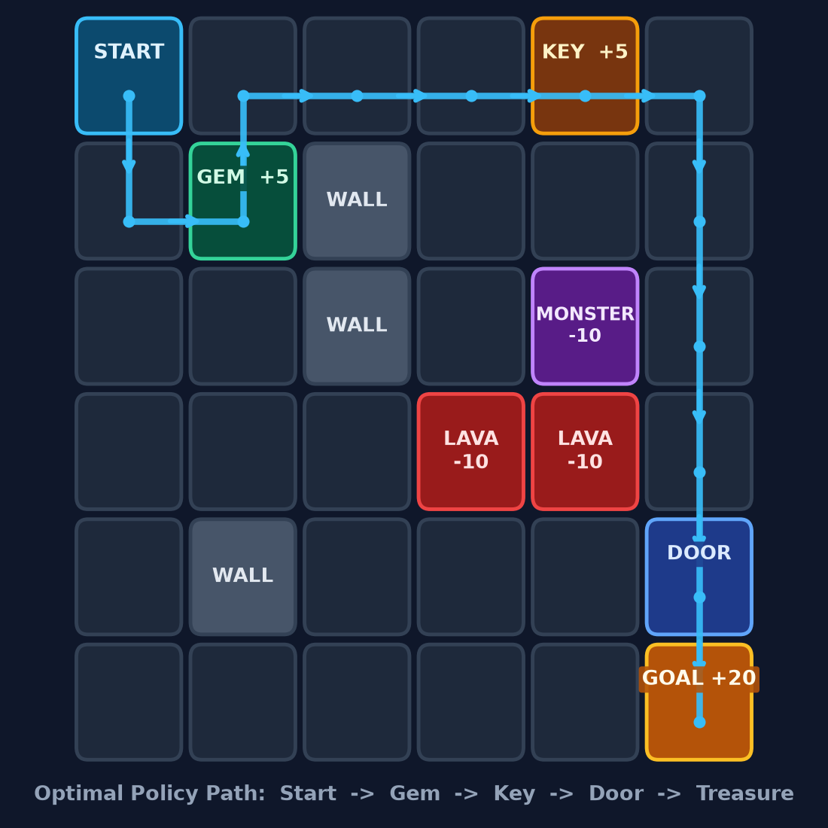
CSA4708 • CA2 PROJECT • MODULE 3: TD LEARNING
Treasure Hunt RL:
10-Level GridWorld
Interactive Human-Playable & Autonomous Agent Game
Powered by Tabular SARSA (On-Policy) & Q-Learning (Off-Policy)
10 Progressive Levels
Dual Play Modes
Pure Tabular TD RL
5x5 Meadow to 12x12 Vault
Human Play + Live AI Rollout
NumPy Q-Table From Scratch
TEAM MEMBERS (5) — [Edit Names / Roll Nos Before Class]
Agent starts with zero map knowledge and learns online from step rewards to collect Gems & Keys, unlock Doors, dodge Lava & Monsters, and reach the +20 Treasure.
1. Member 1 (Intro & Problem) 2. Member 2 (MDP Model)
Submitted to: Dr. Sarvanan | Tech Stack: Python, Streamlit, NumPy, Matplotlib
Notes:
MEMBER 1 (1 min): Good morning Ma'am and everyone. Our CA2 project is Treasure Hunt RL — a 10-level interactive GridWorld game built from scratch using pure Tabular Temporal Difference learning (SARSA and Q-Learning) with NumPy and Streamlit.

Slide 2
01 • MOTIVATION & SCOPE
Member 1
Problem Statement, Objectives & Real-World Link
THE PROBLEM & PROJECT OBJECTIVES
REAL-WORLD APPLICATIONS OF GRID MDP NAVIGATION
• Unknown Dynamic Environment: An autonomous agent starts at (0,0) with no transition model P(s'|s,a) and must discover the shortest safe route.
• Multi-Hazard Navigation: 10 progressive maps add static walls, fatal lava (-10), and moving patrol monsters (-10) that reset the agent.
• Sequential Sub-Goal Dependency: Levels 7, 9 & 10 lock the goal behind a Door — the agent must grab the Key first.
• Objective 1 — Dual-Mode Game: Let humans play manually (Tab 1) AND train RL agents live (Tabs 2 & 3) across 10 difficulty tiers.
• Objective 2 — Model-Free TD Control: Implement tabular SARSA & Q-Learning from scratch without any pre-trained ML library.
Warehouse Fulfillment Robots
Amazon Kiva / AMR robots learn collision-free shortest paths around shelves (walls) and moving workers (patrol hazards).
Search & Rescue Rovers
Autonomous drones navigate fire/radiation zones (lava penalties) without a floor map using online step rewards.
Multi-Stage Task Planning
Industrial robots must fetch a tool first (Key) before unlocking an assembly station (Door -> Goal).
Adaptive Game AI / NPCs
Game agents learn tactical hazard timing directly through trial-and-error episodes.
CSA4708 Reinforcement Learning • CA2 Project (Module 3: TD Learning)
Slide 2 of 7
Notes:
MEMBER 1 (1 min): The agent starts with zero knowledge of walls, lava, or moving patrol monsters, and on harder levels must pick up a key before unlocking the door — mirroring warehouse robots, rescue rovers, and multi-stage task planning.

Slide 3
02 • RL FORMULATION
Member 1
Modeling Treasure Hunt as a Markov Decision Process (MDP)
STATE SPACE (S)
ACTION & Q-TABLE MODEL
HYPERPARAMETERS
• Augmented State Tuple: (row, col, has_key)
• State ID Formula: id = (r * cols + c) * 2 + key
• Why has_key? Makes Key -> Door Markovian!
• Scale: 50 states (L1) up to 288 (L10)
• 4 Discrete Actions: 0:Up, 1:Down, 2:Left, 3:Right
• Model Representation: Tabular NumPy Q[n_states, 4]
• No Neural Net / Library: 100% transparent value table
• Dynamic Step: Monsters patrol every step
• Behavior Policy: epsilon-Greedy exploration
• Epsilon Decay: 1.0 -> 0.01 (x0.995 / ep)
• Learning Rate (alpha): 0.10 (TD step-size weight)
• Discount (gamma): 0.95 (long-horizon planning)
REWARD STRUCTURE R(s, a, s') IN GridEnv.step() (Lines 214–280)
+20
+5
-1
-10
Treasure Goal
Key / Bonus Gem
Every Step / Wall
Lava / Monster
Terminal win (requires Key on door levels)
Rewards sub-goal discovery & bonus score
Penalizes delay -> forces shortest path
Heavy hazard penalty + resets to Start
CSA4708 Reinforcement Learning • CA2 Project (Module 3: TD Learning)
Slide 3 of 7
Notes:
MEMBER 2 (1.5 min): Notice our model is a pure Tabular NumPy Q-table of shape (n_states, 4) — we do not use any external black-box ML model. Multiplying cell index by 2 plus has_key lets the Q-table store separate values before and after picking up the key.

Slide 4
03 • MODULE 3 CORE ALGORITHMS
Member 1
Temporal Difference Learning: SARSA vs. Q-Learning
TD(0) PREDICTION PRINCIPLE:
V(S) <- V(S) + alpha * [ R + gamma * V(S') - V(S) ]
Updates online every 1 step via bootstrapping (model-free).
SARSA — ON-POLICY TD CONTROL
Q-LEARNING — OFF-POLICY TD CONTROL
Q(S,A) <- Q(S,A) + α [ R + γ Q(S', A') - Q(S,A) ]
Q(S,A) <- Q(S,A) + α [ R + γ max_a' Q(S',a') - Q(S,A) ]
• Tuple (S, A, R, S', A'): Bootstraps using action A' actually chosen next by epsilon-greedy.
• Cautious Policy: Penalizes risky paths near Lava/Monsters because random exploration could slip in.
• Greedy Max Target: Bootstraps using best next action max Q(S',a'), regardless of exploration.
• Fast Optimal Policy: Directly learns optimal Q* -> converges faster to shortest path.
Method | Update Target | Policy Type | Needs Model? | Updates Online?
Dynamic Prog. (DP) | Full expected backup E[R + γV(S')] | Optimal / Eval | Yes (P required) | No (sweeps)
Monte Carlo (MC) | Actual episode return G_t | On-Policy | No (Model-Free) | No (episode end)
SARSA | R + γ Q(S', A') [actual A'] | On-Policy TD | No (Model-Free) | Yes (every step)
Q-Learning | R + γ max_a' Q(S', a') [best a'] | Off-Policy TD | No (Model-Free) | Yes (every step)
CSA4708 Reinforcement Learning • CA2 Project (Module 3: TD Learning)
Slide 4 of 7
Notes:
MEMBER 3 (1.5 min): Here is the theoretical foundation from Module 3. Unlike DP which requires P(s'|s,a) or Monte Carlo which waits until the episode ends, both SARSA and Q-Learning update online after every single step.

Slide 5
04 • ARCHITECTURE & ALGORITHM MAP
Member 1
Where Each Model & Algorithm Is Used in app.py
1. Streamlit UI
2. GridEnv MDP
3. Tabular Q-Model
4. Greedy Rollout
Sidebar + 4 Tabs
(Lines 530–845)
->
State, Patrols & Rewards
(Lines 166–280)
->
NumPy Q[S,4] + SARSA/Q
(Lines 286–333)
->
argmax Q[s] Animation
(Lines 335–349)
MODEL USED: Pure Tabular Action-Value Matrix Q = np.zeros((rows * cols * 2, 4)) — Built 100% from scratch in NumPy (No pre-trained Neural Net / Gym library).
Algorithm / Model Component | Where Used in UI | Function & Lines (app.py) | Exact Role in the Program
1. Markov Decision Process (MDP Environment) | Tab 1 (Play Game) & Tabs 2–3 (AI Training) | class GridEnv state_id(), step() [L166–280] | Computes state_id=(r*cols+c)*2+key, moves patrol monsters every step, and returns (next_state, reward, done).
2. Epsilon-Greedy Policy (Behavior / Exploration) | Inside Training Loop (Tabs 2 & 3 + Sidebar) | epsilon_greedy(Q, s, eps) [Lines 286–289] | Picks random move with prob eps (1.0 -> 0.01, decay 0.995) to explore keys/paths, else argmax(Q[state]).
3. Q-Learning Algorithm (Off-Policy TD Control) | Tab 2 ('Train Agent') & Tab 3 ('Train Both') | train_agent('Q-Learning') [Lines 321–328] | Updates Q[s,a] after every step using greedy max target: reward + gamma * np.max(Q[next_state]).
4. SARSA Algorithm (On-Policy TD Control) | Tab 2 ('Train Agent') & Tab 3 ('Train Both') | train_agent('SARSA') [Lines 305–320] | Selects next_action A' first via eps-greedy, then updates Q[s,a] using actual Q[next_state, next_action].
5. Greedy Target Policy (Trained Agent Demo) | Tab 2 ('Watch AI / Auto Play') & Tab 3 Final Boards | greedy_rollout(Q, level) [Lines 335–349] | Sets exploration eps = 0 and executes action = np.argmax(Q[state]) step-by-step to animate the winning path.
CSA4708 Reinforcement Learning • CA2 Project (Module 3: TD Learning)
Slide 5 of 7
Notes:
MEMBER 4 (1 min): This slide maps every single RL model and algorithm to where it runs in our program. We use a pure NumPy Q-table built from scratch: GridEnv handles the MDP transitions, epsilon_greedy drives exploration during training, train_agent runs either Q-Learning or SARSA in Tabs 2 and 3, and greedy_rollout runs pure argmax(Q) when we click Watch AI Play.

Slide 6
05 • BASE CODE WALKTHROUGH
Member 1
Core RL Base Code Implemented in app.py
1. TABULAR Q-MODEL & EPSILON-GREEDY (Lines 193, 286–296)
2. Q-LEARNING BASE CODE — OFF-POLICY (Lines 321–328)
def state_id(self): # 2 states per cell (has_key 0/1)
r, c = self.pos
return (r * self.cols + c) * 2 + int(self.has_key)
def epsilon_greedy(Q, state, epsilon):
if np.random.rand() < epsilon:
return np.random.randint(4) # Explore random
return int(np.argmax(Q[state])) # Exploit Q-table
Q = np.zeros((env.rows * env.cols * 2, 4)) # Tabular model
# Used in Tab 2 (Q-Learning) & Tab 3 (Compare Both)
while not done:
action = epsilon_greedy(Q, state, epsilon)
next_state, reward, done, info = env.step(action)
# Off-policy target: uses BEST next action np.max()
target = (reward if done else
reward + gamma * np.max(Q[next_state]))
Q[state, action] += alpha * (target - Q[state, action])
state = next_state
3. SARSA BASE CODE — ON-POLICY (Lines 305–320)
4. GREEDY ROLLOUT — 'WATCH AI PLAY' (Lines 335–349)
# Used in Tab 2 (SARSA) & Tab 3 (Compare Both)
action = epsilon_greedy(Q, state, epsilon) # Initial A
while not done:
next_state, reward, done, info = env.step(action)
if done:
target = reward
else: # On-policy: uses ACTUAL next_action A'
next_action = epsilon_greedy(Q, next_state, eps)
target = reward + gamma * Q[next_state, next_action]
action = next_action
Q[state, action] += alpha * (target - Q[state, action])
state = next_state
# Used when clicking 'Next Step' / 'Auto Play' in UI
def greedy_rollout(Q, level_id, max_steps=150):
env = GridEnv(level_id)
state = env.reset()
done = False
while not done:
# Pure exploitation (eps = 0): pick highest Q
action = int(np.argmax(Q[state]))
state, reward, done, info = env.step(action)
trajectory.append((env.pos, env.has_key))
return trajectory, total_r, info['reached_goal']
CSA4708 Reinforcement Learning • CA2 Project (Module 3: TD Learning)
Slide 6 of 7
Notes:
MEMBER 4 (1 min): Here are the exact 4 base-code functions from app.py. Box 1 initializes our Q-table and epsilon-greedy exploration. Compare Box 2 and Box 3: Q-Learning computes target using np.max(Q[next_state]), whereas SARSA picks next_action first and uses Q[next_state, next_action]. Finally, Box 4 shows greedy_rollout(), which uses np.argmax(Q[state]) to animate the trained robot live.

Slide 7
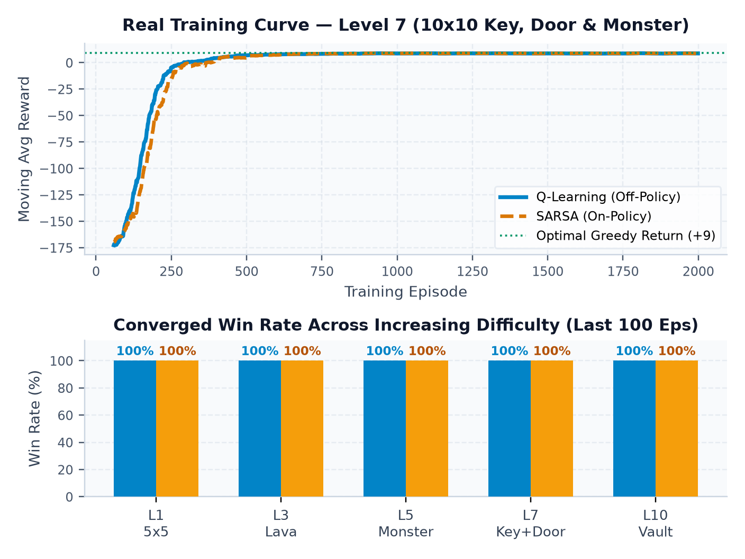
06 • EXECUTION RESULTS & CONCLUSION
Member 1
Experimental Results, Takeaways & Live Demo
BENCHMARK PERFORMANCE ACROSS LEVELS
Level (Grid) | Episodes | Win Rate | Greedy Steps
L1 Meadow (5x5) | 500 | 100% | 8 steps (+19)
L5 Monster (8x8) | 1,500 | 100% | 14 steps (+13)
L7 Key+Door (10x10) | 2,000 | 100% | 18 steps (+9)
L10 Vault (12x12) | 3,000 | 100% | 44 steps (Win)
KEY CONCLUSIONS
• Q-Learning vs. SARSA: Q-Learning learns shortest paths faster; SARSA avoids hazard edges during exploration.
• Generalization: One tabular NumPy Q-table solves static mazes, patrol timing, and Key-Door sub-goals.
Actual output from app.py (alpha=0.10, gamma=0.95, eps decay=0.995). Q-Learning rises slightly earlier; both reach 100% greedy win rate across all 10 levels.
NEXT: LIVE CLASSROOM DEMO (streamlit run app.py)
1. Human Play L1 -> 2. Train Q-Learning Live -> 3. Compare SARSA -> 4. Solve L7/L10
CSA4708 Reinforcement Learning • CA2 Project (Module 3: TD Learning)
Slide 7 of 7
Notes:
MEMBER 5 (1 min + Live Demo): Here are the real learning curves generated from app.py. Both algorithms reach 100% win rate across all 10 levels. Now let's switch to our live Streamlit window for the demonstration!

