Slide 1
What Really Drives U.S.
Industrial GHG Emissions?
A four-stage analysis: structural change vs. atmospheric forcing
EPA GHGRP (2010–2023) · ERA5 Reanalysis · OWID / Global Carbon Project
−22% emissions since 2011
86,000 facility-year obs
R²=0.88 structural ML model
−0.003 climate's marginal value
Harvard D³ Institute Assessment | Suhail Mahmud, PhD

Slide 2
The Question & The Data
Do atmospheric conditions drive U.S. industrial GHG emissions, or is the trend structural? We tested this at four levels of rigor — national, atmospheric correlation, fixed-effects panel, and predictive ML.
EPA GHGRP
ERA5 (ECMWF)
OWID / GCP
Facility-level direct emissions, 2010–2023. 6,470 facilities in 2023, 86,000 facility-year obs in panel. Validated to 0.05% of EPA's published 2,580 MMt CO₂e headline.
Monthly CONUS reanalysis from uploaded GRIB. Seven real atmospheric variables: temperature, dewpoint→VPD, RH, wind, surface pressure, SST, precipitation.
U.S. national CO₂ and total-GHG context, live download. Cross-checks the GHGRP industrial subset against economy-wide totals.
All three datasets are real and verified. This work replaces an earlier draft that relied on fabricated atmospheric values.
Analysis arc:
1
National trend
2
Atmospheric correlations
3
Facility-year panel (FE)
4
Predictive ML

Slide 3
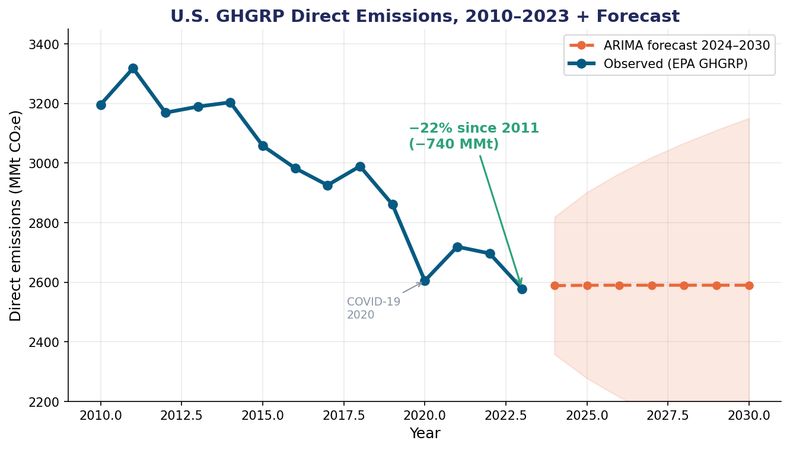
Stage 1 — Emissions Fell 22%, Driven by the Power Sector
Headline findings
3,318 → 2,579 MMt peak (2011) to 2023
−740 MMt total reduction
ρ = −0.93 Spearman, p<0.0001
−54.9 MMt/yr linear trend, R²=0.90
Validated to 0.05% of EPA's published 2023 headline (2,579 vs. 2,580 MMt CO₂e).

Slide 4
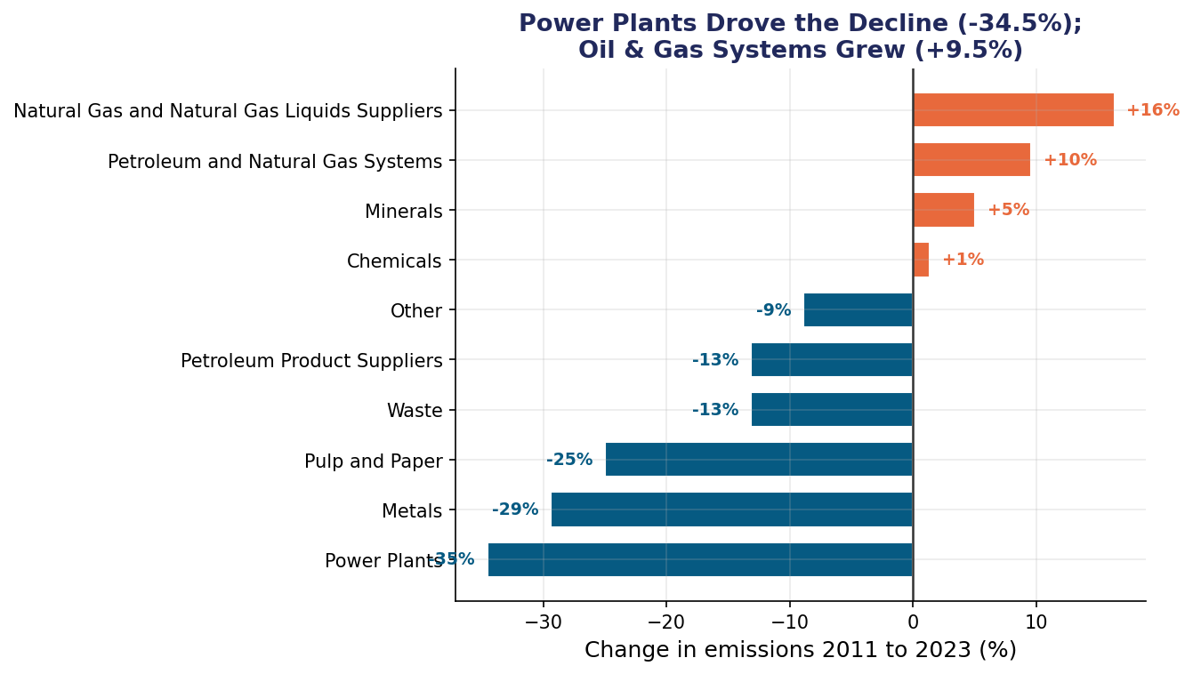
Where the Cuts Came From: Power Sector Decarbonization
What the sectors say
Power Plants: −34.5% 758 MMt cut — essentially the entire national decline. Coal-to-gas plus renewables. Oil & Gas Systems: +9.5% The one major sector that grew, reflecting expanded U.S. production. Metals −29%, Pulp/Paper −25% Genuine but small in absolute terms.

Slide 5
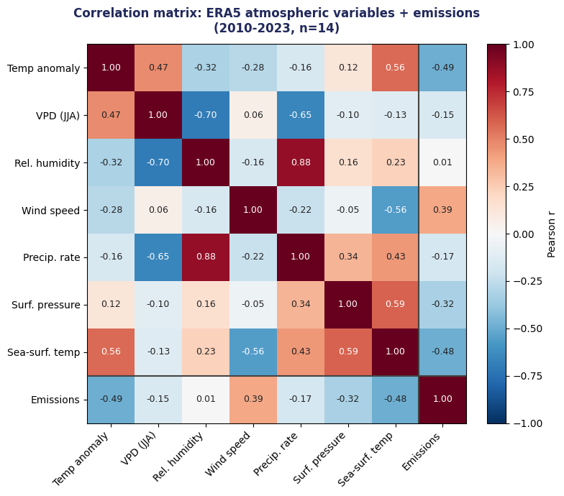
Stage 2 — Atmosphere Explains Little, Multicollinearity Explains Why
The honest atmospheric result
All 7 ERA5 variables tested Temperature, VPD, RH, wind, precip, surface pressure, SST. None significant at p<0.05. Atmospheric model in-sample R² = 0.38 But leave-one-out R² = −4.67 — worse than predicting the mean. No out-of-sample skill. Why: severe multicollinearity RH ↔ Precip r = +0.88 VPD ↔ RH r = −0.70 Temp ↔ SST r = +0.56 Predictors carry overlapping information; with only 14 years, more features hurt out-of-sample skill.

Slide 6
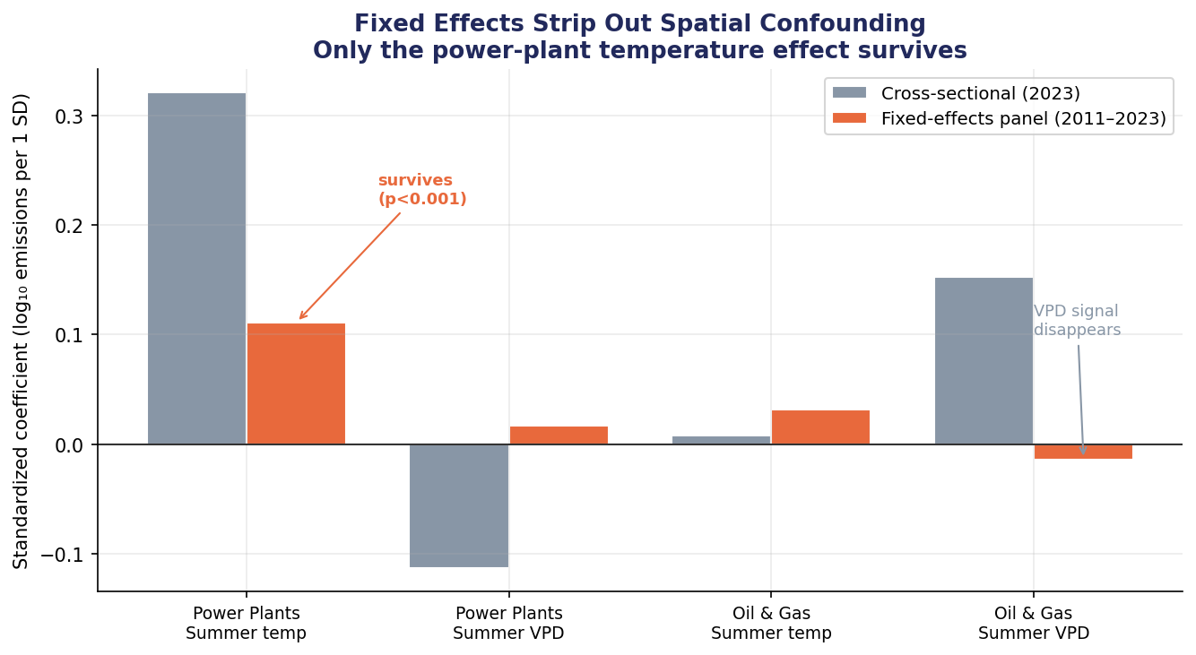
Stage 3 — Fixed Effects Strip Out Spatial Confounding
86k facility-years, 2011–2023
What FE delivers Each facility compared to itself across years, removing 'why it's located there' confounding. One signal survives: Power-plant summer temp β = +0.111 std (p=0.0003), ≈ +7.5% emissions per +1°C. Plausible cooling-demand response. O&G 'VPD effect' collapses From +0.15 to −0.01 (p=0.47) — was pure Permian Basin geography. But within-R² is still only 0.5%.

Slide 7
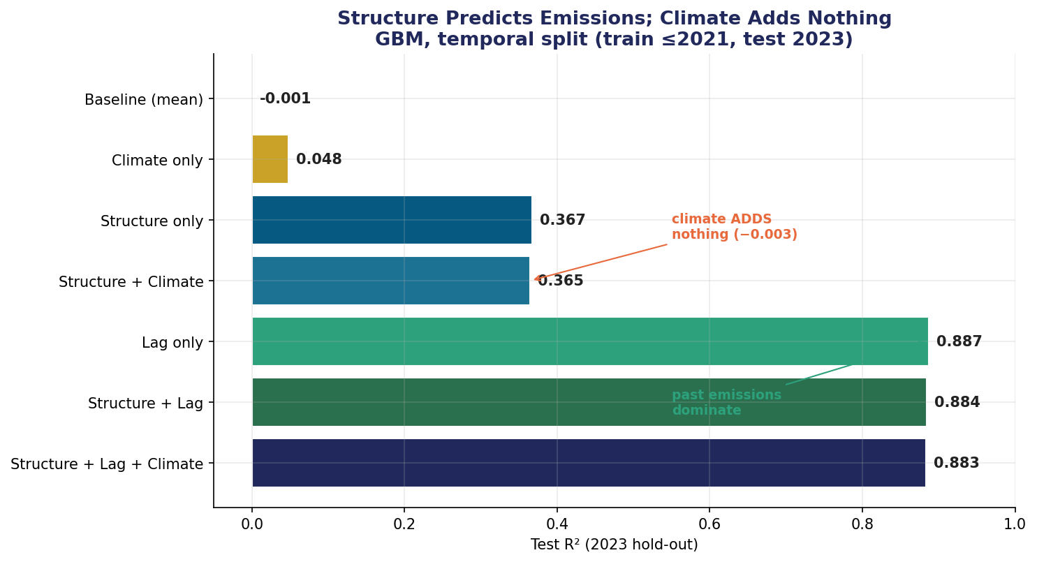
Stage 4 — Predictive ML: Structure Predicts, Climate Doesn't
Staged model R² (test=2023)
Structure only: R²=0.37 + Climate: R²=0.36 (Δ=−0.003) Structure + Lag: R²=0.88 + Climate: R²=0.88 (Δ=−0.001) Climate's marginal value is measured precisely as ~zero. Negative deltas = adding noise to the tree ensemble.

Slide 8
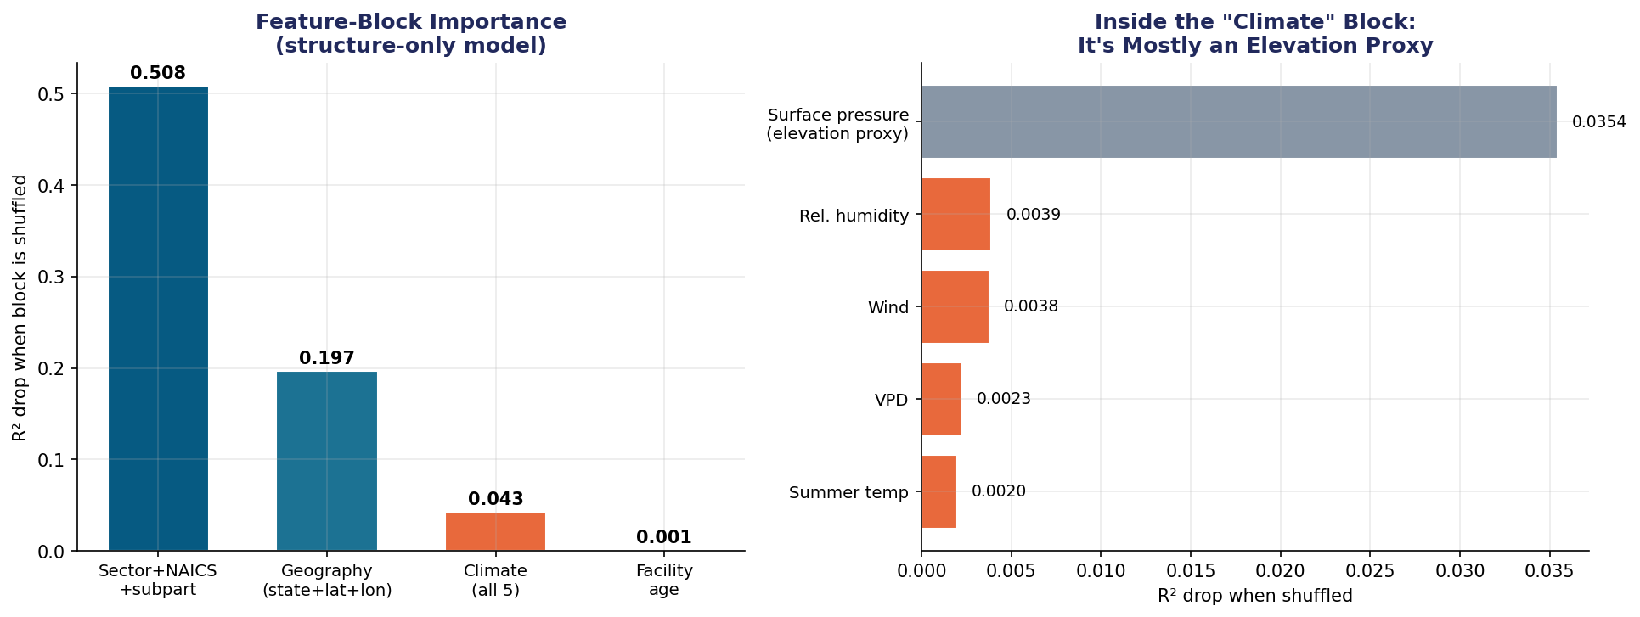
Where the Predictive Power Actually Lives
Industry classification dominates (importance 0.51). Then geography (0.20). Climate scores 0.04 — but 0.035 of that is surface pressure, an elevation proxy (Wyoming 818 hPa vs. coastal 1014 hPa). Real weather variables — temp, VPD, RH, wind — each contribute <0.004.

Slide 9
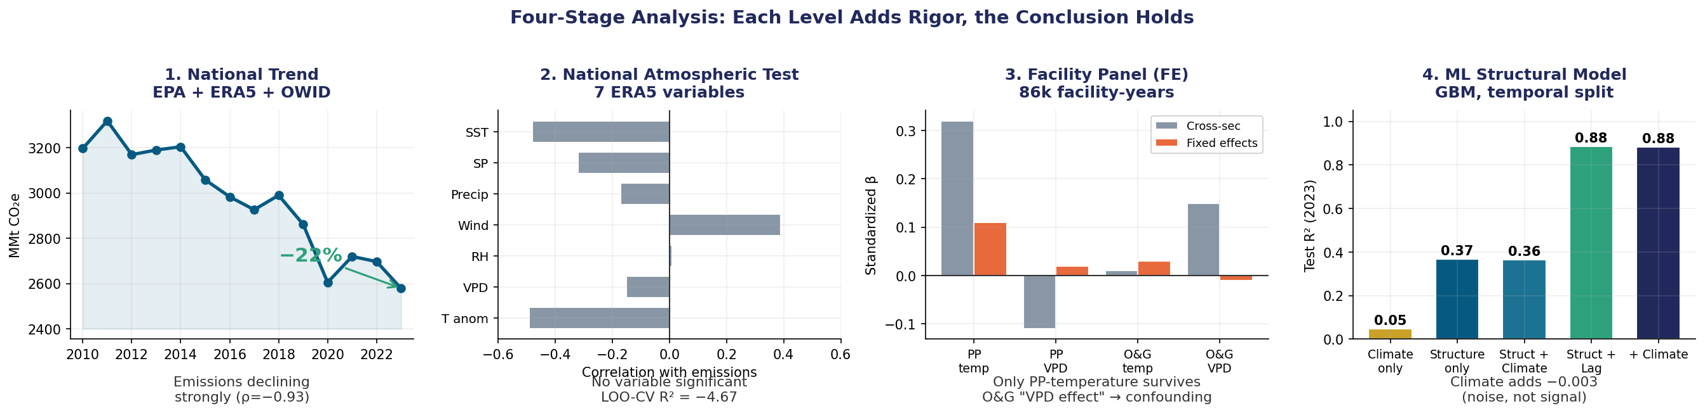
The Conclusion Holds at Every Level of Rigor
National
Atmospheric
Panel (FE)
ML
Emissions ↓ 22%, structural
No variable significant, LOO R² = −4.67
Only PP-temp survives (within-R² 0.5%)
Climate Δ = −0.003 on R²=0.88

Slide 10
What the Real Data Tells Us
1
Decline is real, large, and structural
U.S. industrial emissions fell 22% (2011→2023), almost entirely from power-sector decarbonization. Validated to 0.05% of EPA's published headline.
2
Climate is a weak, secondary signal
No atmospheric variable is significant at the national level. Multicollinearity, not insufficient features, is why adding more atmospheric data does not help.
3
Panel FE reveals one real exception
Power-plant summer temperature has a genuine within-facility effect (+7.5%/°C, p=0.0003) — but within-R² is only 0.5%. The O&G 'VPD effect' was confounding.
4
ML proves climate adds nothing predictive
Structural model reaches R²=0.88. Climate's marginal contribution: −0.003. The apparent climate importance is mostly an elevation proxy in disguise.

