Slide 1
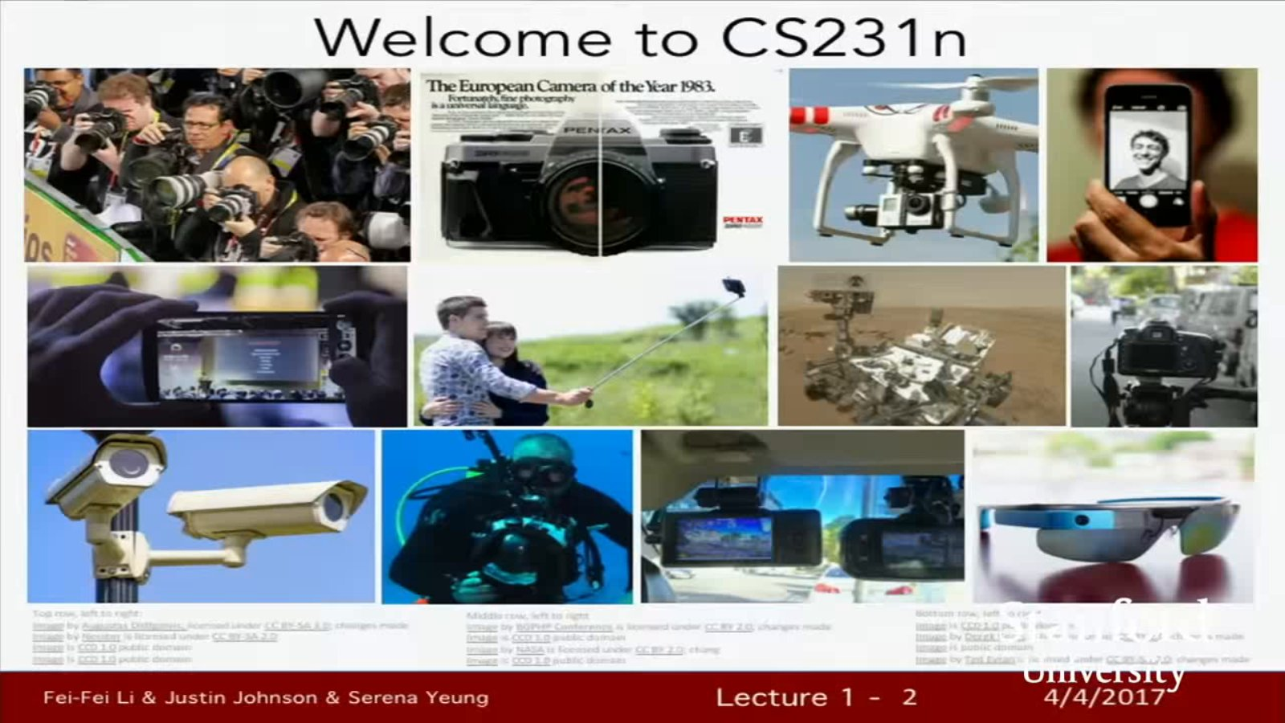
Slide 1 @ 00:00:12
Notes:
Welcome to CS231n TheEuropeanCameraoftheYear1983. Fei-Fei Li &Justin Johnson &Serena Yeung Lecture1-2 4/4/2017

