Slide 1
Algorithms and tools for Big Data Application
- Comparison of Tensor and Matrix based Approach in Foreground\Background Separation
Student: Suhail Ahamed
Supervisor: Jianshu Zhang
Responsible Professor: Univ.-Prof. Dr. –Ing. Martin Haardt

Slide 2
Outline
Motivation and State of the art
Subspace estimation
  Matrix based
  Tensor based
Simulation results
Conclusion

Slide 3
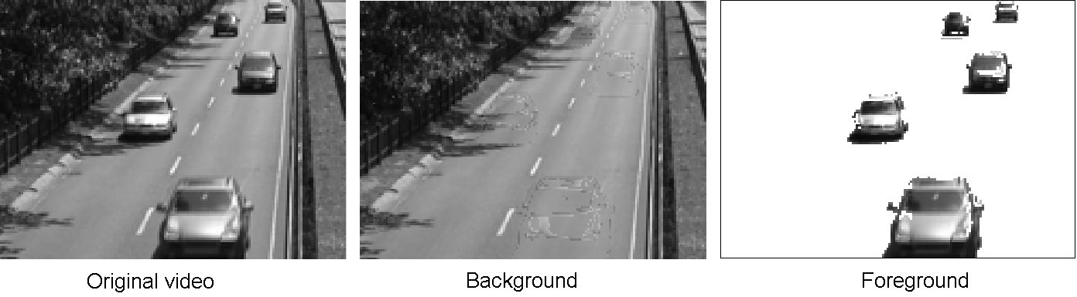
Motivation and State of the Art
Identifying moving objects is a fundamental and critical task in many video applications. It is a big data application since the resolution of each frame might be huge or the video consists a large number of frames
Compressed sensing based approaches [1]-[2] has gained great attraction in recent years ,e.g. the Recursive Projected Compressive Sensing (ReProCS). These methods use matrices (not taking into account the R-D structure)
Our task is to investigate whether and when it is beneficial to use tensor based approach

Slide 4




Foreground and background Separation via Recursive Projected Compressive Sensing
Assume that the video sequence consists of a slowly changing low-rank background and a sparse foreground. For each frame, we have
  Training phase: Estimating the subspace (U_{s}) of the slowly varying background
Data processing phase
  Perpendicular Projection: project the measurement vector (x_{t}) into the space orthogonal to the U_{s}
  Sparse Recovery: basis pursuit is used to estimate the foreground f_{t} ,solving
  Recover b_{t} as: b_{t} = x_{t} - f_{t}
x_{t} = b_{t} + f_{t}
Measurement
Low dimensional background
Sparse foreground

Slide 5

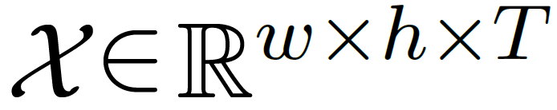
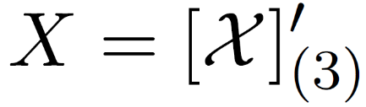

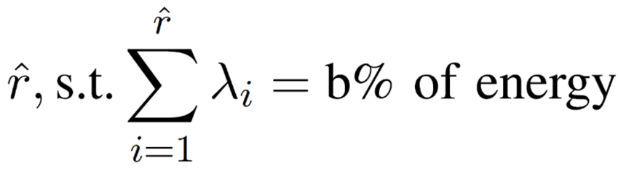
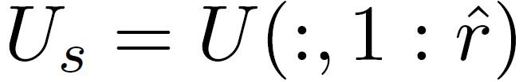
Existing matrix based subspace estimation
The 3-mode unfolding of training video volume is used and we have
Low-rank approximation of X using the truncated Singular Value Decomposition
The matrix based Background Subspace is decided by
we use b=95%

Slide 6
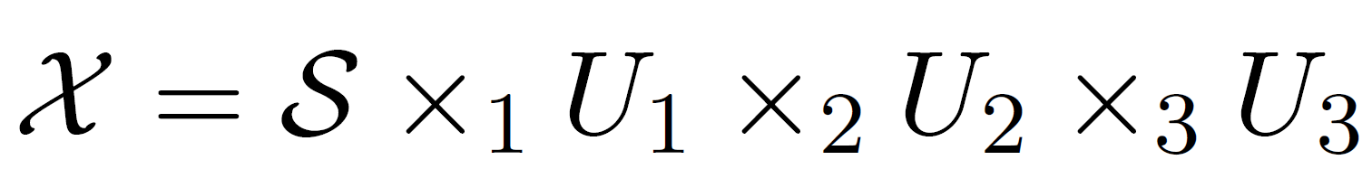
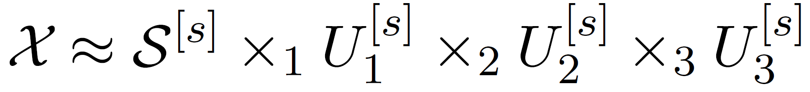
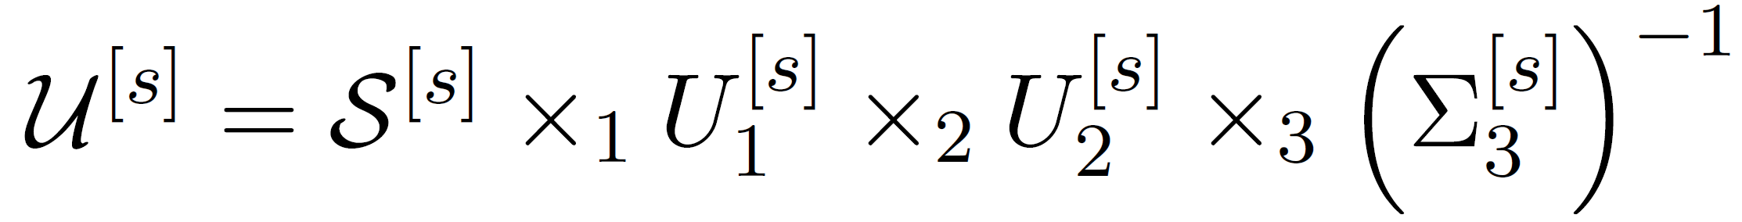
Proposed tensor based subspace estimation
Higher-Order Singular Value Decomposition (HOSVD) of
Truncated HOSVD
The n-ranks are decided via the n-mode unfoldings
The tensor based background subspace

Slide 7
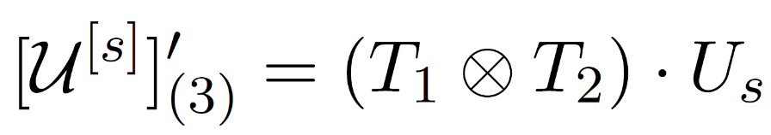
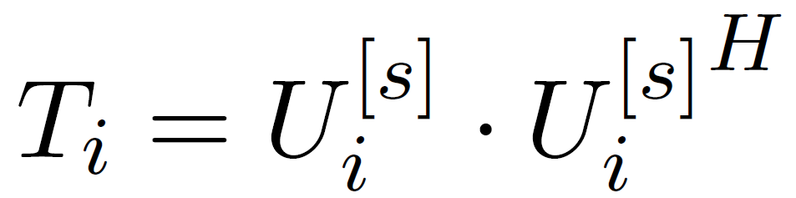
Link between matrix based and tensor based subspace estimates
A link between the matrix based and the tensor based subspace estimates
  do not need to compute the core tensor, only U₁, U₂, U₃.

