Slide 1
Sorting
Sorting:
we have a list of real numbers and need to sort the real numbers in increasing order (smallest first) or decreasing order.
Insertion sort
Merge sort
Quick sort
Heap sort
Counting sort
Radix sort
Mai Kanaan
Notes:
1

Slide 2
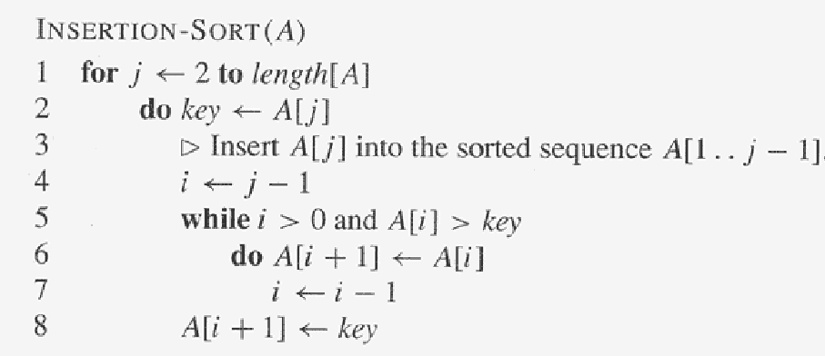
Insertion sort algorithm
Given N items
Mai Kanaan
Notes:
1

Slide 3
Example:
Sort A=<5, 2, 4, 6, 1, 3> using insertion sort.
Mai Kanaan
Notes:
1

Slide 4
A=<1, 2, 3, 4, 5, 6>
J=6
Key = 3
i=1
Insertion Sort
Statement Effort
InsertionSort(A, n) {
for j = 2 to n { c1x(n)
key = A[j] c2x(n-1)
i = j - 1
while (i > 0) and (A[i] > key) { c3 x m
A[i+1] = A[i] c4 x r
i = i – 1
}
A[i+1] = key c5x(n-1)
}
}
Mai Kanaan

Slide 5
Time complexity for Insertion Sort
T(n) = c1x(n)+c2(n-1)+c3(m)+c4(r) + c5(n-1)
t_{j} : # of times the while loop is executed for the j_{th} for loop iteration.
m= t₂+t₃+t₄+………+t_{n}
r= (t₂-1)+(t₃-1)+(t₄-1)+…………..+(t_{n}-1) = t₂+t₃+……t_{n}+(-1-1-1-1…..-1)
r= m + -1*(n-1) = m-(n-1)
This is m
n-1 times
Mai Kanaan

Slide 6
What is t_{j} ??
The while loop depends on j, and j runs from 2 to n according to the for loop.
It also depends on the data in the array:
If it is sorted in the same order, the while loop is executed only once t_{j} = 1
If it is sorted in reverse order, the while loop is executed for all previous elements t_{j} = j
Mai Kanaan
Notes:
<number>

Slide 7
Time complexity for Insertion Sort
Now let’s compute (m):
Best case for (m):
t_{j} = 1
t₂=1, t₃=1, t₄=1, …… t_{n}=1 when the array is already sorted
m= t₂+t₃+…..+t_{n}=1+1+ ………….+1 = 1x(n-1)
Worst case for (m):
t_{j}=j (when the array is sorted in descending order and we want to sort it in ascending order)
t₂=2, t₃=3, t₄=4, t₅=5,……. t_{n}=n.
So, m= t₂+t₃+ …..t_{n} =2+3+……..+n= (n²+n-2)/2
Best case example: 10, 12, 50, 60, 200
Worst case example: 200, 60, 50, 12, 10
Mai Kanaan

Slide 8
Time complexity for Insertion Sort
Best case for T(n):
T(n) = c1x(n)+c2(n-1)+c3(m)+ c4(r) + c5(n-1)
= c1x(n)+c2(n-1)+c3(m)+ c4(m-(n-1)) + c5(n-1)
= c1x(n)+c2(n-1)+c3(n-1)+c4((n-1)-(n-1))+c5(n-1)
= c1x(n)+c2(n-1)+c3(n-1)+c4(0)+c5(n-1)
= Θ (n)
Worst case for T(n):
T(n) = c1x(n)+c2(n-1)+c3(m)+ c4(r) + c5(n-1)
= c1x(n)+c2(n-1)+c3(m)+ c4(m-(n-1)) + c5(n-1)
= c1x(n)+c2(n-1)+c3 ((n²+n-2)/2)+ c4(((n²+n-2)/2 -(n-1)) + c5(n-1)
= Θ (n²)
Mai Kanaan

