Slide 1

ValeBridge

Slide 2











About us
2
ValeBridge Technologies LLC formed in 2017. Offices located in USA and India
The company’s goal is to help financial institutions execute RISK strategy more models
efficiently
Experienced in developing efficient real-time software solutions
Experienced in architecting high available systems with designed availability above 99.999%
Have successfully implemented solutions executing models at very low latency
Models executed include logistic regression, gradient boosting machine, neural network

Slide 3
RAVEN®

Slide 4











Key Features
4
RAVEN is a complete out-of-box solution for risk analysis transaction processing
Business rules, Models - GBM/Logistic, Variable calculation, Data Persistence, Data Transfer, Version control are provided out of the box
Self Service – facilitates fast time to market
Integration with flowable to create workflows
Is highly available with data replication within and across data centers
Transaction Replay capability in DR / Test environment

Slide 5






Application Architecture
5
RAVEN is MODULAR in design which allows for speedier execution
The orchestrator component is called the MODULE
The MODULE component is the basic building block of a transaction and defines execution units
Other components are: DATABASE, RECORDS, VARIABLES, MODELS, RULES, TRANSACTION

Slide 6
Overview
6
Database
Fast Performance
API
Variables
Version Control
Access Control
Self Service
Data transfer
Rules
Highly Available
Cross data center replication
Models
Guard Rails

Slide 7












MODULE
7
Basic building block of a transaction and defines execution units
Defined Input and Output
Executes user logic
rules, models, data operations, calculations
A module can be part of multiple transaction definitions
Modules can be run in parallel Entry conditions specified by user

Slide 8












Database
8
In-memory database with persistence
Based on rocksdb
Data partitioning for distribution across multiple nodes and horizontal scalability
Replication within and across data center
Backup and selective restore
User defined compaction filter to purge old data Online schema evolution
Upcoming RAFT/GRIT consensus

Slide 9







Variables
9
Variables defined through the UI using a Blockly/Scratch type interface
Complex variable logic can be built in minutes by dragging and dropping predefined
blocks
Automatic dependency tracking ensuring that variables are calculated in the right
order
Invalid logic flushed out during editing itself, saving time
Much easier to look at logic per variable that can be understood by business users and programmers alike

Slide 10





Rules
10
Rules can be activated/deactivated within seconds
Rule Sets to enable rule management
Ability to go through millions of rules per second
Rule hierarchy to enable fine grained control over order of execution Statistics per rule to check on rule performance

Slide 11










Models
11
Model files in PMML are uploaded to RAVEN
Subset of PMML relevant to GBM models, Random Forest and Logistic Regression is supported Segmentation support for model selection
Data transformation support for model execution such as missing value treatment, invalid value replacement
Supporting ramp up to slowly introduce a new model
Offline scoring against CSV files is supported

Slide 12









Data Transfer
12
Batch and real-time data transfer
Various file formats supported such as fixed length, delimited Apache Camel integration (> 300 components available) Real-time Monitoring
Easy configuration using yml files
Automatic schema updates

Slide 13



Replay
13
Log transaction info and replay later
Selection criteria can be specified if the log backend supports SQL such as Hive
User can bring in new variables for testing, or replace value of specific variables by overriding the generated SQL
This provides users the ability to quickly test their changes based on earlier transactions and compare results

Slide 14
High Level Architecture
14
Monitoring (Health Check)
Models
Rules
Logging
Variable
Models
Admin
Communication Component
Transaction Execution Engine
Change Control
Rules
Web UI
Transaction Replay Capability
Data Module
Variable Calculation
Data
Online/Offline Data Transfer Component
Online Transaction Process

Slide 15
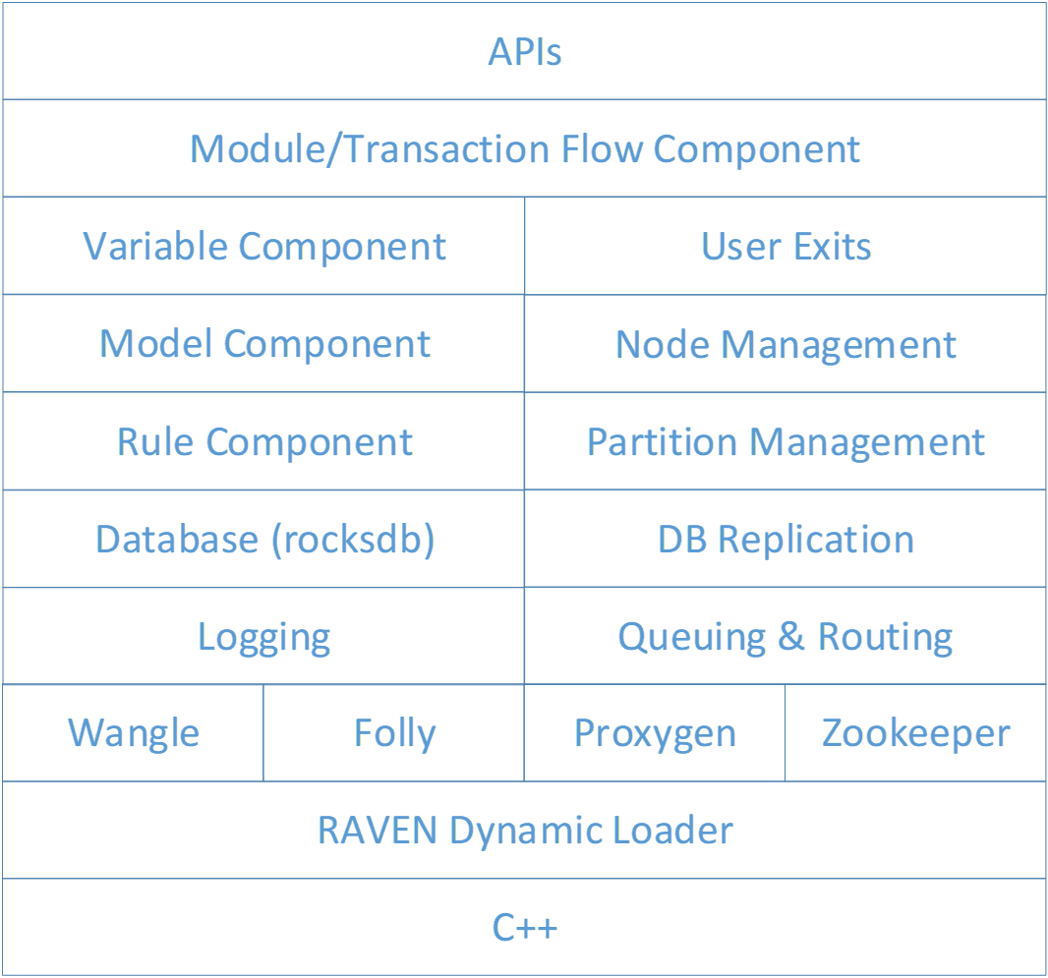
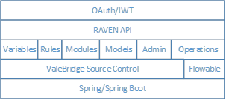
Technical Stack
15
Core
Java/UI Stack
RAVEN UI
Angular 5 | Other frameworks and libraries

Slide 16
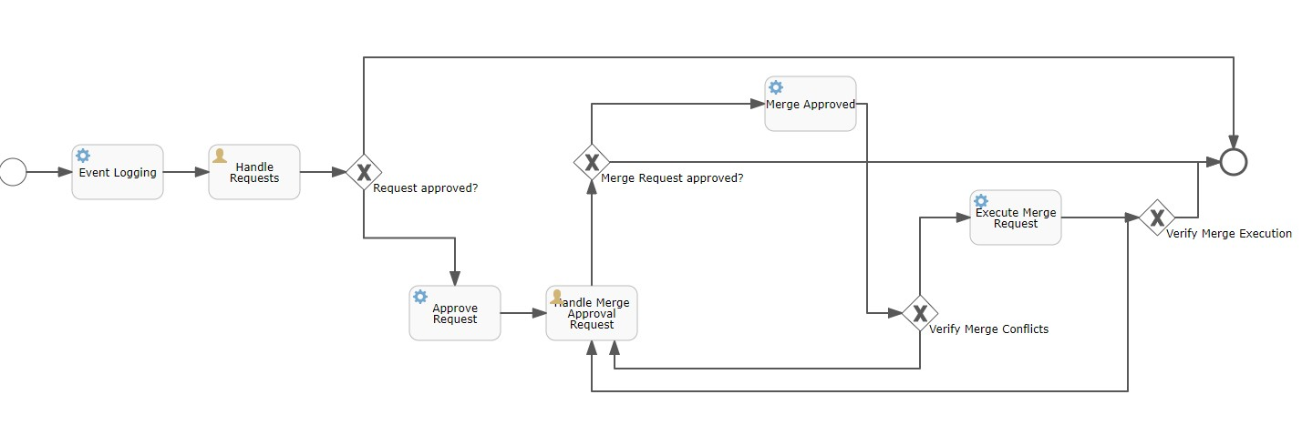
Flowable workflow example
16

Slide 17
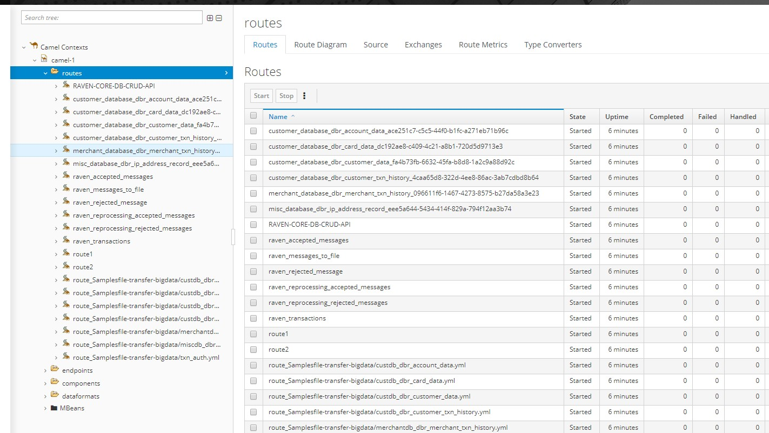
Data Transfer – Monitoring UI example
17

Slide 18
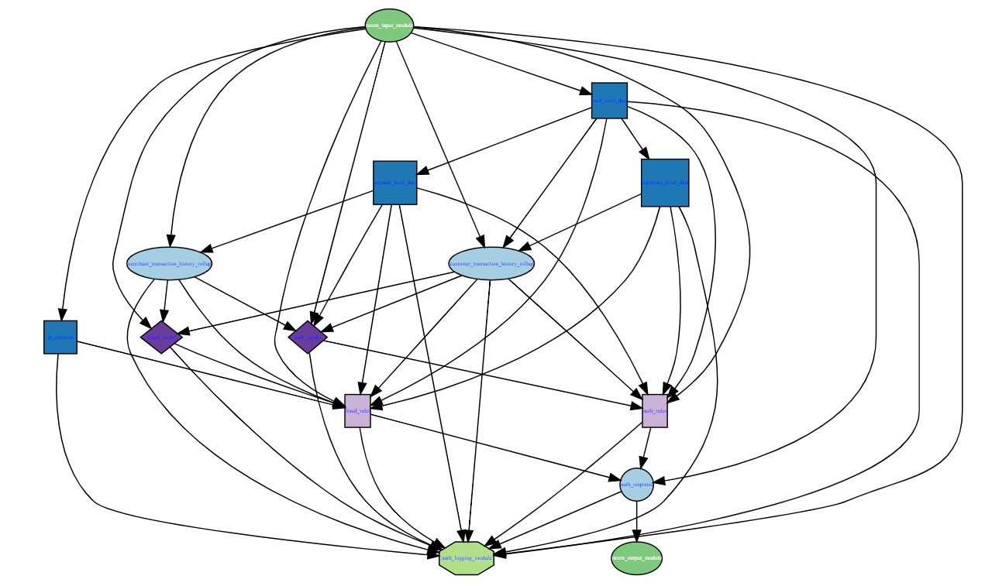
Transaction Graphic example
18

Slide 19
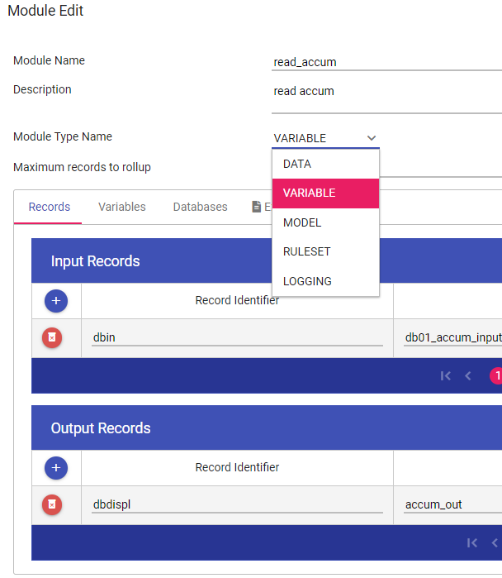
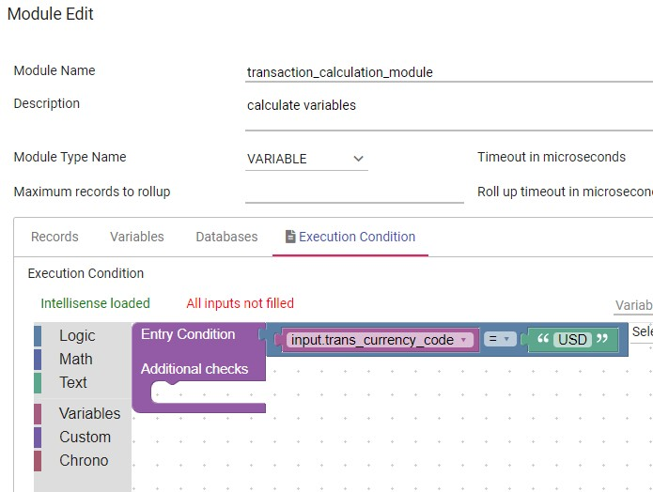
Module Example
19

Slide 20
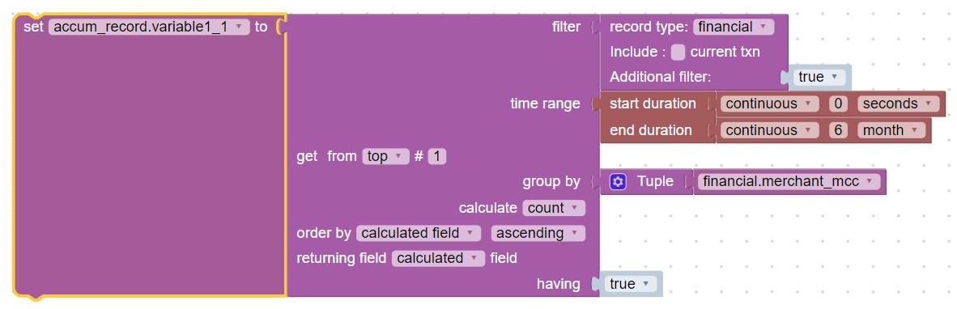
Variable Example
20

Slide 21




Demo video
21
This short video demonstrates the use of BLOCKLY
We will add a new field: dollar_amount_of_transactions_in_last_20plus_days_at_current_se to an existing data record type: DERIVED_VARIABLES
We will define the properties (metadata) and then build the logic
The logic at the end is merely added to show the simplicity of updating or changing logic
Click video to view

