Slide 1
UNDER WATER ACOUSTIC SIGNAL DETECTION AND CLASSIFICATION
SUHAIL K
M3 SP
ROLL NO 16

Slide 2
INTRODUCTION
Oceans are the largest ecosystem
Millions of variety of species
The scientists study the ecosystem by listening ,ie; from sound waves
Acoustics is the branch of physics that deals with the study of all mechanical waves such as vibrations ,sound etc

Slide 3
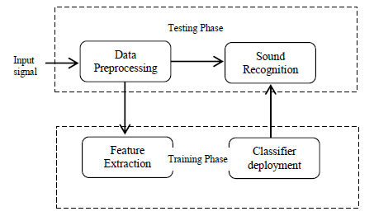
Block diagram of underwater acoustic recognition system

Slide 4
Methods
Classification of Underwater Acoustic Signals Using Multi-Classifiers
    Underwater acoustic channel is a dynamic one that not only includes noise due to fish and marine life but also that from commercial human activity and military operations
    This work shows that a single classification approach is not enough to classify signals with very high accuracy
    In the classification stage, multiple techniques including Naive Bayesian, K nearest neighbors, Artificial neural networks, Support vector machines and Hidden Markov Models have been performed to evaluate classification results

Slide 5
Classification of Underwater Objects Based on Probabilistic Neural Network
    Underwater target classification can be considered as a problem of small sample recognition.
    The PNN classifier is contrasted with a Gaussian classifier and a support vector machine (SVM) using lake or sea trial data

