Slide 1
UNDER WATER ACOUSTIC SIGNAL DETECTION AND CLASSIFICATION
SUHAIL K
M3 SP
ROLL NO 16

Slide 2
Introduction
Oceans are the largest ecosystem
Millions of variety of species
The scientists study the ecosystem by listening ,ie; from sound waves
Acoustics is the branch of physics that deals with the study of all mechanical waves such as vibrations ,sound etc
Underwater acoustics is the scientific study of natural and man-made sounds underwater.
Applications include sonar to locate submarines, underwater communication by whales, climate change monitoring by measuring sea temperatures acoustically etc

Slide 3
Acoustic signals- Characteristics and Properties
The four basic properties of sound waves are
Pitch : The relative highness or lowness we hear in sound measurable by vibrations per second.
Dynamics : degrees of loudness or softness in music.
Timbre: The quality of a tone that distinguishes it from other tones of the same pitch
Duration :The length of time in which vibration is maintained without interruption

Slide 4
Under Water Acoustics
Sound in water is measured using a hydrophone.
A hydrophone measures pressure fluctuations, and these are usually converted to sound pressure level (SPL), which is a logarithmic measure of the mean square acoustic pressure.

Slide 5
Under Water Acoustic channel Estimation
Underwater acoustic (UWA) channels have large delay spread and significant Doppler effects , and hence fall into the category of doubly (time- and frequency-) spread channels.
One approach is to use a basis expansion model (BEM) to approximate the time-varying UWA channels, so that the number of unknowns in channel estimation can be reduced.
The other approach is to directly exploit the fact that UWA channels are naturally sparse, meaning that most channel energy is concentrated on a few delay and/or Doppler values

Slide 6
The basis expansion model (BEM) can fit the channel with dynamic changes by several basis functions, which is a valid tool for fast time-varying (TV) channel estimation.
In other words, the fast TV channel is represented as the sum of several basis functions multiplied by the corresponding coefficients

Slide 7
Sparse Channel Estimation for Multicarrier Underwater Acoustic Communication: From Subspace Methods to Compressed Sensing
In this paper, we present various channel estimators that exploit the channel sparsity in a multicarrier underwater acoustic system.
Includes
subspace algorithms :root-MUSIC and ESPRIT
compressed sensing algorithms : Orthogonal Matching Pursuit (OMP) and Basis Pursuit (BP).
Numerical simulation and experimental data of an OFDM block-by-block receiver are used to evaluate the proposed algorithms in comparison to the conventional least-squares (LS) channel estimator

Slide 8
SYSTEM MODEL
We consider zero-padded (ZP) OFDM system
OFDM block duration : T ′ = T +Tg
Subcarrier spacing =1/T
The kth subcarrier is at frequency;fk = fc + k/T, -(1)
where k = −K/2, . . . ,K/2 − 1,
T : OFDM symbol duration
Tg : guard interval for the ZP
bandwidth is B = K/T

Slide 9
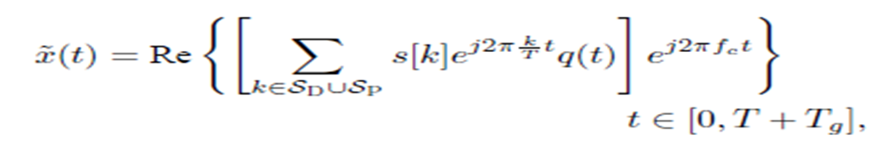
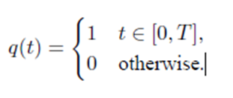
Let s[k] denote the information symbol to be transmitted on the kth subcarrier.
The non-overlapping sets of data subcarriers SD, pilot subcarriers SP, and null subcarriers SN satisfy SD ∪ SP ∪ SN = {−K/2, . . . ,K/2−1}
The transmitted signal is given by
(2)
Where q(t) is the ZP operation
(3)

Slide 10



A. Channel Model
The underwater acoustic (UWA) time-varying channel model is often defined as
For the duration of an OFDM symbol, the time variation of the path delays can be reasonably approximated by a Doppler rate as,
path amplitudes are assumed constant Ap(t) ≈ A

Slide 11

we specifically keep the path dependent Doppler rates ap. The received passband signal is then
where ˜n(t) is additive noise.

Slide 12
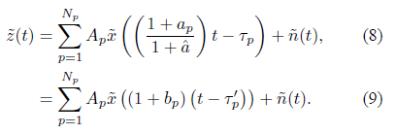
B. Receiver Processing
A two-step approach
1) The first step is to resample ˜y(t) in passband with a resampling factor ˆa that corresponds to a rough Doppler estimate, leading to ˜z(t),
2) The second step is to perform fine Doppler shift compensation on ˜z(t) to obtain ˜z(t)*e^−j2πǫt, where ǫ is the estimated residual mean Doppler shift.
The resampling can be written as

Slide 13

B. Receiver Processing(contd..)
We define the new residual Doppler rates and scaled delays
Comparing (7) with (9), the received waveform after resampling is equivalent to one that passed through a channel with Doppler rates bp

Slide 14


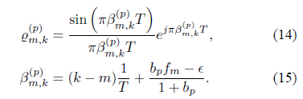
B. Receiver Processing(contd..)
Performing ZP-OFDM demodulation, the output zm on the mth subchannel is
where vm is the additive noise and

Slide 15



B. Receiver Processing(contd..)
Defining a stacked received vector z, data vector s, and noise vector v across all subcarriers, then
channel mixing-matrix H has entries

Slide 16

SUBSPACE METHODS
Collecting the diagonal entries of H into a vector ˜h, we obtain
where w(τp’) has the mth entry e^(−j2πm/T *τp’)
The formulation in (21) is thus equivalent to a direction finding problem in the array processing literature; each arrival from a certain direction has a steering vector in a similar form to w(τ′ p).
Hence, subspace methods from array processing can be applied to identify the distinct path arrivals.

Slide 17

SUBSPACE METHODS(contd..)
From the collected measurements, one needs to estimate the covariance matrix
In our work, we assume a block-by-block receiver . Hence, we need to estimate the covariance matrix based on one OFDM symbol only
Root-MUSIC: after matrix decomposition of the covariance matrix, we choose all eigenvectors corresponding to eigenvalues less than twice the noise variance to compose the noise space.
Once the {τ′p} are estimated, the channel response on the data subcarriers are estimated by using the LS

Slide 18
SUBSPACE METHODS(contd..)
ESPRIT
we choose all eigenvectors corresponding to eigenvalues larger or equal to twice the noise variance. To improve robustness against model mismatch (especially caused by Doppler), we solve for the unknown delay parameters τ′p using a total-least-squares (TLS) formulation

Slide 19

COMPRESSED SENSING
H has K^2 entries, it is defined by Np triples of (ξp, bp, τp’).
To facilitate implementation, we rewrite z as
If the parameters (bp, τp’) were available, we could construct the
(K × Np)-matrix in (26) and solve for the ξp using the least-squares solution.

Slide 20
CONCLUSION
In comparison to the LS receiver we found that the subspace methods show significant performance increase on channels that are sparse
But perform worse if most received energy comes from diffuse multipath
Compressed sensing algorithms do not suffer this drawback.

Slide 21
Description of underwater acoustic target detection and classification
Classification of Underwater Acoustic Signals Using Multi-Classifiers
Performance Evaluation of Linear and Multi-linear Subspace Learning Techniques for Object Classification Based on Underwater Acoustics
Classification of Underwater Objects Based on Probabilistic Neural Network
Distributed Data Classification in Underwater Acoustic Sensors based on Local Time-Frequency Coherence Analysis

Slide 22
1. Classification of Underwater Acoustic Signals Using Multi-Classifiers
Problem statement:
Due to increased anthropogenic noise, the classification of Underwater acoustic signals cannot produce efficient results by deploying denoising mechanisms mainly because of the pink noise, additive white Gaussian noise (AWGN)
The most effective method for underwater acoustic signal classification is through feature extraction technique.
The primary goal behind this research is that a single classification approach is not enough to classify signals with much accuracy.
Each type of signature has distinct characteristics and should therefore be classified through a robust classifier.

Slide 23
Proposed work
The proposed scheme is to deploy multiple classifiers. Following steps explain the proposed model.
Identification of Classification & Accumulation of Data repository.
These includes the mammal noise and shipping noise. Sound files falling inthe identified categories are accumulated from online repositories and existing resources
Vectorization of Categorized sounds
Development and Testing of Classification Algorithms

Slide 24
Implementation
Preprocessing of signals
The sounds which are in very small amount and recorded, 50% as training and other 50% is fed to noise generator
Feature Extraction
Time domain features: Short Time Energy ,Root mean square, Zero Crossing, Gradient Index and Unit Lag .
Frequency Domain Features: Spectral Flatness and Spectral Roll off
Perceptual features: Mel Frequency Cepstral coefficient(MFCC).

Slide 25
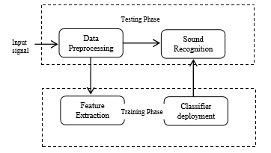
Block diagram of proposed system

Slide 26
Experiments And Results
Dataset
Data contains 29 machines and 24 fishes’ sounds
50% as training and 50% as testing
Experiments
To classify that the test sound is either from fish or machine dataset, we extracted features of the test sounds and fed them to each classifier.
After getting the best classifier that separates fish sound or machine sound, we further classified them based on the feature set to determine the type of machine or fish.

Slide 27
There are total 2^8=256 possible combinations of features
For example, if we take root mean square and short time energy then it is one possible combination and if we take root mean square and zero crossing rate then this will be another possible combination.
We firstly found each possible combination of feature and gave them separately to five different classifiers.
Thus, our working is based on five experiments where in each experiment, the parameters of noise remained the same.

Slide 28
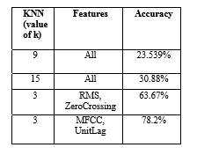
Results
K nearest neighbour
frequency domain features are efficient for classification of fishes

Slide 29
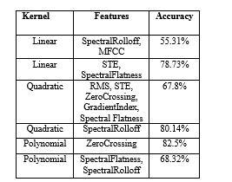
Support Vector Machines
It gives 82.5% accuracy for fish dataset and 68.32% for machine dataset.

Slide 30
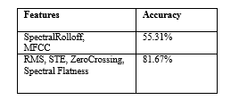

Naïve Bayesian approach
does not work well for machines data.
Artificial neural networks

Slide 31
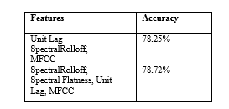
Hidden Markov models

Slide 32
2.Performance Evaluation of Linear and Multi-linear Subspace Learning Techniques for Object Classification Based on Underwater Acoustics
In this work, performance of two different class of learning approaches i.e. linear and multi-linear subspace learning, have been evaluated
Two linear subspace learning techniques, namely, principal component analysis (PCA) and linear discriminant analysis (LDA) along with one multi-linear subspace learning (MSL) technique, namely, multi-linear principal component analysis (MPCA) have been used

Slide 33

Methodology
In this work, LOFAR + Sub-space learning approaches have been used for feature learning
RVLR-NN & CNN approaches have been used for cIassification
Low Frequency Analysis and Ranging (LOFAR)
Broadband signal analysis technique and furnishes machinery characteristics of the objects i.e ships and vessels

Slide 34
Two-Pass Split Window (TPSW): Two-pass split window [14] has been applied for spectrum smoothing against background noise
Subspace Learning Techniques
Principal Component Analysis (PCA): It is a statistical data analysis technique also known as an un-supervised classifier and known for increasing the variance amongst the data elements of the input set.
Linear Discriminant Analysis (LDA) :Minimizing the variance between data elements belonging to same class
Multi-linear Principal Component Analysis (MPCA):It is a multi-linear subspace (MSL) learning approach, used for feature learning and dimensionality reduction of the tensor objects

Slide 35
Classifier
For automated classification of underwater objects, two cIassifiers have been used in this study
Robust Variable Learning Rate Feed-forward Neural Network(RVLR-NN)
Convolutional Neural Network (CNN):

Slide 36
Conclusions
Time-Frequency metric contains more information about the characteristics of the source and are more robust as compared to be dealing with only spectral estimates (ID) of the signal.
Source characteristics are sparsely populated in the spectrum, so it is better to use some transformation with spectral estimates of the source. It may well also reduce the size of the feature vector, which will eventually result in a less complex classification process.
Convolutional neural network (CNN) has performed exceptionally well compared to RVLR-NN

Slide 37
3.Classification of Underwater Objects Based on Probabilistic Neural Network
The objects can be classified by analyzing the echo signal structure
In this paper, a procedure is proposed, in which analyzing the echo signal is the first step of the classification, and features are extracted through the analyzing, then the features are arranged to a vector
Feature extraction
The features are extracted just as follows
Coefficients of time-domain AR model
Power spectrum features
WVD features

Slide 38
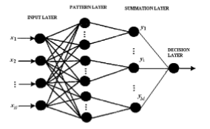
PNN CLASSIFIER

Slide 39
Experiments
To evaluate the performance of the PNN classifier, two classifiers are used as comparison, a SVM with a 4-degree polynomial kernel and a Gaussian classifier
The samples were divided into two classes, class A is man-made gas tank and class B stones with equivalent size.
The training set consists of 31 A class files and 34 B class files (one file is just one sample).
The testing set consists of 60 A class files and 60 B class files, and they are selected equally from the lake trial and the sea trial

Slide 40
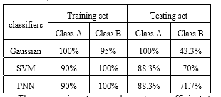
Results
These experiments may be not so sufficient to compare the classifiers, but it shows the proposed approach is effective.

Slide 41
Distributed Data Classification in Underwater Acoustic Sensors based on Local Time-Frequency Coherence Analysis
This paper introduces a stochastic approach that considers the distributed classification problem for a network of underwater acoustic sensors
The proposed classifier applies the third order polynomial regression to the instantaneous frequency extracted from time-frequency representation of different classes of signals and represent the polynomial’s coefficients in a threedimensional representation space
The time-frequency-phase algorithm assumes that the signal is scanned locally with windows of N samples. For each window W, we firstly look for the local Linear Frequency Modulation (LFM) that approximate the best the local time frequency behaviour.

Slide 42

The research study is concerned with the detection and description of the following marine acoustical sources,
Mono-Chromatic Signals
Linear frequency modulated signals.
Second order frequency modulations
Third order frequency modulations
The principle consisting of processing of a large amount of data and representing them in a 3D vector space by using the first three coefficient of the regression polynomial defined by

Slide 43
Data sets used
DOSITS

