Slide 1
EMPLOYEE ATTENDENCE MANAGEMENT SYSTEM
Notes:
Fill in the project title and all identity fields before presenting.

Slide 2
01
PROJECT OVERVIEW
Introduction
TimeFlow is a full-stack employee attendance management system that provides organizations with a centralized platform for managing employees and attendance through a structured web application. It enables administrators to manage employee records, monitor attendance, handle correction requests, and generate attendance reports, while employees can perform check-in/check-out operations and access their attendance information through role-based access.
Problem addressed
Traditional employee attendance management often involves manual record keeping, communication errors, and limited attendance tracking. Employees may face difficulties recording attendance and accessing their attendance information, while administrators need an efficient system to manage employee records, monitor attendance, handle corrections, and generate accurate attendance reports.
Purpose
The purpose of TimeFlow is to provide a centralized, secure, and user-friendly platform for employee attendance management. It simplifies employee and attendance management while providing organized data handling, role-based access, and efficient attendance tracking for administrators and employees.
Project Review · Sasthik K

Slide 3
02
PROBLEM STATEMENT
Existing problem
Traditional employee attendance management can involve manual record keeping, limited attendance visibility, and inefficient workforce management. Employees may face difficulty recording daily attendance and accessing their records, while administrators need an efficient way to manage employee information, monitor attendance, and generate accurate reports.
Limitations of current approach
Manual attendance handling can lead to recording errors and communication issues.
Employee and attendance record management may be difficult to organize efficiently.
Employees may have limited centralized access to their attendance information.
Lack of integrated authentication and role-based access can create security concerns.
Attendance tracking, correction requests, and report generation may not be handled through a single platform.
Why this project is required
TimeFlow provides a centralized platform for managing employees and attendance. It simplifies employee management, attendance check-in/check-out, attendance tracking, attendance report generation, and correction handling while providing organized data management and role-based access for administrators and employees.
Project Review · Sasthik K

Slide 4
03
OBJECTIVES
Key objectives
Expected outcomes
Develop a secure employee attendance management platform.
smooth and user-friendly employee attendance management experience.
Enable employees to record and manage their daily attendance.
Centralized employee, attendance, and report management.
Provide secure JWT-based authentication and role-based access.
Secure access based on Administrator and Employee roles.
Allow administrators to manage employee records, attendance data, correction requests, and attendance reports.
Efficient employee and attendance management through REST APIs.
Project Review · [Student Name(s)]

Slide 5
04
PROPOSED SOLUTION
How it works
TimeFlow provides a centralized web platform where Administrators and Employees can securely access the system through role-based access. Administrators can manage employee records, monitor attendance, handle correction requests, manage holidays, and generate attendance reports, while Employees can perform check-in/check-out operations, view attendance information, and submit correction requests.
Major features
Secure JWT Authentication
Employee & Attendance Management
Why this solves the problem
Attendance Tracking
The system replaces manual attendance processes with a structured digital workflow. It centralizes employee and attendance information, simplifies attendance recording, correction handling, and report generation, and uses authentication and role-based access to provide secure access to different users.
Check-In & Check-Out
Attendance Reporting
Project Review · [Student Name(s)]

Slide 6
05
TECHNOLOGY STACK
Frontend
Backend
Database
React.js
JavaScript
CSS
Java
Spring Boot
Spring Security
MySQL 8.0.41
Relational Database
JPA Entities
APIs / libraries / frameworks
Development tools
Other
Spring Data JPA
JWT
Swagger / OpenAPI
REST API
VS Code
MySQL Workbench
Postman
Git & GitHub
Maven
React Router
Axios
Project Review · [Student Name(s)]

Slide 7
06
SYSTEM ARCHITECTURE
Frontend
Backend
Database
External
services / APIs
React.js Web Application
Administrator & Employee UI
Axios / REST Requests
Spring Boot REST API
Controller → Service → Repository
Spring Security + JWT
MySQL 8.0.41
Employee • Attendance • User
Correction • Holiday • Role
Swagger / OpenAPI
REST API Documentation & Testing
Data flow description
1. User interacts with the React.js frontend.
2. Frontend sends HTTP/JSON requests to Spring Boot REST APIs.
3. Spring Security validates the JWT and authorizes the user's role.
4. Controllers forward requests to the Service layer for business logic.
5. Repository layer uses Spring Data JPA to access MySQL.
6. Backend returns JSON responses to the React frontend.
Project Review · Sasthik K
Notes:
Replace the block labels and arrows with your project's real components, and describe the data flow underneath.

Slide 8
07
MODULES / FEATURES
Module | Purpose
User Management | Registration, login & role-based access
Restaurant Management | Manage employee details & departments
Attendance Management | Check-in, check-out & attendance tracking
Attendance Reporting | Monthly reports, work hours & attendance summaries
Correction & Holiday Management | Manage attendance corrections & organizational holidays
Project Review · Sasthik K

Slide 9
08
DATABASE / DATA MODEL
User
Employee
Attendance
id
username
email
role
Manages
id
employeeId
name
email
department
joiningDate
has
id
employeeId
attendanceDate
checkInTime
checkOutTime
workHours
Key entities & relationships
User → Employee: User account is associated with employee information.
Employee → Attendance: Employee has multiple attendance records.
Employee → Correction: Employee can submit attendance correction requests.
User → Role: User is assigned a role for access control.
Employee → Department: Employee belongs to a department.
Attendance → Report: Attendance records are used to generate monthly attendance reports.
Project Review · Sasthik K
Notes:
Replace with your actual ER diagram or entity list if you have one — this is a placeholder structure.

Slide 10
09
APPLICATION WORKFLOW
Start
Login
Employee
Check-In / Check-Out
End
Employee logs in, accesses the attendance module, selects their employee profile, records check-in and check-out times, views attendance information and monthly reports, and completes the attendance workflow.
Project Review · Sasthik K
Notes:
Expand the flowchart to match your actual number of workflow steps.

Slide 11
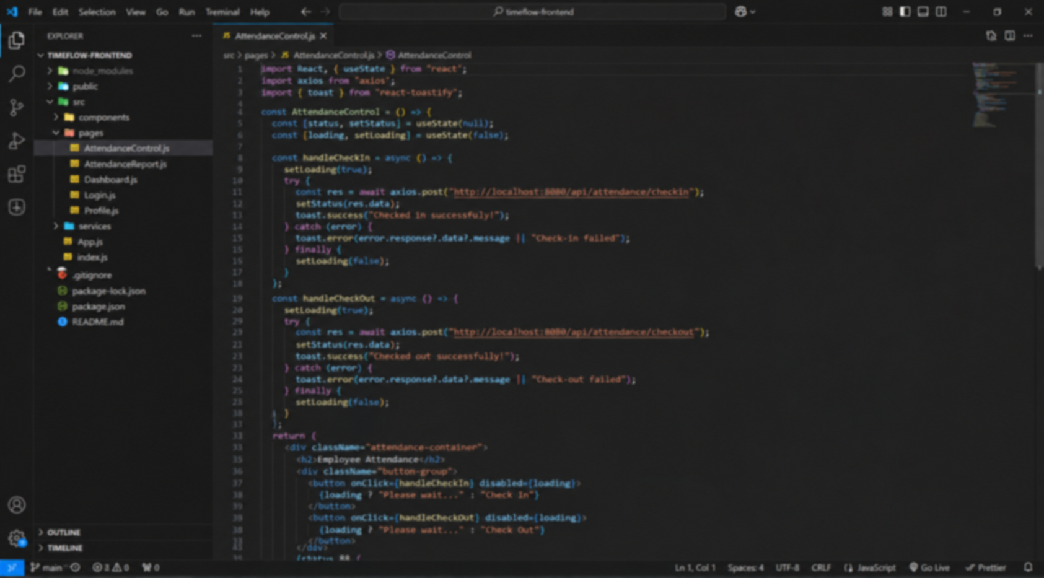
10
KEY FUNCTIONALITY
Duplicate per feature
Employee Attendance Management
What the user can do
Log in and access the attendance system
Select employee and view attendance information
Record employee check-in and check-out
[Insert screenshot of this functionality]
View monthly attendance reports
How it works
The employee accesses the attendance module, records the check-in and check-out time, and the system stores the attendance details through the backend. The recorded data is used to calculate attendance status, working hours, and generate monthly attendance reports.
Project Review · Sasthik K
Notes:
This slide is a repeatable template — duplicate it once per key functionality (Slide 11 onward) and swap in the real name, behavior, and screenshot.

Slide 12
11
CHALLENGES & SOLUTIONS
Challenge | Solution
Secure access for different user roles | Implemented role-based access control for Administrators and Employees
Efficient attendance recording | Implemented check-in and check-out processing with attendance timestamps
Handling attendance discrepancies | Implemented an attendance correction workflow for managing attendance record changes
Project Review · Sasthik K

Slide 13
12
FUTURE ENHANCEMENTS
Possible improvements
AI-Based Attendance Analytics — intelligent attendance trends and performance insights
Leave Management — employee leave requests, approvals, and attendance integration
Notifications — automated attendance reminders and correction status alerts
Payroll Integration — integration of attendance and working-hour data with payroll systems
Mobile Application — Android and iOS support for convenient attendance management
Project Review · Sasthik K

Slide 14
13
CONCLUSION
Summary
The TimeFlow Employee Attendance Management System provides a secure and centralized platform for managing employees, recording attendance, handling correction requests, and generating attendance reports. Administrators can manage employee information and attendance records, while employees can perform check-in/check-out operations and access their attendance information.
Key achievements
Secure Access — Role-based access for Administrators and Employees
Attendance Management — Check-in, check-out, and attendance tracking
Attendance Reporting — Monthly attendance summaries and work-hour reports
Thank you

