Slide 1
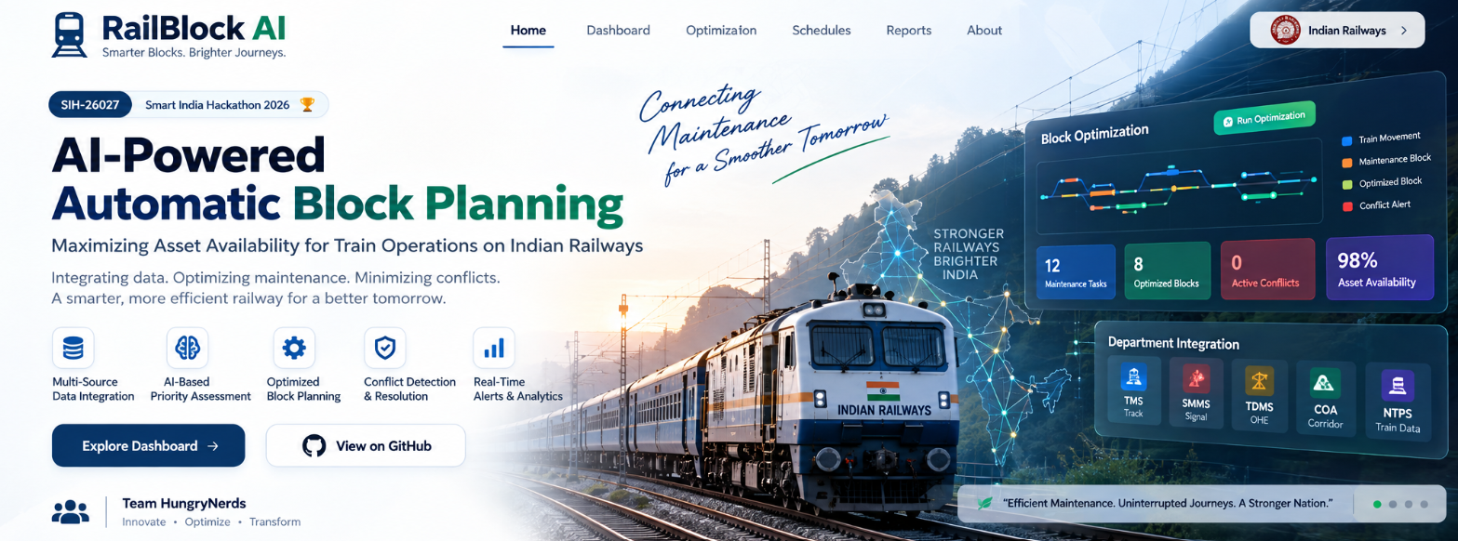

Slide 2

SMART INDIA HACKATHON 2026
TITLE PAGE
Problem Statement ID – SIH-26027
Problem Statement Title- Al-Powered Automatic Block Planning to Maximize Asset Availability for Train Operations on Indian Railways
Theme- Transportation & Logistics
PS Category- Software
Team ID-
Team Name- Hungrynerds

Slide 3
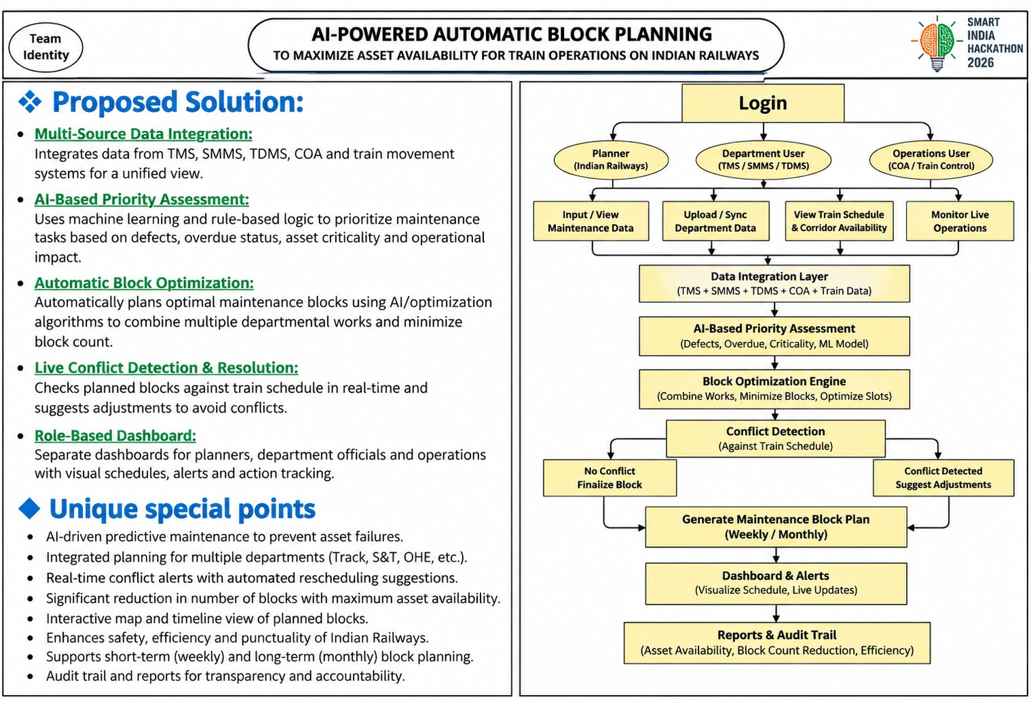


Slide 4
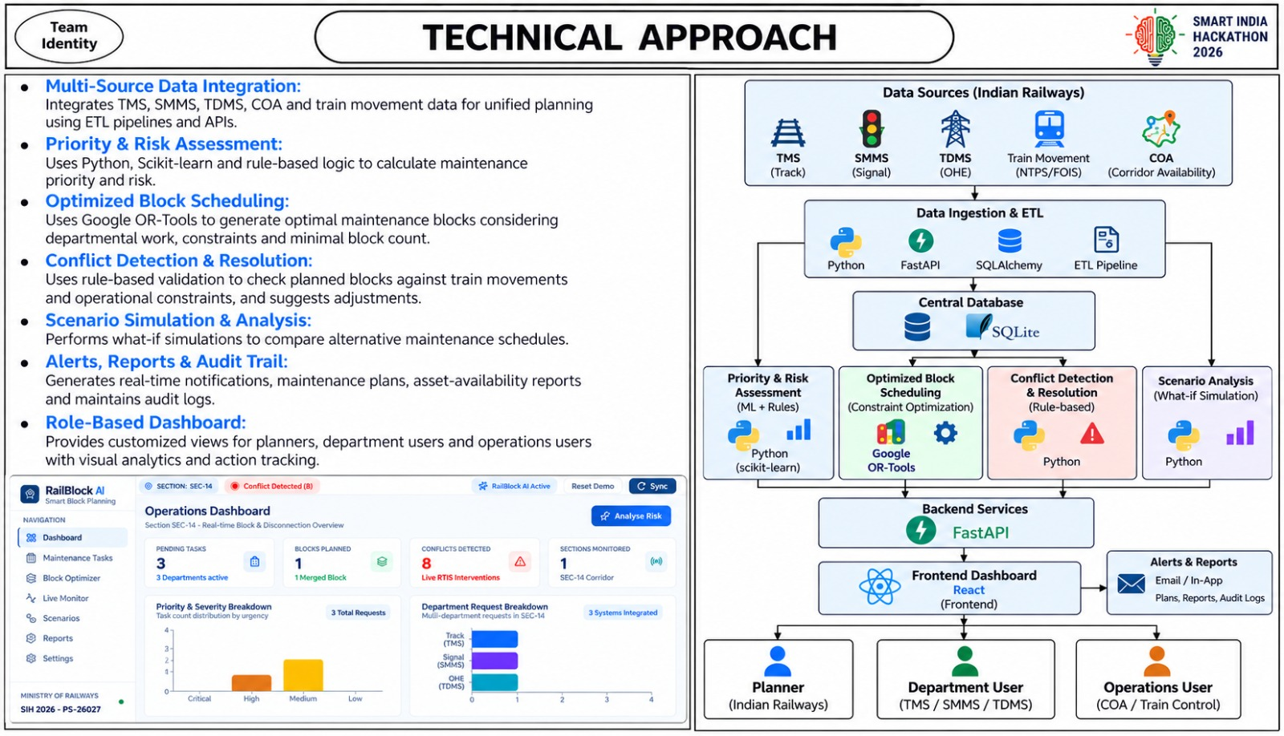

Slide 5
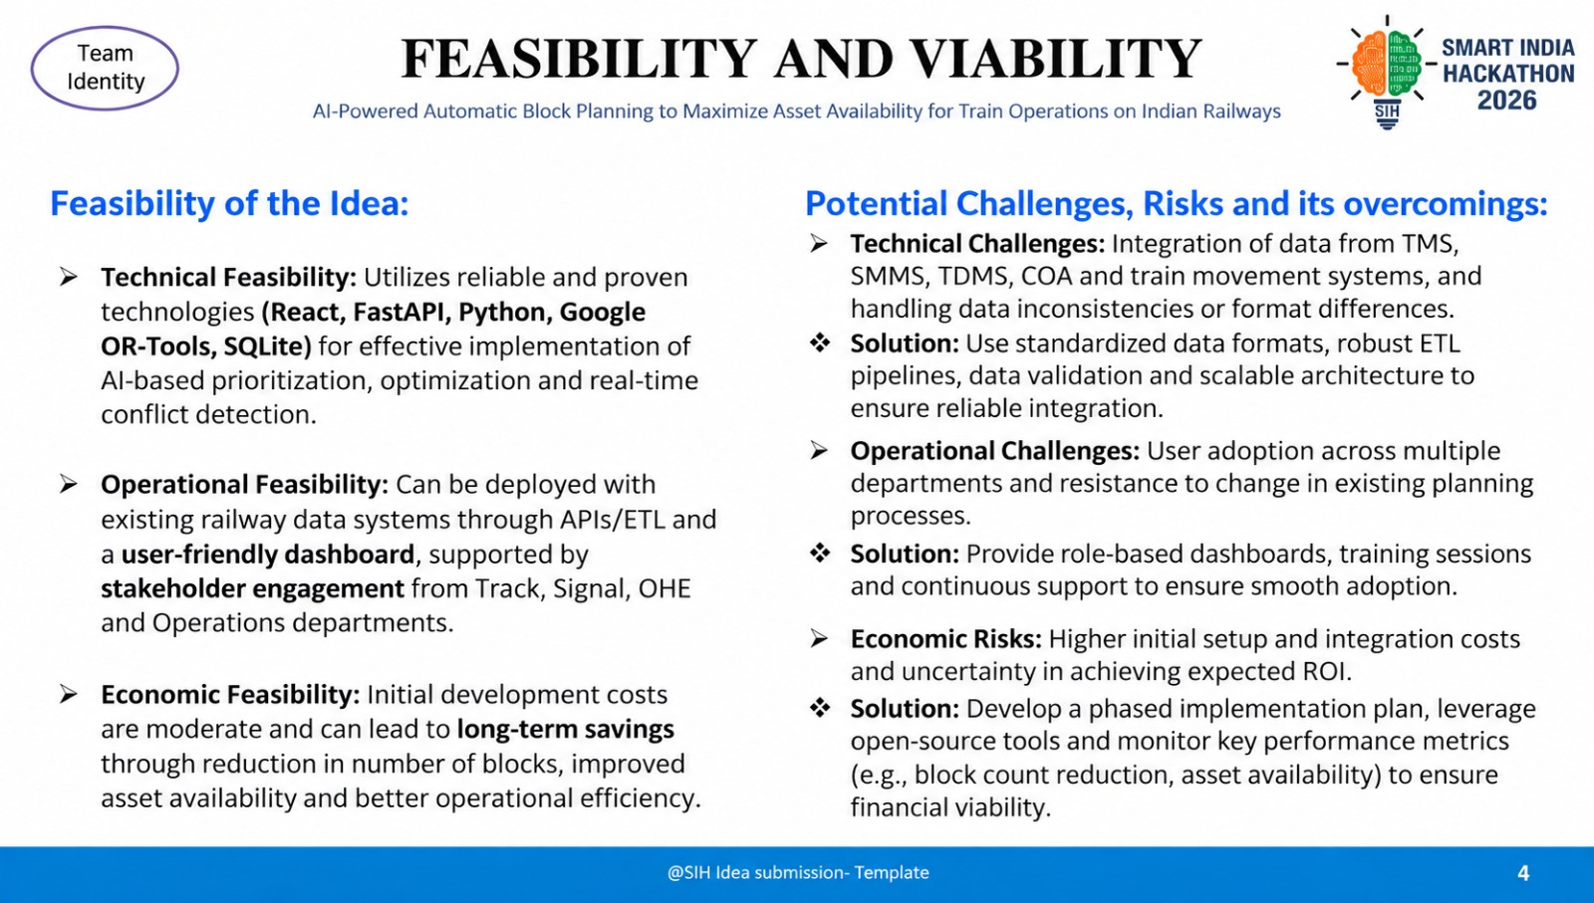

Slide 6
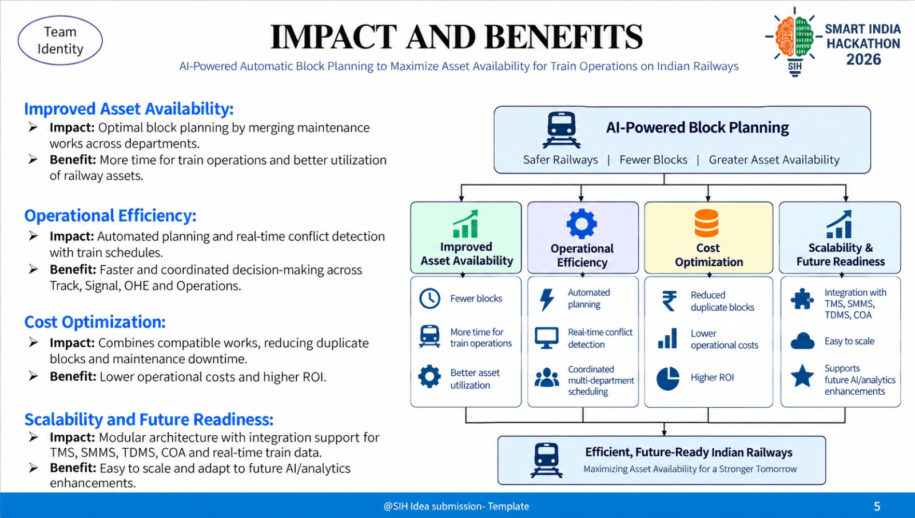

Slide 7
RESEARCH AND REFERENCES
Your Team Name
Indian Railways Train Time Table – Data.gov.in
Data.gov.in – Indian Railways Train Time Table
Indian Railways – Official Website
Indian Railways Official Website
Integrated Train Scheduling & Preventive Maintenance
ScienceDirect – Integrated Optimization
Train Timetable & Track Maintenance Scheduling
ScienceDirect – Train Timetable According to Maintenance Plans
Joint Train Scheduling and Maintenance Planning
ScienceDirect – Joint Optimization of Train Scheduling and Maintenance Planning
Train Timetabling & Railway Maintenance Scheduling
ScienceDirect – Integrated Train Timetabling and Maintenance Scheduling
Railway Maintenance Scheduling with Hindrance & Capacity Constraints
ScienceDirect – Railway Maintenance Schedules
Indian Railways Year Book 2023–24
Indian Railways Year Book 2023–24

