Slide 1
August 17, 2017
SESSION: T3-56
ROOM: 256
Arithmetic Coding
and
Compression is Prediction
Duffy O’Craven, Quinda Inc.

Slide 2
Arithmetic Coding and Compression is Prediction

Slide 3
Arithmetic Coding
and
Compression is Prediction
Make clear at the start where we're going.
I'll bring you through one of the most approachable doors to artificial intelligence: compression.

Slide 4
Arithmetic Coding
and
Compression is Prediction
We are a probabilistic programming Meetup.
Prediction? Compression? Probability?

Slide 5
Arithmetic Coding
and
Compression is Prediction
We seek methods that programming can exploit.
Range Encoding
defined by G. Nigel N. Martin in 1979, effectively rediscovering the FIFO arithmetic code introduced by Richard Clark Pasco in 1976 https://en.wikipedia.org/wiki/Range_encoding

Slide 6
Arithmetic Coding
and
Compression is Prediction
We seek methods that programming can exploit.
Arithmetic Coding
used in lossless data compression. Not using a fixed number of bits per character, frequently used characters will be stored with fewer bits, resulting in fewer bits used in total. https://en.wikipedia.org/wiki/Arithmetic_encoding

Slide 7
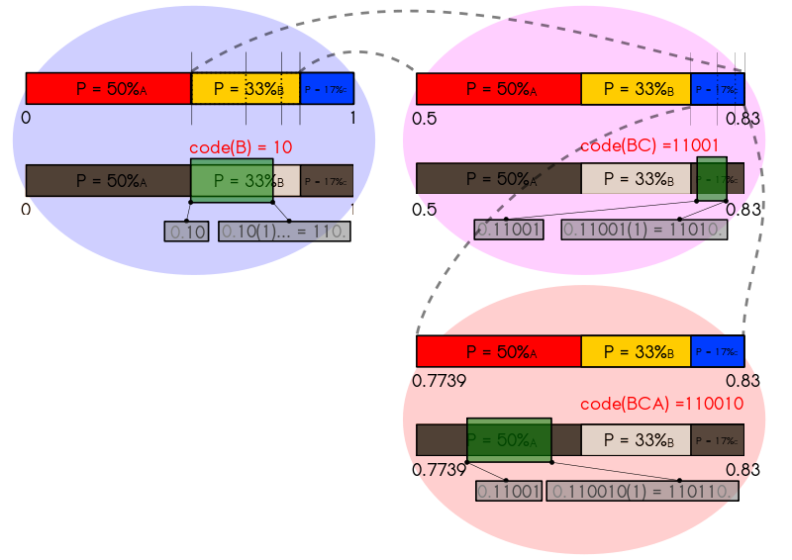
Arithmetic Coding
and
Compression is Prediction

Slide 8
Arithmetic Coding
and
Compression is Prediction
Asymmetric Numeral Systems
Not using a fixed number of bits per character, where 0.0 ≤ q < 1.0. It represents the current information as a range, defined by two numbers adaptively using variable number of bits that a character will be stored with.

Slide 9
Arithmetic Coding
and
Compression is Prediction
We adapt deterministic programming methods.
Continuing Binary Fraction
Not even bothering to define needed number of bits per character, just using enough bits that a character will be recoverable.

Slide 10
Arithmetic Coding
and
Compression is Prediction
We combine programming methods.
Predictive Coding
Not encoding the needed number of bits, just hedging a bet that we've correctly guessed the next bit.

Slide 11
Arithmetic Coding
and
Compression is Prediction
We reach the place where a model participates.
Deep Learning
Bounded only to prevent overflow/underflow, continually train the model, and decide how lop-sided to make the bet that we've correctly guessed the next bit.

Slide 12
Arithmetic Coding
and
Compression is Prediction
Get comfortable with: Compression is Prediction. Prediction is Compression.
Store only what you must.

Slide 13
Arithmetic Coding
and
Compression is Prediction
At the end of the chain you get things like:
Mathematical definition of intelligence -- largely rediscovery of work by Marcus Hutter

Slide 14
Arithmetic Coding
and
Compression is Prediction
"Whatever makes the best decisions with the available information is the smartest." is a workable definition of "smarter"

Slide 15
Arithmetic Coding
and
Compression is Prediction
Ockham's Razor
12th century philosopher, William of Ockham, quoted as: "It is vain to do with more what can be done with less."

Slide 16
Arithmetic Coding
and
Compression is Prediction
Hutter's Razor
"It is truer to explain with less that which can be explained with more."
https://groups.google.com/forum/#!topic/Hutter-Prize/PxO9eiuOOFU

Slide 17
Arithmetic Coding
and
Compression is Prediction
Marcus Hutter's seminal theorem
Smaller <==> Smarter
If a representation is smaller, then your approach is smarter than it was. If larger, then your approach is less smart than it was.

Slide 18
Arithmetic Coding
and
Compression is Prediction
"If we had had this theorem in the 1960's the entire history of Artificial Intelligence research would have gone a different way." - James Bowery
http://prize.hutter1.net/hfaq.htm

Slide 19
Arithmetic Coding
and
Compression is Prediction
When there is prediction, there is information time-travel.
What do you want to predict?

