Slide 1
Git mini project
SUHAIR
18MER200
MECHANICAL ENGINEERING

Slide 2
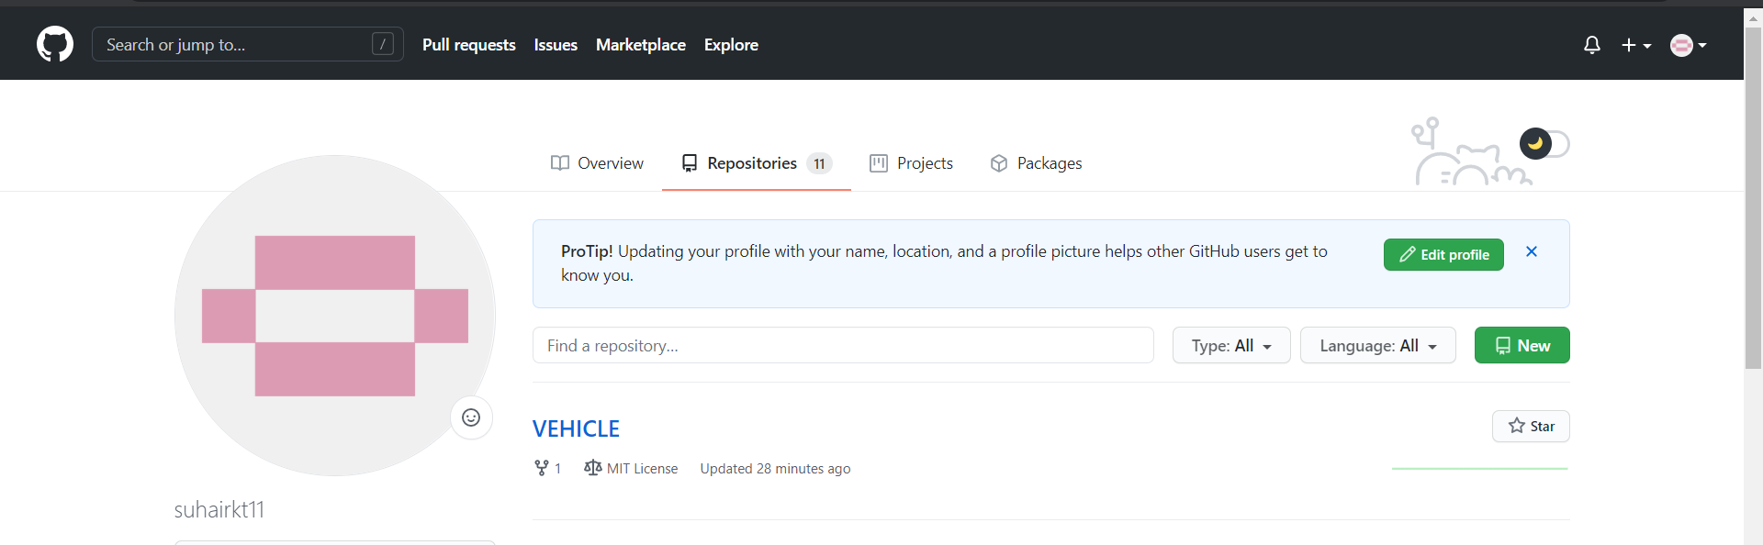
CREATING remote REPOSITORY

Slide 3
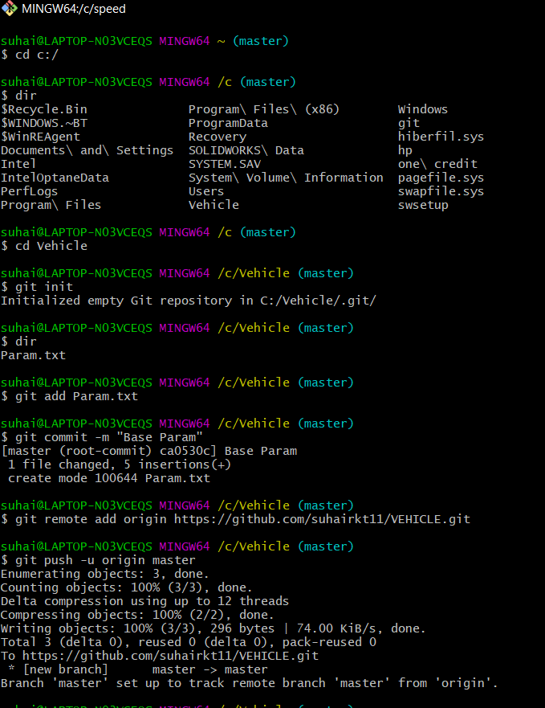
Commit 1 base param in master

Slide 4
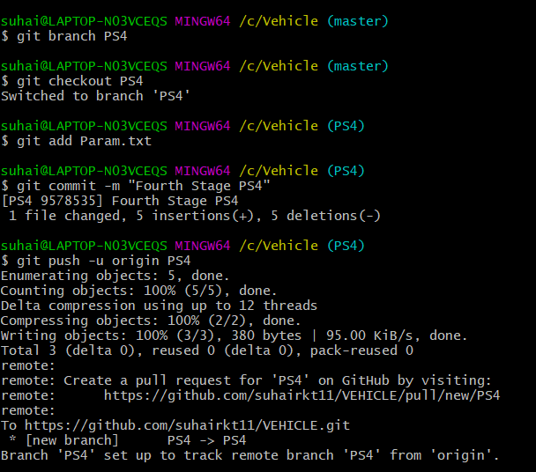
Commit 2 fourth stage in ps4

Slide 5
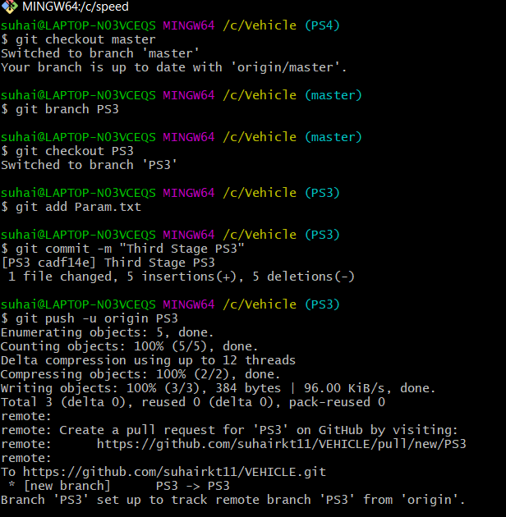
Commit 3 third stage in ps3

Slide 6
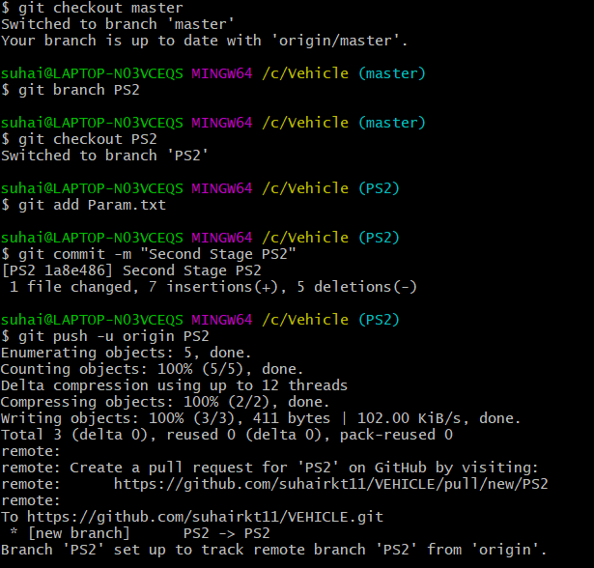
Commit 4 second stage in ps2

Slide 7
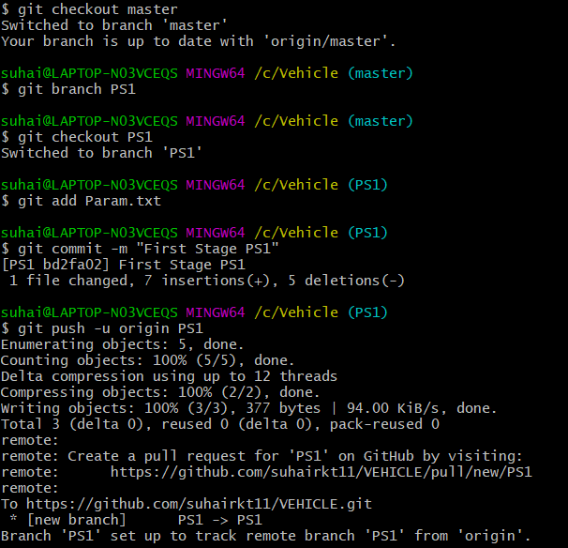
Commit 5 first stage in ps1

Slide 8
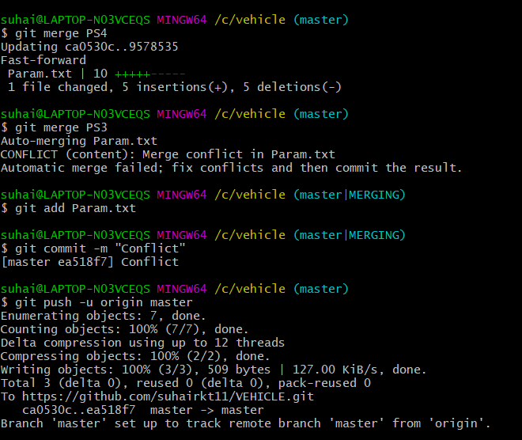
Git merge and merge conflict

Slide 9
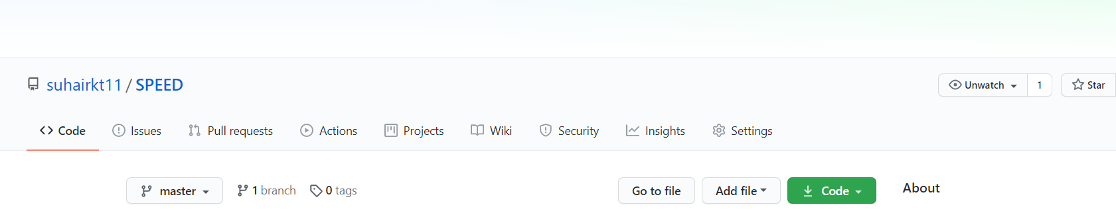
Creating speed remote repository

Slide 10
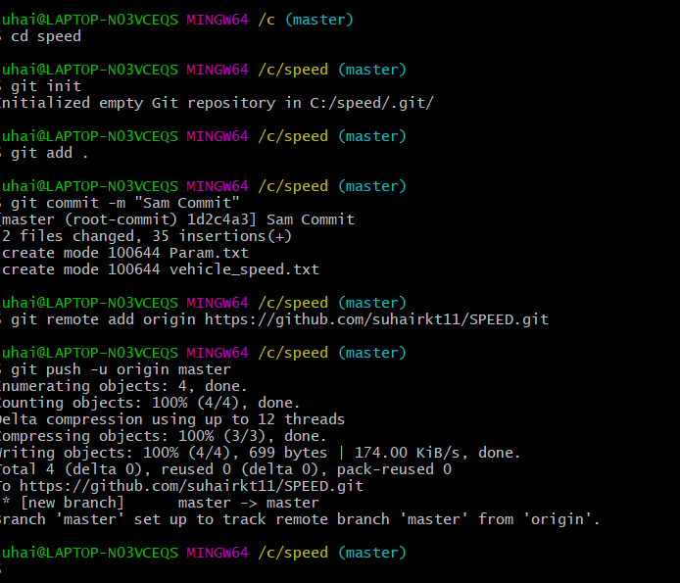
Adding and commiting files

Slide 11
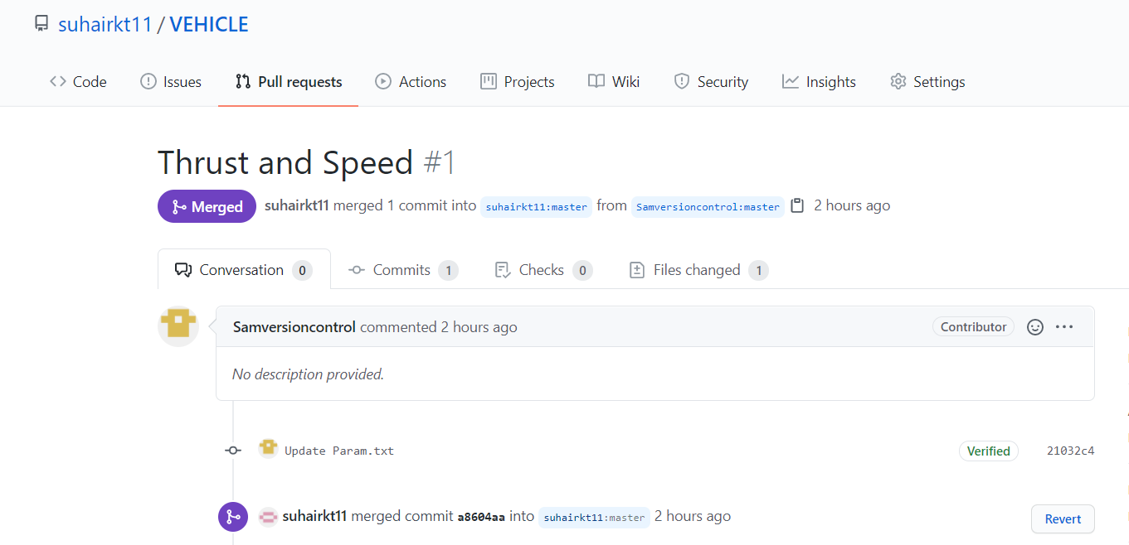
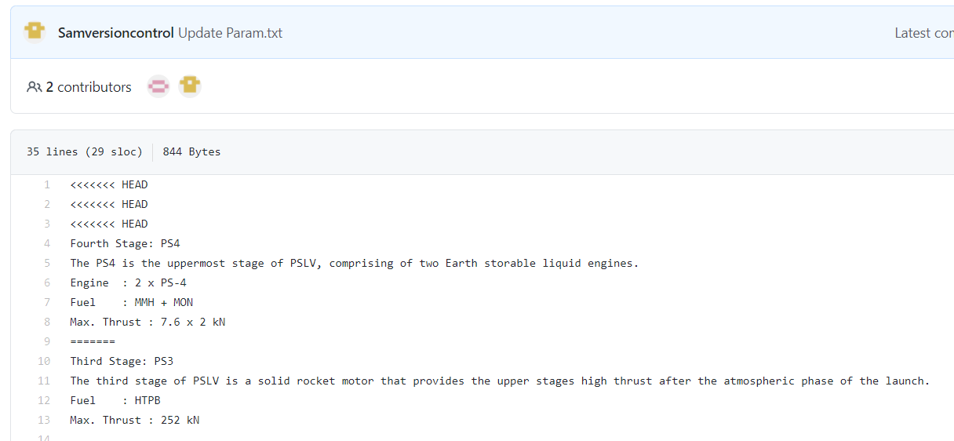
Pull request and thrust value is changed

Slide 12
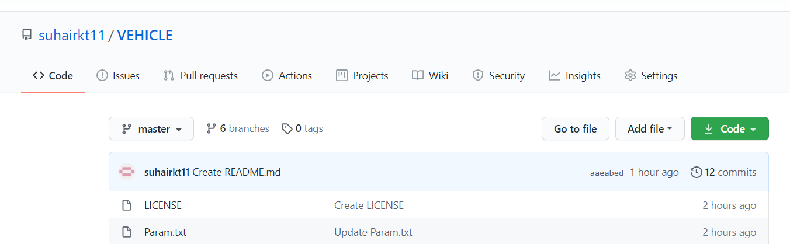
MIT LICENSE

Slide 13
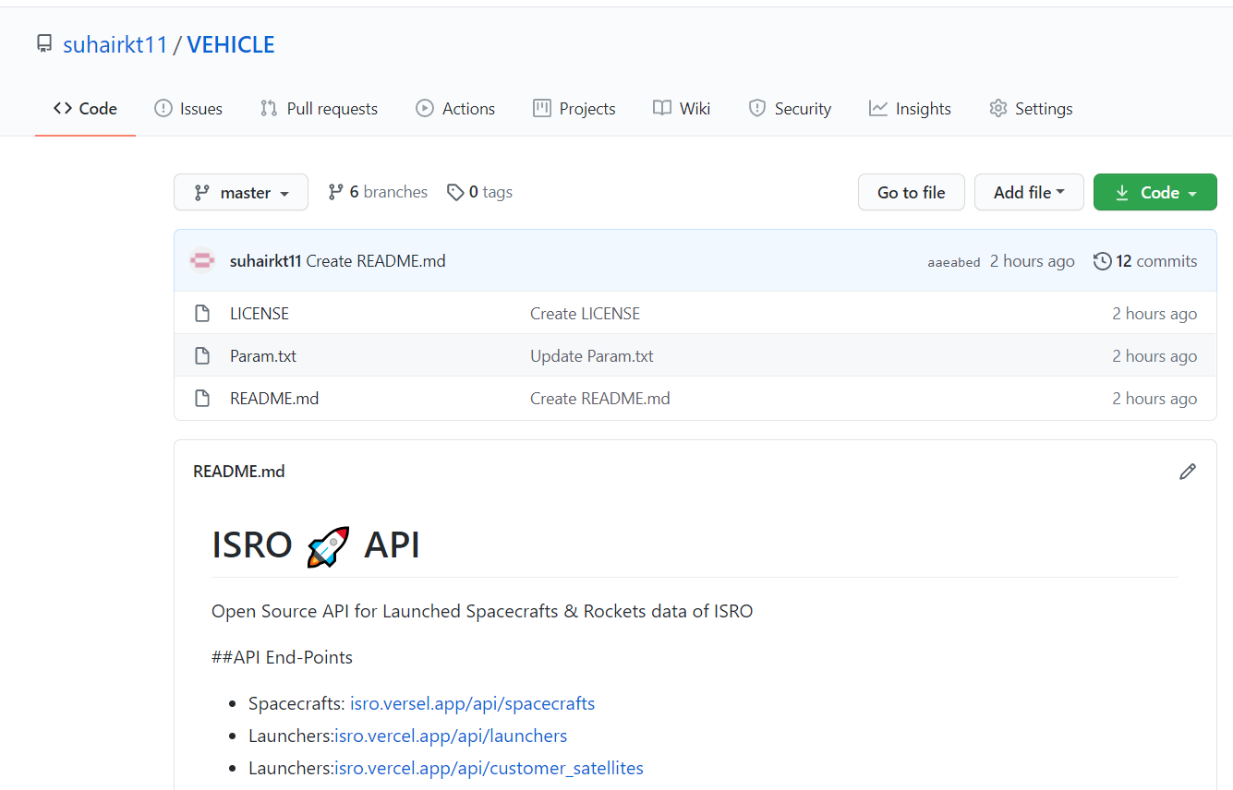
Readme file added

Slide 14
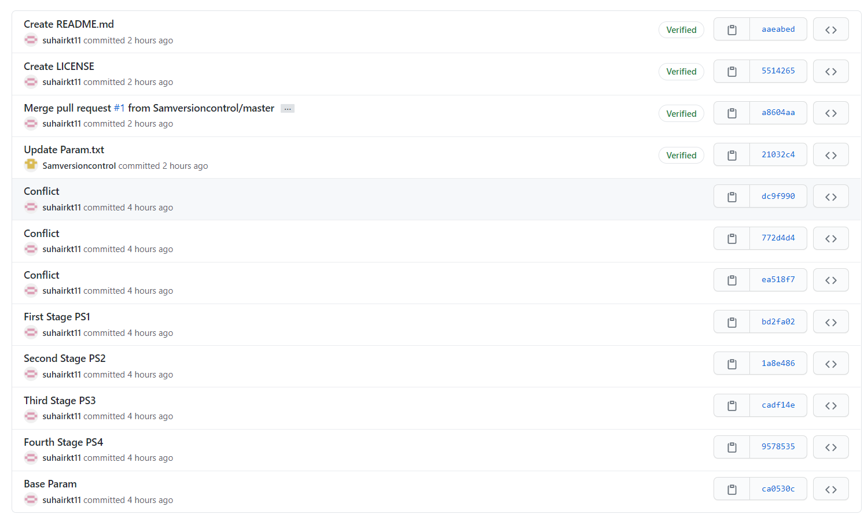
Graphical view of commits

Slide 15
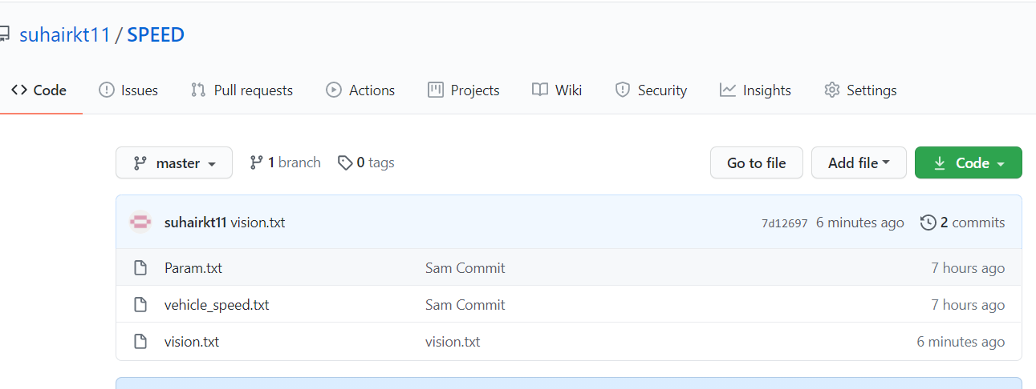
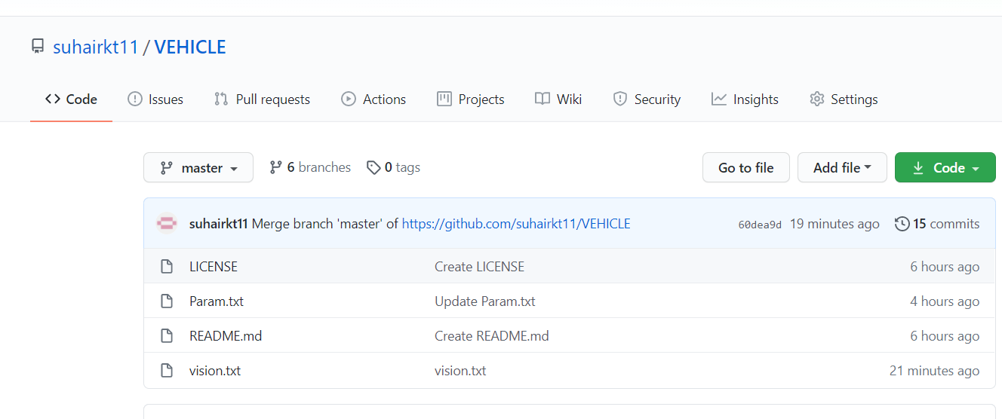
PUSHING VISION

Slide 16
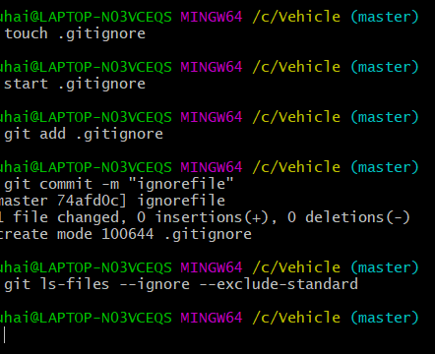
CREAting git ignore file

