Slide 1
Digital Image Processing
Image Enhancement

Slide 2
Image Enhancement
The principal objective of enhancement is to process an image so that the result is more suitable than the original image for a specific application.
There is no general theory of image enhancement.

Slide 3
Image enhancement categories:
Image enhancement approaches fall into two broad categories:
Spatial domain methods and
Frequency domain methods
Enhancement techniques based on various combinations of methods from these two categories are not unusual.

Slide 4
Image Enhancement
Spatial Domain Methods: The term spatial domain refers to the image plane itself, and approaches in this category are based on direct manipulation of pixels in an image.
Frequency Domain Methods: Frequency domain processing techniques are based on modifying the the Fourier transform of a given image for enhancement.

Slide 5
Spatial Domain Methods:
The term spatial domain refers to the aggregate of pixels composing an image. Spatial domain methods are procedures that operate directly on these pixels. Spatial domain processes will be denoted by the expression
g(x, y) = T[f(x, y)]
where f(x, y) is the input image, g(x, y) is the processed image, and T is an operator on f, defined over some neighborhood of (x,y). In addition, T can operate on a set of input images, such as performing the pixel-by-pixel sum of K images for noise reduction.
.
f(x,y) : input
g(x,y) : output
T : transformation function

Slide 6
Image Enhancement in Spatial Domain
Point Processing: enhancement at any point in an image depends only the gray-level at that point.
Mask Processing/Filtering: where the values of the mask coefficients determine the nature of the process.

Slide 7
Contrast Stretching
Contrast: is the difference in visual properties making an object/image distinguishable from other objects and the background.

Slide 8
Spatial Filtering
w(-1,-1) | w(-1,0) | w(-1,1)
w(0,-1) | w(0,0) | w(0,1)
w(1,-1) | w(1,0) | w(1,1)
Mask coefficients showing coordinate arrangement

Slide 9
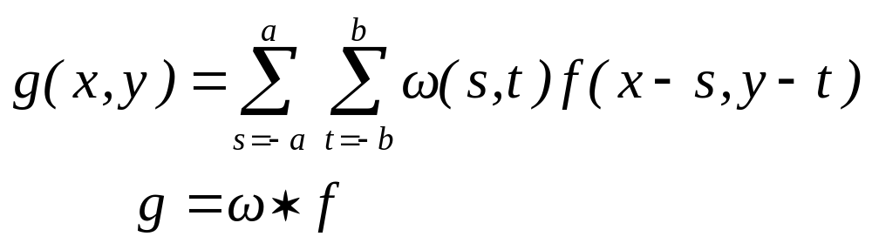
Convolution

Slide 10
Convolution
Convolution kernel, ω
Input Image, f
1 | -1 | -1
1 | 2 | -1
1 | 1 | 1
2 | 2 | 2 | 3
2 | 1 | 3 | 3
2 | 2 | 1 | 2
1 | 3 | 2 | 2
Rotate 180º
1
1
1
-1
2
1
-1
-1
1

Slide 11
Convolution
1
1
1
2
2
2
3
-1
2
1
2
1
3
3
-1
-1
1
2
2
1
2
1
3
2
2
1
1
1
-1
2
2
2
3
5
4
2
-1
2
1
3
3
Output Image, g
-2
1
2
2
1
2
1
3
2
2
Input Image, f

Slide 12
1
1
1
2
2
2
3
Convolution
-1
2
1
2
1
3
3
-1
-1
1
2
2
1
2
1
3
2
2
1
1
1
2
2
2
3
5
4
-2
4
2
2
1
3
3
Output Image, g
-2
-1
3
2
2
1
2
1
3
2
2
Input Image, f

Slide 13
Convolution
1
1
1
2
2
2
3
-1
2
1
2
1
3
3
-1
-1
1
2
2
1
2
1
3
2
2
1
1
1
2
2
2
3
5
4
4
-2
4
3
2
1
3
3
Output Image, g
-1
-3
3
2
2
1
2
1
3
2
2
Input Image, f

Slide 14
1
1
1
2
2
2
3
Convolution
-1
2
1
2
1
3
3
-1
-1
1
2
2
1
2
1
3
2
2
1
1
1
2
2
2
3
5
4
4
-2
-2
6
1
2
1
3
3
Output Image, g
-3
-3
1
2
2
1
2
1
3
2
2
Input Image, f

Slide 15
1
1
1
2
2
2
3
Convolution
-1
2
1
2
1
3
3
-1
-1
1
2
2
1
2
1
3
2
2
1
2
2
2
2
2
3
5
4
4
-2
Output Image, g
-1
4
1
2
1
3
3
9
-1
-2
2
2
2
1
2
1
3
2
2
Input Image, f

Slide 16
1
1
1
2
2
2
3
Convolution
-1
2
1
2
1
3
3
-1
-1
1
2
2
1
2
1
3
2
2
2
2
2
2
2
2
3
5
4
4
-2
Output Image, g
-2
2
2
1
3
3
3
9
6
-2
2
-2
2
1
1
2
1
3
2
2
Input Image, f

Slide 17
Convolution
5
4
4
-2
9
6
14
5
11
7
6
5
9
12
8
5
Final output Image, g

Slide 18
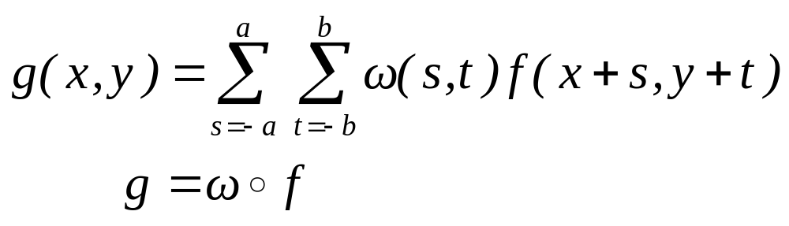
Correlation

Slide 19
Correlation
correlation kernel, ω
1 | -1 | -1
1 | 2 | -1
1 | 1 | 1
Input Image f
2 | 2 | 2 | 3
2 | 1 | 3 | 3
2 | 2 | 1 | 2
1 | 3 | 2 | 2
Don’t rotate use it directly

Slide 20
Correlation
1
-1
-1
2
2
2
3
1
2
-1
2
1
3
3
1
1
1
2
2
1
2
1
3
2
2
1
-1
-1
1
2
2
2
3
5
4
-2
1
2
1
3
3
2
1
output Image, g
2
2
1
2
1
3
2
2
Input Image, f

Slide 21
1
-1
-1
2
2
2
3
Correlation
1
2
-1
2
1
3
3
1
1
1
2
2
1
2
1
3
2
2
1
-1
-1
2
2
2
3
5
10
2
4
-2
2
1
3
3
2
1
3
output Image, g
2
2
1
2
1
3
2
2
Input Image, f

Slide 22
1
-1
-1
2
2
2
3
Correlation
1
2
-1
2
1
3
3
1
1
1
2
2
1
2
1
3
2
2
1
-1
-1
2
2
2
3
5
10
10
2
4
-3
2
1
3
3
1
3
3
output Image, g
2
2
1
2
1
3
2
2
Input Image, f

Slide 23
1
-1
-1
2
2
2
3
Correlation
1
2
-1
2
1
3
3
1
1
1
2
2
1
2
1
3
2
2
1
-1
-1
2
2
2
3
5
10
10
15
2
6
-1
2
1
3
3
3
3
1
output Image, g
2
2
1
2
1
3
2
2
Input Image, f

Slide 24
1
-1
-1
2
2
2
3
Correlation
1
2
-1
2
1
3
3
1
1
1
2
2
1
2
1
3
2
2
1
-2
-2
2
2
2
3
5
10
10
15
1
4
-1
2
1
3
3
3
output Image, g
1
2
2
2
2
1
2
1
3
2
2
Input Image, f

Slide 25
1
-1
-1
2
2
2
3
Correlation
1
2
-1
2
1
3
3
1
1
1
2
2
1
2
1
3
2
2
2
2
-2
2
-2
2
3
5
10
10
15
2
2
2
1
-3
3
3
3
4
output Image, g
2
2
1
2
2
2
1
1
3
2
2
Input Image, f

Slide 26
Correlation
5
10
10
15
3
4
6
11
7
11
4
9
-5
4
4
5
Final output Image, g

