Slide 1
Guidelines
Kindly use the given template for submitting your prototype(Make a copy of the template)
One team is only required to submit one project.
Follow this template while preparing your presentation.
You are welcome to add as many POCs and design concepts to support your project.
The project should be feasible and the team members should be capable enough, to come up with the fully functioning prototype of the same idea, if required.
In case of queries, kindly reach out to us at solutionchallengesupport@hack2skill.com
Note: Prototype must include cloud deployment and use at least one Google AI model or service (e.g., Gemini) as part of the solution.

Slide 2


Team Details
Team name: RescueGrid
Team leader name: Kumari Suhana
Problem Statement: Modern emergency management faces a dual point of failure during severe crises: fragile cloud infrastructure that collapses under blackout conditions, and human dispatchers who become overwhelmed by chaotic, multi-lingual distress signals. There is a critical technological gap in bridging raw human panic at the edge of a network, and instantly synthesizing it into prioritized, actionable deployment logistics for first responders without depending on vulnerable backend servers.

Slide 3
RESCUE GRID’S SOLUTION:
RescueGrid A.I.D.A. is a "Zero-Infrastructure" tactical web dashboard that eliminates these dual points of failure using serverless edge-computing and Google Gemini 2.5 Flash.
First, it guarantees up-time during severe blackouts by deploying as an offline-capable Progressive Web App (PWA). It completely bypasses vulnerable centralized databases, processing data natively on the client device.
Second, it permanently removes the human dispatcher bottleneck by routing all incoming distress signals directly into Gemini AI. The system immediately ingests, translates, and synthesizes chaotic, multi-lingual human panic from the edge natively, mathematically structuring it into optimized deployment constraints and map coordinates in milliseconds—without requiring human oversight.

Slide 4
OPPORTUNITIES
How different is it from any of the other existing ideas?
Traditional emergency systems rely on fragile, centralized cloud databases and human operators who quickly become overwhelmed during disasters. RescueGrid is a 100% serverless, zero-infrastructure Edge application. Instead of depending on backend servers that cross-fail during blackouts, our Progressive Web App (PWA) handles logic directly on the client's device. We completely bypass the human language barrier by using Google Gemini AI to natively process and translate distress signals without human intervention.
B. How will it be able to solve the problem?
By integrating Google Gemini 2.5 Flash, RescueGrid ingests raw, panicked distress signals in any regional language and immediately normalizes them. It instantly transforms unstructured human chaos into precise map geometries, exact medical supply requirements, and automated drone dispatch protocols. It solves the latency problem by turning mass human panic into clean, actionable tactical data in milliseconds.
C. USP of the proposed solution
Our core USP is the combination of Zero-Infrastructure Up-Time alongside Agentic Autonomous Logic. Unlike typical dispatch software, RescueGrid features:
Multi-Agent Conflict Resolution: Two AI agents (MEDICAL vs LOGISTICS) negotiate resource distribution in the background before generating a final dispatch.
Holographic Command Mode: Built-in matrix inversion that projects a 3D "Pepper's Ghost" reflection onto glass, allowing for a military-grade, hands-free Heads-Up Display (HUD) in chaotic environments.

Slide 5
List of features offered by the solution
Multilingual AI Triaging: Uses Gemini 2.5 Flash to instantly translate raw, multi-lingual civilian panic into structured, machine-readable dispatch data—without human operators.
Autonomous Agent Negotiation: Two distinct AI sub-agents (MEDICAL vs LOGISTICS) autonomously negotiate and resolve resource conflicts before executing a deployment.
Holographic Command HUD: Inverts the display layer to project a 3D "Pepper's Ghost" reflection, creating a hands-free, military-grade terminal for chaotic environments.
Automated UAV & Thermal Tracking: Calculates automatic intercept vectors to simulate drone supply drops, complete with a live-streaming FLIR thermal uplink.
Tactical Quarantine Geofencing: Lets commanders physically draw exclusion zones over the live map to instantly halt and re-route escaping civilian swarms away from danger.
Multi-Modal Sensory Intake: Natively processes raw disaster photography and dispatch audio clips directly through Gemini’s multi-modal visual and audio processing layers.
1-Tap Offline SOS: Edge-based PWA functionality allowing users in shattered 4G networks to queue distress pings that instantly fire the millisecond a connection returns.
Live Broadcast Ticker: A ubiquitous warning marquee running along the HUD, syncing active evacuationand hazard protocols across all active terminals.

Slide 6
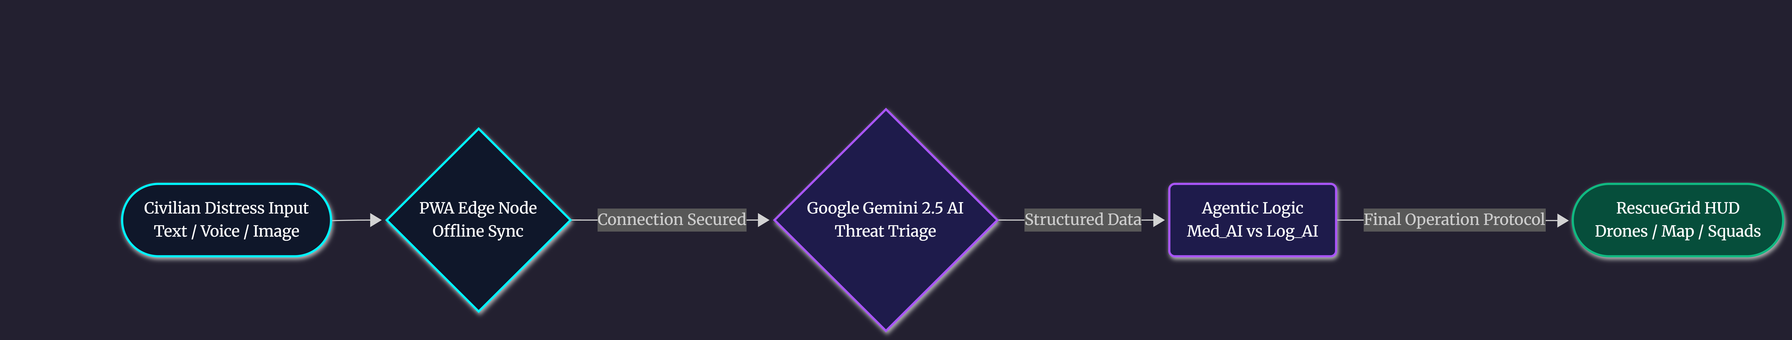
Process flow diagram

Slide 7
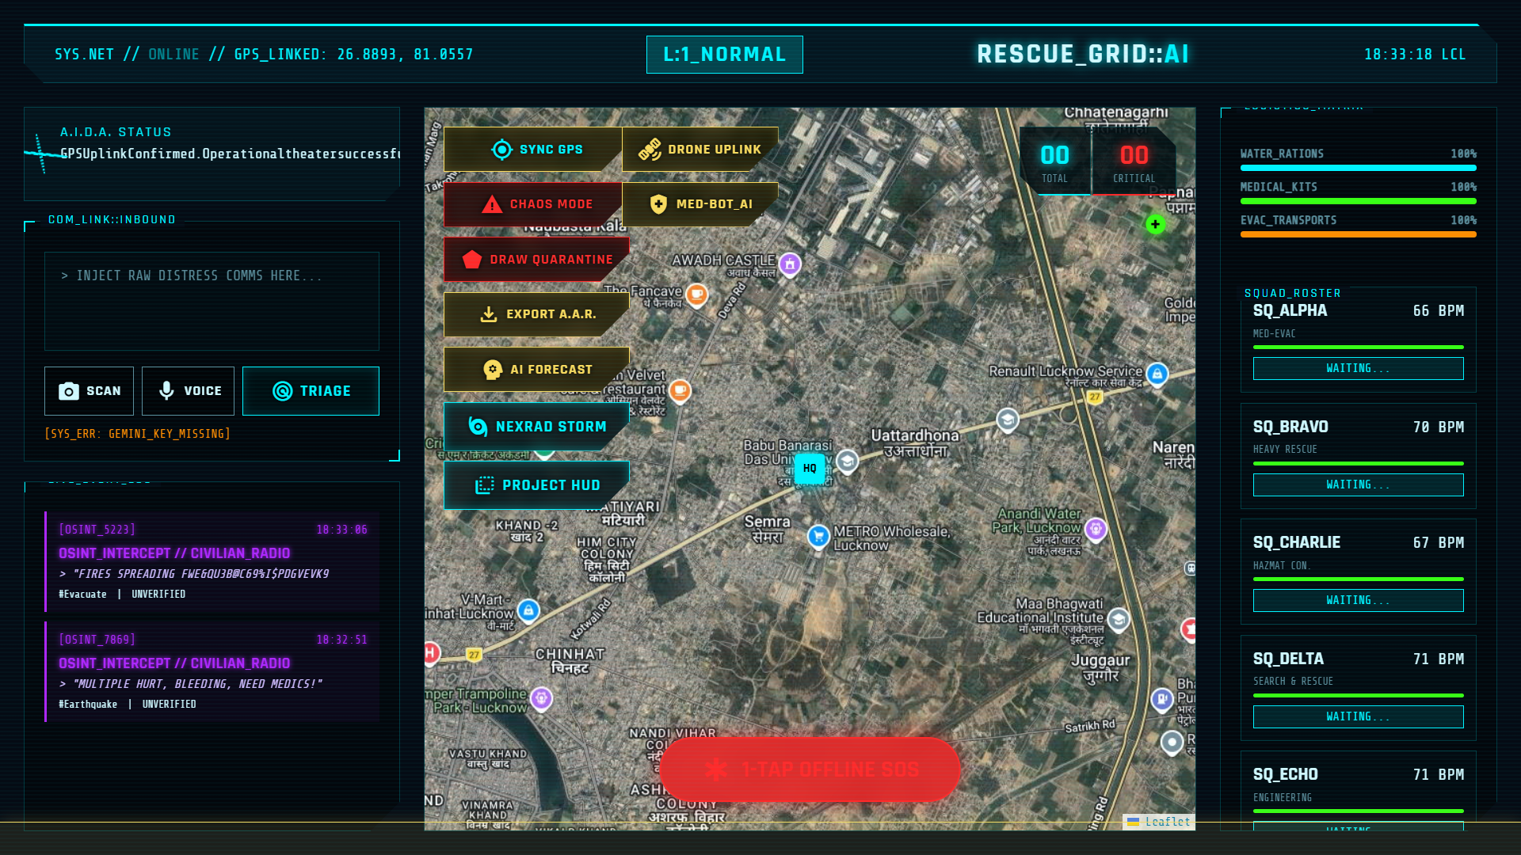
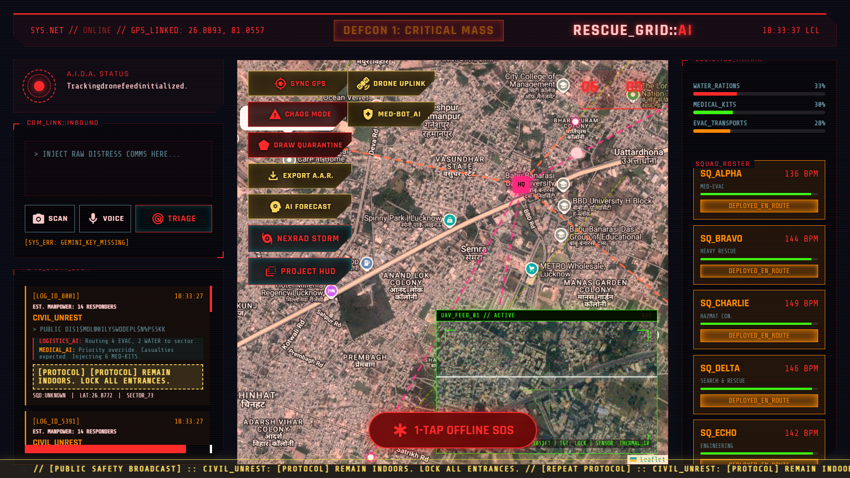
1) "Base Command Matrix:" Progressive Web App (PWA) operating seamlessly over Edge logic. Displays live Leaflet map rendering, squad logistics, and the central AI distress intake feed.
".
2) Automated UAV Integration: Drone Simulation Module calculating intercept vectors for emergency airdrops, featuring a live-rendered FLIR Thermal Tracking simulation.

Slide 8
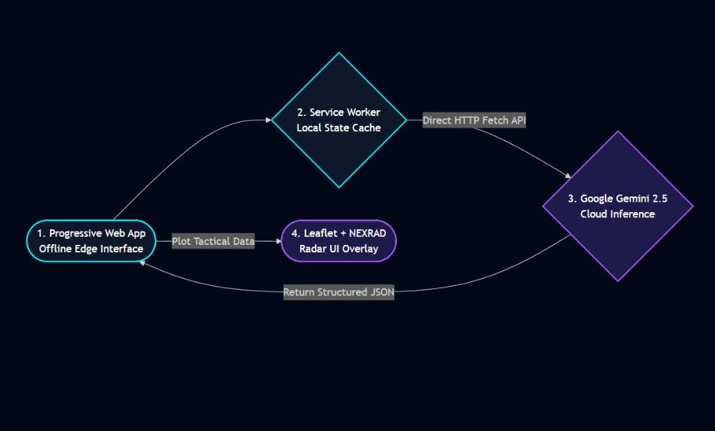
Architecture diagram of the proposed solution
The "Zero-Infrastructure" Advantage: To guarantee up-time during catastrophic infrastructure blackouts, RescueGrid intentionally bypasses traditional centralized SQL databases. All routing, threat caching, and UI rendering occurs on the Edge Computing Layer via Service Workers. The local client negotiates directly with the Google Gemini 2.5 API, resulting in a 100% serverless, zero-maintenance command application.

Slide 9
Technologies used in the solution
Google Generative AI (gemini-2.5-flash): Powers the core intelligence, handling native multi-lingual translation, distress normalization, and the Multi-Agent logistics negotiation.
Progressive Web App (PWA) Architecture: Utilizes browser Service Workers and Manifests to allow the dashboard to function offline and queue requests during network blackouts.
Vanilla HTML5, CSS3, & JavaScript: A zero-dependency frontend stack. Avoiding heavy frameworks like React ensures ultra-low latency and instant load times on edge devices.
Leaflet.js Mapping Engine: An open-source, mobile-friendly interactive mapping library used to plot geospatial coordinates, heatmaps, and simulated drone telemetry.
NEXRAD WMS API: Integrates live National Weather Service severe storm radar layers directly onto the tactical map.
Firebase Hosting / GitHub Pages (Cloud Deployment): Provides decentralized, high-availability static delivery of the application to meet the Solution Challenge cloud deployment requirements.

Slide 10
Estimated implementation cost
The competitive advantage of the RescueGrid architecture is its near-zero operational cost. By pushing the heavy lifting to the Edge (the user's device) via Progressive Web App (PWA) limits, we avoid expensive cloud database scaling.
Development & MVP Cost: $0.00
Cloud Hosting (Firebase / GitHub Pages): $0.00 (Deployable entirely on free-tier static hosting).
Mapping & Telemetry (Leaflet + NEXRAD): $0.00 (100% open-source libraries and public government APIs).
Database Management: $0.00 (Eliminated entirely. State is managed via local caching and Service Workers).
AI Inference (Google Gemini Flash): Free-Tier for MVP. Upon commercial scaling, the cost is strictly pay-per-token API usage, which is exponentially cheaper than maintaining active 24/7 server instances.

Slide 11
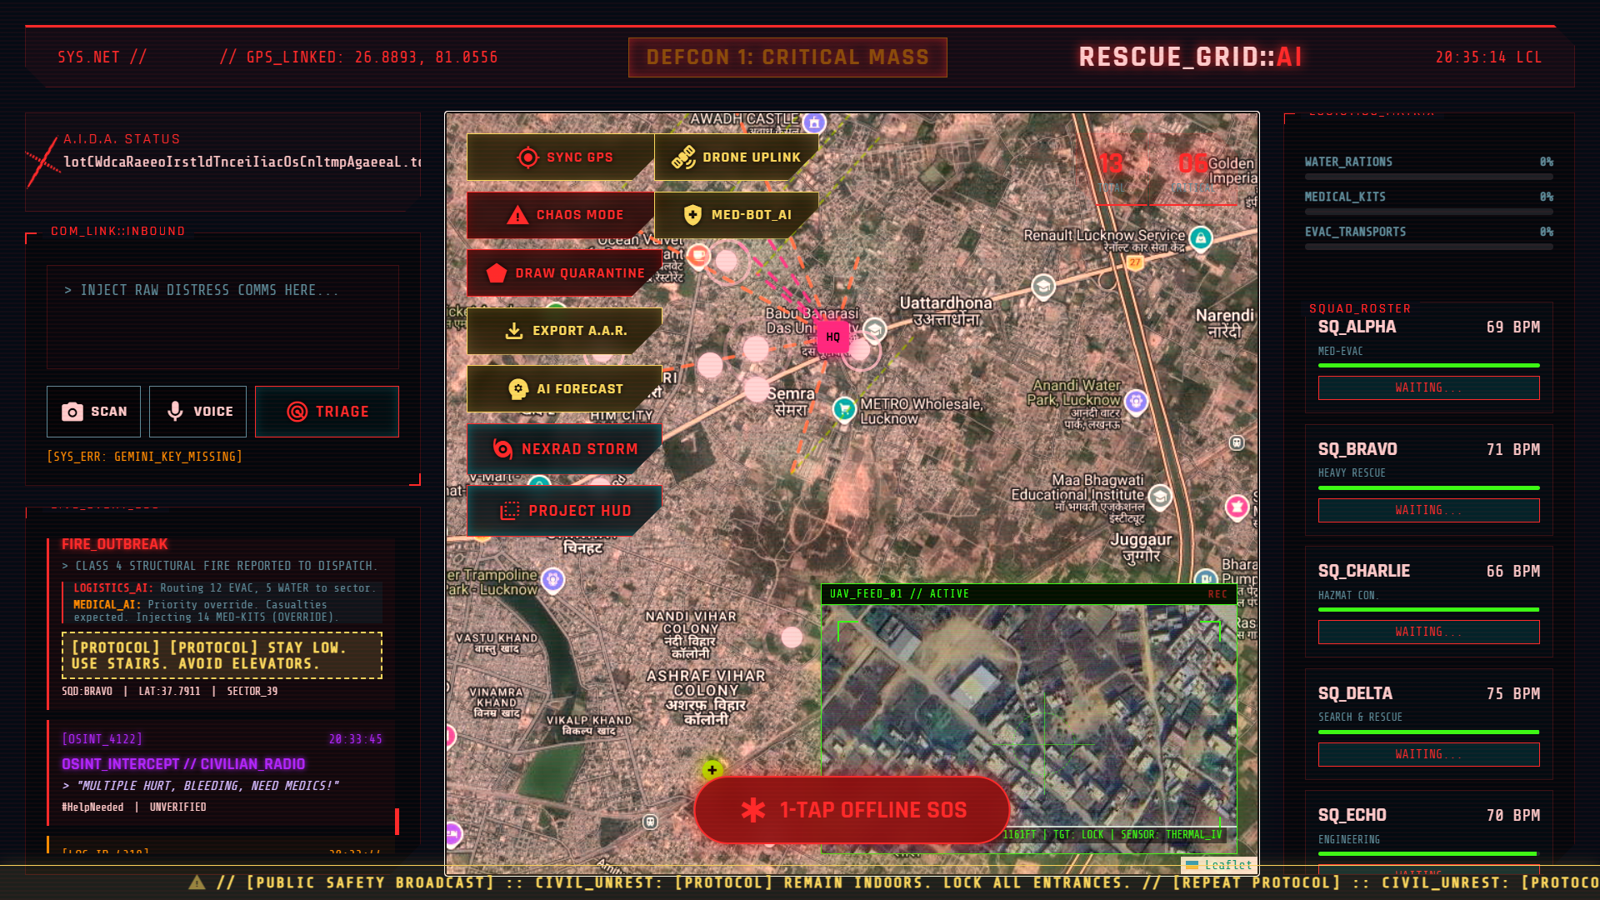
Snapshots of the MVP
RescueGrid Command Interface: This is the fully integrated, edge-deployed Progressive Web App dashboard. It provides real-time geospatial awareness using Leaflet.js mapping while maintaining zero reliance on backend servers.
Key Visual Features Displayed:
Multi-Modal Inbox (Left): Allows commanders to ingest raw voice dictation and camera images directly into the Gemini API.
Agentic Logistics Protocol (Bottom Left): The live terminal feed showing the MEDICAL_AI and LOGISTICS_AI autonomously negotiating supply drops.
UAV Drone Uplink (Center Right): A simulated Picture-in-Picture (PiP) FLIR thermal camera feed tracking ground targets.
1-Tap Offline SOS (Center): A native Service Worker function that caches emergency pings locally when the device loses network connectivity.

Slide 12
Future Development
Future Development Roadmap
Physical Mesh Networking: Deploying lightweight Raspberry Pi Edge servers in disaster zones to create physical offline mesh networks when cellular towers collapse.
Real-World Drone SDK Integration: Bridging our current simulated UAV FLIR module with live DJI Drone APIs to push physical flight paths to actual hardware.
Legacy 911 Bridging Pipelines: Creating backwards-compatible data streams so legacy 911 dispatch centers can securely receive our AI-triaged data without upgrading their internal servers.
Live Video Multimodal Assessment: Expanding our current image analysis pipeline to stream live video directly into Gemini to calculate real-time structural collapse risks.

Slide 13
Provide links to your:
GitHub Public Repository
Demo Video Link (3 Minutes)
MVP Link
Working Prototype Link
- GitHub Public Repository: [Insert URL] - Demo Video Link: [Insert YouTube] - MVP Link: [Insert Vercel / Firebase Hosting URL]

Slide 14


