Slide 1
Project Presentation of Co-Op Project at Industry (Module-2)
On
Machine Learning Based Early Detection
of Burnout in Young Adults
Suhana Kaura
2210992414 Supervised By :
Ashish Kumar
Department of Computer Science and Engineering,
Chitkara University, Punjab

Slide 2
Introduction
This project looks at whether machine learning can detect burnout risk in young adults early — before it reaches a severe stage. Burnout among students and early-career professionals is increasing, yet most detection methods only kick in after symptoms have already become serious.
The study collects data through a structured questionnaire covering:
Sleep patterns and sleep deprivation
Daily study or work hours and workload pressure
Stress levels, emotional exhaustion, and motivation
Exercise frequency and screen time
Three machine learning classifiers — Logistic Regression, Random Forest, and Support Vector Machine — were trained on this data to classify individuals as Low, Moderate, or High burnout risk.
2

Slide 3
Problem Statement
Burnout among young adults typically goes undetected until it has already reached a critical level.
The current standard for detection — self-report surveys like the Maslach Burnout Inventory — is
reactive by design.
Because of this:
People are assessed only after they seek help, not before
By that point, burnout has usually been building for months
There is no proactive system that flags risk early
Young adults juggling college and work are among the most affected but least
studied group
The existing approaches either require expensive wearable hardware or focus on
employed adults in organised workplaces — neither of which fits the young adult
demographic well.

Slide 4
Objectives
The main goals of this study were:
Build a machine learning pipeline that predicts burnout risk from questionnaire data
Compare three classifiers — Logistic Regression, Random Forest, and SVM — to identify the best
performing model
Identify which behavioral and psychological features most strongly predict burnout risk
Demonstrate that a low-cost, hardware-free approach can serve as a practical early warning tool
Establish a methodological foundation for larger-scale future studies in this demographic

Slide 5
Methodology Overview
Data was collected from 23 respondents via a structured Google Form. Since 23 responses alone are insufficient to train a reliable model, 200 synthetic samples were generated using rule-based logic grounded in burnout research — giving a combined dataset of 223 instances.
The pipeline followed these steps:
Text responses encoded to numeric values (1–5 ordinal scale)
Burnout risk labels derived using a weighted composite score
Dataset split 80/20 into training (178 samples) and testing (45 samples)
Three classifiers trained and evaluated using accuracy, precision, recall, and F1-score
Feature importance analysis run on the best-performing model (Random Forest)

Slide 6
Methodology (Detailed Flow)
Conventional Approach
Person feels burned out
Seeks help from counsellor
Counsellor administers MBI survey
Burnout confirmed — already severe
Intervention begins too late
This Study's Approach
Person fills simple Google Form
Answers encoded to numbers
Trained ML model predicts risk level
Output: Low / Moderate / High Risk
Counsellor alerted early — before breakdown

Slide 7
Tools and Technologies
The following tools and technologies were used:
Python 3.10 – core programming language for the ML pipeline
Scikit-learn – Logistic Regression, Random Forest, SVM implementation
Pandas & NumPy – data loading, preprocessing, and feature engineering
StandardScaler – feature normalisation before model training
Matplotlib & Seaborn – charts and visualisations for results
Google Forms – primary data collection from 23 respondents
Google Colab – cloud-based environment for running the pipeline

Slide 8
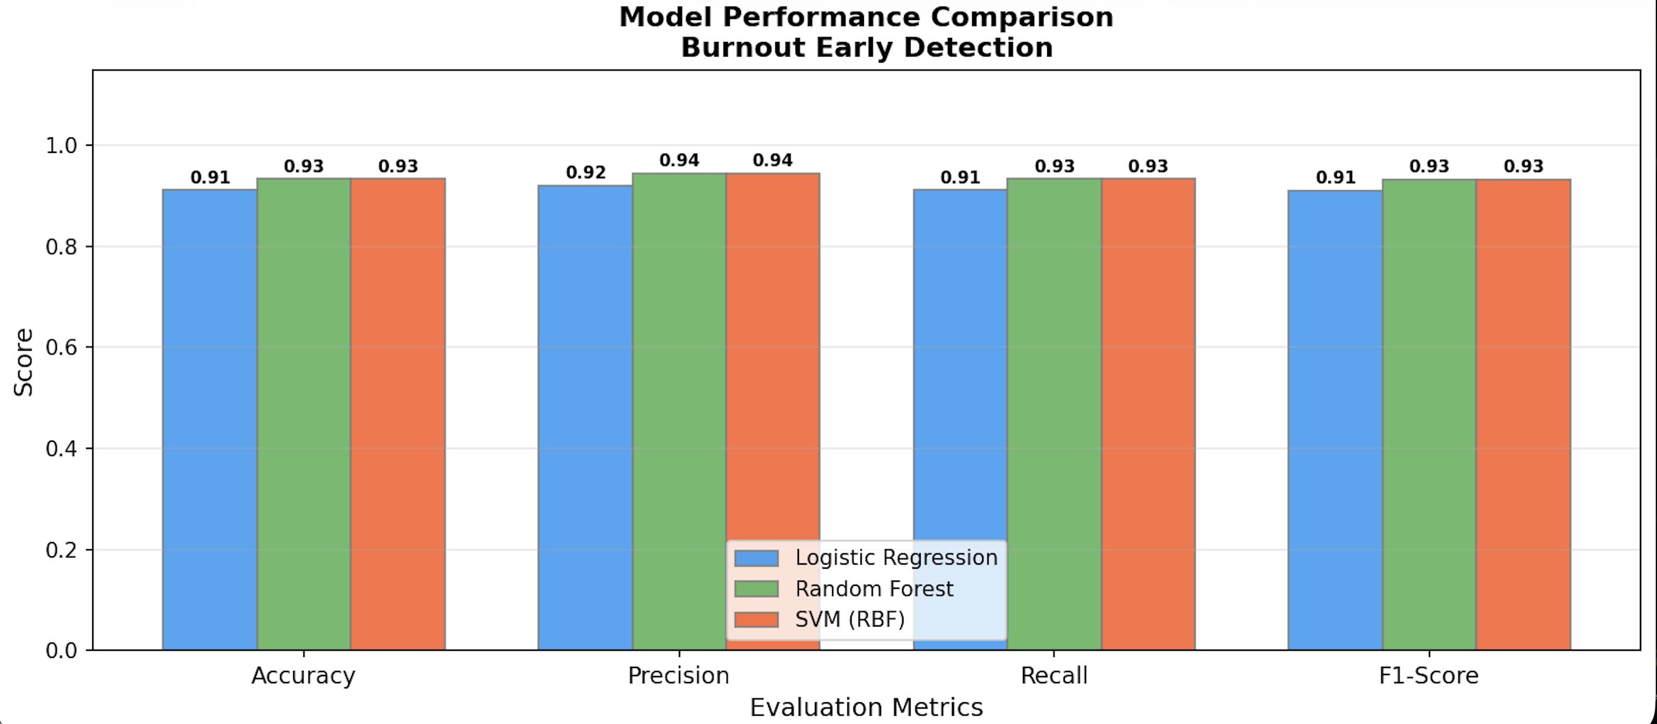
Results
All three classifiers were evaluated on 45 held-out test samples:
Random Forest performed best across all four metrics. The 13-point accuracy gap over Logistic Regression
shows that burnout risk does not follow a linear pattern — ensemble methods handle this non-linearity well.
5-fold cross-validation confirmed consistency: Random Forest averaged 86.2% ± 2.1% across folds.

Slide 9
Challenges and Learnings
Challenges
Limited primary dataset of only 23 responses
Deriving meaningful labels without clinical diagnosis
Balancing synthetic and real data without overfitting
Choosing appropriate feature weights for composite scoring
Learnings
Importance of data quality over quantity in ML
How feature engineering affects model performance
Practical application of ensemble methods on small datasets
How interpretability tools like feature importance make ML output actionable
This project improved my understanding of end-to-end ML pipelines, from raw data collection and
preprocessing through to model evaluation and result interpretation.

Slide 10
References
[1] C. Maslach and M. P. Leiter, “Understanding the burnout experience,” World Psychiatry, vol. 15, no. 2, pp. 103–111, 2016.
[2] A. Gjoreski et al., “Continuous stress detection using a wrist device,” in Proc. ACM UbiComp, 2016.
[3] G. Mark et al., “Email duration, batching and self-interruption,” in Proc. ACM CHI, 2016.
[4] M. Gkotsis et al., “Characterisation of mental health conditions using deep learning,” Sci. Rep., vol. 7, 2017.
[5] F. Bianchi et al., “Predictors of occupational burnout,” Int. J. Environ. Res. Public Health, vol. 15, 2018.
[6] L. Breiman, “Random forests,” Mach. Learn., vol. 45, no. 1, pp. 5–32, 2001.
[7] World Health Organization, “Burn-out an ‘occupational phenomenon’,” ICD-11, WHO, 2019.

Slide 11
Thank You
11

