Slide 1
Pharmaceutical Sales prediction Suhana kumari

Slide 2
Problem Statement
Rossmann Pharmaceuticals wants to improve its sales forecasting by automating the prediction of future sales for all their stores across multiple cities. Currently, store managers rely on personal judgment, but an automated approach can provide more consistent and data-driven insights. The forecast will be used to:
Optimize inventory and resource allocation.
Improve financial forecasting.
Plan for promotions and marketing activities.

Slide 3
Objectives of the project
The objective of this project is to develop an end-to-end machine learning solution for sales forecasting at Rossmann Pharmaceuticals. The project aims to leverage historical sales data along with multiple external factors (such as promotions, holidays, competition, and seasonality) to generate accurate sales predictions for all stores across multiple cities. These predictions will be made six weeks ahead of time and delivered to the finance team for better decision-making in areas such as inventory management, resource allocation, financial forecasting, and strategic planning

Slide 4
Specific Goals
Automate Sales Forecasting:Replace manual forecasting by store managers with a data-driven, automated solution to predict sales in all stores across various cities
Improve Accuracy of Sales Predictions
Use machine learning models (such as LSTM (Long Short-Term Memory) networks, time series models, or other regression techniques) to predict sales with a high level of accuracy.
Provide Actionable Insights:Generate insights for the finance and store management teams to optimize inventory, staffing, and budgeting.
Scalable and Deployable Solution:Develop a scalable end-to-end solution that can be deployed in production, serving the sales predictions reliably for multiple stores and cities, integrating smoothly with Rossmann Pharmaceuticals' business processes.

Slide 5
Flow Chart
Loading DataSet
Model Training
Model Evaluation
Data Preprocessing
Feature Engineering
Evaluate Model
metrics
Handling Missing
Values
Visualize
Distribution
Model Selection
Data Normalization
EDA
Deployment

Slide 6
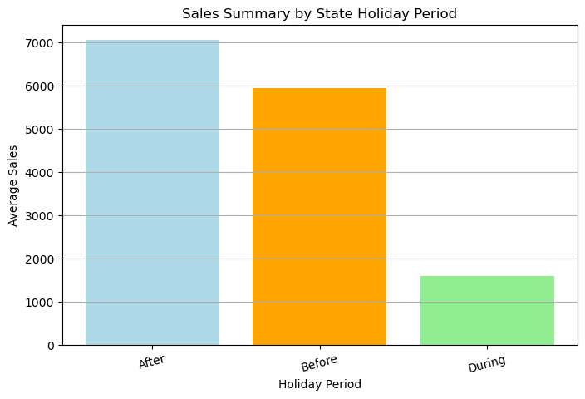
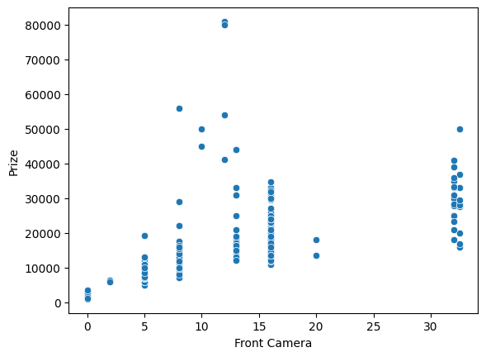
EDA

Slide 7
Observation
Sales Before Holidays:
Average Sales: 5937.72
This indicates that sales tend to be relatively high as consumers prepare for upcoming holidays, likely purchasing gifts or stockpiling for festivities.
Sales During Holidays:
Average Sales: 1600.76
Sales drop significantly during the holidays. This could be due to several factors, such as:
Many stores being closed on public holidays.
Shoppers potentially prioritizing spending .
on experiences or family activities over shopping.
Reduced foot traffic as people take time off from their usual shopping routines
Sales After Holidays:
Average Sales: 7048.49
Stores often have discounts to sell leftover holiday items, which attracts buyers looking for good deals.
People may need to buy things they used up during the holidays, like food or gifts

Slide 8
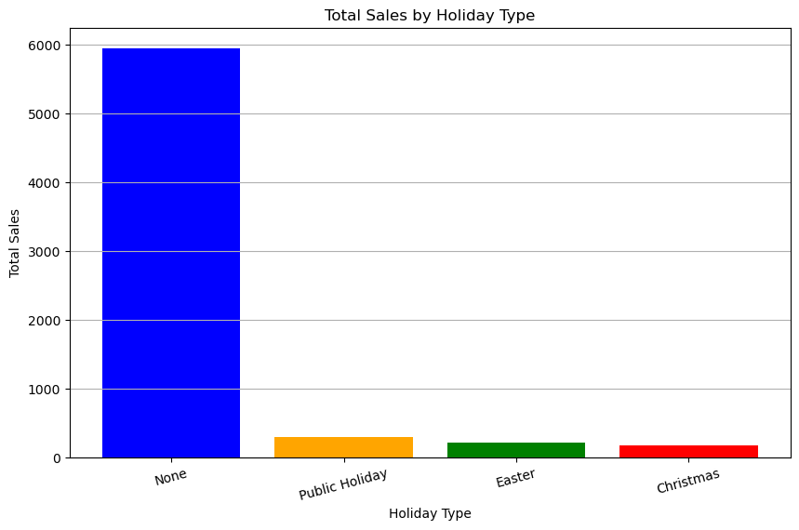
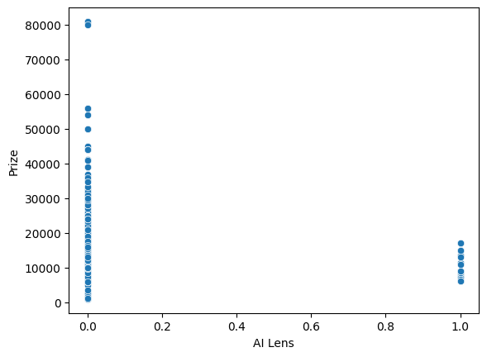
By looking at graph , we are not able to judge the proper relationship between AI Lens and price

Slide 9
Observation
Sales Variations:
The sales for StateHoliday values like 0 (which indicate no holiday) seem significantly higher compared to sales on specific holidays.
For example, the first row with StateHoliday = 0 has 5947.48 in sales, which is much higher than the sales values recorded during holidays (Public Holiday, Easter, Christmas observation).
On holidays like Public Holiday (a), Easter (b), and Christmas observation (c), the sales are much lower, suggesting that either the store is closed or fewer customers are shopping due to the holiday.
Impact of Holidays on Sales:
Public Holiday (a): When a public holiday occurs, sales drop significantly (from 5947.48 to 290.74). This may indicate that the store might be closed, or people may avoid shopping on these days.
Easter (b): Similarly, sales on Easter are lower (214.31), but still higher than during public holidays.
Christmas Observation (c): Sales on Christmas observation are also lower (168.73), though they are still slightly higher than sales during a public holiday.

Slide 10
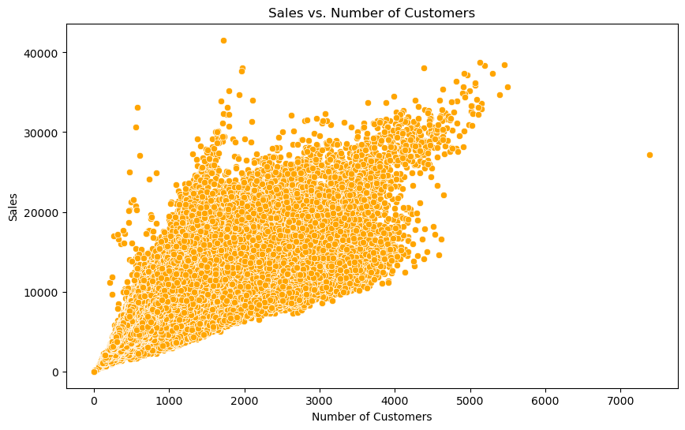
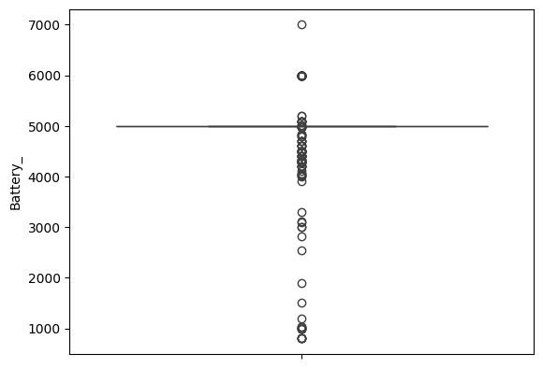
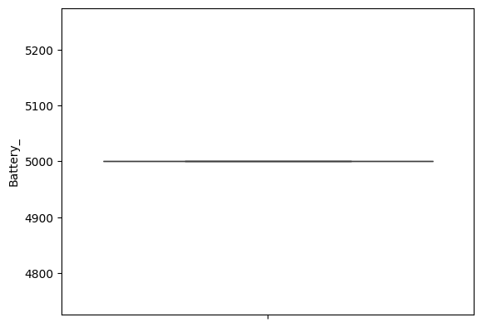
Handling Outliers

Slide 11
Observation
Positive Correlation
The correlation coefficient of 0.8947 indicates a strong positive correlation between the number of customers and sales. This means that, generally, as the number of customers increases, sales also tend to increase significantly.

Slide 12
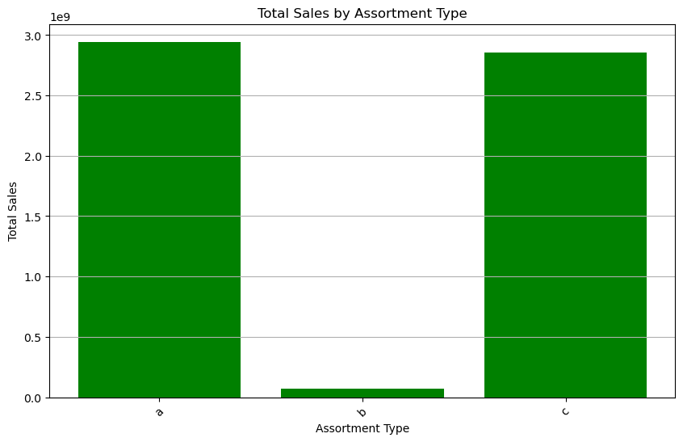
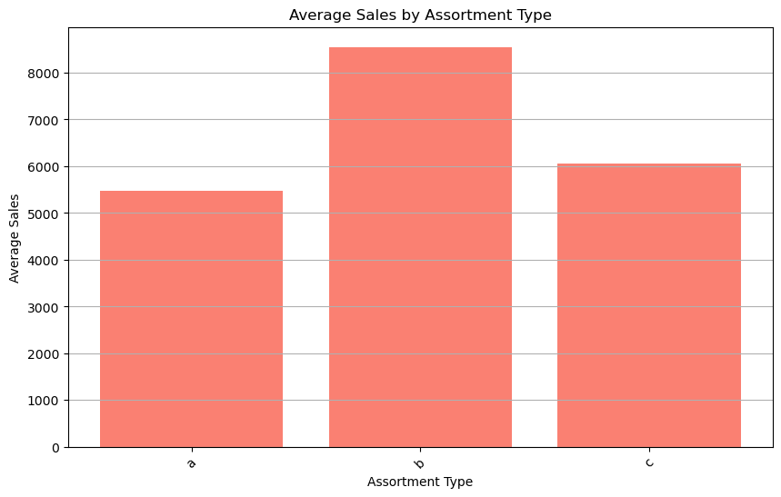

Slide 13
Observation
Total Sales Distribution:
Assortment a and c dominate the total sales, combined total of approximately 5.8 billion, while assortment b contributes significantly less at about 70.9 million. This indicates that assortments a and c are likely more popular or have broader product offerings.
Average Sales per Store:
Assortment b has the highest average sales per store (8,553.93), suggesting that stores that carry assortment b may have higher sales efficiency or that the products in this assortment are priced higher or in demand.
Assortments a and c have lower average sales per store, at 5,481.03 and 6,058.68 respectively, indicating that while these assortments generate more total sales, they may have a larger number of stores contributing to that figure.
Store Count Analysis:
Assortment a has the highest store count (537,445), which correlates with its high total sales. This suggests a wide distribution or availability of this assortment type.
Assortment b has a significantly lower store count (8,294), which might indicate either a more specialized or premium product line that is not as widely distributed.

Slide 14
Model Perfomance
models R2_Score for training R2_Score for test \
0 LinearRegression() 0.974433 0.974561
1 DecisionTreeRegressor() 1.000000 0.999822
MAE for training MAE for testing
0 374.746871 375.713226
1 0.000000 13.369825

Slide 15
Evalution
R2 Score: R2 score indicates how well the model explains the variability of the target variable. A score of 1 indicates perfect prediction. The Decision Tree Regressor has a perfect training score and a very high testing score, while the Linear Regression model has slightly lower scores but still performs very well.
MAE (Mean Absolute Error): MAE measures the average magnitude of errors in predictions, with lower values indicating better performance. The Decision Tree Regressor has a MAE of 0 for the training set, which suggests it fits the training data perfectly, but its MAE on the testing set is 13.25, indicating some error in predictions. The Linear Regression model has a higher MAE, but it is relatively consistent between training and testing.
Conclusion
Overfitting Concern: The Decision Tree Regressor shows a perfect fit on the training data but has a noticeable error on the testing data. This suggests that it may be overfitting, capturing noise rather than the underlying pattern.
Better Generalization: The Linear Regression model, while it doesn't fit the training data as perfectly, demonstrates better generalization with similar R2 scores and lower variability in MAE.

Slide 16
Conclusion
models R2_Score for training R2_Score for test \
0 LinearRegression() 0.954105 0.954196
1 DecisionTreeRegressor() 1.000000 0.999913
MAE for training MAE for testing
0 584.981957 585.969510
1 0.000000 8.190875
Analysis
By using only important feature we almost got the same accuracy but error is little bit ups . So instead of using 51 feature we can use 5 feature and with this we reduce training time and our model became more fast with almost same accuracy.

Slide 17
LSTM Model Summary
┃ Layer (type) ┃ Output Shape ┃ Param # ┃
┡━━━━━━━━━━━━━━━━━━━━━━━━━━━━━━━━━━━━━━━━━━━━━━━━━┩
│ lstm_1 (LSTM) │ (None, 50) │ 10,800 │
├──────────────────────────────────────┼─────────────────────────────┼─
│ dense_1 (Dense) │ (None, 1) │ 51

Slide 18
Observation
loss: 0.1290: This is the training loss for the first epoch. A loss of 0.1290 means that, on average, the difference between the model's predictions and the true values for the training data is relatively high at this point.
val_loss: 0.0305: This is the validation loss for the first epoch. A loss of 0.0305 on the validation set is significantly lower than the training loss, suggesting that the model is performing much better on unseen data during this first epoch.
In general, as the epochs progress, the training loss decreases. For instance, after Epoch 1, the training loss decreased from 0.1290 to 0.0218 by Epoch 20, which is a good sign. This means that the model is learning and fitting the training data better with each epoch.
Similarly, the validation loss also decreases, which indicates that the model is generalizing better to unseen data. For example, validation loss decreased from 0.0305 to 0.0214 from Epoch 1 to Epoch 20

Slide 19
References
https://www.kaggle.com/
https://www.youtube.com/
https://www.google.com/

Slide 20
Thanks !!!

